Slide 1
An Introduction To The Physics Behind the Carillon
October 7, 2019
Bell Shapes, Vibrations and Virtual Frequencies

Slide 2
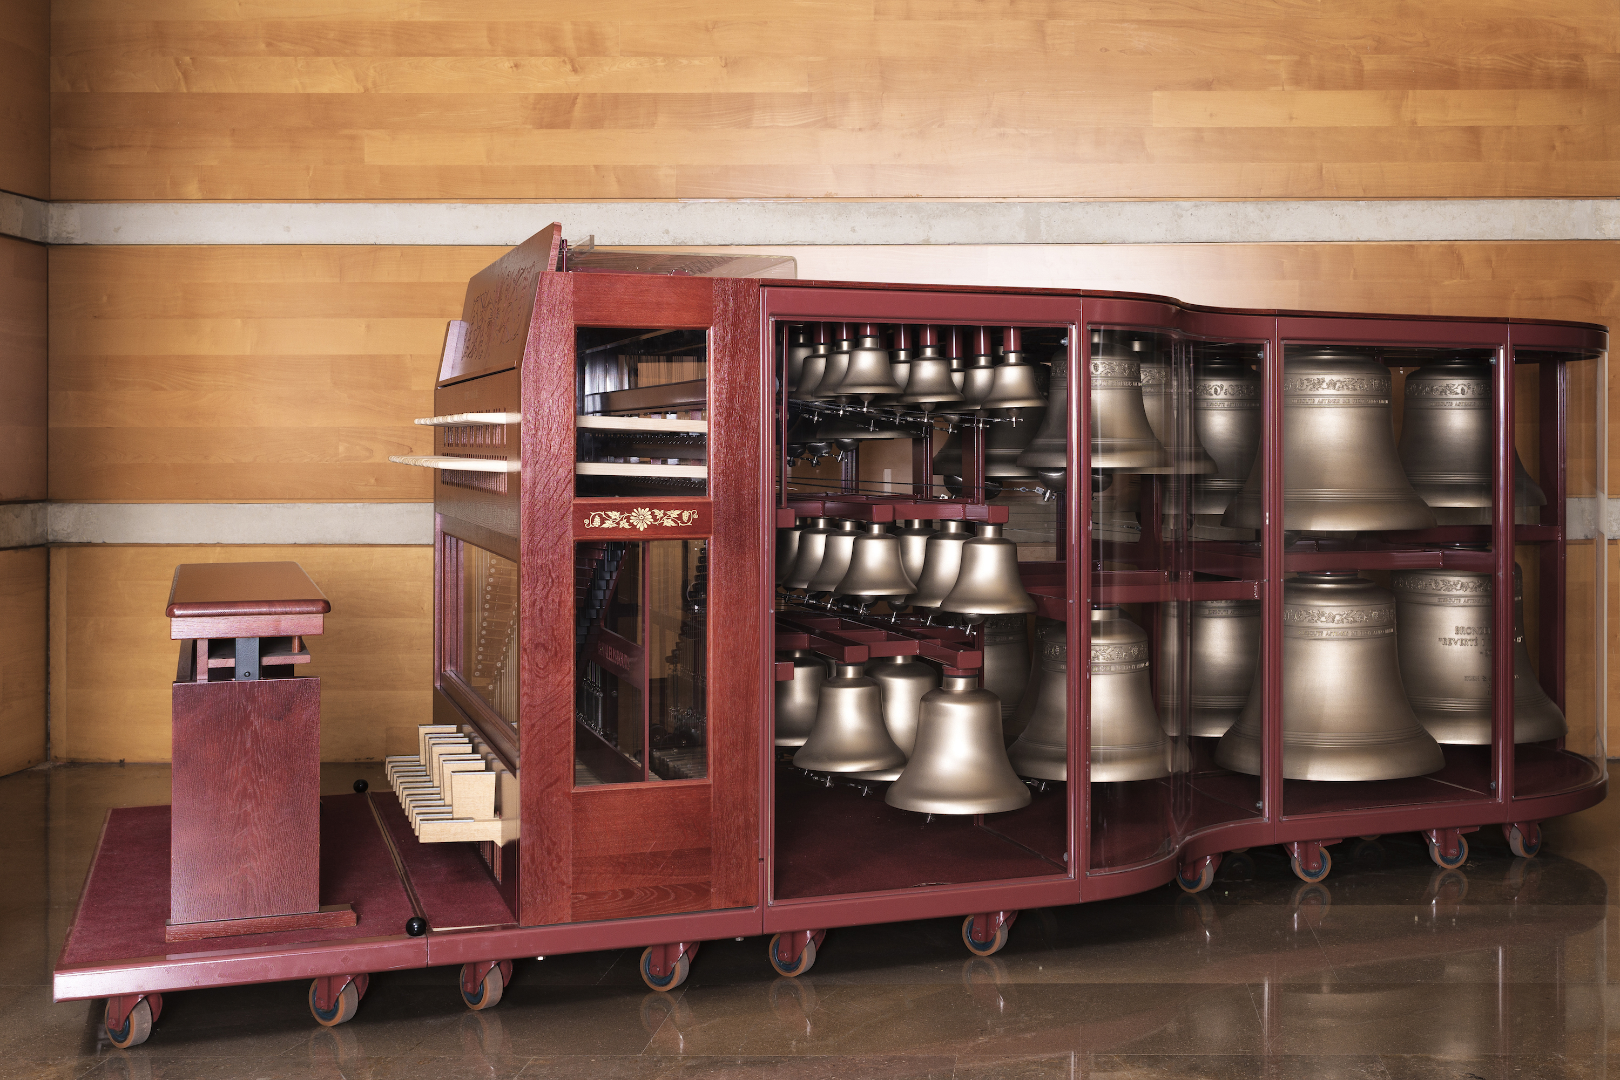
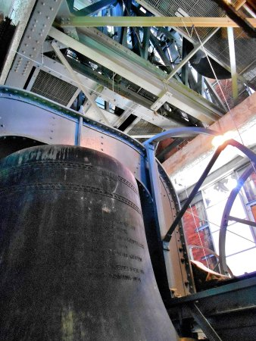
The Carillon
An old and large musical instrument

Slide 3
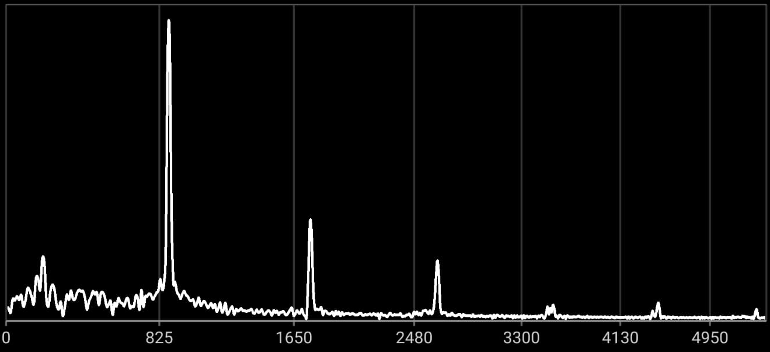
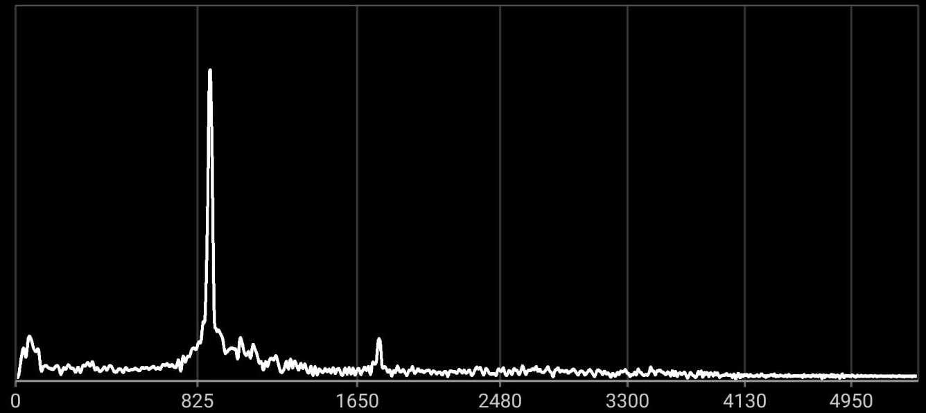
Piano A440 Hz
Whistle A440 Hz

Slide 4
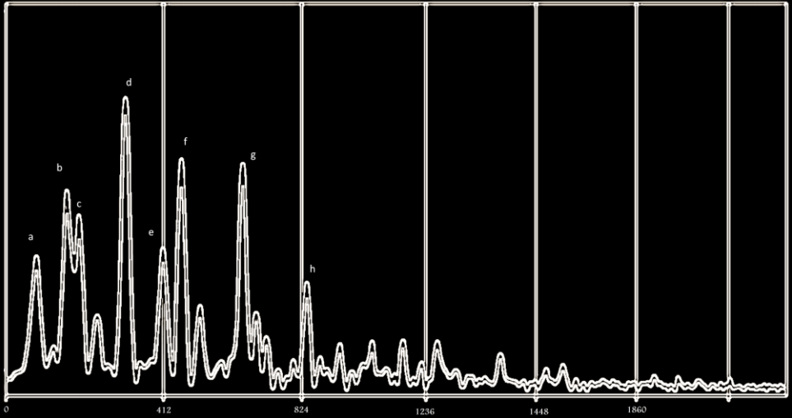
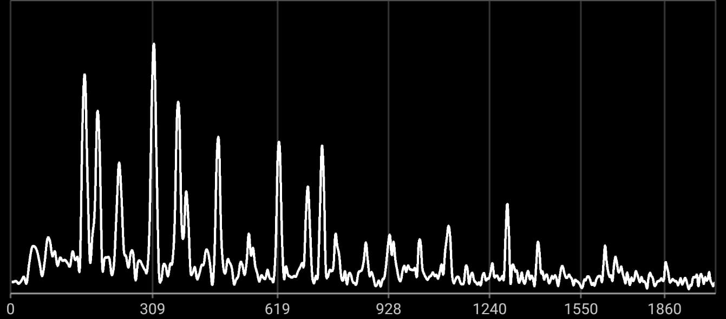
Eb3 bell of the Laura Spelman Rockefeller Memorial Carillon
Eb4 minor chord (Eb-Gb-Bb) + Eb3 + Eb5 played on a piano

Slide 5
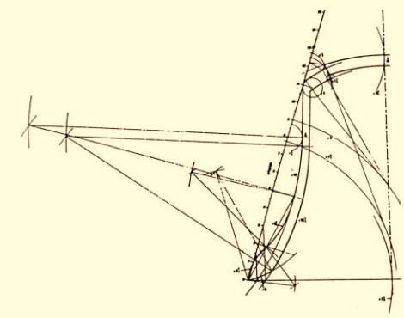
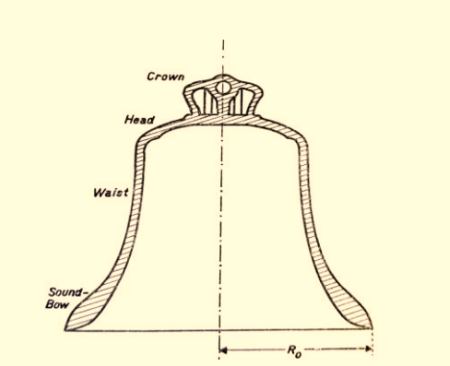
The Shape of Bells
Not a simple shape to analyze mathematically

Slide 6
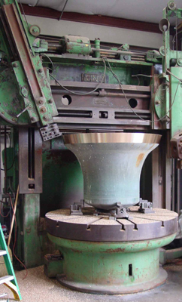
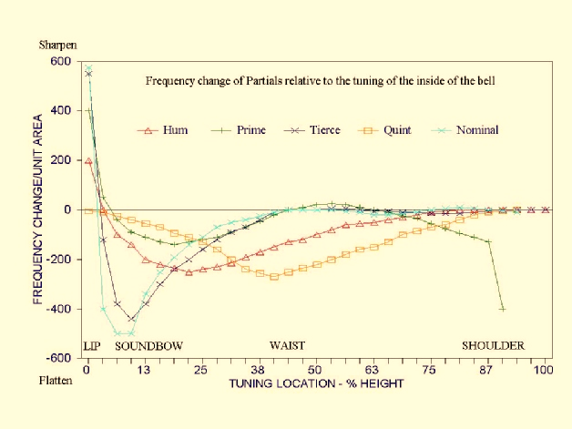
Experimental Tuning

Slide 8
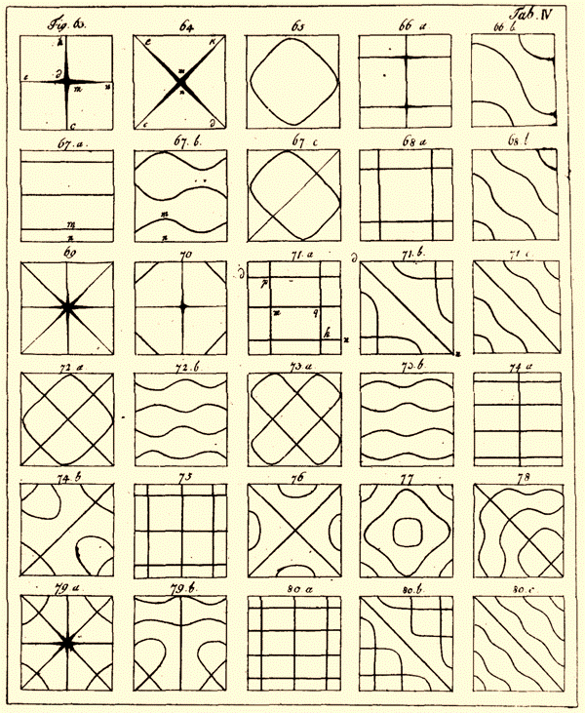
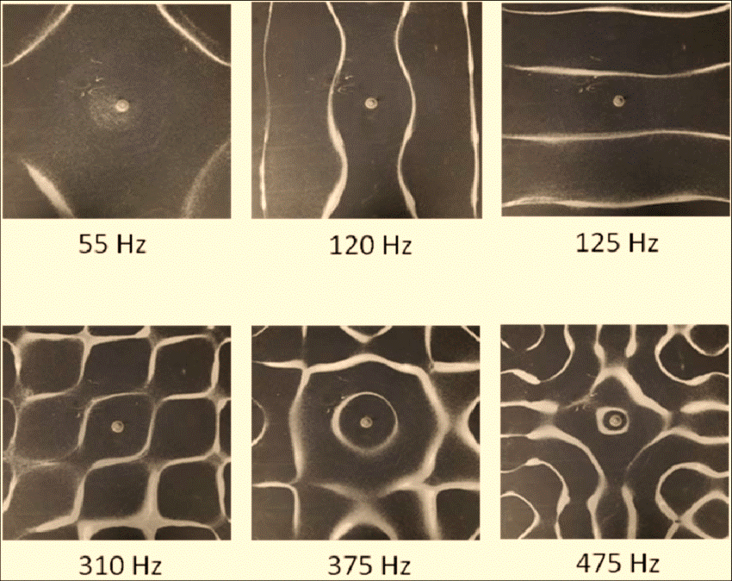
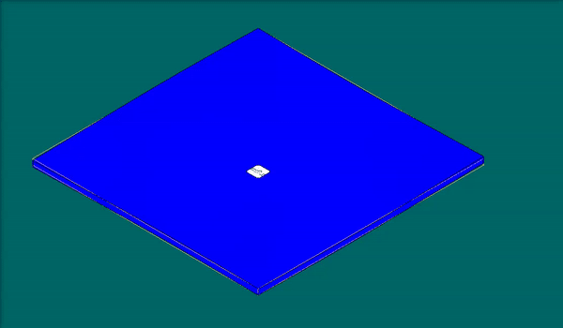
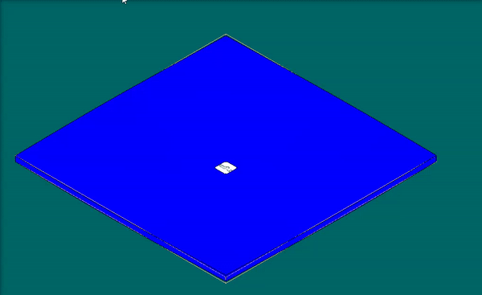
2D Vibrations – Chladini’s Plates

Slide 9
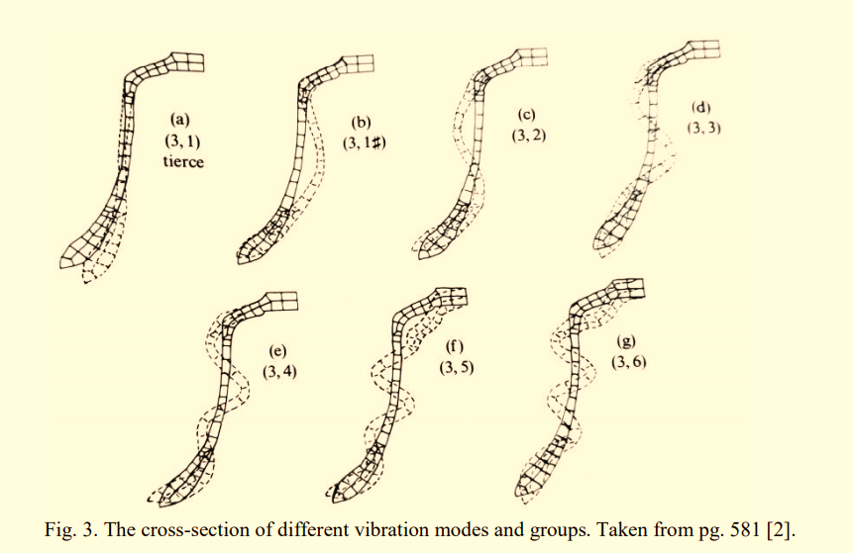
2D Vibrations – Bells
Longitudinal Modes

Slide 10
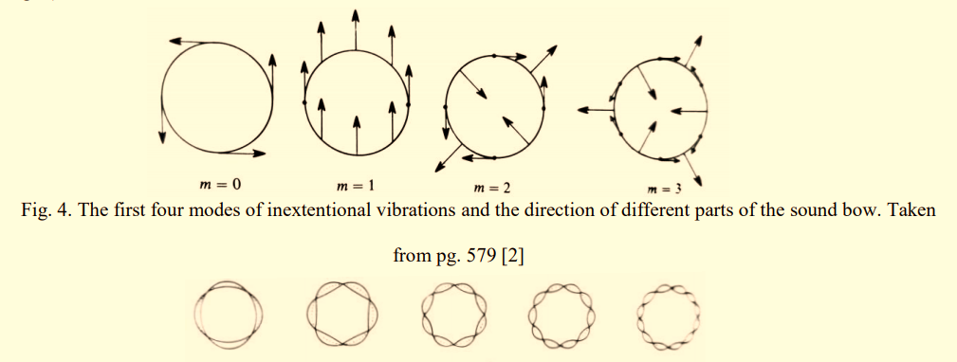
2D Vibrations – Bells
Paralel Modes

Slide 11
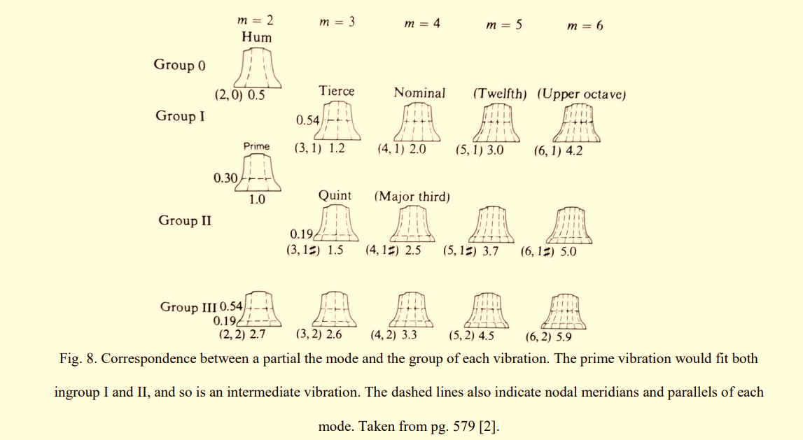

Slide 12
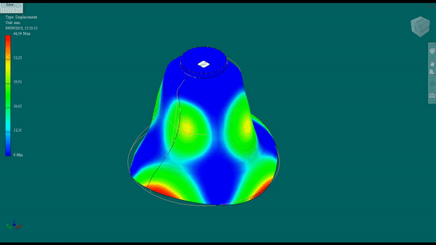
The vibrations corresponding to the Prime, m = 2

Slide 13
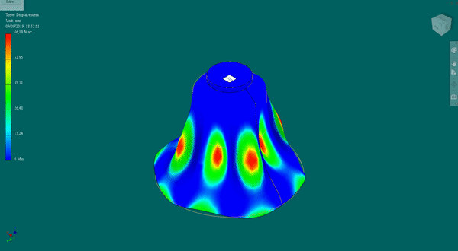
m = 4, Group 2 (Major Third)

Slide 14
The Strike note Mystery
Eb3<
<E3
But a perfect ear hears it as a precise Eb3 (155.78Hz)

Slide 15
Virtual Pitches

Slide 16
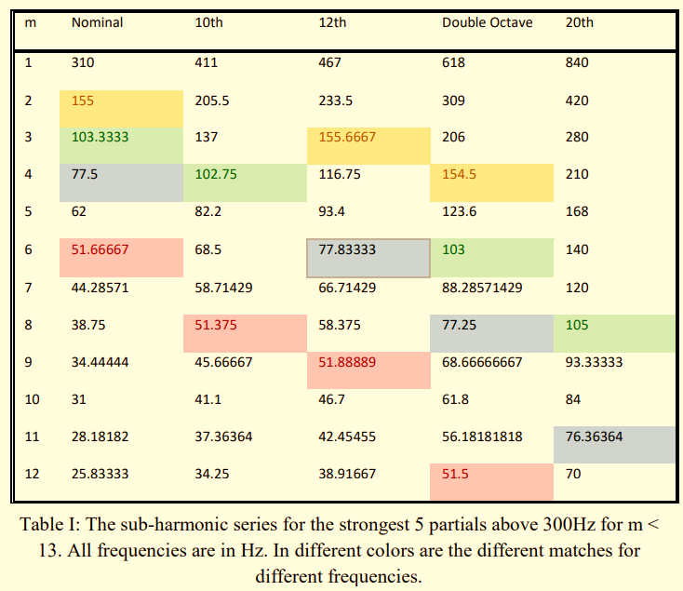
Sub-harmonic
Matching

Slide 17
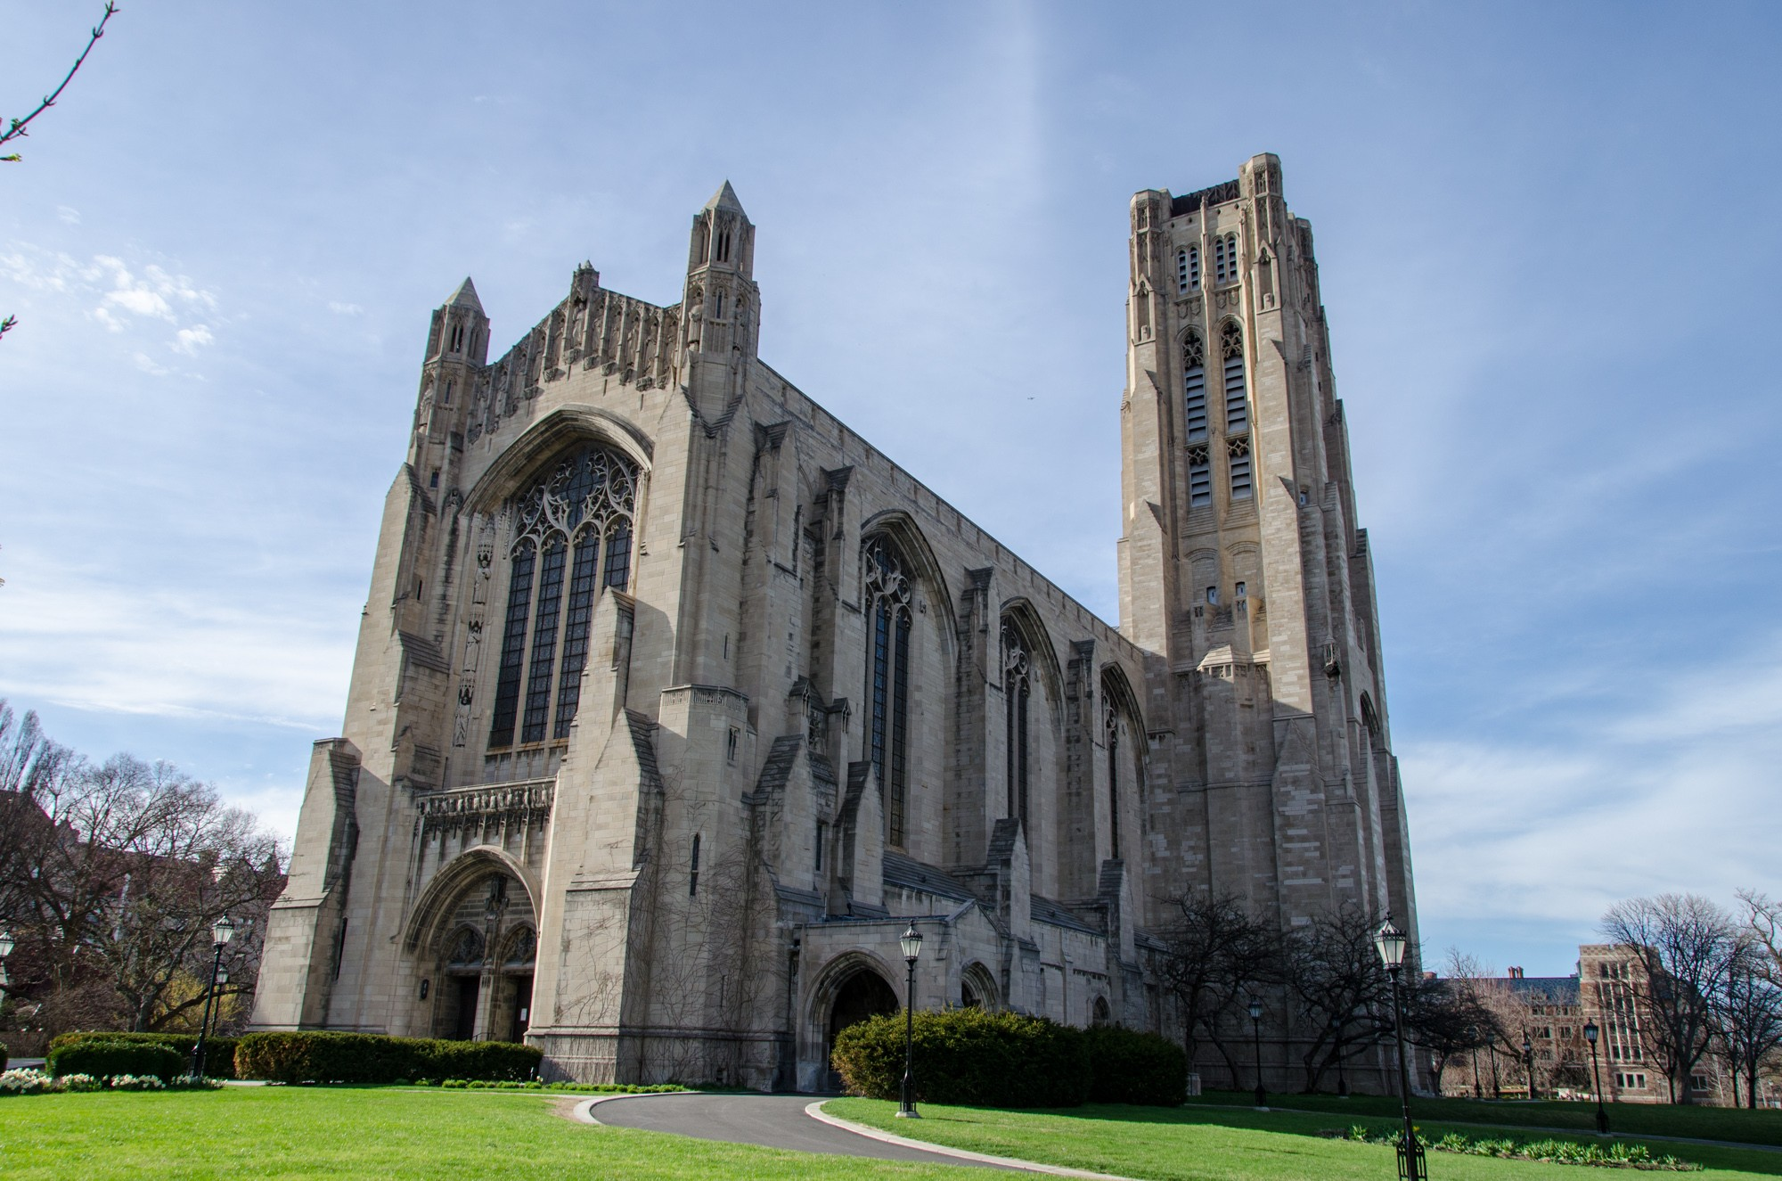
Het Einde

Slide 18
Appendix A: Extra Images

Slide 19
