Slide 1
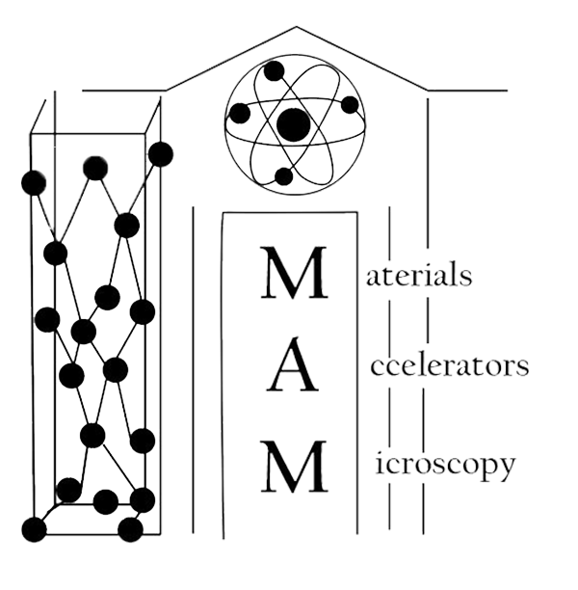

https://www.egr.msu.edu/mam/
Quantum Effects in Electron Emission from Nanodiamond
Sergey Baryshev
Electrical and Computer Engineering
Michigan State University
Center for Bright Beams, University of Chicago
Monday, June 3, 2019

Slide 2



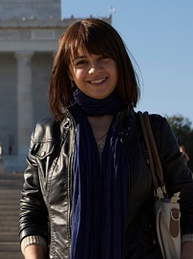



Acknowledgments
Prof. Andreas Schroeder @ UIC
Dr. Alexander Zinovev @ ANL
Dr. Oksana Chubenko
ASU
Dr. Stas Baturin
U Chicago
Gongxiaohui Chen
co-advisee @ Illinois Tech
Tanvi Nikhar
PhD @ ECE, MSU

Slide 3
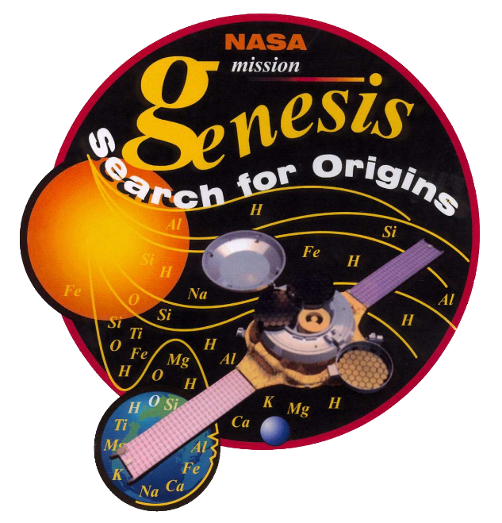
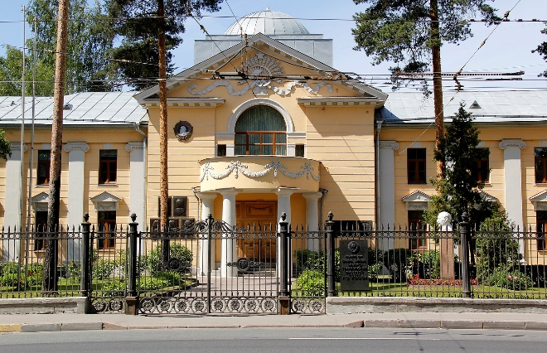
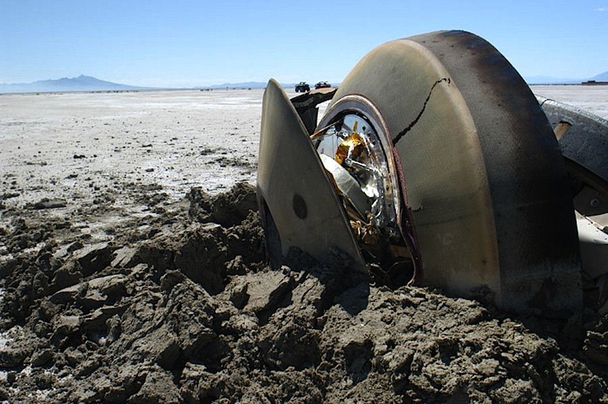
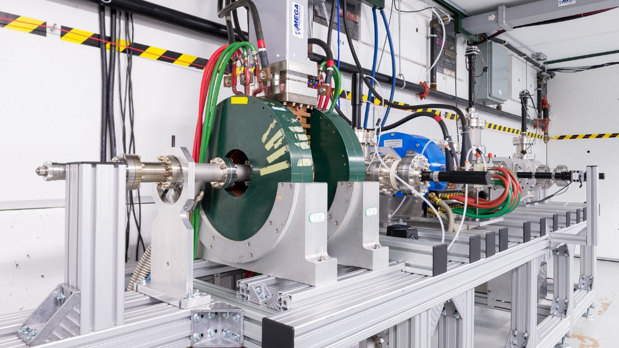
Some background
Solid state
Surface science
Accelerator R&D

Slide 4
ASET program at PA/ECE, MSU
On September 25, 2017, the U.S. Department of Energy Office of Science Office of High Energy Physics awarded MSU a five-year Accelerator Science and Engineering Traineeship (ASET) cooperative agreement to train domestic graduate students in four areas of emphasis to meet future workforce
*offers full 2 year support at MSU followed by PhD research at U.S. Nat’l Labs
Physics of large accelerators and systems engineering
Superconducting radiofrequency accelerator physics and engineering
Radiofrequency power system engineering
Cryogenic systems engineering (especially liquid helium systems)
Peter Ostroumov and Steve Lund are PI’s from Physics and Astronomy
*ASET is tightly related with USPAS and Nuclear Physics program (#1 in US)
John Verboncoeur is co-PI from ECE

Slide 5
Talk outline
~ Quantum efficiency and mean transverse energy of nanodiamond photocathode
~ Electron emission saturation effect of nanodiamond field emitter
~ Light emission and self-heating of nanodiamond field emitter

Slide 6
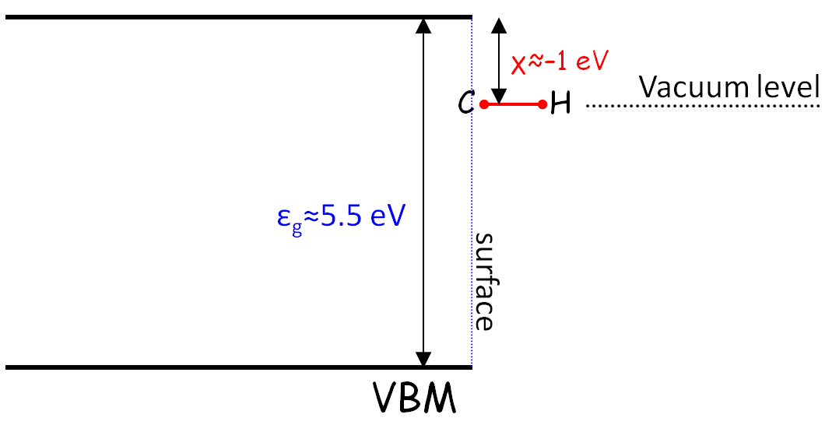
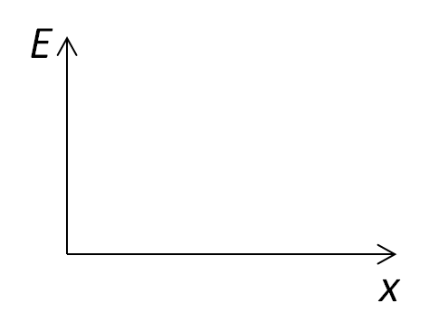
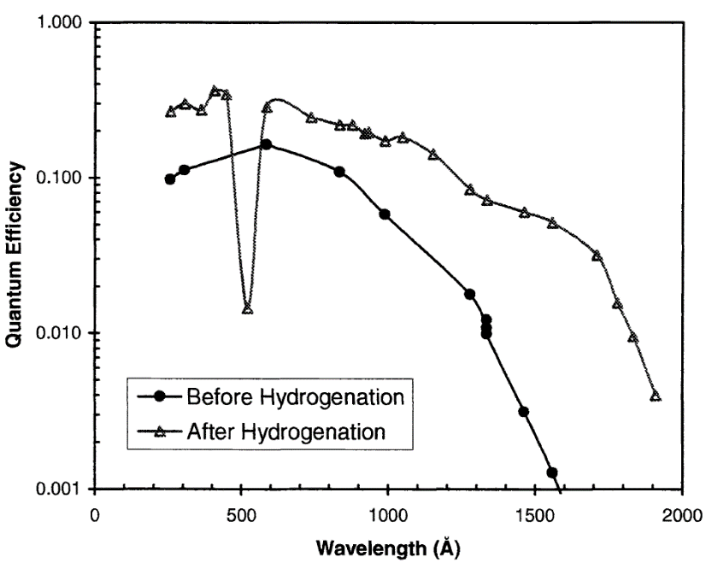
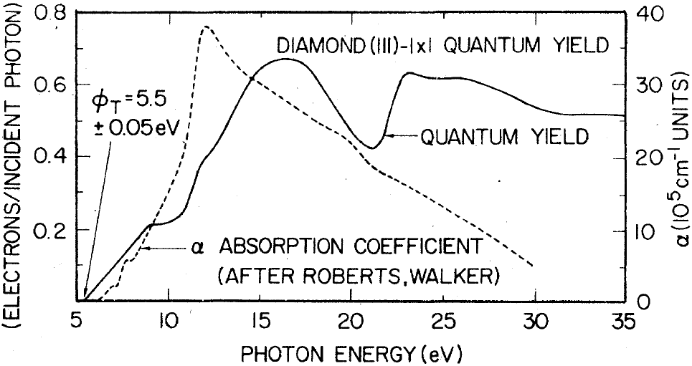
Diamond is a NEA material
Excellent solar blind photocathode QE>~1-10%
CBM
Poly crystal
Single crystal
PRB 20, 624 (1979)
Proc. SPIE 4139, 16 (2000)

Slide 7
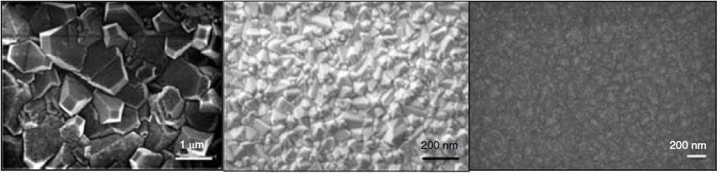
Nano- and ultra-nano- crystalline diamond: what’s in a name?
Microcrystalline:
dia. grain ≥500 nm
Nanocrystalline:
dia. grain 10-200 nm
UNCD:
dia. grain ≤10 nm
MRS Bulletin 35, 281 (2010)

Slide 8
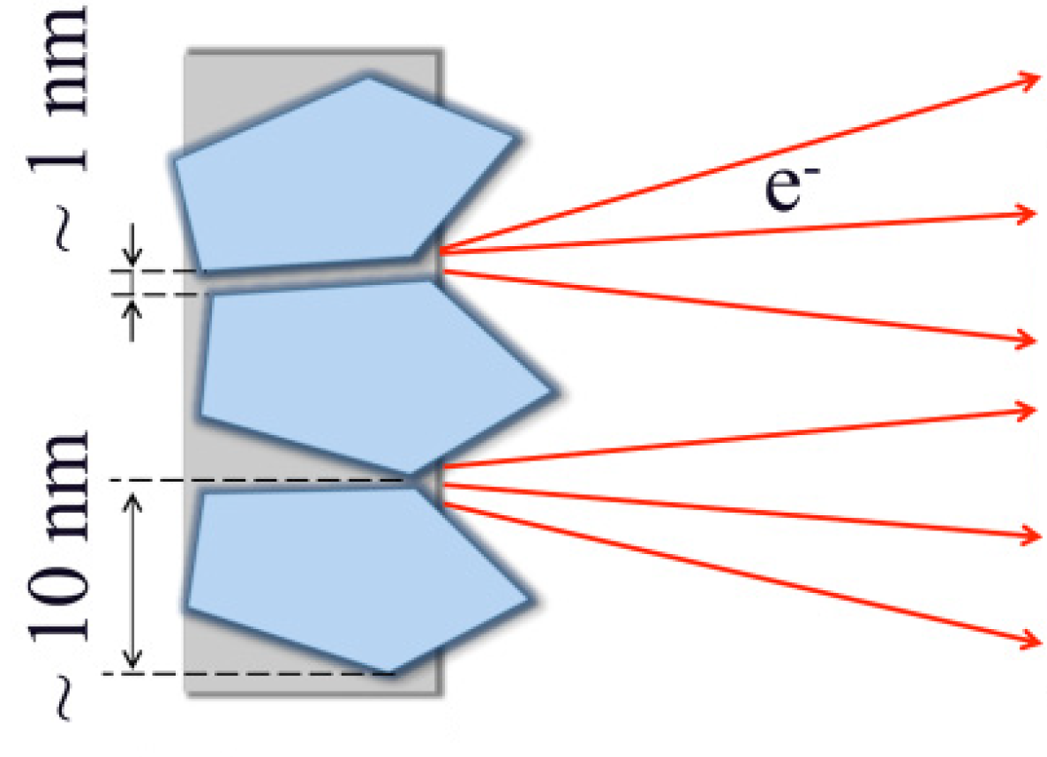
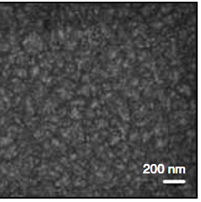
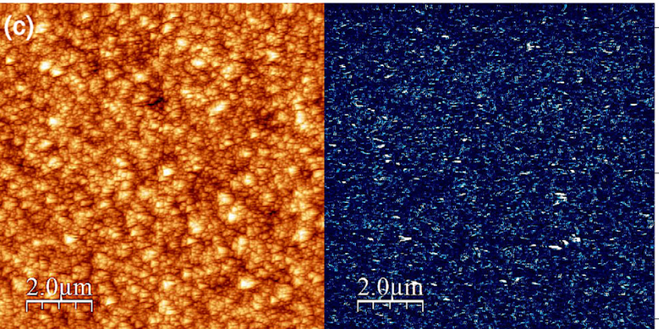
Importance of grain boundaries
Field- and photo- emission data is consistent:
sp² grain boundaries (GBs) emit electrons
PRB 60, 16135 (1999);Carbon 94, 386 (2015)
Electron transport is also through sp² GBs:
m* ≈ 1/18m₀
PRB 82, 184206 (2010)

Slide 9
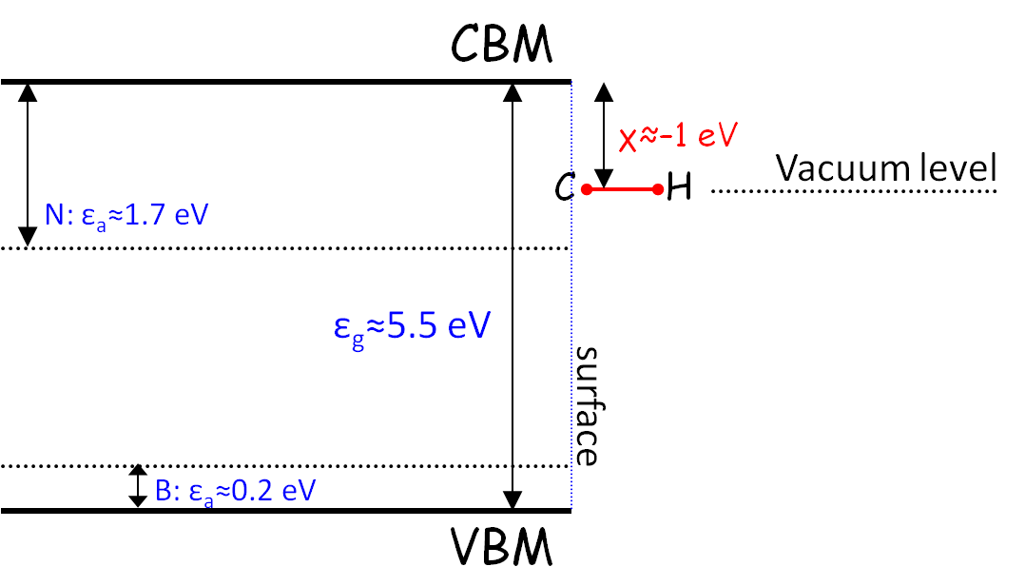
Single crystal vs. polycrystalline diamond
The ideal cathode not only would have high QE and low emittance, but it should also help mitigate image and space charge forces by emitting electrons with a high average velocity
Ref: Dowell’s summary @ P3 2014
CVD single crystal
upward band bending
CVD ultrananocrystalline
no bending
add
barrier
~2 eV

Slide 10
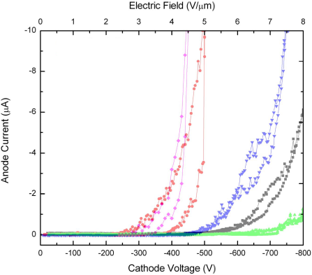
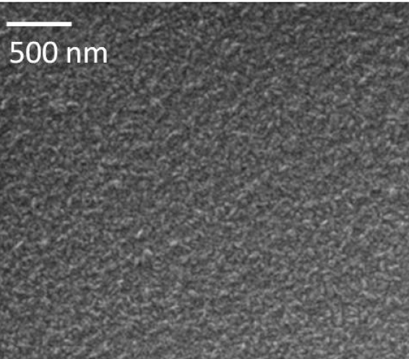
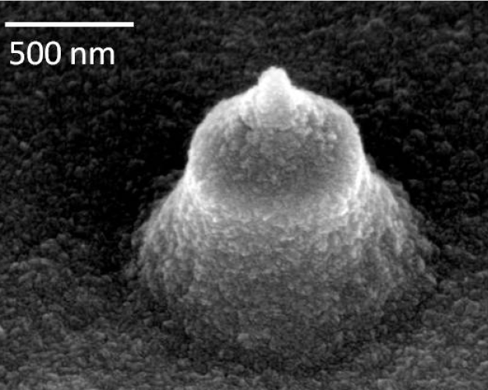
N-incorporated UNCD field emitters: no sharp needles
Excellent field emitter: low turn on field, high charge
(N)UNCD:
grain ≤10 nm
Proc. SPIE 7679, 76791N (2010)

Slide 11
Nanodiamond
photocathode

Slide 12
Naive picture of diamond doping
Effective work function is activation energy of a dopant!
CBM
S: ε_{a}≈0.4 eV
χ≈–1 eV
P: ε_{a}≈0.6 eV
Vacuum level
C
H
N: ε_{a}≈1.7 eV
ε_{g}≈5.5 eV
E
surface
VBM
x

Slide 13
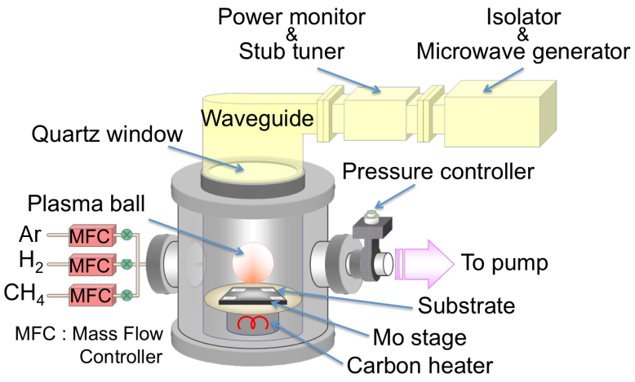
(N)UNCD / Basic characterization
Microwave-assisted plasma chemical vapor deposition
100-200 nm highly conductive (N)UNCD by SEM and Raman

Slide 14
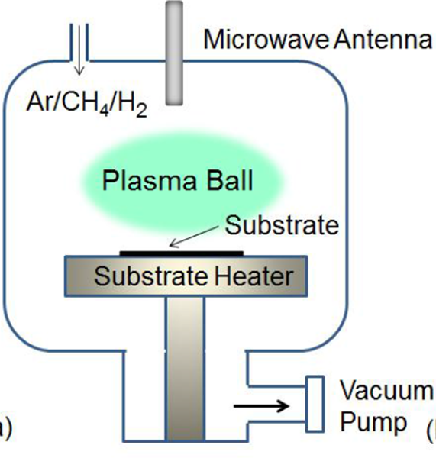

(N)UNCD:H samples transfer: 2 hours in air
Light in
e– out
V
A
KP tip
Pérez Quintero et al., APL 105, 123103 (2014)

Slide 15
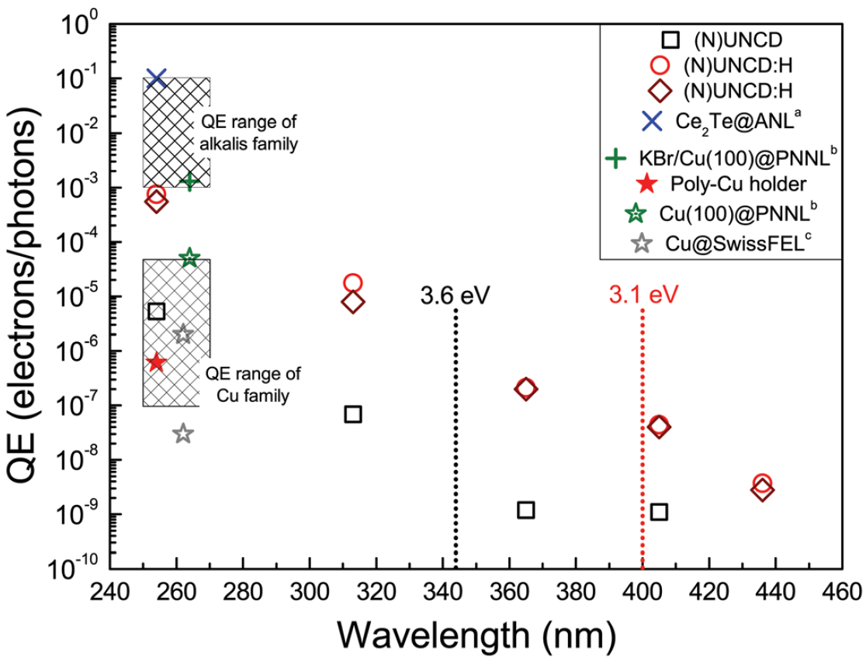
Experimental results on work function and QE
Work function drops after H-termination!
QE substantially grows!
Pérez Quintero et al., APL 105, 123103 (2014)

Slide 16
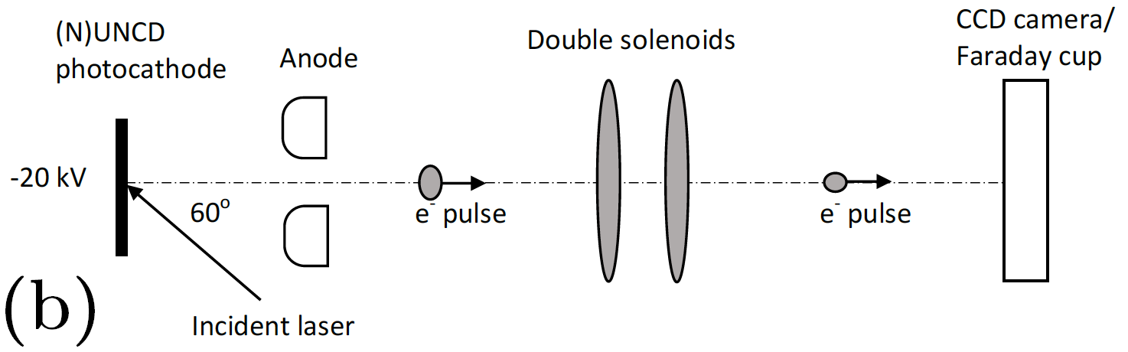
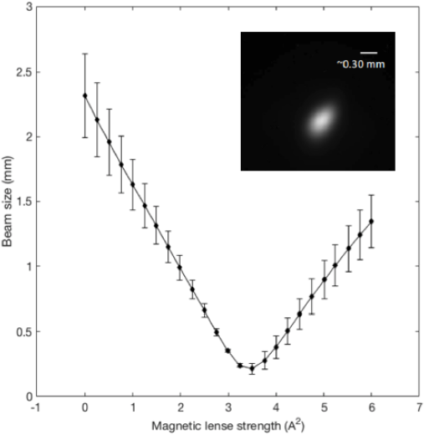
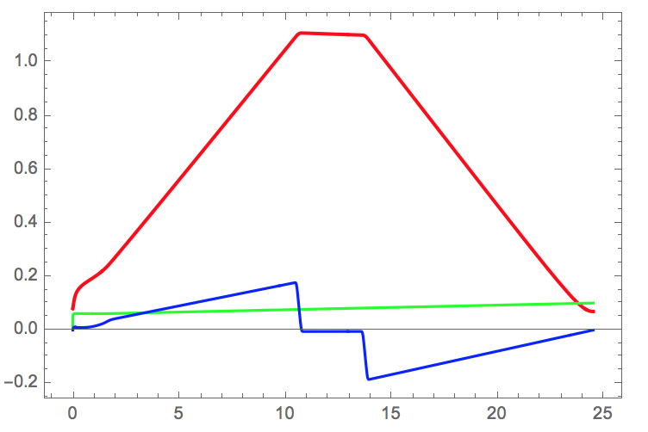
MTE experiment at UIC
I=1.83 A,
focus on YAG screen
Berger and Schroeder, JAP 108, 124905 (2010)

Slide 17
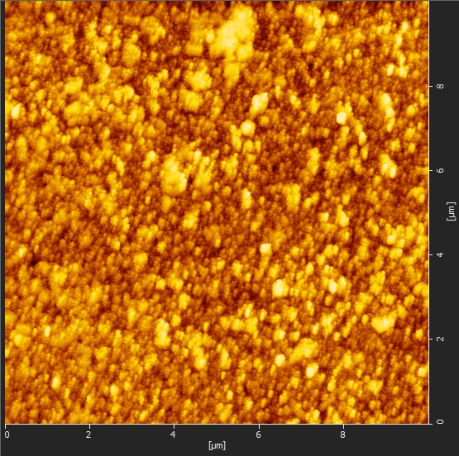
MTE results and why are they so?
says (N)UNCD:H could be x100 brighter than Cu
DS 1/3 line
No phys or chem roughness effects
266 eV
roughness ~10 nm
checked by
Karkare and Bazarov,
PR Appl. 4, 024015 (2015)
Chen et al., APL 114, 093103 (2019)

Slide 18
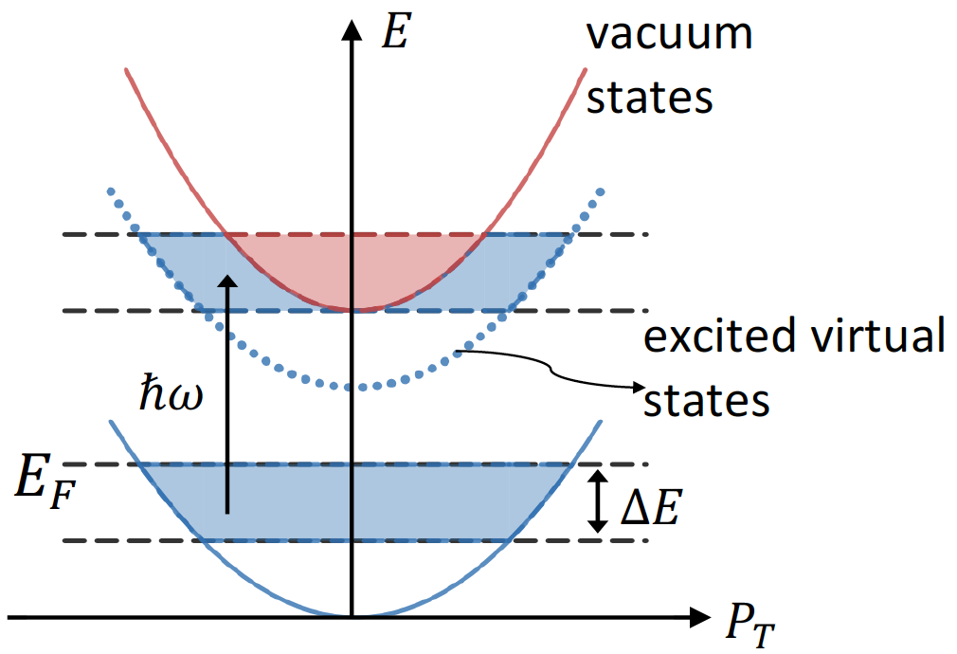
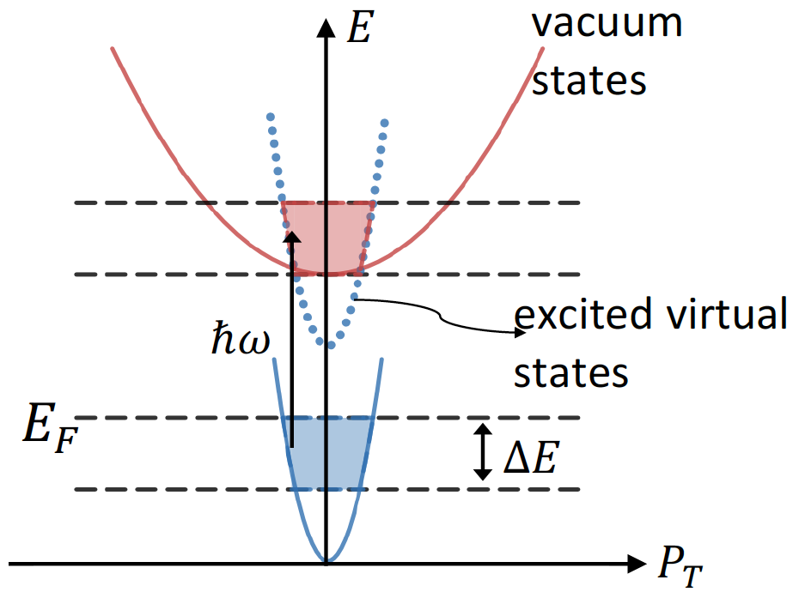
No effective mass effect
Expected value would be 30 meV from transverse momentum p_{T} conservation
but we measure ~300 meV
Classical metal (m* = m₀)
p_{T,max}=(2m₀(ħω – φ))^{1/2} = (2m₀ΔE)^{1/2}
Metal with m* < m₀
p_{T,max}=(2m₀ΔE)^{1/2} > (2m*E_{F})^{1/2}
PRL 111, 237401 (2013)
Vacuum level
Chen et al., APL 114, 093103 (2019)

Slide 19
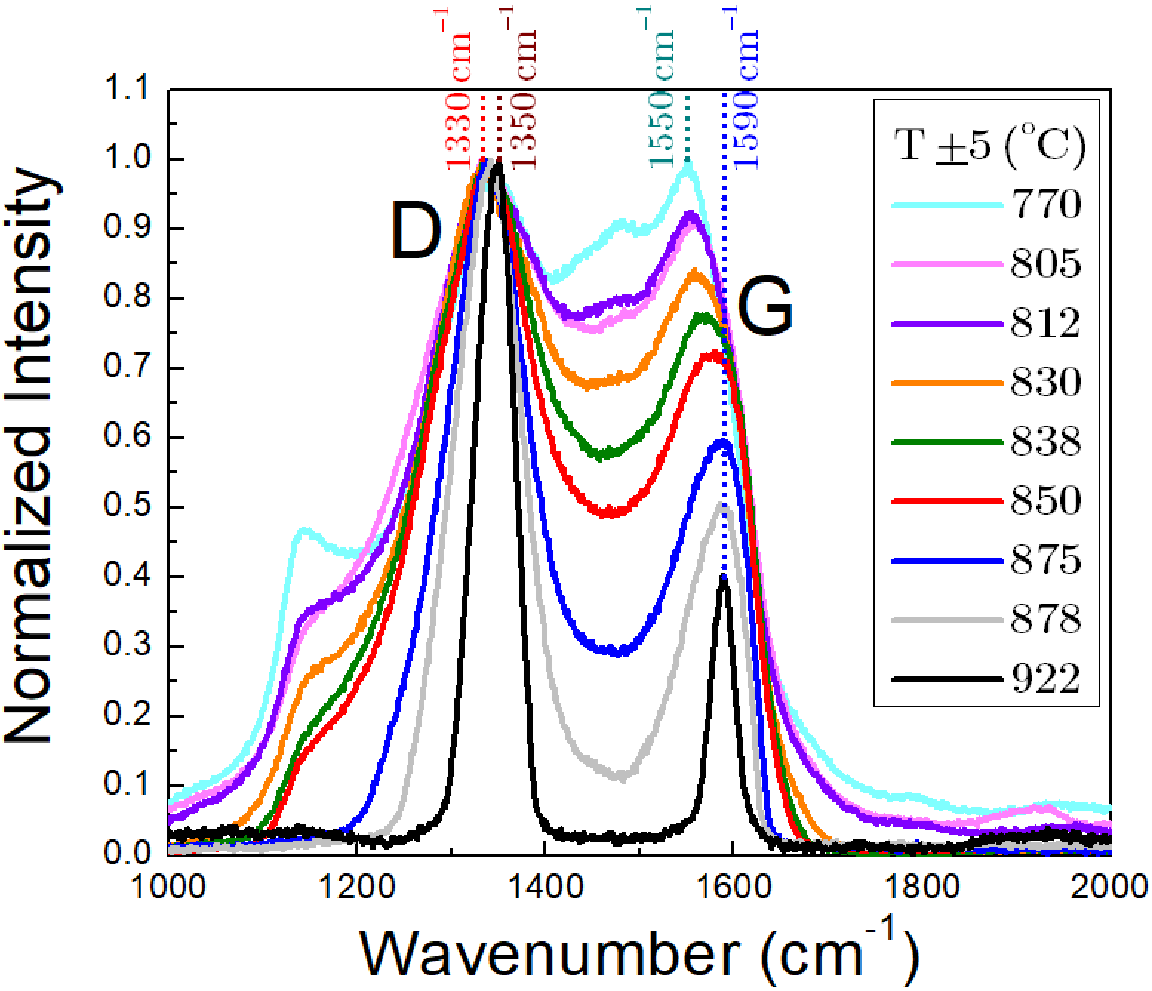
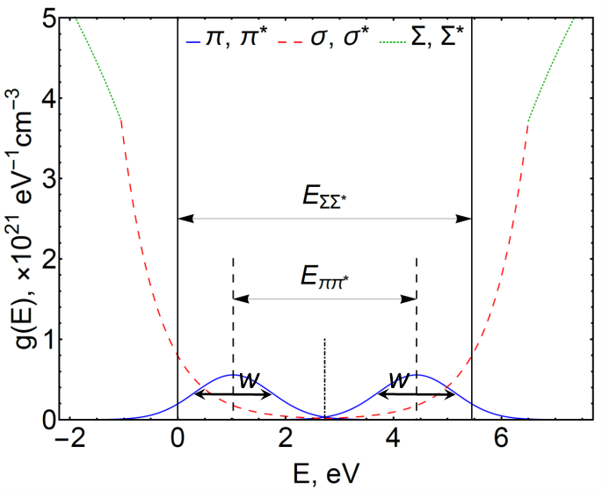
Working hypothesis:
ground state spatially confined photoemission
The Uncertainty Principle
ΔxΔp_{T}≥ħ/2
tells us
266 meV → 1 nm (GB size!)
Tanvi’s work in progress with
Fraunhofer Diamond Center and UIC
Chen et al., APL 114, 093103 (2019)
Chubenko et al., JAP 125, 205303 (2019)

Slide 20
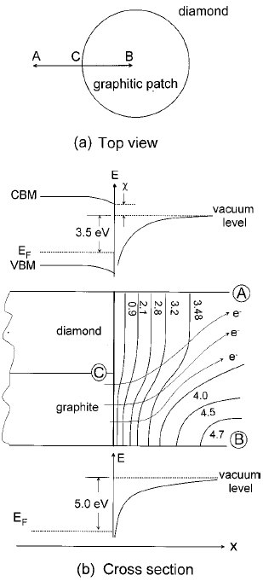
Graphitic patch model and optimal (N)UNCD:H design
NEA induced on diamond grains (χ≈–1 eV)
around sp² GB lowers their work function by 1 eV Ref: PRB 60, 16135 (1999)
In balanced (N)UNCD (balanced sp³-to-sp² ratio of ~1/10) we may get the best of all worlds:
~ GB large enough → low MTE, 50-100 meV;
~ GB crystallized well → 0.1 Ω×cm for good electron supply → no image charge;
~ Large sp² fraction → good overlap between π and π*, π* is 1-2 eV below the diamond conduction band minimum/vacuum level → low emission threshold (can be in the visible);
~ Emission from well crystallized graphitic → ultrafast emission

Slide 21
Saturation

Slide 22
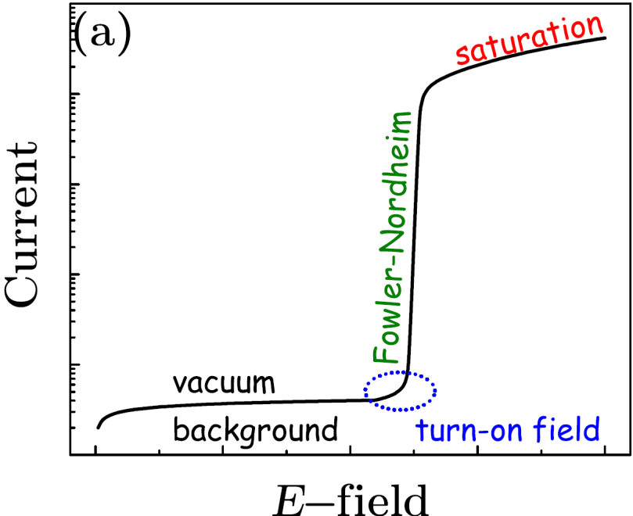
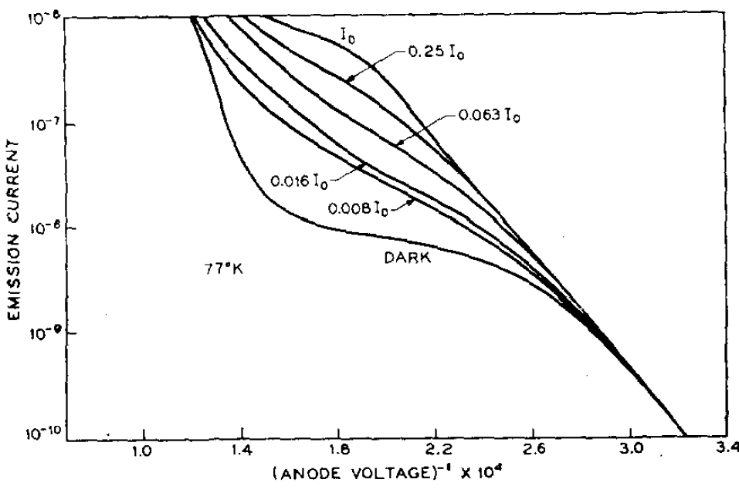
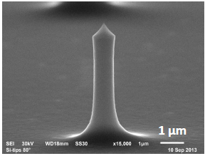
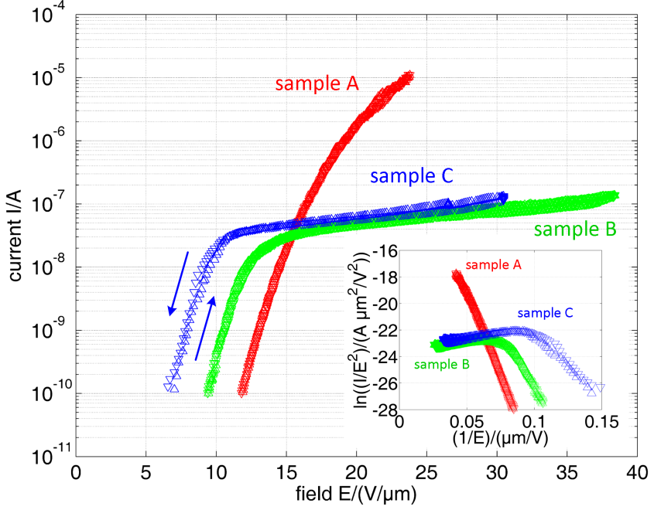
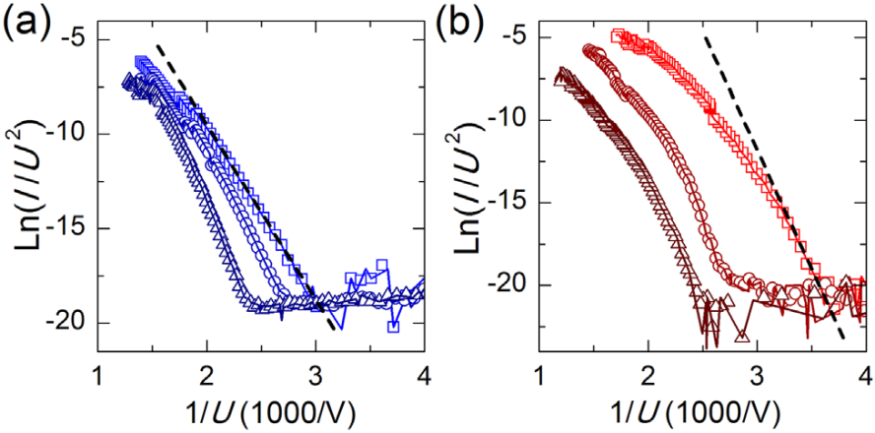
Deviation from FN law in nonmetals (saturation)
plasma/
breakdown
p- type Ge
n-Si
p-Si
Arthur, JAP 36, 3221 (1965)
metallic CNT
semicond CNT
JVSTB 31, 02B101 (2013);
IVNC S9-C1 (2014)
Phys. Stat. Solidi B 1700268 (2017)

Slide 23
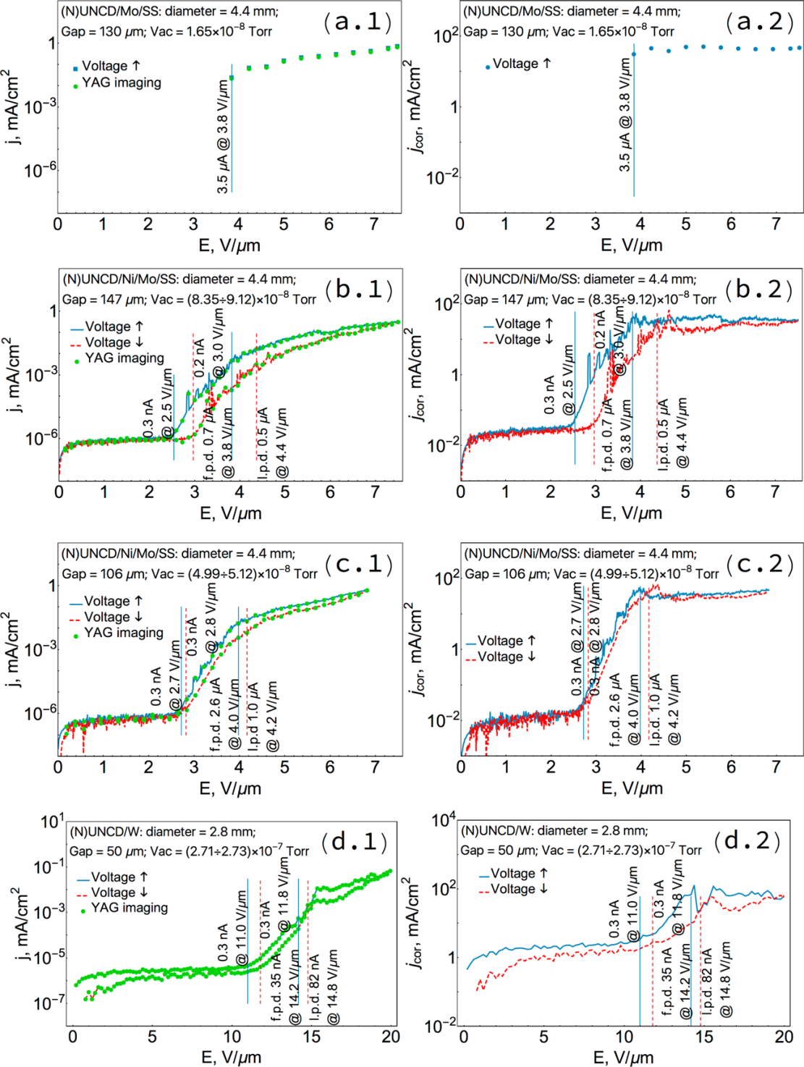
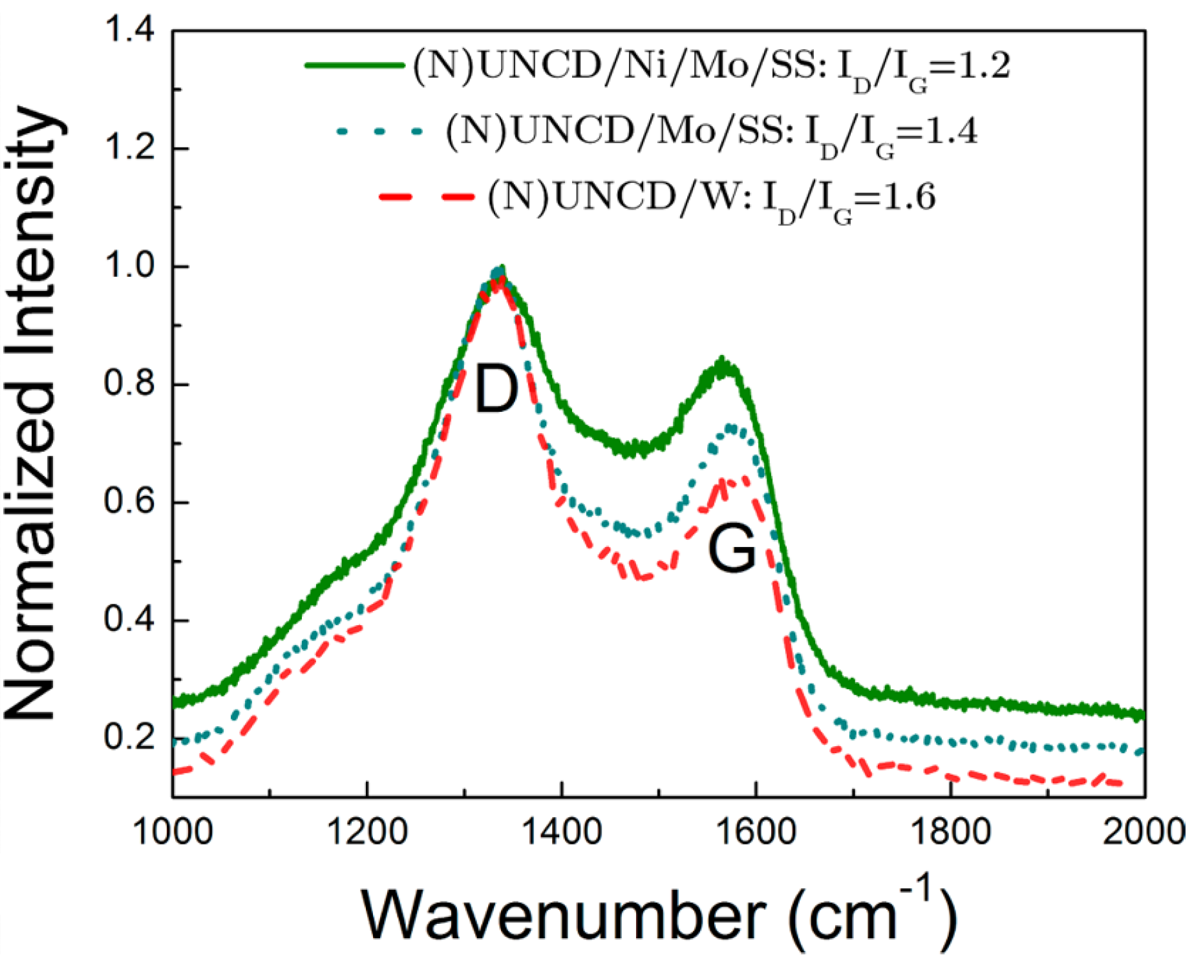
Semi-metallic (N)UNCD also saturates!
Chubenko et al., ACS Appl. Mater. Interfaces 9, 33229 (2017)

Slide 24
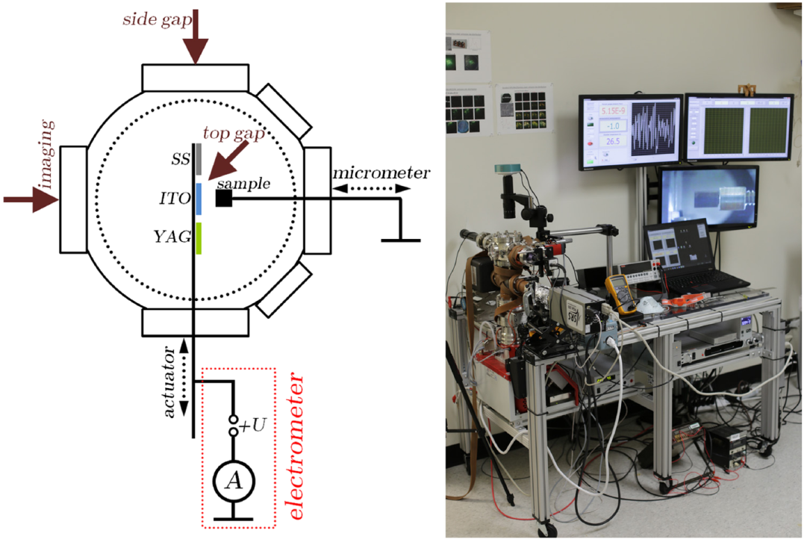
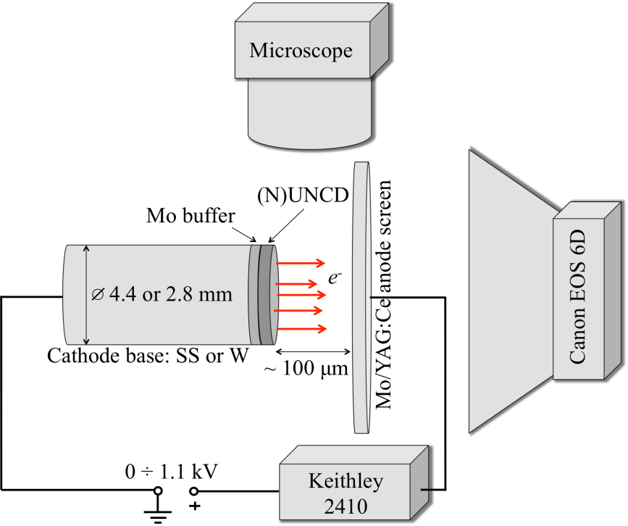
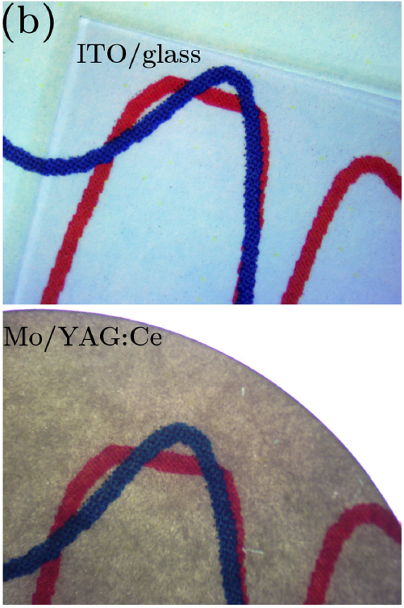
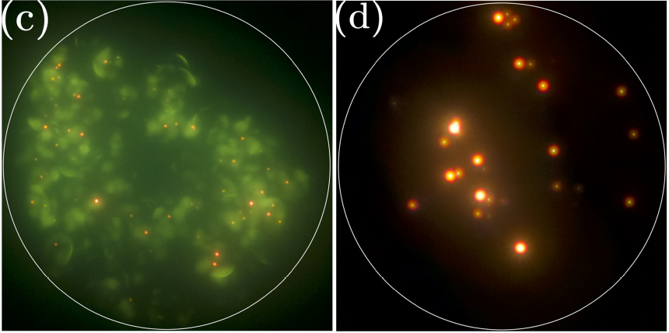
Field emission projection microscope
(a)
Baturin and Baryshev, Rev. Sci. Instrum. 88, 033701 (2017)

Slide 25
What’s going on (N)UNCD surface?
Field of view is 4.4 mm

Slide 26
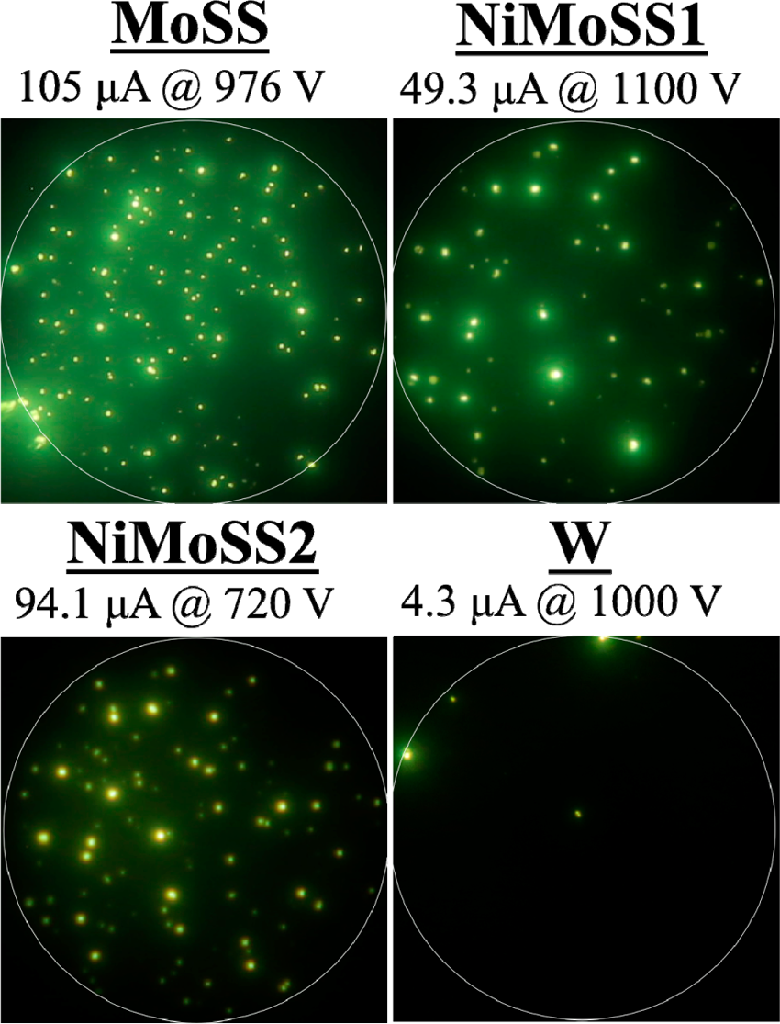
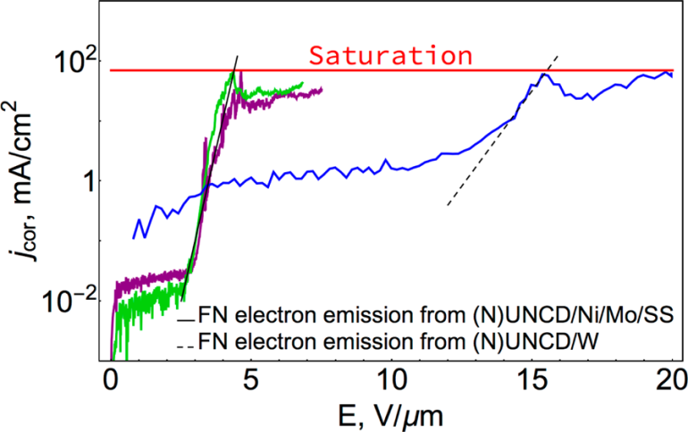
3 different samples and 4 lessons
~ Semi-metallic (N)UNCD saturates similarly to semiconductors
~ In planar uniform (N)UNCD, field emission is not uniform
~ Emission area depends on electric field
~ Saturation is ~100 mA/cm² is specific to (N)UNCD, regardless of substrate
Chubenko et al., ACS Appl. Mater. Interfaces 9, 33229 (2017)

Slide 27
Band diagrams
Chubenko et al., JAP 125, 205303 (2019)

Slide 28
Stratton–Baskin–Lvov–Fursey formalism
Stratton, Proc. Phys. Soc. B 68, 746 (1955) and Phys. Rev. 125, 67 (1962)
Baskin, Lvov, Fursey, Phys. Stat. Solidi B 47, 49 (1971)
Poisson
Stratton
Chubenko et al., JAP 125, 205303 (2019)

Slide 29
Describing saturation: theory vs. experiment
Child-Langmuir
266 meV → 0.9°
image process
Chubenko et al., JAP 125, 205303 (2019)

Slide 30
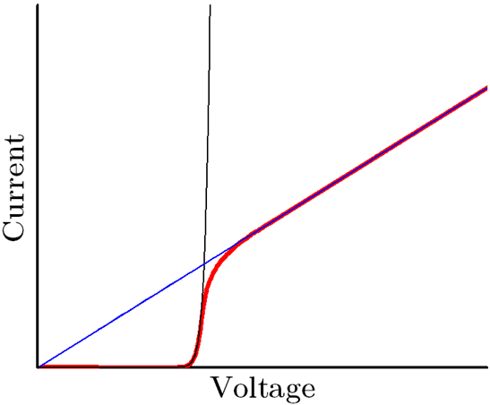
Saturation: diode-to-resistor switching
n-Si
r_{FN}= ∂V/∂I
(∞→0)
p-Si
+
r_{S}= ∂V/∂I
(0→large N)
JVSTB 31, 02B101 (2013);
IVNC S9-C1 (2014)

Slide 31
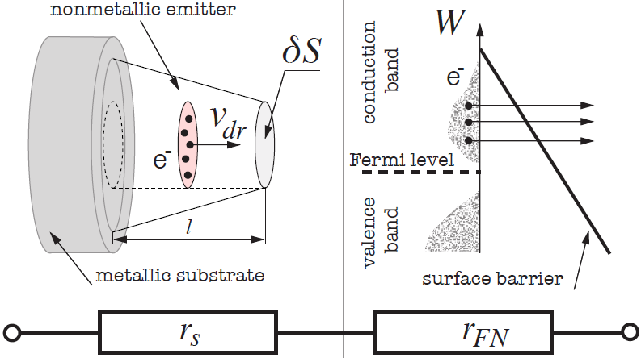








General series resistor formulas
supply term
emission term
v∞ ~10⁷ cm/s
limited!
Baturin et al., arXiv:1710.03692 (2017)

Slide 32
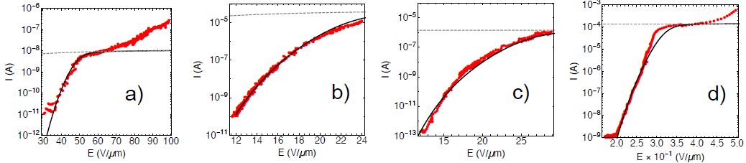
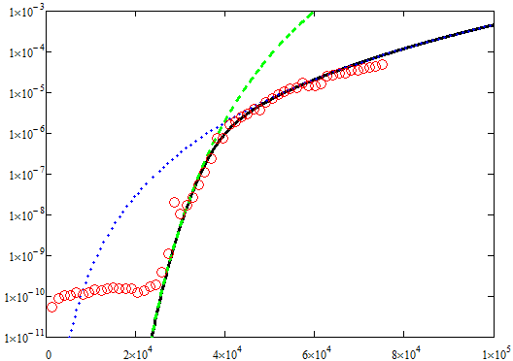
Formulas versus experiments
single tip p-Si
arrayed n-Si
single CNT
fiber CNT
JVSTB
31, 02B101 (2013)
IVNC S9-C1 (2014)
Nano Lett. 5, 2135 (2005)
APL 105, 173107 (2014)
I, A
planar (N)UNCD
E, V/cm
Chubenko et al., ACS Appl. Mater. Interfaces 9, 33229 (2017)

Slide 33
Any relevance to photocathodes?
Quick depletion in photocathodes based on 2D materials/2D surface states?

Slide 34
Heating, evaporation
and blow away

Slide 35
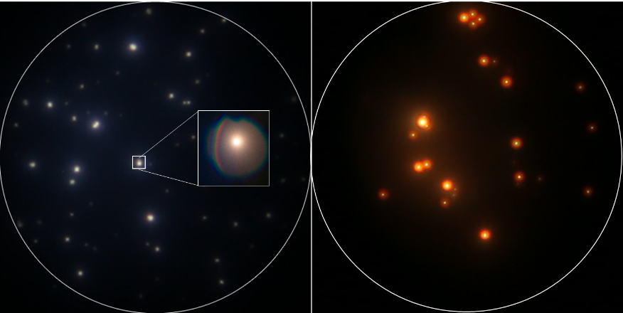
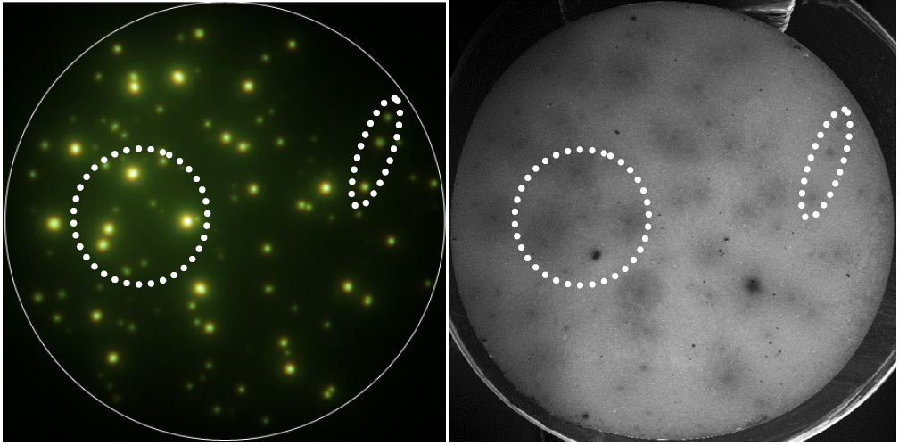
Blue light from (N)UNCD
ITO
YAG
SEM

Slide 36
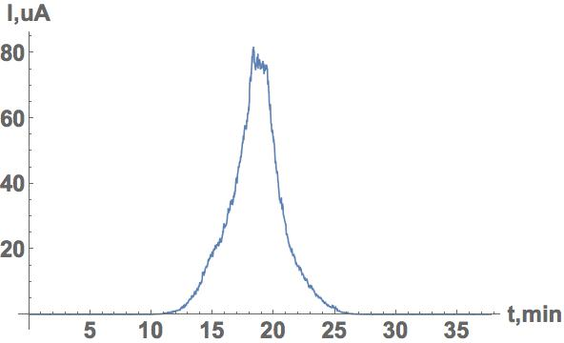


First evidence for micro-plasma formation
Current vs. time
Side-view into the gap
Pressure vs. time

Slide 37




sp² content of UNCD versus emissivity
All samples
~100 μA@1 kV
Baturin et al., J. Phys. D: Appl. Phys. 52, doi:10.1088/1361-6463/ab2183 (2019)

Slide 38
Side-view (in gap) and front-view (on YAG)
Vacuum ~10⁻⁹ Torr
Front-view
Side-view
Baturin et al., J. Phys. D: Appl. Phys. 52, doi:10.1088/1361-6463/ab2183 (2019)

Slide 39




Self-induced, self-stabilized glow discharge

Slide 40



Two estimations on temperature
Phase diagram
(T>~3,500 K)
Diamond-to-graphite
(T>~2,000 K)
Baturin et al., J. Phys. D: Appl. Phys. 52, doi:10.1088/1361-6463/ab2183 (2019)

Slide 41


Third temperature estimation
stable 2,000 K
(m_{eff}~1/2m)
unstable 4,500 K
(m_{eff}~1/18m)

Slide 42


In situ light emission and breakdown formation
1500 K
PR Rev. Accel. Beams 21, 122002(2018)

Slide 43
Any relevance to photocathodes?
Nottingham-like heating in low mass photocathodes?

