Slide 1
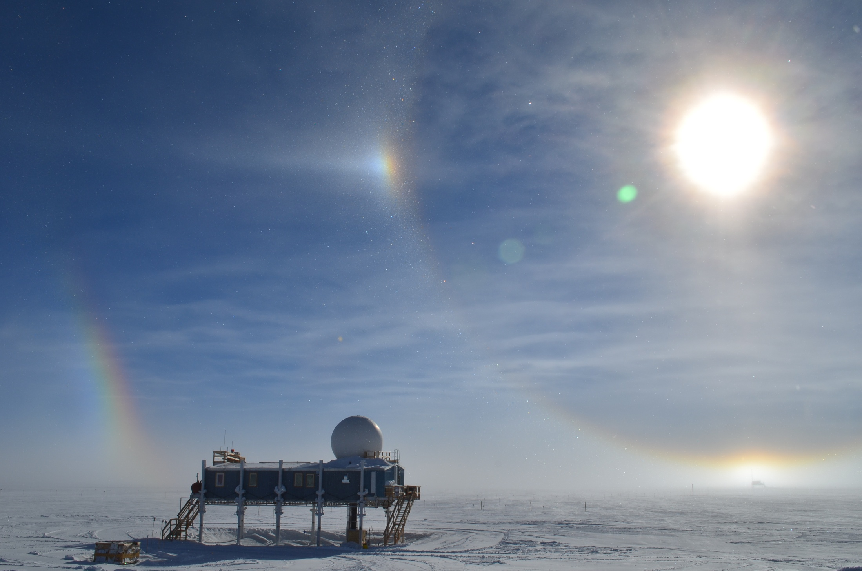





PUEO and RNO-G: Two New Experiments to Discover Ultra-high Energy Neutrinos
Abby Vieregg
University of Chicago
4 April 2022

Slide 2


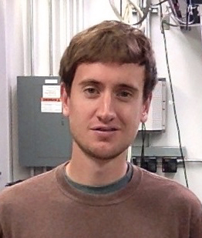



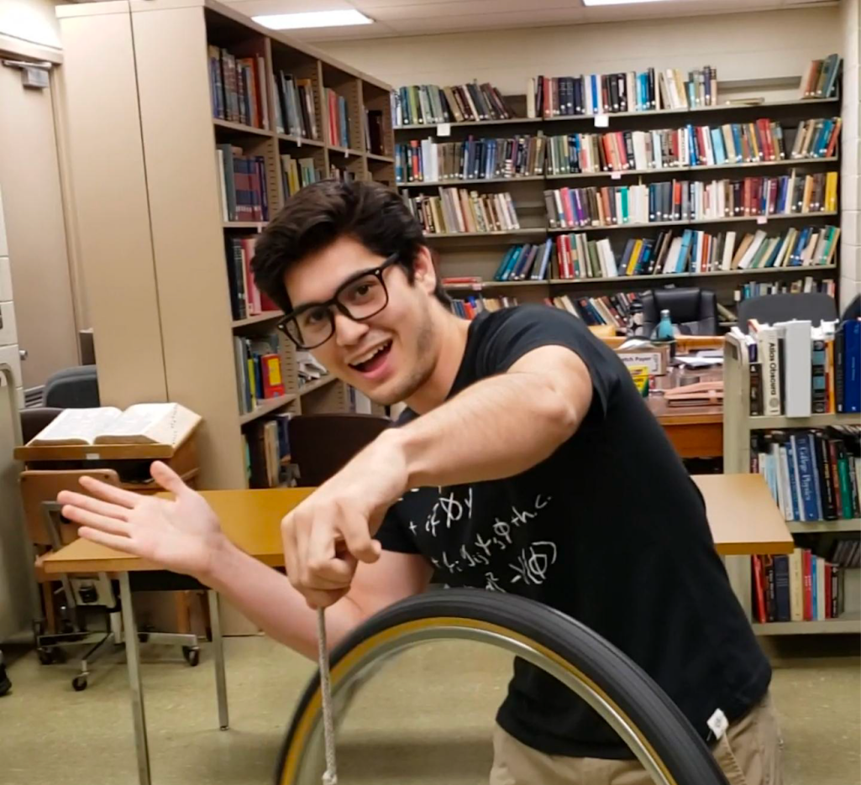




The People at UChicago Doing the Real Work
Cosmin Deaconu
Eric Oberla
Dan Smith
Dan Southall
Kelli Michaels
Rachel Scrandis
Zach Martin
Kaeli Hughes
Joalda Morancy
Zach Curtis-Ginsberg
Katherine McDonough

Slide 3
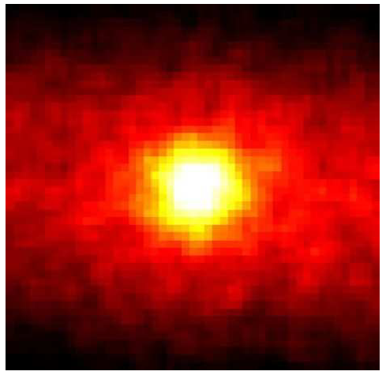
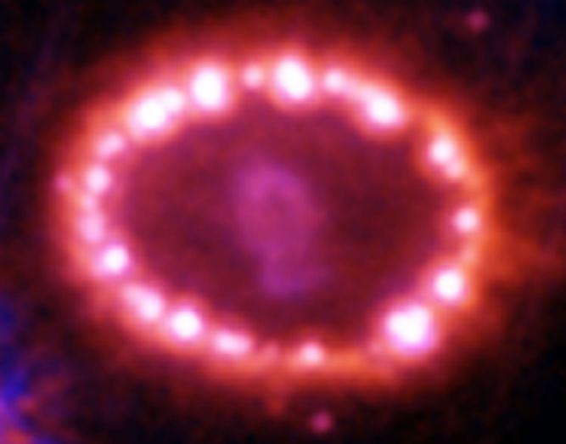
Neutrino Astronomy: A Brief But Important History
The Sun in the light of neutrinos
Supernova 1987a
Hubble
Super-K (1998)
Spread in Arrival Time
→ Neutrino Mass Limits
Constrain neutrino decay scenarios
“Solar Neutrino Problem” → Oscillations
Mass eigenstates ≠ weak eigenstates
3

Slide 4
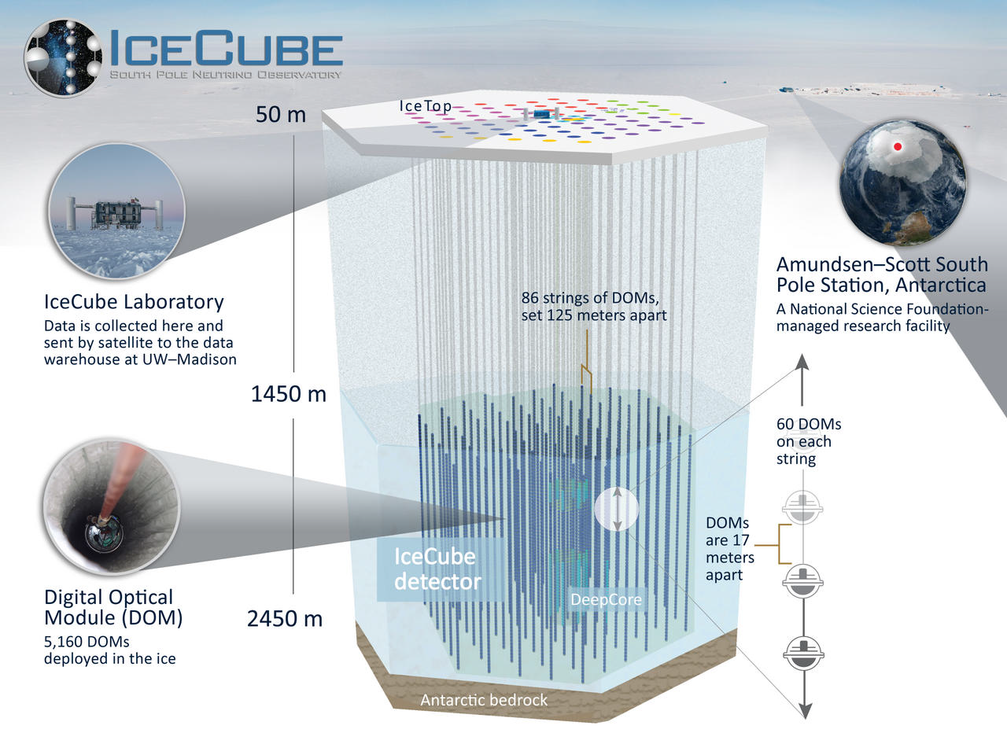
IceCube Collaboration

Slide 5
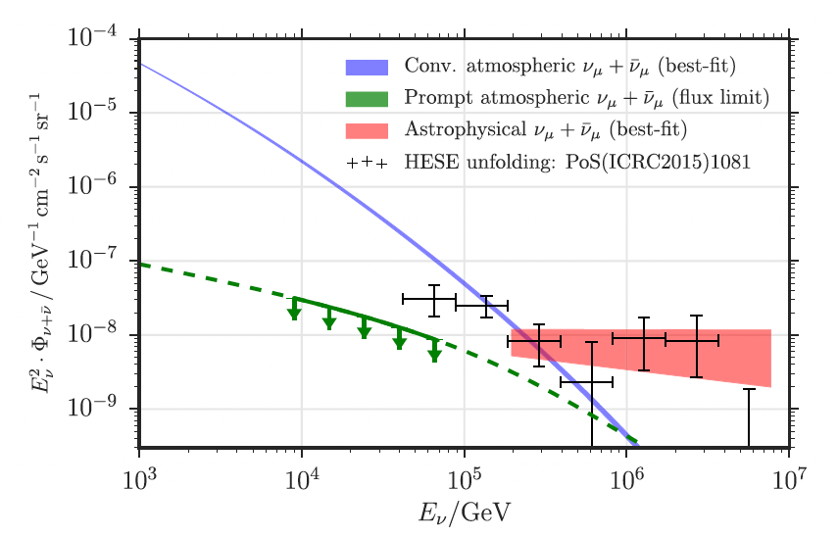
First Detection of Astrophysical Neutrinos (IceCube)
2013: first astrophysical neutrino events ever observed
e.g. IceCube Coll.
ApJ 2016
Energy: TeV – PeV range
(This plot is 6 Years of muon neutrino data)

Slide 6
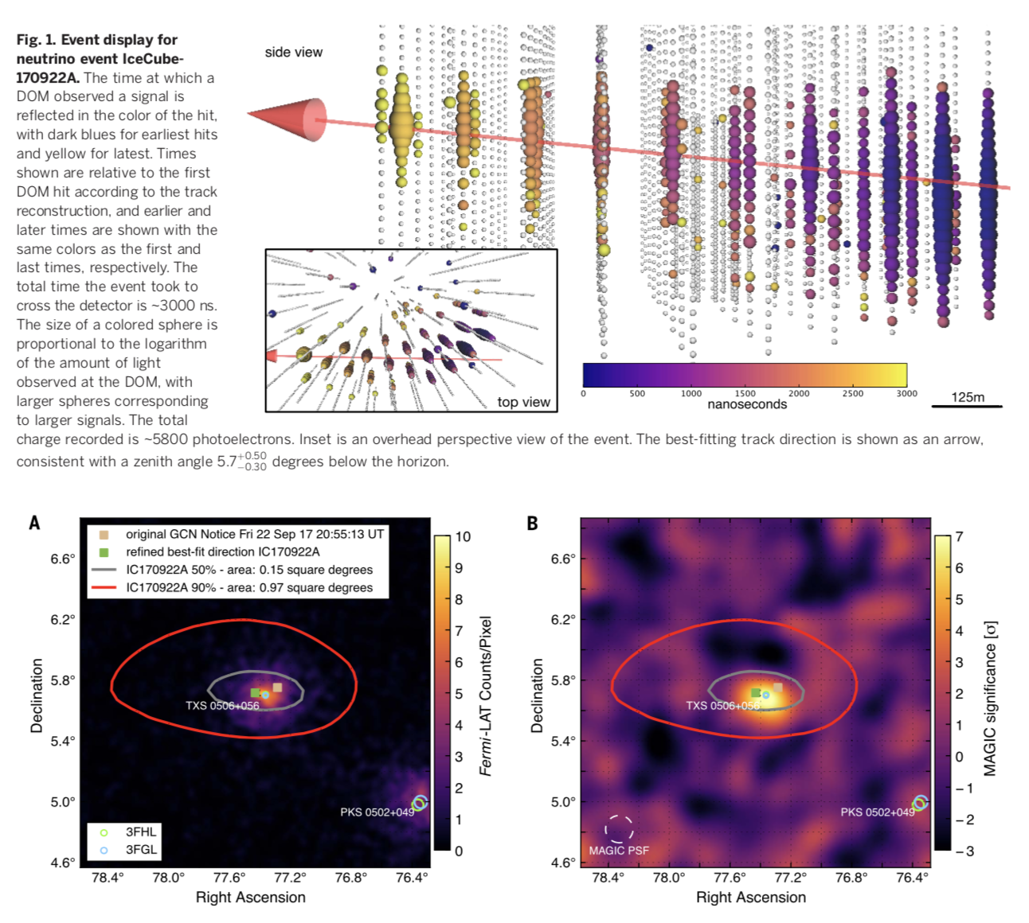
The First Multi-Messenger Observation with Neutrinos?
IceCube Neutrino Detected
2018: Neutrino event seen in IceCube, coincident in time and space with the blazar TXS 0506+056 (3𝛔 significance)
Fermi Observation
Magic Observation
Science 361 (6398)
2018
Science 361 (6398) 2018

Slide 7
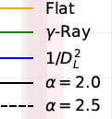
(But Can Blazars Like This Source Account for the Observed IceCube Flux?)
Answer: no. Upper limit on flux fraction that can be from Blazars is 15% of IceCube’s flux.
Smith, Hooper, Vieregg 2020

Slide 8
Hints of Steady Sources Seen with Neutrinos?
Analysis of 10 years of IceCube data yields 2.9𝜎 significance for excess at NGC1068
Neutrino excesses at locations of other sources as well.
NGC 1068
IceCube, PRL 2020

Slide 9
(But Can Active Galactic Nuclei Like This Source Account for the Observed IceCube Flux?)
Answer: maybe. Limits have to stop getting better before you have a discovery!
Smith, Hooper, Vieregg 2020

Slide 10
The Ultra-High Energy Universe
There are sources making particles x 10⁴ more energetic than the neutrinos seen by IceCube (we’ve seen cosmic rays from them)
How are these particles accelerated?
  Active Galactic Nuclei (black holes accreting mass)?
  Blazars (Jets emitted in our direction by AGN)?
  Gamma Ray Bursts (most luminous events in the universe)?
Auger, ICRC 2021

Slide 11
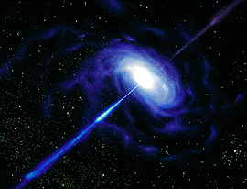
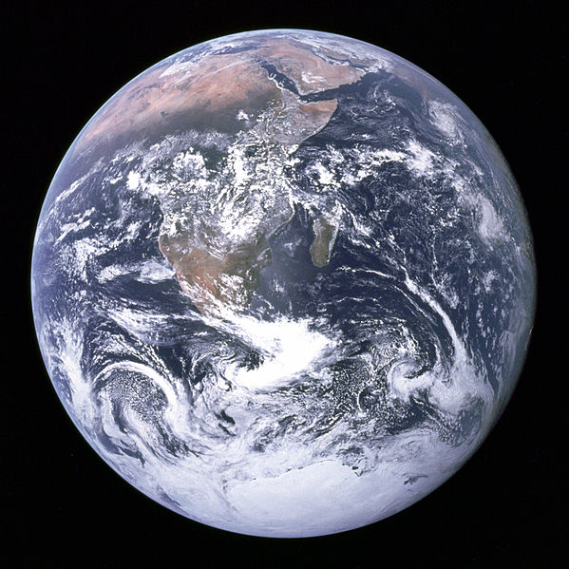
Neutrinos are the Best Way to View the Ultra-High Energy Universe!
Possible Messenger Particles:
Photons are lost above 100 TeV (pair production on CMB & IR)
Protons and Nuclei deflect in magnetic fields
Neutrons decay
Neutrinos: point back to sources, travel unimpeded through universe
Ultra-High Energy Neutrino Telescopes:
Open a unique window into the universe
  Highest energy observation of extragalactic sources
  Very distant sources
  Deep into opaque sources
How the high energy universe evolves?

Slide 12
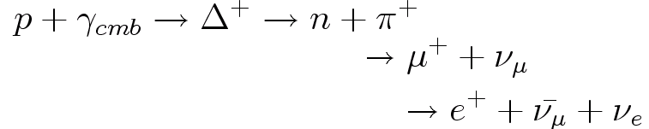
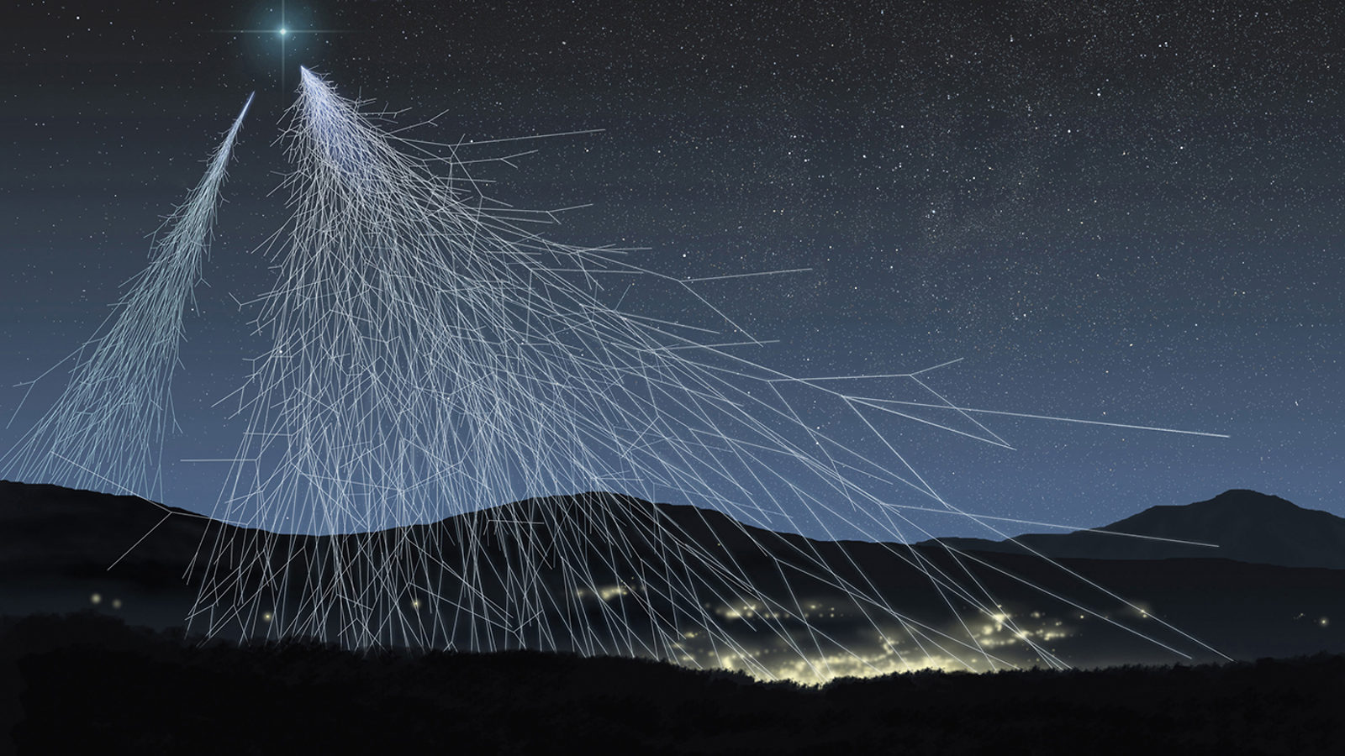
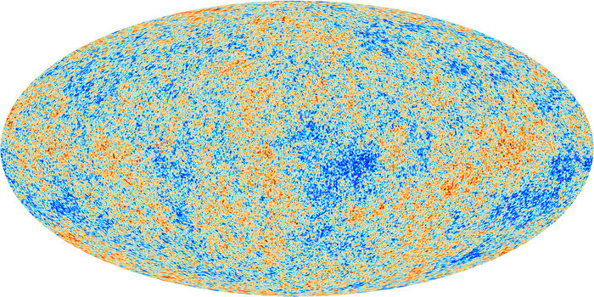
Neutrino Production: The GZK Process
GZK process: Cosmic ray protons (E> 10^{19.5} eV) interact with CMB photons
Cosmic Rays
CMB
+
= Neutrino Beam!
Discover the origin of high energy cosmic rays and neutrinos?
What is the high energy cutoff of our universe?
What is(are) the acceleration mechanism(s)?

Slide 13
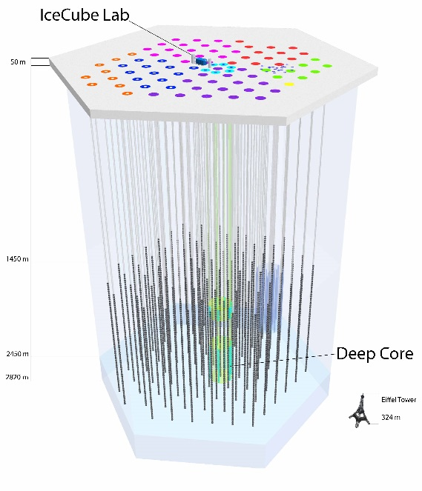
The Problem with Neutrino Astronomy
Neutrinos don’t interact very often, so it is hard to detect them!
  Need a huge detector to have a chance to see them (hence IceCube)
The highest energy neutrinos are even more rare, so you need an even bigger detector
  You have to get creative (that’s the fun part!)
… ?

Slide 14
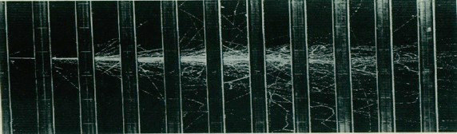
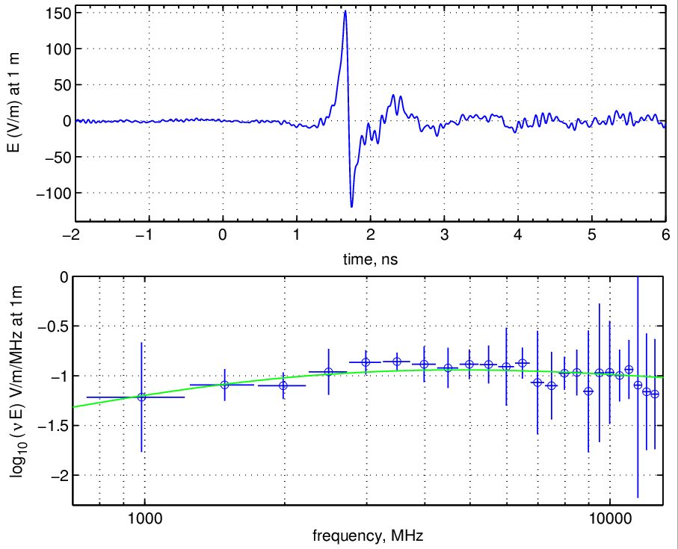
Method 1: Radio emission from neutrino interactions in dense material
EM shower in dielectric (ice, sand) → moving negative charge excess
Coherent radio Cherenkov radiation (P ~ E²) if λ > Moliere radius
Typical Dimensions:
L ~ 10 m
R_{moliere} ~ 10 cm
e⁺,e⁻,γ
ANITA Coll., PRL (2007)
→ Radio Emission is stronger than optical for UHE showers
Askaryan Effect Observed at SLAC

Slide 15
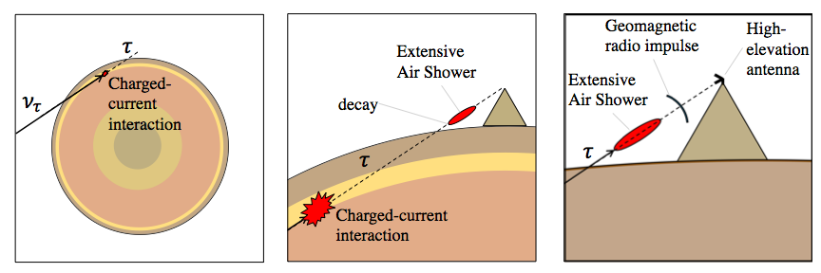
Method 2: Emission (Radio or Optical) from Tau Neutrino Induced Air Showers
S. Wissel
Looks like an upward going cosmic ray air shower
Observe from surface, a mountain, balloon, or space

Slide 16
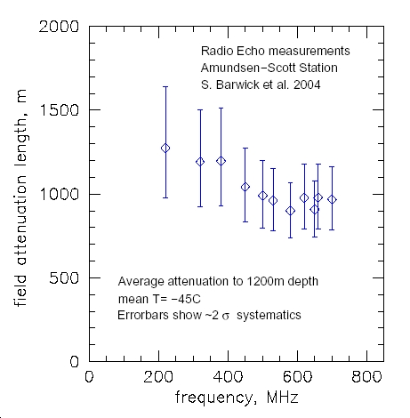
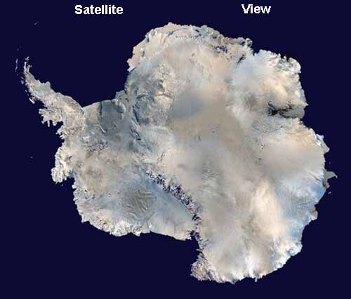
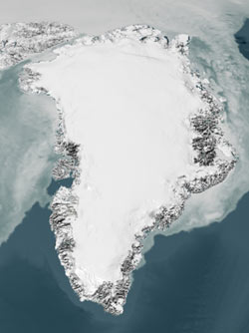
Askaryan Emission Detector Requirements
~1 GZK neutrino/km²/year
L_{int} ~ 300 km
  → 0.01 neutrinos/km³/year
Need a huge (~100 km³), radio-transparent detector
Long radio attenuation lengths in ice
    1 km for RF (vs. ~100 m for optical signals used by IceCube)
→ Ice is good for radio detection of UHE neutrinos!
1 km

Slide 17
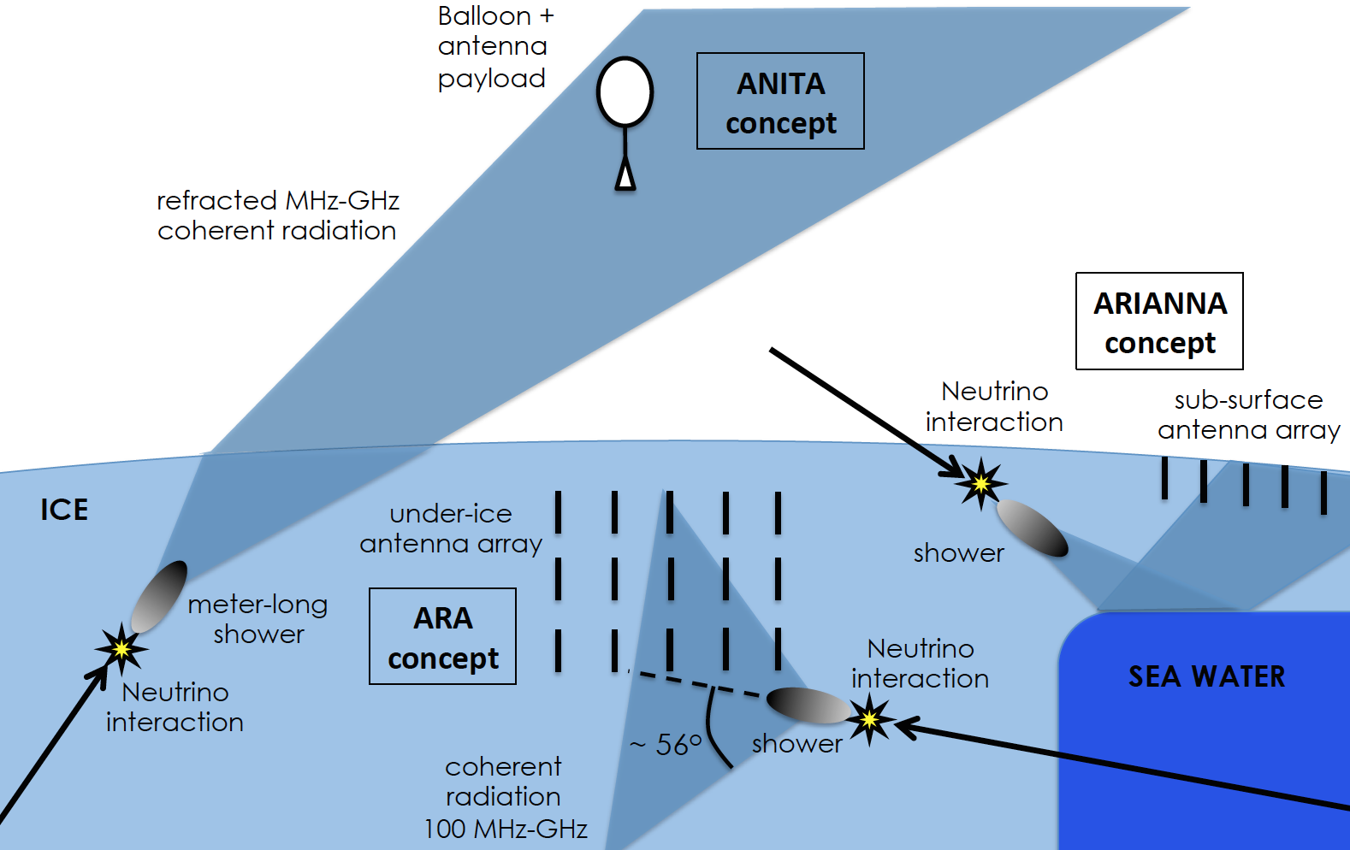
The Concept: Radio Detection in Dense Media
Balloon
Ground
J. Alvarez-Muniz

Slide 18
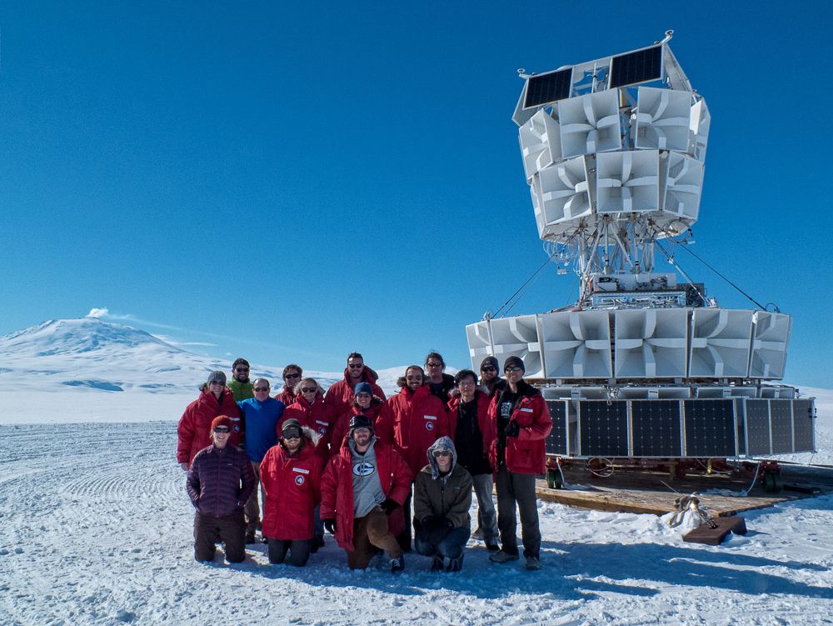
ANITA: Designed for the Highest Energies
NASA Long Duration Balloon launched from Antarctica, four flights
Instrument Overview:
40 horn antennas, 200-1200 MHz
Direction calculated from timing delay between antennas (interferometry)
In-flight calibration from ground
Threshold limited by thermal noise
ANITA-III

Slide 19
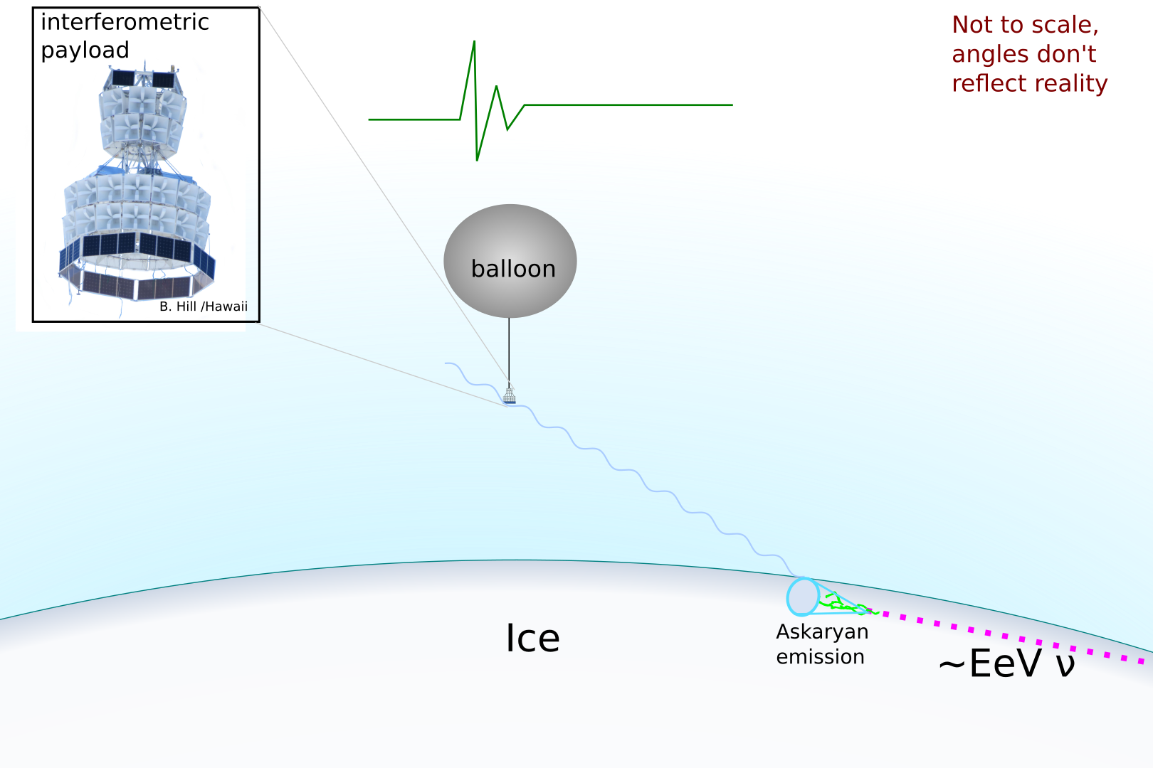
1) Neutrino-Induced Askaryan Emission in Ice
Signals are vertically polarized

Slide 20
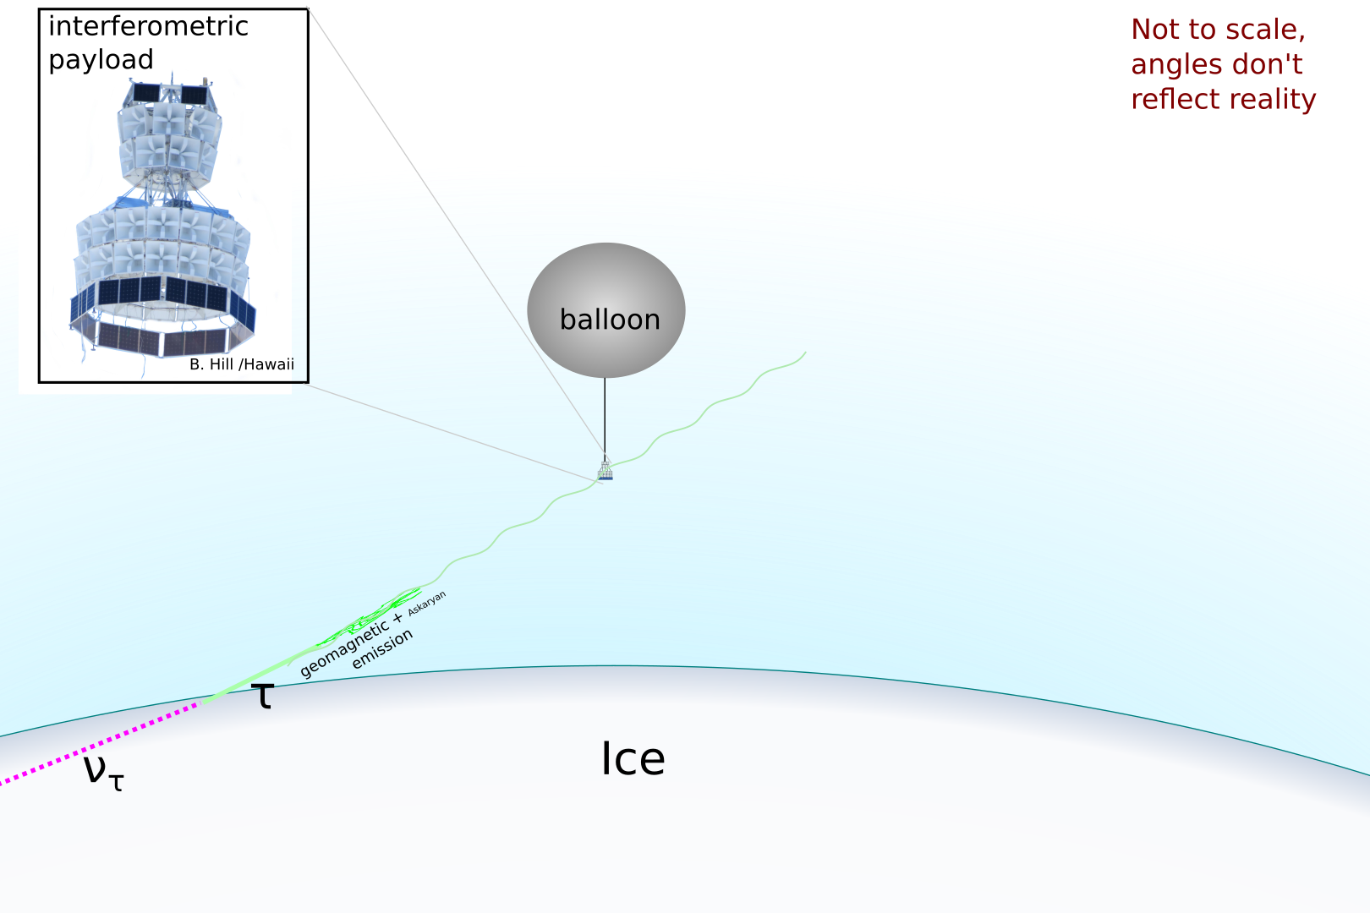
2) Radio Emission from Tau-Neutrino-Induced Air Showers
Signals are horizontally polarized
Comes from below the horizon

Slide 21
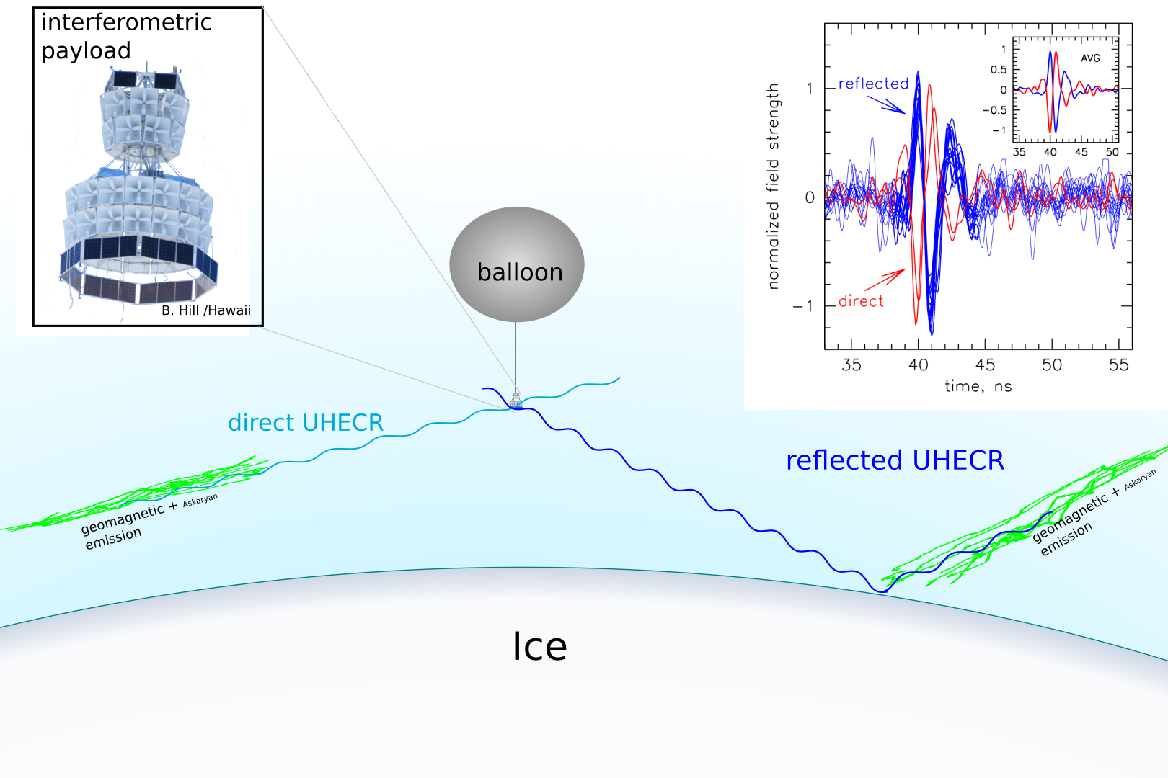
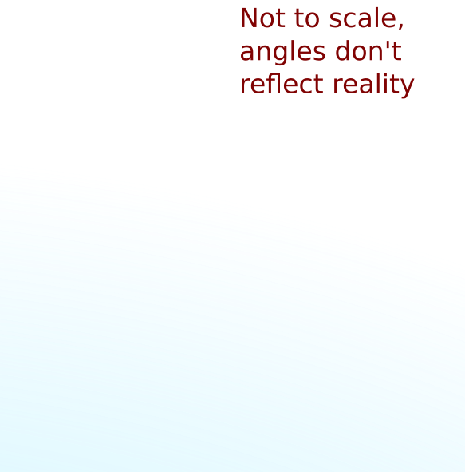
3) Radio Emission from Cosmic-Ray-Induced Air Showers
Signals are horizontally polarized
Polarity of reflected (below-horizon) signal is inverted compared to direct (above-horizon) signal and tau neutrino (below-horizon) signal

Slide 22
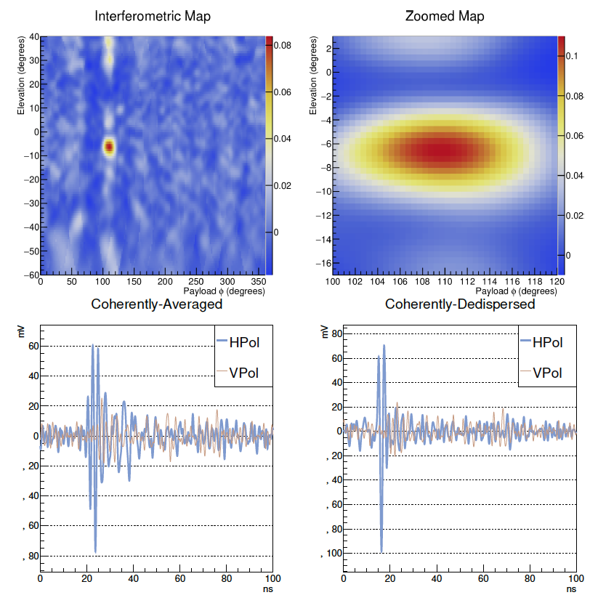
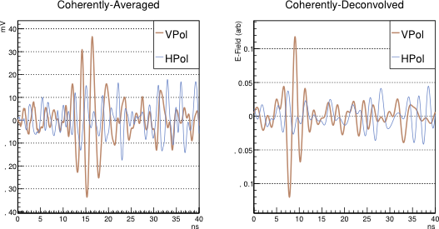
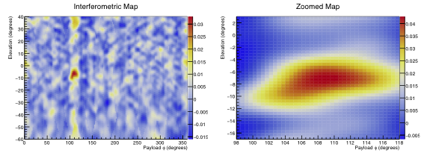
ANITA3 and ANITA4 Neutrino Search Results
 | Number of Events in Signal Region | Background Estimate
ANITA3 | 1 | 0.7^{+0.5}_{-0.3} events
ANITA4 | 1 | 0.6^{+0.7}_{-0.4} events
ANITA Coll., PRD 2018 & 2019
Simulated Neutrino Event
Candidate Event
C. Deaconu

Slide 23
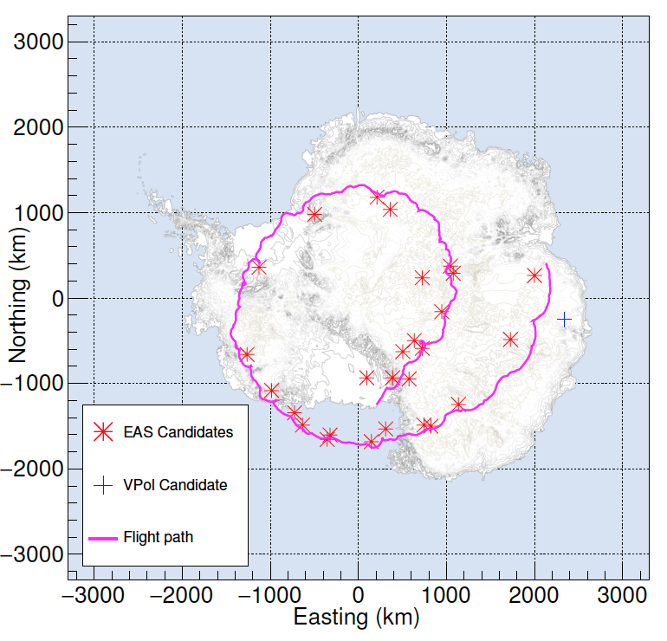
ANITA Also Sees Air Showers
(Cosmic Rays + Tau Neutrinos + Anything Else That Might Make Air Showers)
Signals are distinguishable from in-ice neutrinos via polarization
Energy > 10¹⁸ eV
ANITA3 Candidate Events
ANITA Coll., PRL 2016
ANITA Coll., Astroparticle Phys. 2016
ANITA Coll., PRD 2018
ANITA Coll, arXiv:2008.05690
ANITA Coll.,
PRD 2018

Slide 24
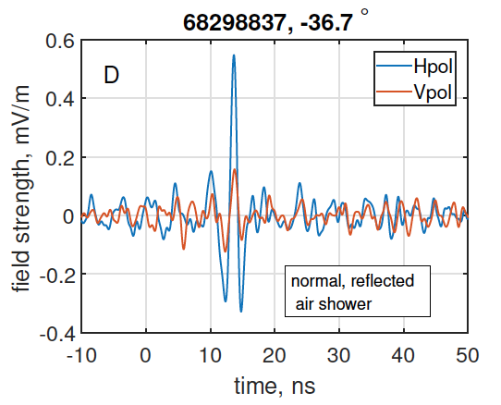
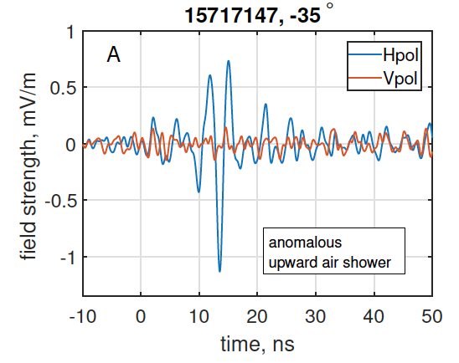
Polarity Flipping and Tau Neutrinos
Polarity should be the same for all reflected cosmic ray events
One of the 28 air showers in ANITA3 is NOT the same polarity as the rest
  There was another one of these in ANITA1!!
Each of these two observations is 1 event on a background of ~0.01
Sign of an upgoing (tau neutrino?) air shower?
Typical Cosmic Ray Event
Mystery Event
ANITA Coll., PRL 2018

Slide 25
Problem with a Tau Neutrino Interpretation
Both events are too steeply upgoing to nicely fit the standard model for a diffuse flux of tau neutrinos.
Maybe it is Transition Radiation (Motloch et al. 2017, de Vries & Prohira 2019) from cosmic ray air showers? (acceptance too low)
Or (more mundane) maybe there is some non-physics background we have not yet accounted for?
Maybe it is beyond-standard-model physics? (e.g. Fox et al. 2019, and even I joined the fun: Hooper et al. 2019)
A. Romero-Wolf et al., 2018

Slide 26
The Mystery Deepens
ANITA-IV saw a handful of polarity-flipped events, this time near the horizon. (SMH).
~3σ that the ensemble not explained by:
  Mis-pointed above-horizon air shower events (including systematics)
  Man-made background
  Mis-identified event polarity
We basically have no idea what is going on.
ANITA Coll. PRL 2021

Slide 27

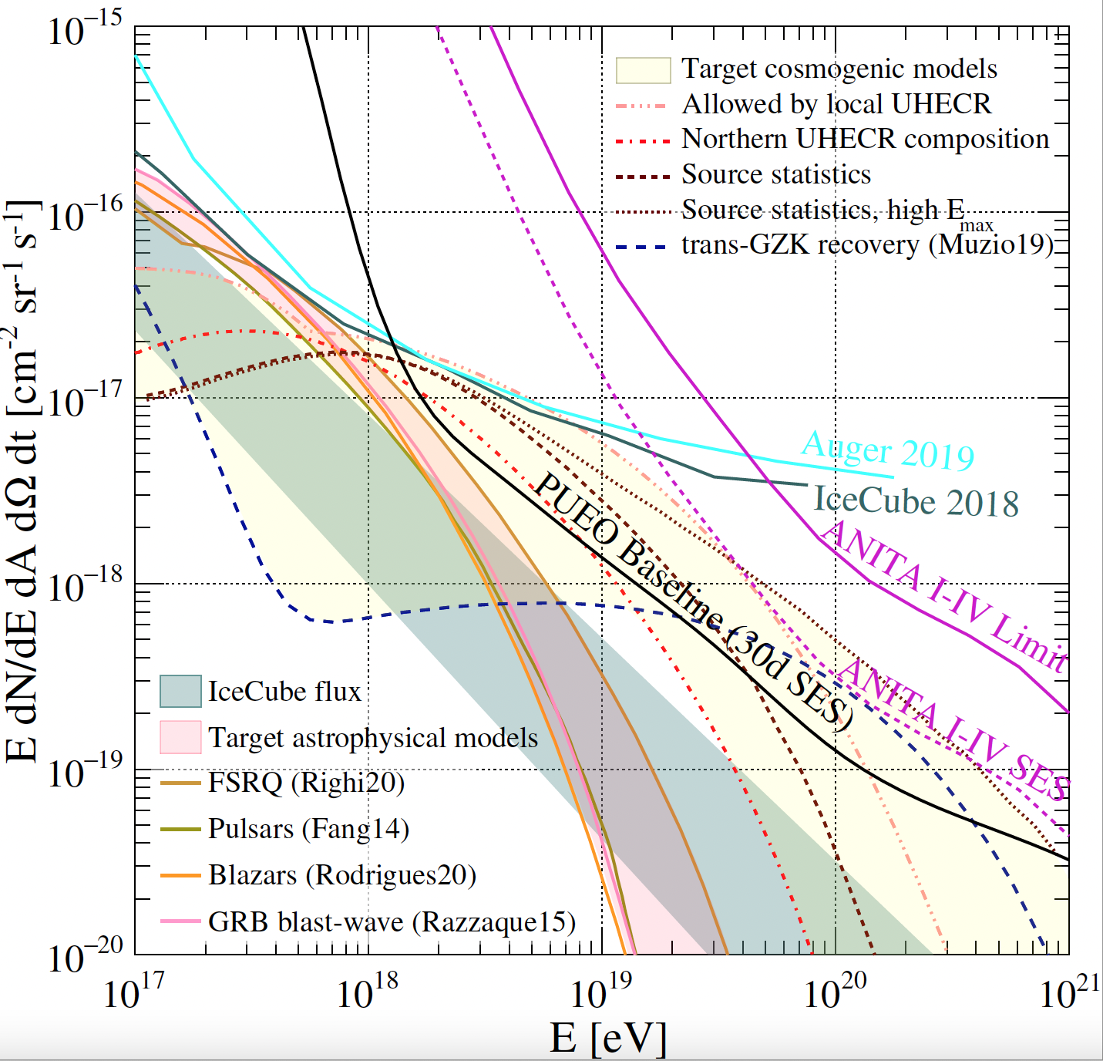
PUEO: The Payload for Ultrahigh Energy Observations
PUEO Neutrino Sensitivity Projections
arXiv:2010.02892
What do Experimentalists do? Figure out a way to change the discovery space significantly.
Especially large instantaneous effective volume, for transient, point source, and multi-messenger searches
Much lower threshold than ANITA (x10 more sensitive across energies), takes over from IceCube at 10¹⁸ eV

Slide 28
PUEO Selected for Astrophysics Pioneers Mission by NASA
A new class of larger, more science capable balloon missions, small satellites, cubesats, rockets, or ISS payloads, up to $20M.
Inaugural class is 4 missions: 3 small satellites and PUEO.
All 4 missions passed the gate review and have been approved to proceed to implementation.
PUEO is scheduled to fly in December 2024!!

Slide 29
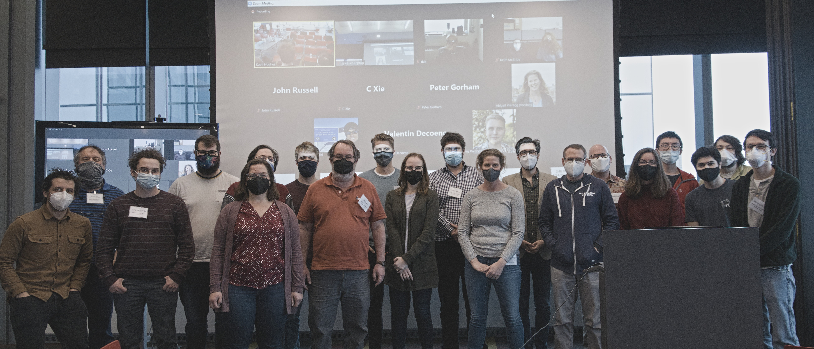











The PUEO Team

Slide 30
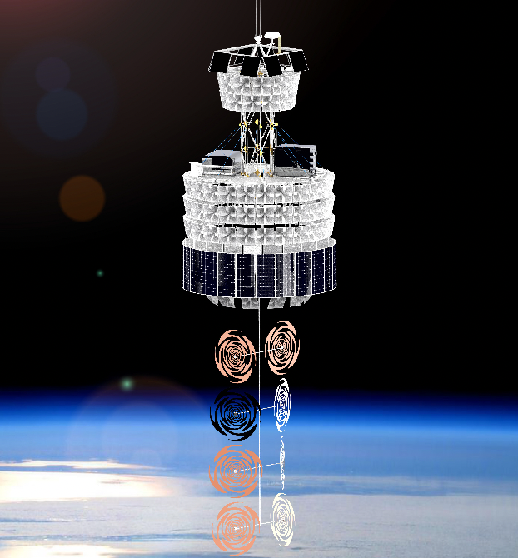
The PUEO Instrument
216-RF-Channel Main Instrument, with a 16-antenna, dual-polarization beamforming trigger
16-RF-Channel Low Frequency Instrument
Triply redundant 128 TB onboard data storage
Command and control, data transfer to the ground
Suite of navigation instruments: heading, pitch, roll, location
Housekeeping/environment sensor system
In-flight calibration from the ground and from a suite of hand-launched HiCal payloads.

Slide 31
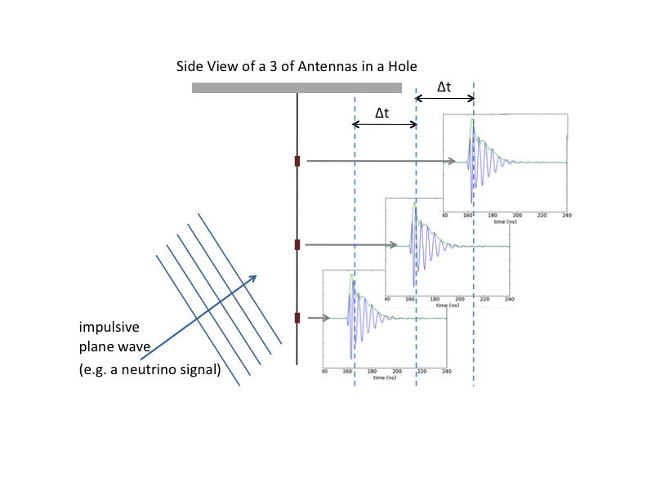
Pushing the Threshold Down and Increasing Sensitivity: A Phased Array
Si
3 Antenna Example, Side View
You know Δt based on the antenna geometry and the speed of light in ice
Line up signals according to the Δt you know, then sum
For real neutrino events (plane waves), you a get a higher signal-to-noise sqrt(N) in voltage
Do this all the time for all possible incoming angles
This is the major technological advancement for PUEO; we’re flying 24 RFSoC-based boards

Slide 32
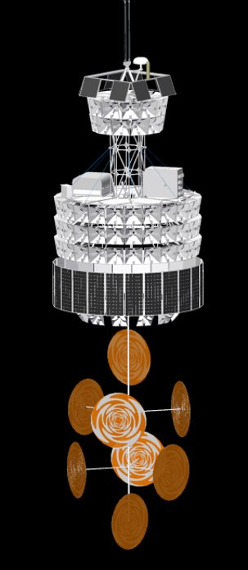
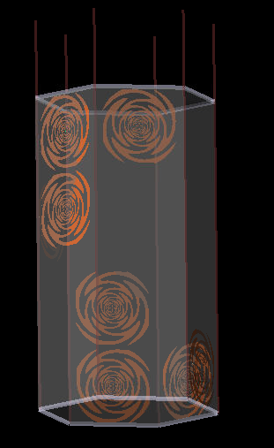
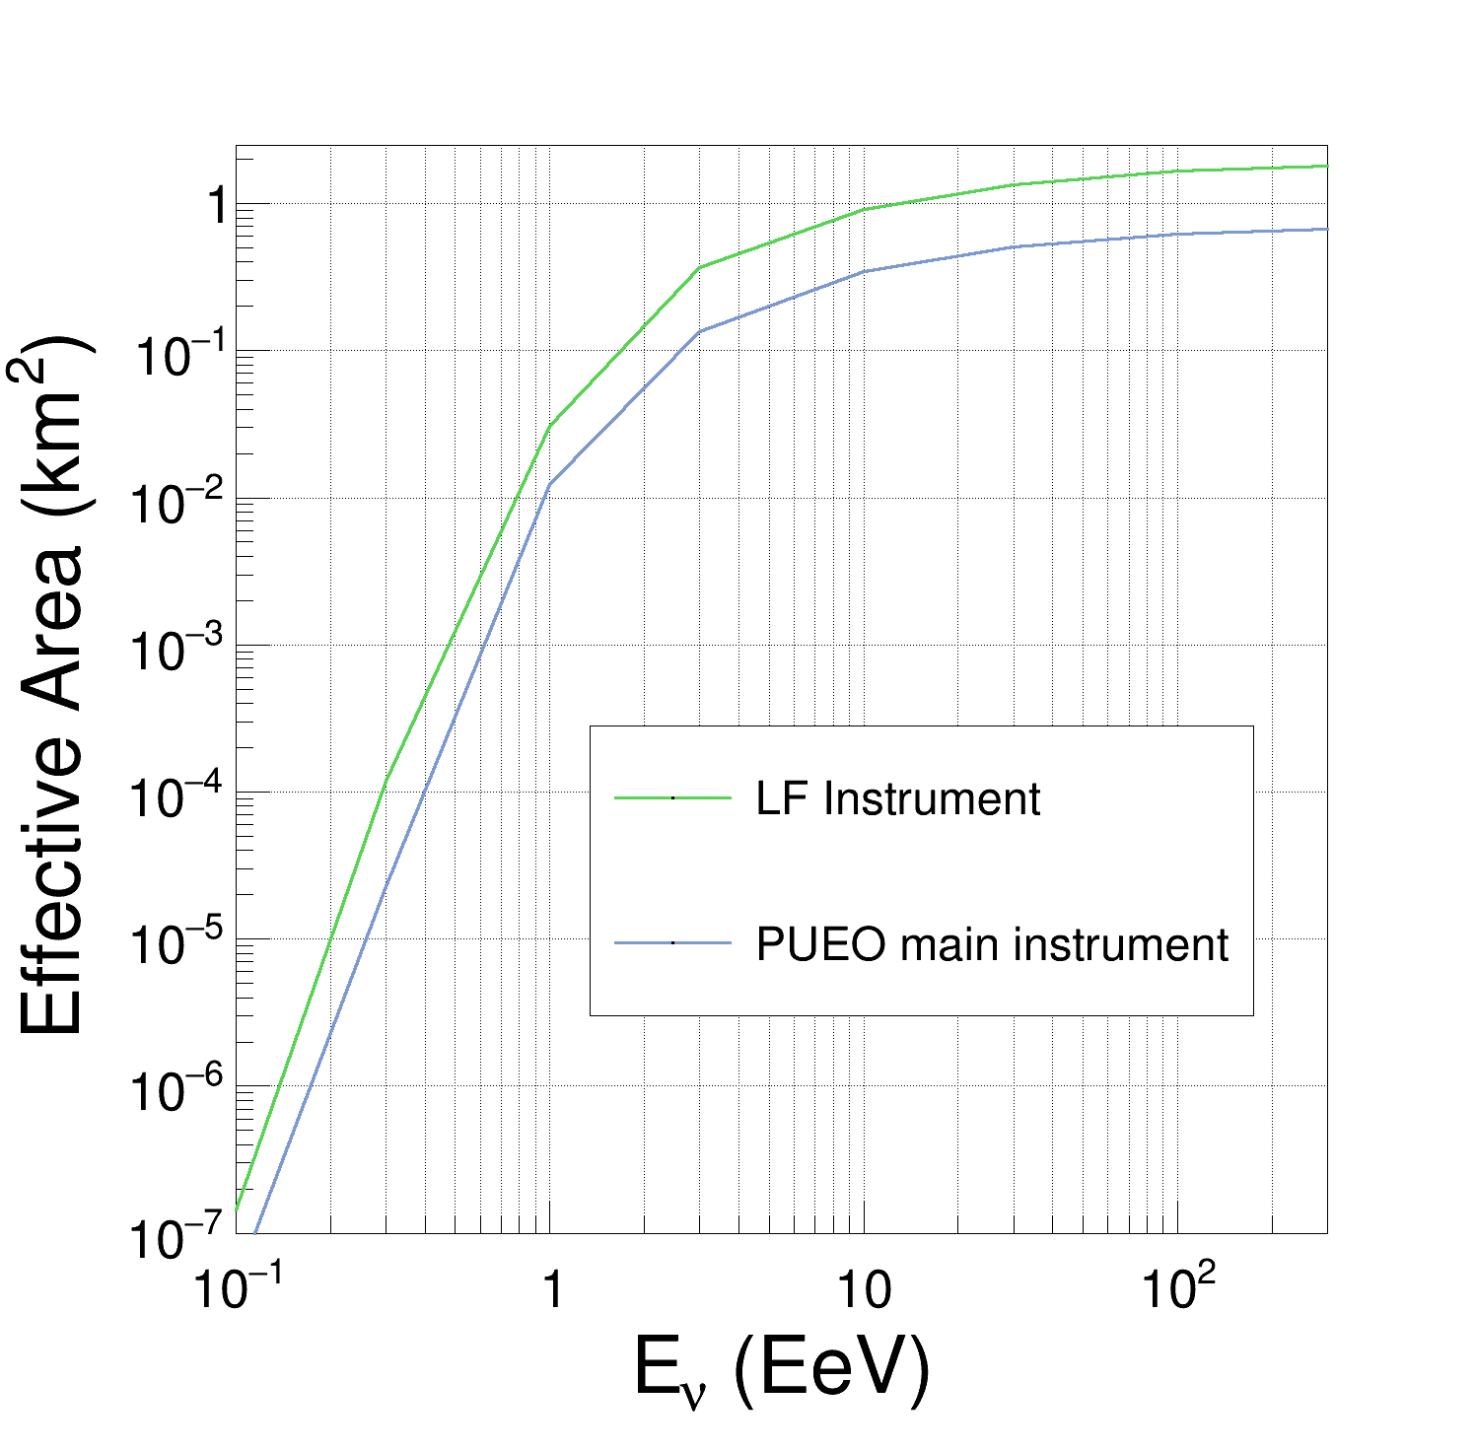

Low Frequency Instrument Performance
Degree-scale angular resolution expected
Factor of 2 improved sensitivity (effective area) to tau neutrinos compared with Main Instrument
32

Slide 33

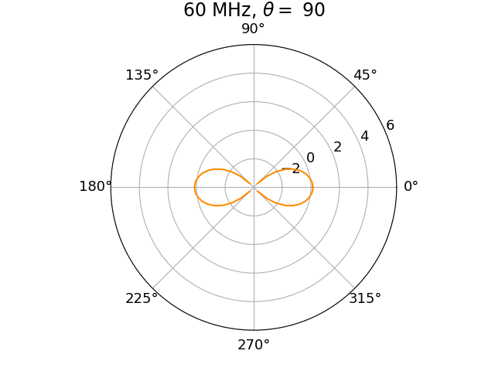
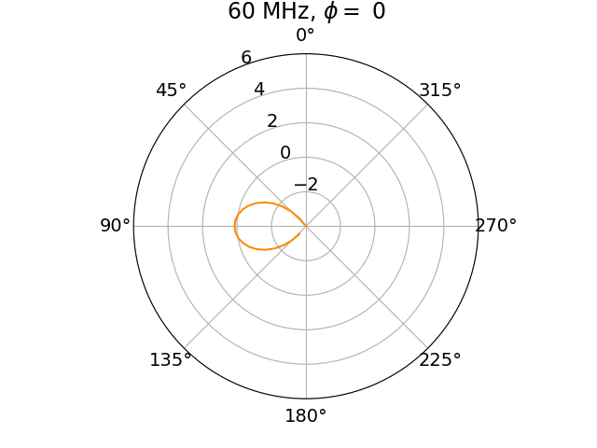
Low Frequency (LF) Antenna
Sinuous antenna has log-periodic, complementary structure → Wideband: 50-300 MHz
Dual polarization: independent horizontal and vertical polarization feeds
4-6 dBi gain at boresight
Conductive fabric sewed on curtain
Single antenna gain (dBi) vs azimuth
vs zenith

Slide 34
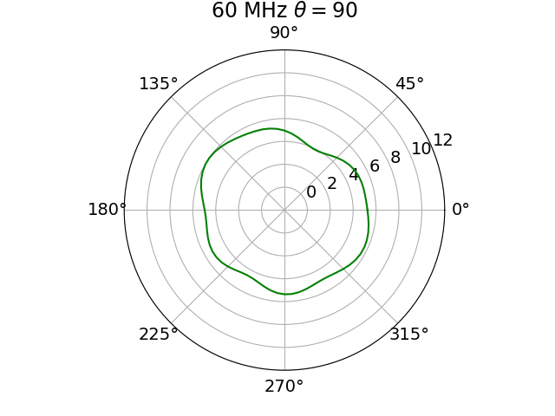
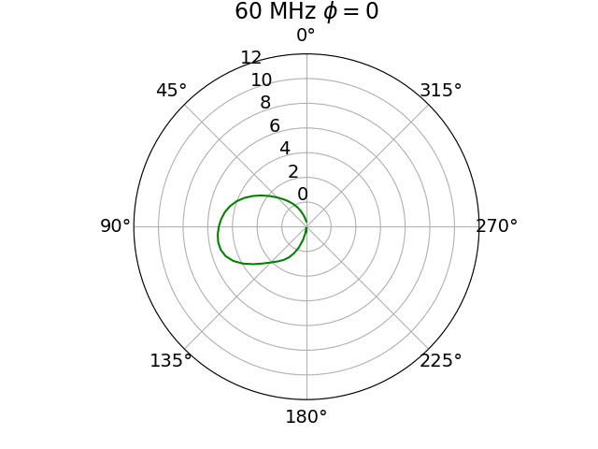
Array Performance
Layout chosen so that antennas in adjacent layers are not in beam of other antennas
Array gain ~10 dBi
Asymetric beam pattern in azimuthal direction (±2 dB) requires good antenna indexing
Array again (dBi) vs azimuth
vs zenith

Slide 35
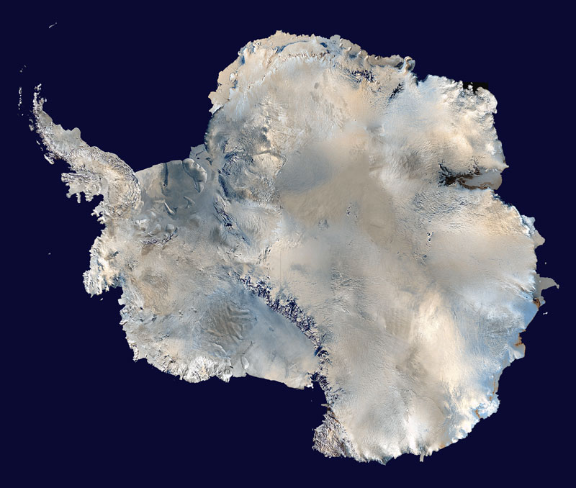
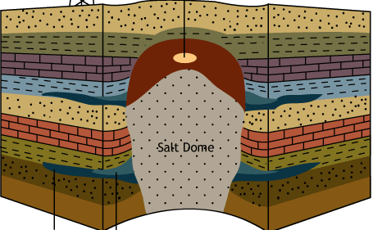
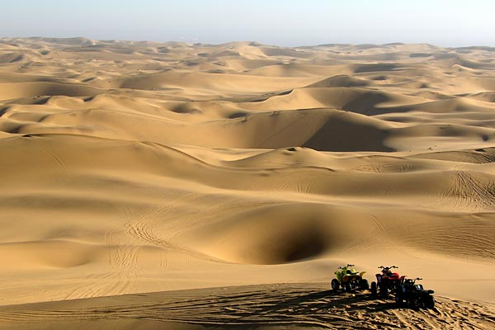
Advantages of Ground-Based Detectors
  Lower energy threshold: cover energy range between IceCube & PUEO
  More livetime
    300 days/year vs. 30 days/3 years
  Less man-made background to battle
  Use more antennas than on a balloon
  But: smaller instrumented volume

Slide 36
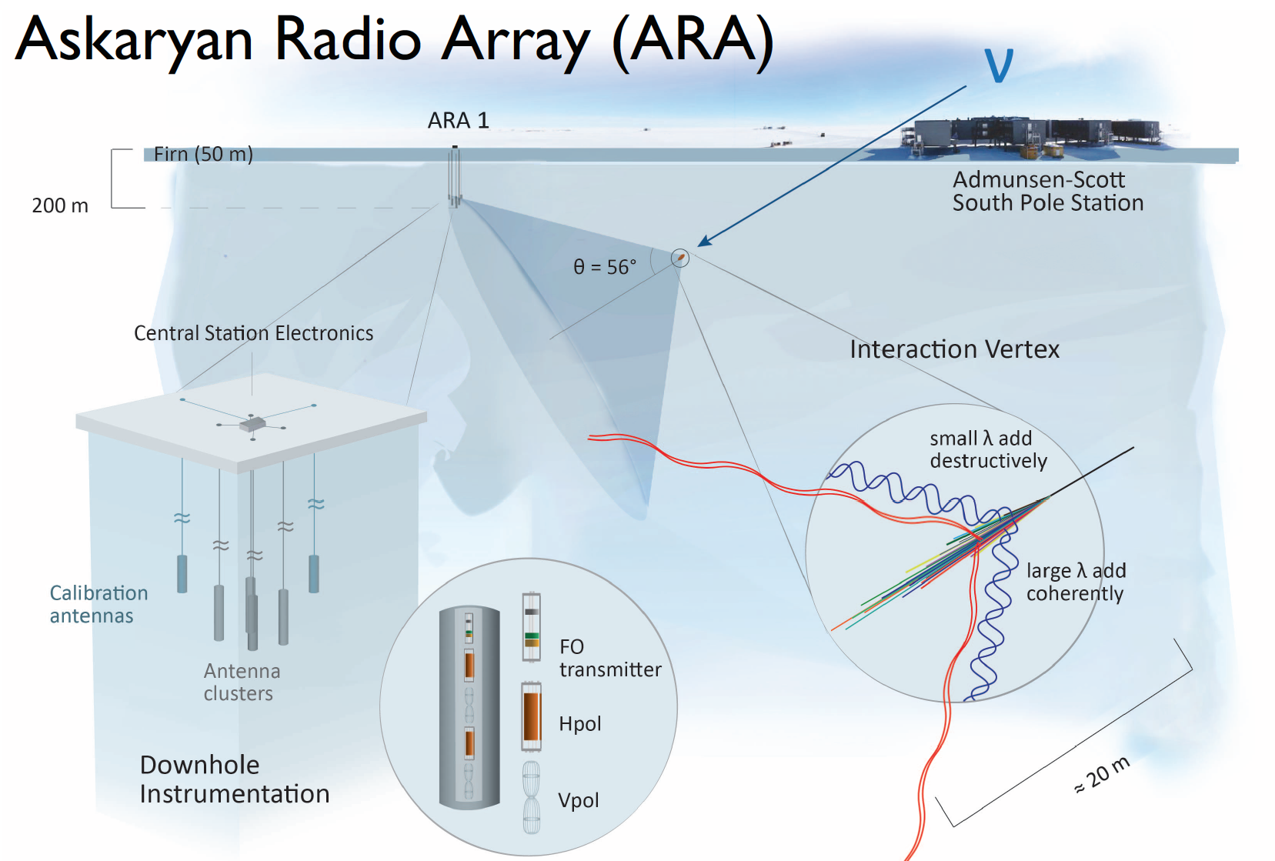










ARA: In-Ice Radio Detector at South Pole
An ARA Station
incoherently
36

Slide 37
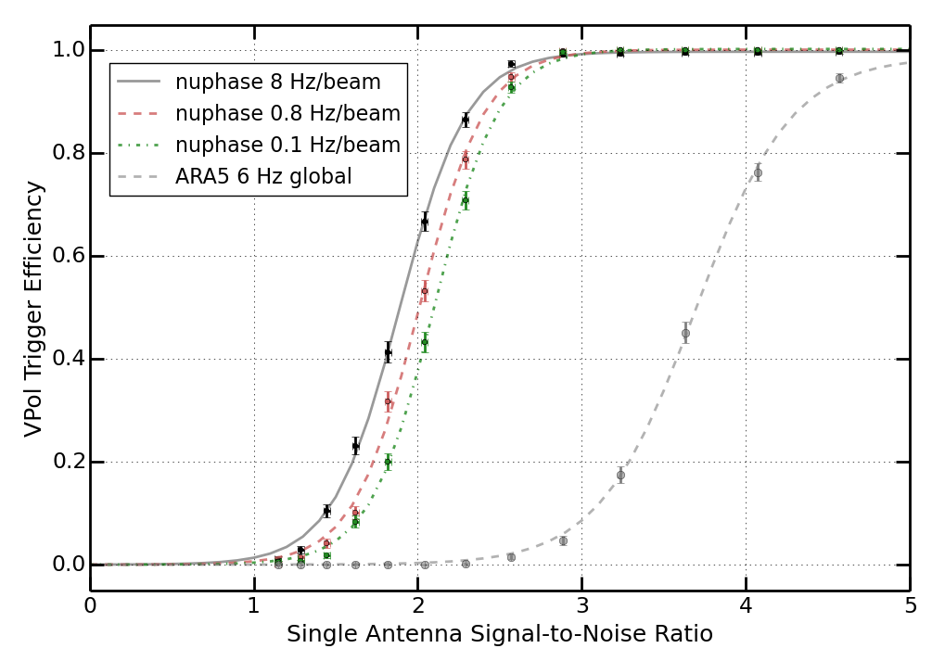
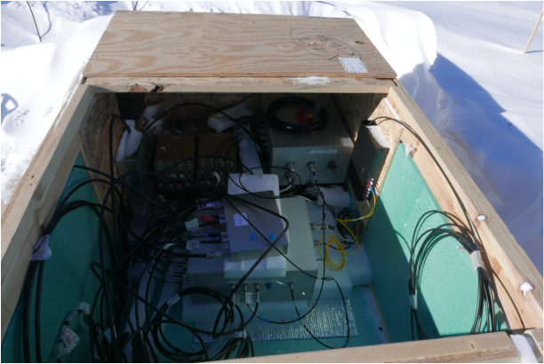
Upgrade for ARA in 2018: Demonstrating a Phased Array Trigger
A real-time interferometric phased array trigger system
  New DAQ – has been perfectly stable since deployment
  Trigger performance matches simulations exactly
  Improvement x2 effective volume achieved already
ARA Coll., NIM 2018

Slide 38



First Analysis of ARA Phased Array Data
Its nice to get more sensitivity in hardware, but it only matters if you can analyze the data near threshold
Turns out you can analyze the data down to threshold (see arXiv:2202.07080), and do it better than before.
Points the way to building future detectors with the low-threshold phased array trigger design.
Eyeballing: 50 station-years beats 10 years of IceCube @ 10¹⁸ eV. Another x 10 is a real ultra-high energy neutrino detector.
ARA Collaboration:
arXiv:2202.07080
OLD NEW

Slide 39
Toward IceCube-Gen2
IceCube Gen2: a multi-component facility to reach the broadest range of energies.
Radio component required to reach the science goals at the highest energies (e.g. revealing the sources and propagation of the highest energy particles)
IceCube Gen2 Whitepaper: arXiv: 2008.04323

Slide 40










Radio Neutrino Observatory in Greenland (RNO-G): Discovering UHE Neutrinos and Paving the Way for IceCube-Gen2
NSF-Operated Year-round Summit Station
3km thick glacial ice
Site is good for Solar/Wind generation
2013: Attenuation Length Measurement
2015: Prototype of phased array system in Greenland
2021: First deployment of stations with scalable design

Slide 41







35 stations, 1.25 km spacing
Summit Station, Greenland
First deployment season in 2021
3 complete stations running well now!
See https://rno-g.github.io/station-map/
Kangerlussuaq
Summit Station
Notes:
So what does RNO-G look like?
There are 35 quasi-independent stations, spaced 1.25 km apart to ensure that each additional station adds a significant new volume of ice. The stations are named using Greenlandic names of arctic animals.
We plan to deploy all 35 stations starting this season and for the next four seasons, ending in 2024.
The field teams are there right now and expect to complete these three stations by the end of the summer.
21 Amaroq: Artic Wolf
22 Avinngaq: Arctic Lemming
11 Nanoq: Polar Bear

Slide 42

RNO-G Station Layout
Notes:
RNO-G searches for UHE neutrinos by looking for the radio-frequency emission they generate

Slide 43



RNO-G Drill
BAS BigRAID Drill
Custom auger drill developed for RNO-G by the British Antarctic Survey
11-inch diameter holes
Capable of drilling 1 hole to 100 m in 1 shift (2 people)
  Most holes drilled this season are 2 shifts / hole
Notes:
Fast!
BAS built us a drill
soo cool because it makes big holes
We expect to be able to drill one 100m hole in one day shift.

Slide 44






Station Deployment
Warm deployment sled movable by snowmobile
Shallow antennas deployed in trenches
Deep channels lowered by hand
Vpol:
Fat dipoles
…or people!
Shallow:
LPDAs
Hpol:
Wide quad-slots

Slide 45




We Can Trigger On Stuff!
Snowmobile lights up the deep channels

Slide 46




The DAQ SYSTEM
Low threshold trigger board
Low bandwidth phased trigger (80-236 MHz) optimized for broad range of view angles
RADIANT DAQ Board
24 channel ADC using LAB4D SCA
>850 ns (2048 samples) per event,
dual-buffered,
3.2 GSa/s, 1.3 GHz analog bandwidth
Low power envelope trigger
Notes:
Fast!

Slide 47



First RNO-G Paper With Real Data from the Field
Measuring the Radio Frequency Attenuation Length (which determines how big a volume RNO-G can monitor for neutrino interactions)
RNO-G Collaboration: arXiv:2201:07846

Slide 48
Summary
The groundwork for a new generation of detectors has been laid with new technology development.
PUEO & RNO-G are both under construction, and the discovery of ultra-high energy neutrinos is in sight.
PUEO will open up discovery space at the highest energies, and will launch in 2024.
RNO-G covers the energy range between IceCube and PUEO where astrophysical neutrinos should be, and is under construction!
PUEO
First RNO-G Station

