Slide 1


A Physicist’s Experience in Radiation Therapy
Jiasen Ma, 03/11/2019, @ UChicago HEP Seminar
Notes:
Describe what are you going to do 1) one site, the considerations 2) some specific works

Slide 2
Outline
Introduction: a clinical example – comparing photon and proton beam therapies
Optimization of a clinical proton beam therapy treatment plan
Biological planning optimization
A potential particle detector application in particle beam therapy

Slide 3
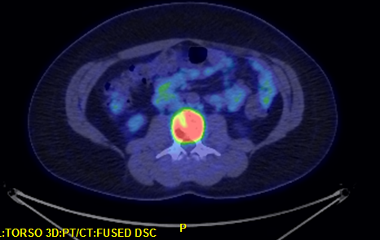
36 years old female
2017 PET scan revealed lumbar #3 spine metastasis from advanced stage cervical cancer 5 years ago.
Notes:
L3 constraints on bowel; hysterectomy

Slide 4
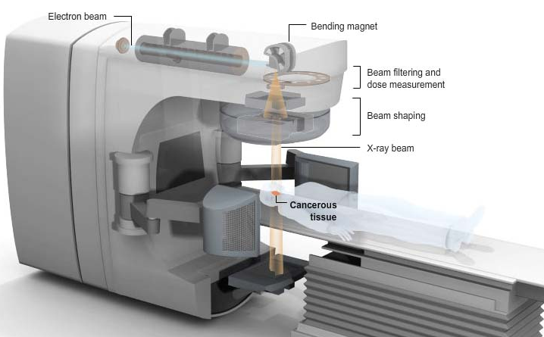
Photon radiation therapy
Notes:
Talk about photon energy a few MeV, talk about mostly compton interaction

Slide 5
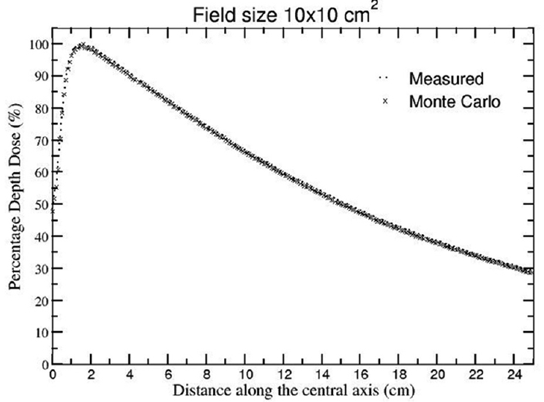
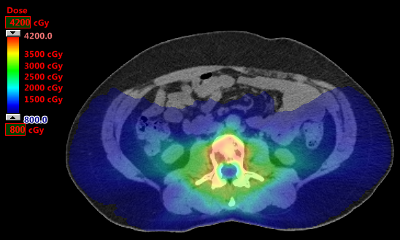
Photon beam (~a few MeV) dosimetric characteristics
Donut shaped dose
distribution achievable
Notes:
Talk about photon energy a few MeV, talk about mostly Compton interaction

Slide 6
Toxicity
Myelopathy (0.03cc of spinal cord, 22Gy 3 fractions)
Bowel obstruction (5cc of small bowel, 18Gy 3 fractions)
Malignant hypertension (1/3 volume of kidney hilum/vascular trunk, 15Gy 3 fractions)
Renal dysfunction (<200cc of kidney cortex, 12Gy 3 fractions)
Moussazadeh et al, IJROBP 93(2):361-367, 2015
AAPM Report 101, 2012
ASTRO white paper in Practical Radiation Oncology, 2011
QUANTEC report, IJROBP, 2010, 76(3)

Slide 7
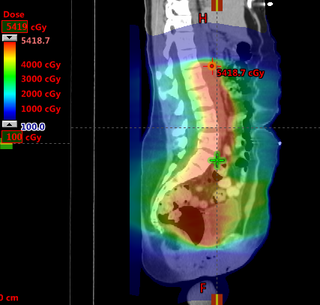
Primary cervical cancer treatment in 2012
Hysterectomy and pelvis radiation 5000cGy in 25 fractions in 2012. Record obtained from outside institute.
Notes:
L3 constraints on bowel; hysterectomy

Slide 8
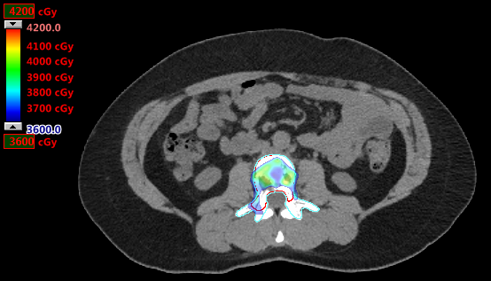
Re-irradiation with photon?
3600/3000 cGy in 3 fx. Avoid 8Gy in bowel.
Adequate target coverage cannot
be achieved simultaneously with
organ at risk sparing.
Notes:
L3 constraints on bowel; hysterectomy; left image ripple due to breathing, slow scanner in 2012

Slide 9
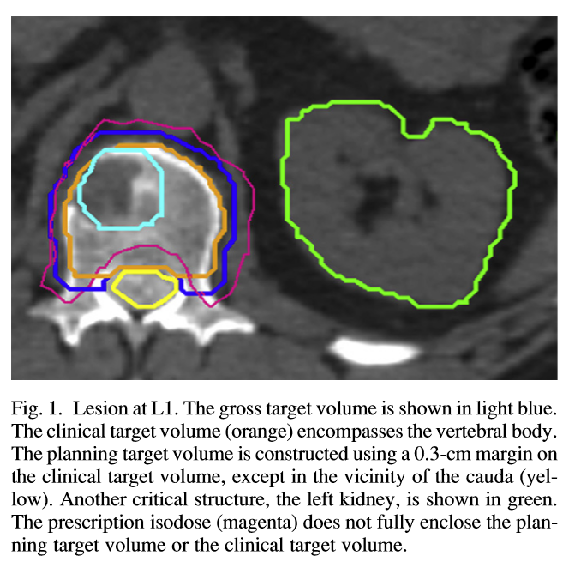
Pattern of failure
Single fraction for first irradiation in the region
79 patients treated 18-24 Gy
The median Dmin
  7 Failures: 10.4 Gy (range 0.9-14.4)
  All patients: 15.1 Gy (range 0.9-25.9)
Authors rec’d Dmin >15 Gy
Lovelock, et. al. IJROBP 77(4) 1282-1287 2010

Slide 10
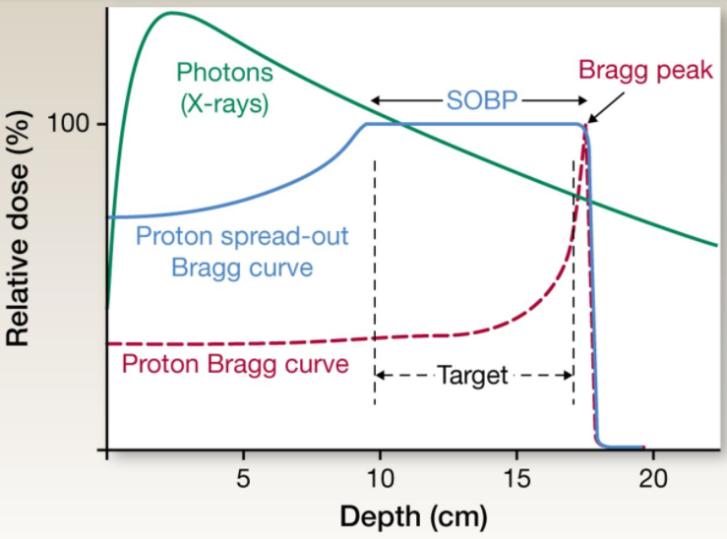
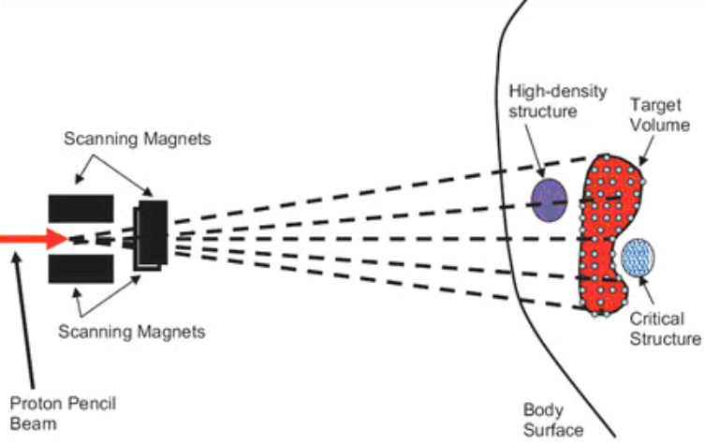
Proton beam therapy
Spot scanning proton beam therapy
Large number of variables
Robustness
Proton delivery cartoon
Notes:
The optimizer is developed for pencil beam scanning technique in particular. The primary difference of proton beam therapy is depth dose curve (as shown here). We often talk about Bragg peak, which has a plateau entrance region and a sharp peak at the end of the track. However due to lateral scattering, the Bragg peak curve is actually not seen in a single spot. (here is the cross section view of the dose from one single spot, in this plane,) The dose will go down first, and only rise again at the end. The rise depends on spot size and energy, but may be even lower than the entrance dose. Only when spots are packed together to form a energy layer, the typical Bragg peak will appear. To cover the 3D target, One need multiple layers to cover the target with uniform dose. For example it could be a SOBP. The total number of spots is usually large, can be of 100,000. As proton dose deposition is more localized, a change in the path will cause great dosimetric effect. For example, if the high density structure were not taken into account, a section of target will receive almost no dose. ; build up 6x 10% 18x 10 x 5 % 6fff 15-20% 10fff goes to 10%; add hetergeounous MC for homeview

Slide 11
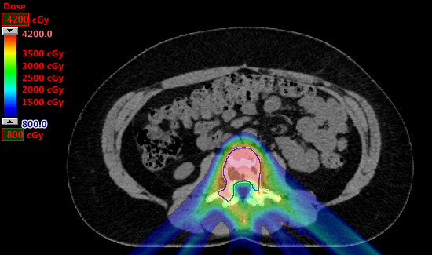
Proton plan
Notes:
L3; cauda with nerve roots are bigger than typical cord. No good options, MD was concerned, called in another MD. Decided that if SBRT is not done, surgery will likely mess up the nerve roots as well.

Slide 12
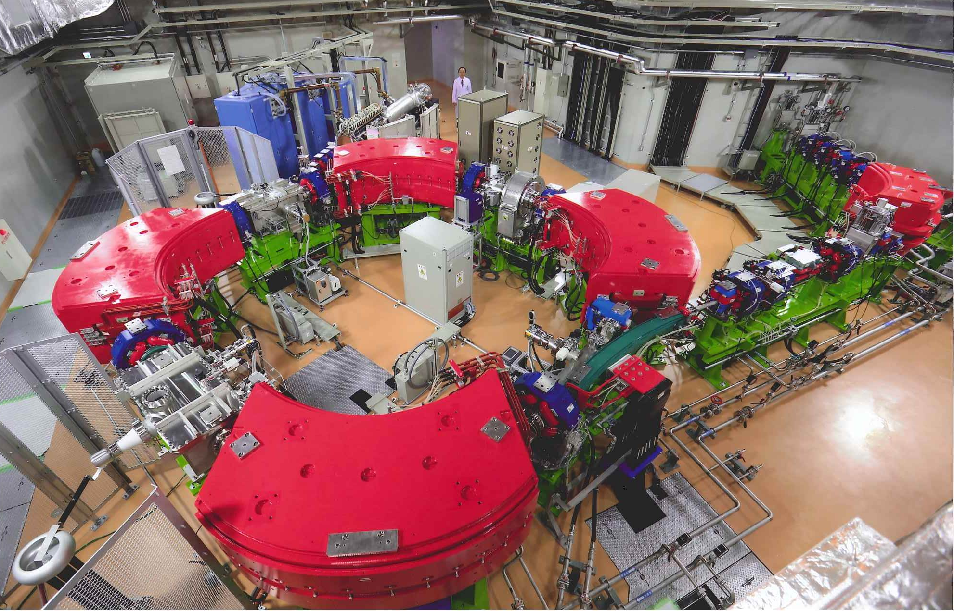
Synchrotron
Notes:
Slow extraction

Slide 13
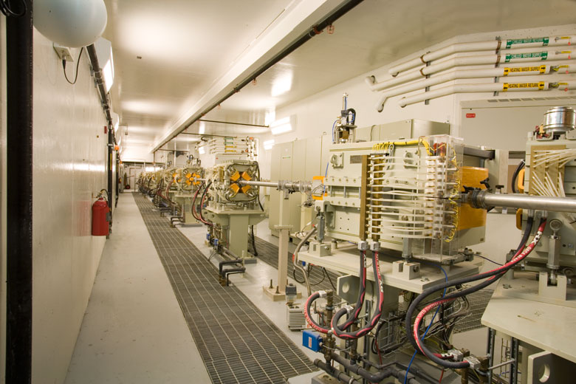
Beam line

Slide 14
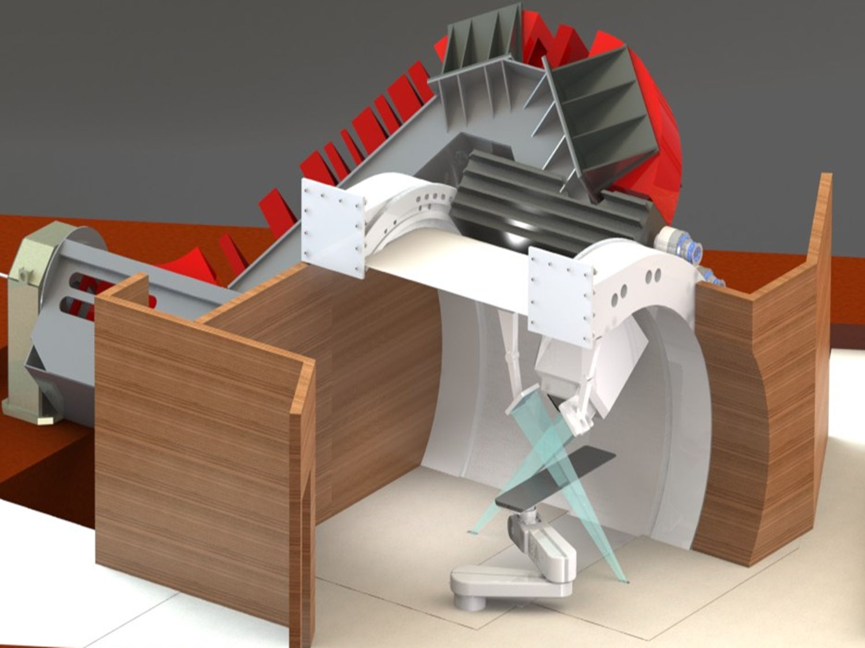
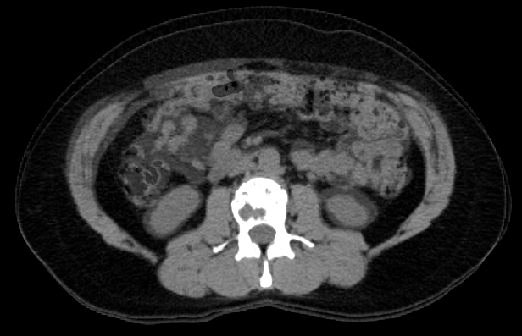
Gantry delivers proton therapy to patients
Notes:
Mention multiple beams on this page; mention CT on rail. mention the patient is treated with

Slide 15
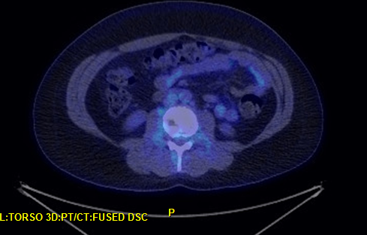
Follow up
2017
2019
Notes:
Proton relaxation property change due to radiation but not very well corresponds to tumor control

Slide 16
How do we make a plan
CT/MRI/PET images are taken for the patient.
Physicians defines targets and critical structures.
With predefined proton beam spot spacing, all spots that has Bragg peak in the target are found.
Optimize beam spot weights in terms of number of protons to satisfy known dose-volume constraints.

Slide 17
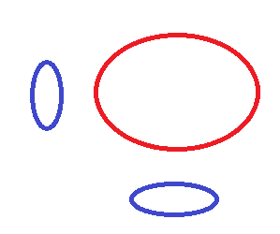
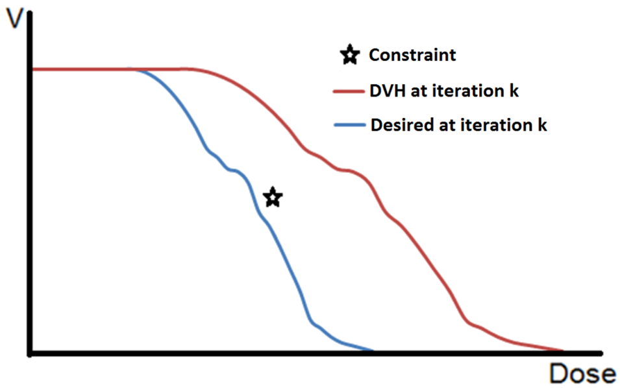
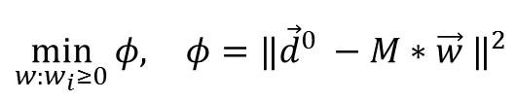

Optimization method
Adaptive penalty based on what can be achieved: varied desired dose $d_{j}^{0k}$.
1
target
Beam A
2
Beam B
$$\min_{{w:w}_{i}≥0}{φ, }φ{=‖{\vec{d}}^{0} −M∗\vec{w} ‖}^{2}$$
Notes:
The optimization problem is formed as a quadratic form. M is the only known. a matrix with each row being the doses that a unit weight spot will deposit in each voxel. W is the spot weight, this is what we are trying to find out. D0 is an array of dose that we want each voxel to be. In addition to dvh constraints, all spot weights can not be negative. Optimization is to find a set of spot weight that minimize phi while satisfying the dvh constraints that set out at the beginning.
Our optimization method is based on a simple and fast algorithm proposed by Lomax in late 90’s. It is a version of quasi newton method by approximating the first and second order derivatives of the objective function phi. It gurantees non-negativity of w
In Lomax’s original method, Gaussian fall-off from a uniform dose in the target is assumed for dd. This causes unnecessary penalty in phi and cause some constraints not met while others are over constrained. We assign the voxel dose of current iteration as the desired dose for voxels of structure with achieved constraints, and tighten the desired dose adaptively to better achieve all constraints. If a constraint is not met, we apply a factor for voxels in that structure so the desired dose DVH is 10%(in dose) below the constraint value. This assumes the DVH shape and same voxel dose ranking to squeeze the DVH below the constraints. From iteration to iteration, the assumption can vary.

Slide 18
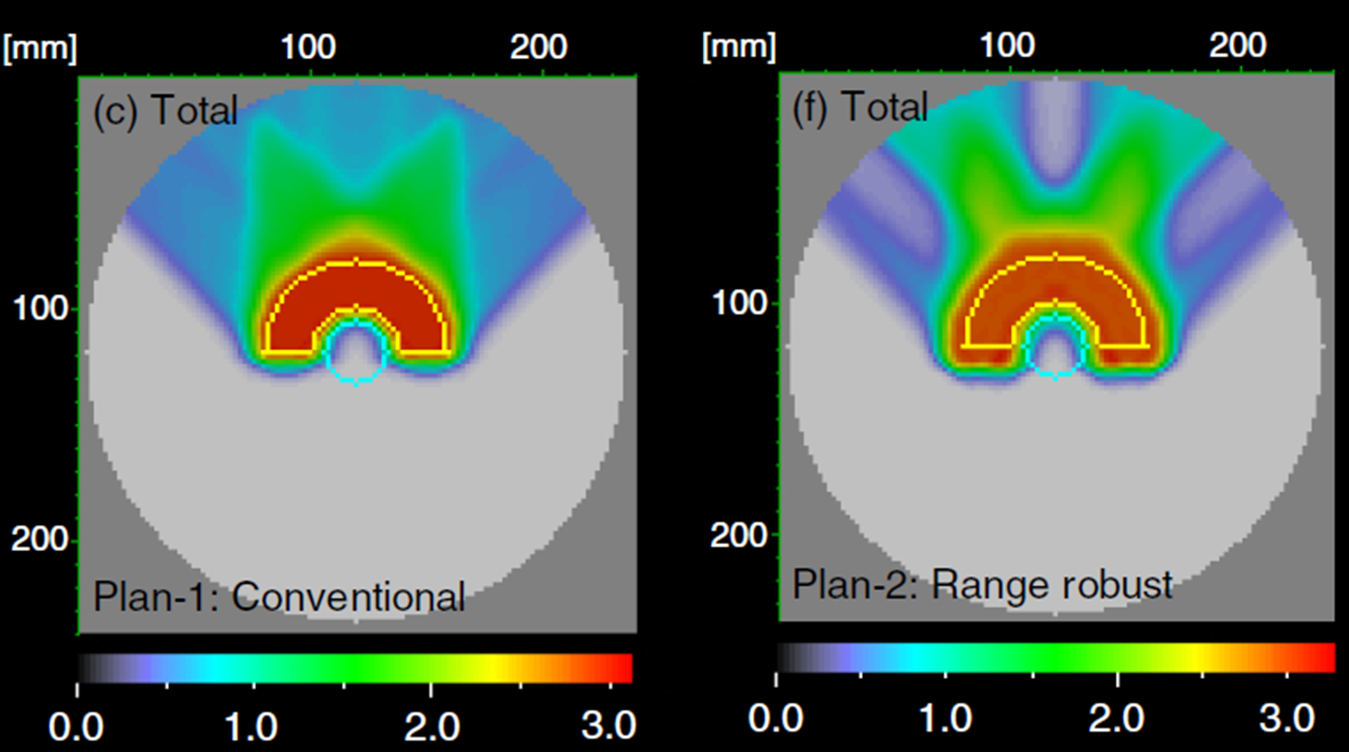
Robust optimization introduction
Similar target coverage and OAR sparing can be achieved with different plans.
Inaniwa et. al. Phys. in Med. & Biol. (2011)
Same 3 beam
configuration
Notes:
With the non-robust IMPT done, we have moved to robust optimization in proton therapy treatment planning. Here is a plot to motivate us: the plot shows the dose color wash superimposed on the phantom. Critical structure is shown here. The target is the yellow contour. the left and right represent two different proton plans. Both plans have three fields with the same orientation as depicted by the entrance dose. The target coverage and the center critical structure sparing looks to be the same for these two plans.

Slide 19
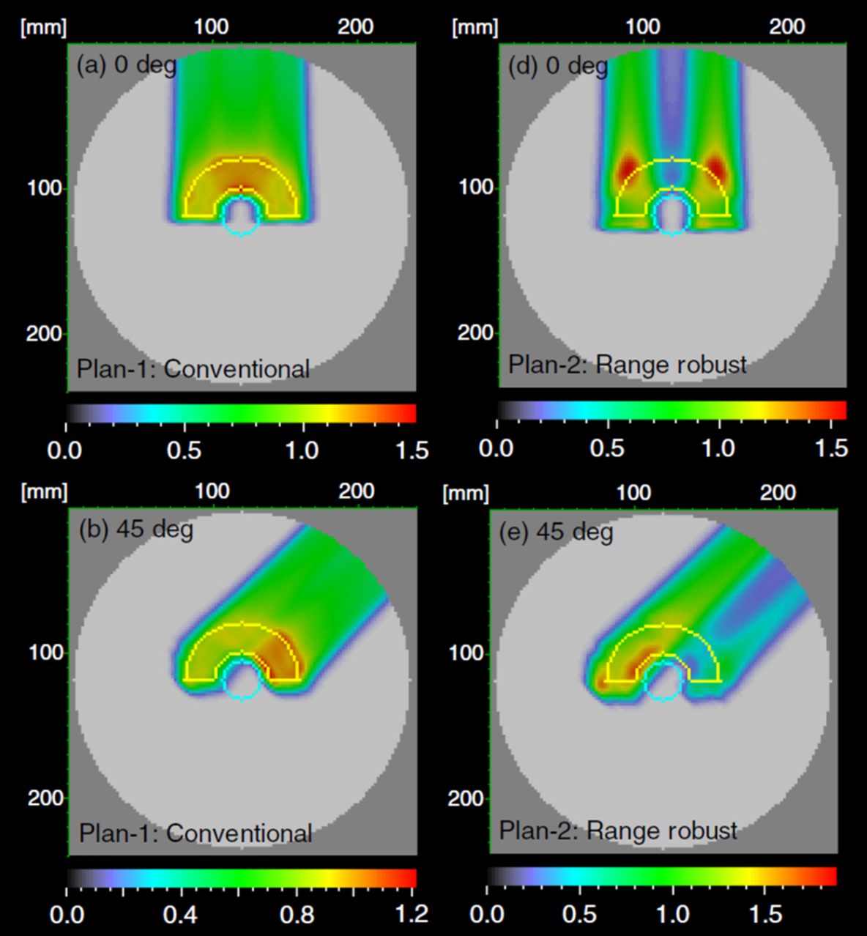
Robust optimization introduction
Proton therapy is less forgiving in dose distribution when uncertainties are present.
Re-arranging proton spot
weights can mitigate
dosimetric effect under
uncertainties.
Inaniwa et. al.
PMB 56 (2011)
Longer proton range ->
Higher OAR dose in conventional plan
Notes:
In this plot is the dose from each field of the two plans shown on the previous page. The right and left obliques beams are mirror images of each other in both palns. Only one of them is shown. We see that the conventional plan has heavily weighted Bragg peak end right before the critical structure. The range robust plan delivers dose to the same same region with the lateral part of the beam, and packed other heavy Bragg peaks in the middle of the target. Range is just one type of the uncertainty, it can be caused by patient body contour change, organ motion, uncertainties in conversion of CT HU values to proton stopping power. The other ones are setup uncertainty and the intra fraction beam shift. They all need to be considered to have a good proton plan.

Slide 20
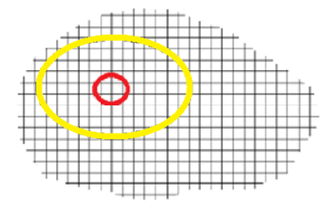



Existing robust optimization methods
Three worst case optimizations: voxel-wise, object-wise, composite.
voxel-wise
Scenario for each voxel is chosen such that:
Lowest dose for target voxels
Highest dose for OAR voxels
$${ d}_{target}^{0,i}$$
$$d_{OAR}^{0,j}$$
Nominal
$$φ\left({ d}_{target}^{p,i},……,d_{OAR}^{q,j},………\right)$$
$${ d}_{target}^{1,i}$$
$$d_{OAR}^{1,j}$$
Left 3mm
...
...
...
Notes:
Say that worst case robust optimization is a prevailing appraoch in robust optimization. Stress how it works in a iteration

Slide 21



Existing robust optimization methods
Three worst case optimizations: voxel-wise, object-wise, composite.
object (structure)-wise
Scenario for each structure is chosen such that the scenario is worst for that structure.
$$φ_{target}^{0}$$
$$φ_{OAR}^{0}$$
Nominal
$φ=φ_{target}^{p}$ + $φ_{OAR}^{q}$
$$φ_{target}^{1}$$
$$φ_{OAR}^{1}$$
Left 3mm
...
...
...
Notes:
Stress how it works in a iteration; say non physical

Slide 22



Existing robust optimization methods
Three worst case optimizations: voxel-wise, object-wise, composite.
composite
A single scenario is chosen at
each iteration of optimization
so the composite objective
function is worst.
Nominal
$φ_{}^{0}=φ_{target}^{0}$ + $φ_{OAR}^{0}$
$φ$= $φ_{}^{p}$
Left 3mm
$φ_{}^{1}=φ_{target}^{1}$ + $φ_{OAR}^{1}$
...
...
...
Notes:
Stress how it works in a iteration

Slide 23

All-scenario robust optimization
The total DVH violations of all structures in each scenario is calculated, and used to weight the scenario contribution to the total cost function.
All scenarios now enter the optimization as opposed to the previously mentioned worst case methods.
The weight is updated in each optimization iteration with DVH calculation.
$$\sum_{m,q;upper}{max\left(0,\left({DVH}_{q,m}\left(d_{m}\right)−V_{m}\right)\right)+ \sum_{m,q;lower}{max\left(0,\left(V_{m}−{DVH}_{q,m}(d_{m})\right)\right)}}$$
Notes:
The term is the amount of DVH violation for this upper constraints(point to lower eqaution). This is for the lower constraints. The additional 1 is used to prevent dividing 0. All scenarios enter the objective function at each iteration. Stress scenario change in worst case. This plot is the convergence behavior. Shown on the x axis is the iteration, y is…. We use the same IMPT solver.

Slide 24
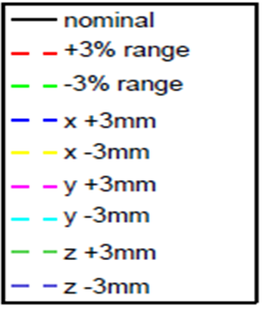
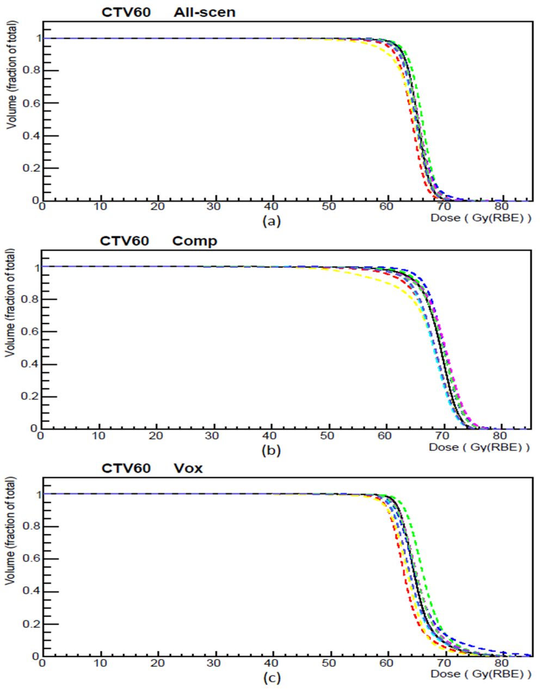
Comparison with worst case robust optimizations: H&N
Voxel-wise approach ignores the hot spots in the target.
Med. Phys. 2018, 45(9), p 4045-4054
Notes:
Say that vox is better in the left plot. note hot spots, come back to the voxel wise method

Slide 25

GPU computing
Scale of problem: ~10¹⁰ nonzero elements. ~100GB. -> Multi node GPU.
Optimization is sequential. Parallelization needs to be at low level of calculation.
Coded to meet the limitation of computing hardware.
$$w_{i}^{k+1}=w_{i}^{k}\frac{\sum_{j}{\left(\frac{d_{j}^{0}}{d_{j}^{k}}∗M_{ij}^{2}\right) }}{\sum_{j}{{(M}_{ij}^{2}}) }$$
Notes:
The computation was performed on GPU to accelerate. GPU stands for graphics processing unit. It is optimized for processing same operations over thousands of computing cores in a card. For a large clinical case, the scale of computation can invovle 100GB of memory. We developed multi-node program to contain the problem.
Optimization is sequential inherently. One iteration depends on the iteration before it. We need to paralle computing has to happen at low level. For example, one GPU thread or kernel may just calculate a sub-term in the summation.
This summation sums over the voxel ID, and the result is summed into a single factor for each spot. In the natural order, the weight of a spot is calculated before the next spot is processed. a proton beam spot deposit dose to a few tens of thousands of voxels. When summing together, multiple thread will try to modify the same memory cell for that spot, this causes conflict and inefficiency. To overcome this problem, we transposed matrix M. At a given time, one voxel contribution is summed into all the different spots that contributed dose to that voxel. All GPU thread are working efficient.
DVH is calculated at each iteration for calulating the desired dose. We parallelized the DVH calculation as well.

Slide 26
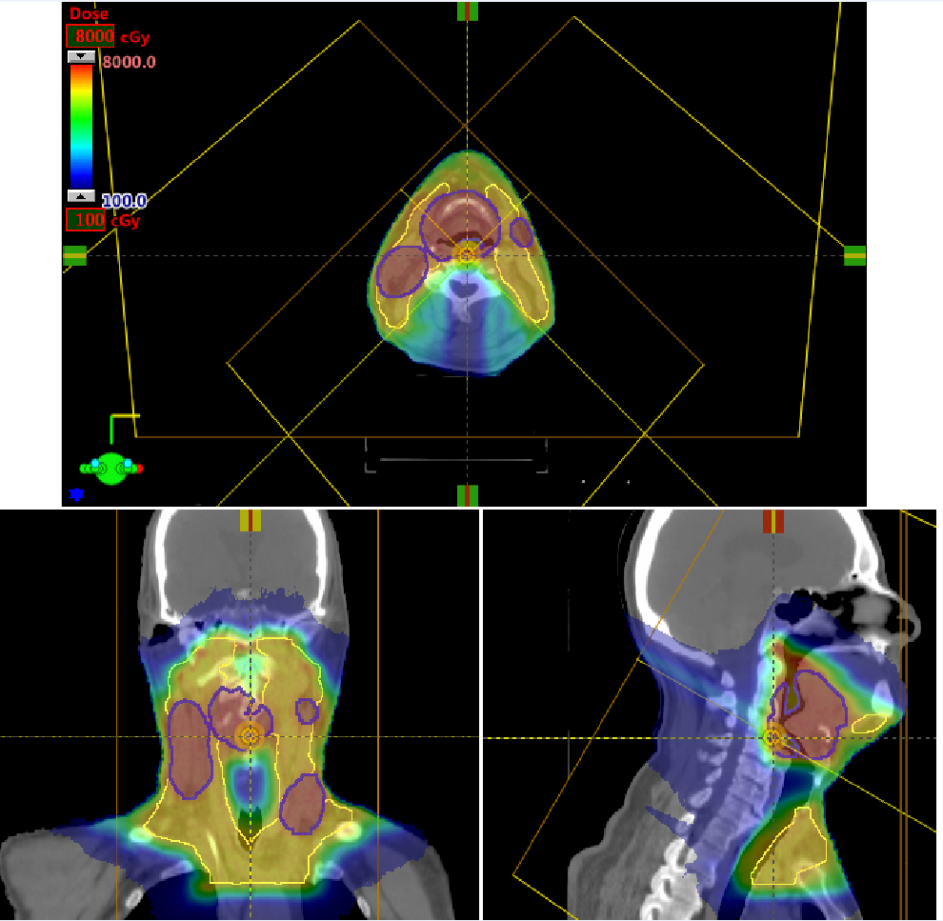
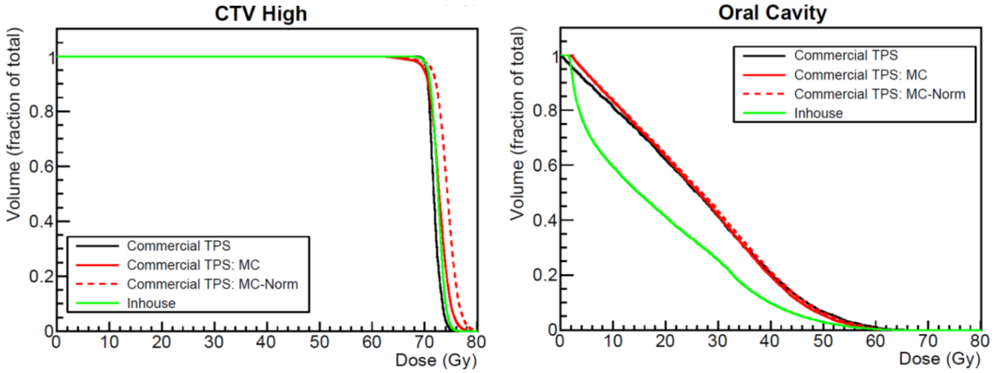
Comparison with the commercial plan
Head and neck
Med. Phys. 41 (12), 121707(9pp), (Dec. 2014)
Notes:
To comparison with the commercial plan, we plot the commercial plan in three DVHs for each structure. One of them is from the commercial TPS which is calculated with analytical models. The second is MC calculation of the same commercial plan. And because the MC calculation shows that the commercial plan loses target coverage. We normalize the second to get the third one which is the dashed line in the figure. By looking at all three cases, and the in-house plan compares favorably. One feature we would like to mention is that our optimization was done without adjustment of initial constraints and or special contours for hot and cold regions. Say that sign of continual push No manual constraint adjustments or special dose contours, in contrast to the commercial system.
Our IMPT optimization work has been published in Med. Phys.

Slide 27
Biological optimization

Slide 28
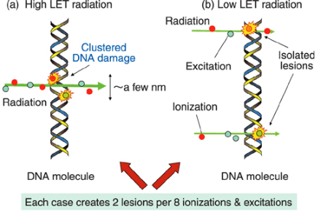
LET enhanced optimization - motivation
Biological effectiveness is related to linear energy transfer (LET).
Enhance LET for radio-resistant tumors: glioblastoma, unresectable salivary tumor, etc.
Notes:
In the LET range of proton beam therapy, LET is proportional to RBE. Other than dose, proton beam has another dimension, namely LET. LET affects RBE. Talk about the plot. Proton LET ranges from 0.5keV/um at the entrance to 15keV/um at the very end of Bragg peak. Furthermore radiation with higher LET may be more effective in the hypoxic center of a tumor. We try to take advantage of this by increase LET in the radioresistant tumors such as… A IRB is written, and we are trying to enroll patients on the trial;

Slide 29
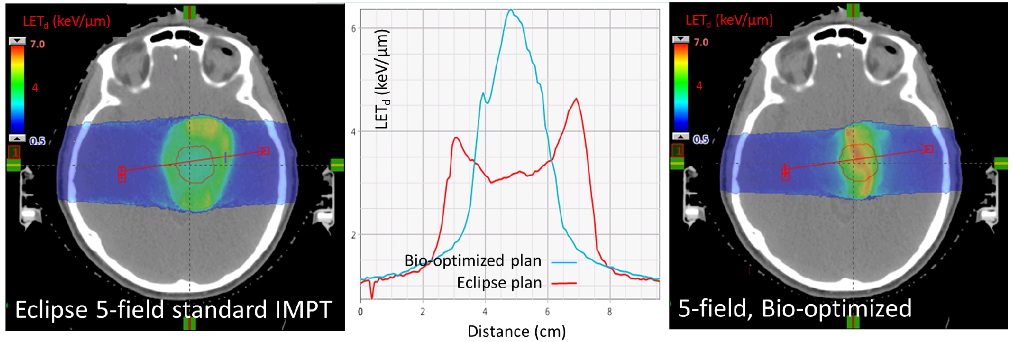
LET enhanced optimization
According to various models, increased LET corresponds to a relative biological effectiveness (RBE) boost of ~25%.
Notes:
To enhance LET, We calculate the weigted LET inside the target, and outside the target, reweight the beam weights by the ratio and asks for higher biological dose in the desired dose at each iteration. We further increase the number of fields. Traditional planning tend to put high LET at the edge or even out of the target. High LET is at the center; According to various model, the RBE boost is increased by up to 20%. On this figure. Dose weighted LET color wash is shown. The LET profile is compared. Red, Blue…; keep the dose

Slide 30
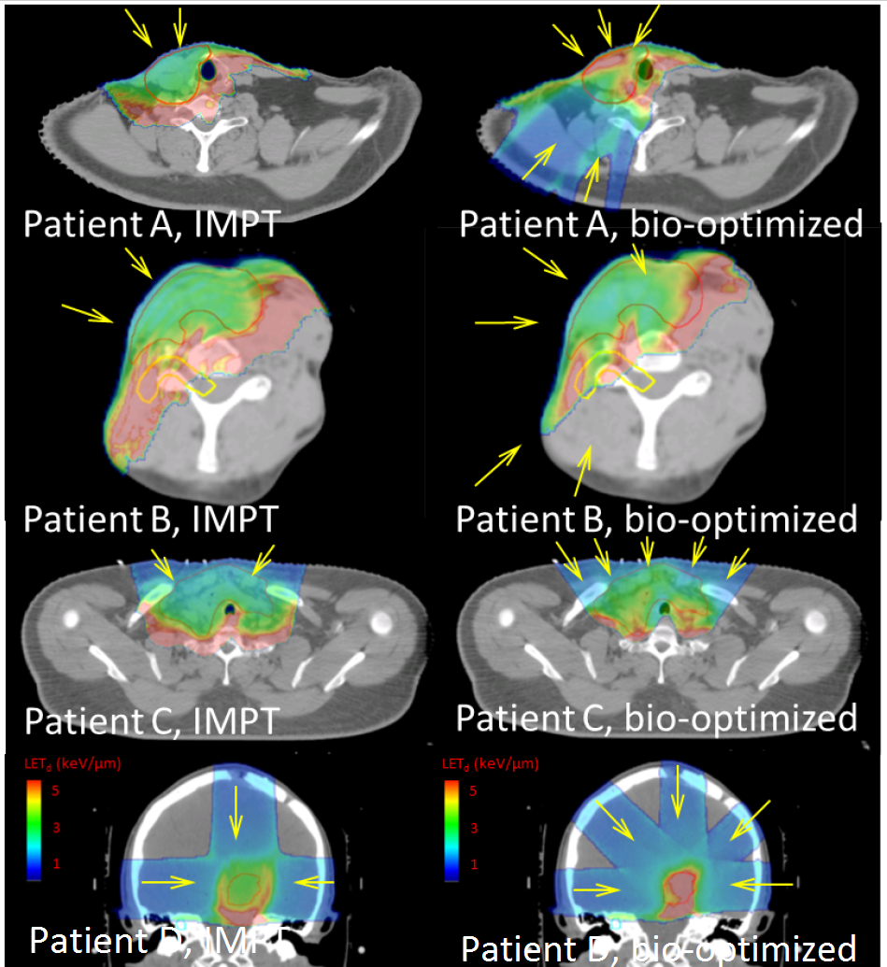
LET distributions: conventional v.s. bio-optimization
Beam orientation, critical structures, target size all affects LET enhancement.
IJROBP 95(5), pp.1535-1543 (2016)
Notes:
Read the title and say in the LET color wash, patient B is not improved much, because of brachial plexus and 3 beam from anterior covering target, heavy bragg peak need to be dumped at the distal edge of the target, therefore higher LET was not at the middle of the tumor. Disease site of all; ABC are thyroid tumor. D is a brain case. This LET enhanced biological planning is published in red journal.

Slide 31
Particle beam therapy with heavier particles – carbon, helium, etc
Make no attempt to compute from first principle
Approach: relate unknown therapies to decades of photon experience - renormalization

Slide 32
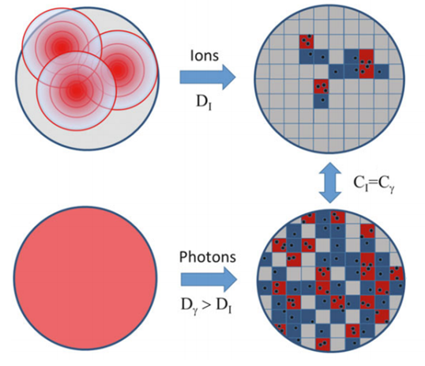
Microscopic model of radiobiology
Domain size: ~500nm DNA, ~chromatin giant loop.
Stewart et. al. Med. Phys. 45(11) 2018

Slide 33
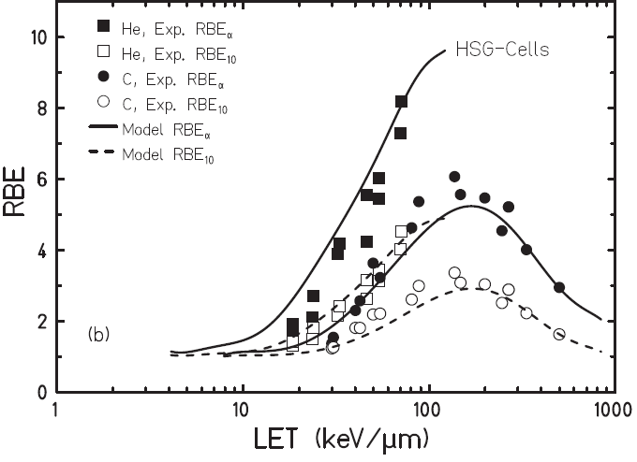
Compared with cell survival experiment
Elsasser et. al. IJROBP 78(4) 1177-1183 2010
Notes:
Mention need to check with clinical experience

Slide 34
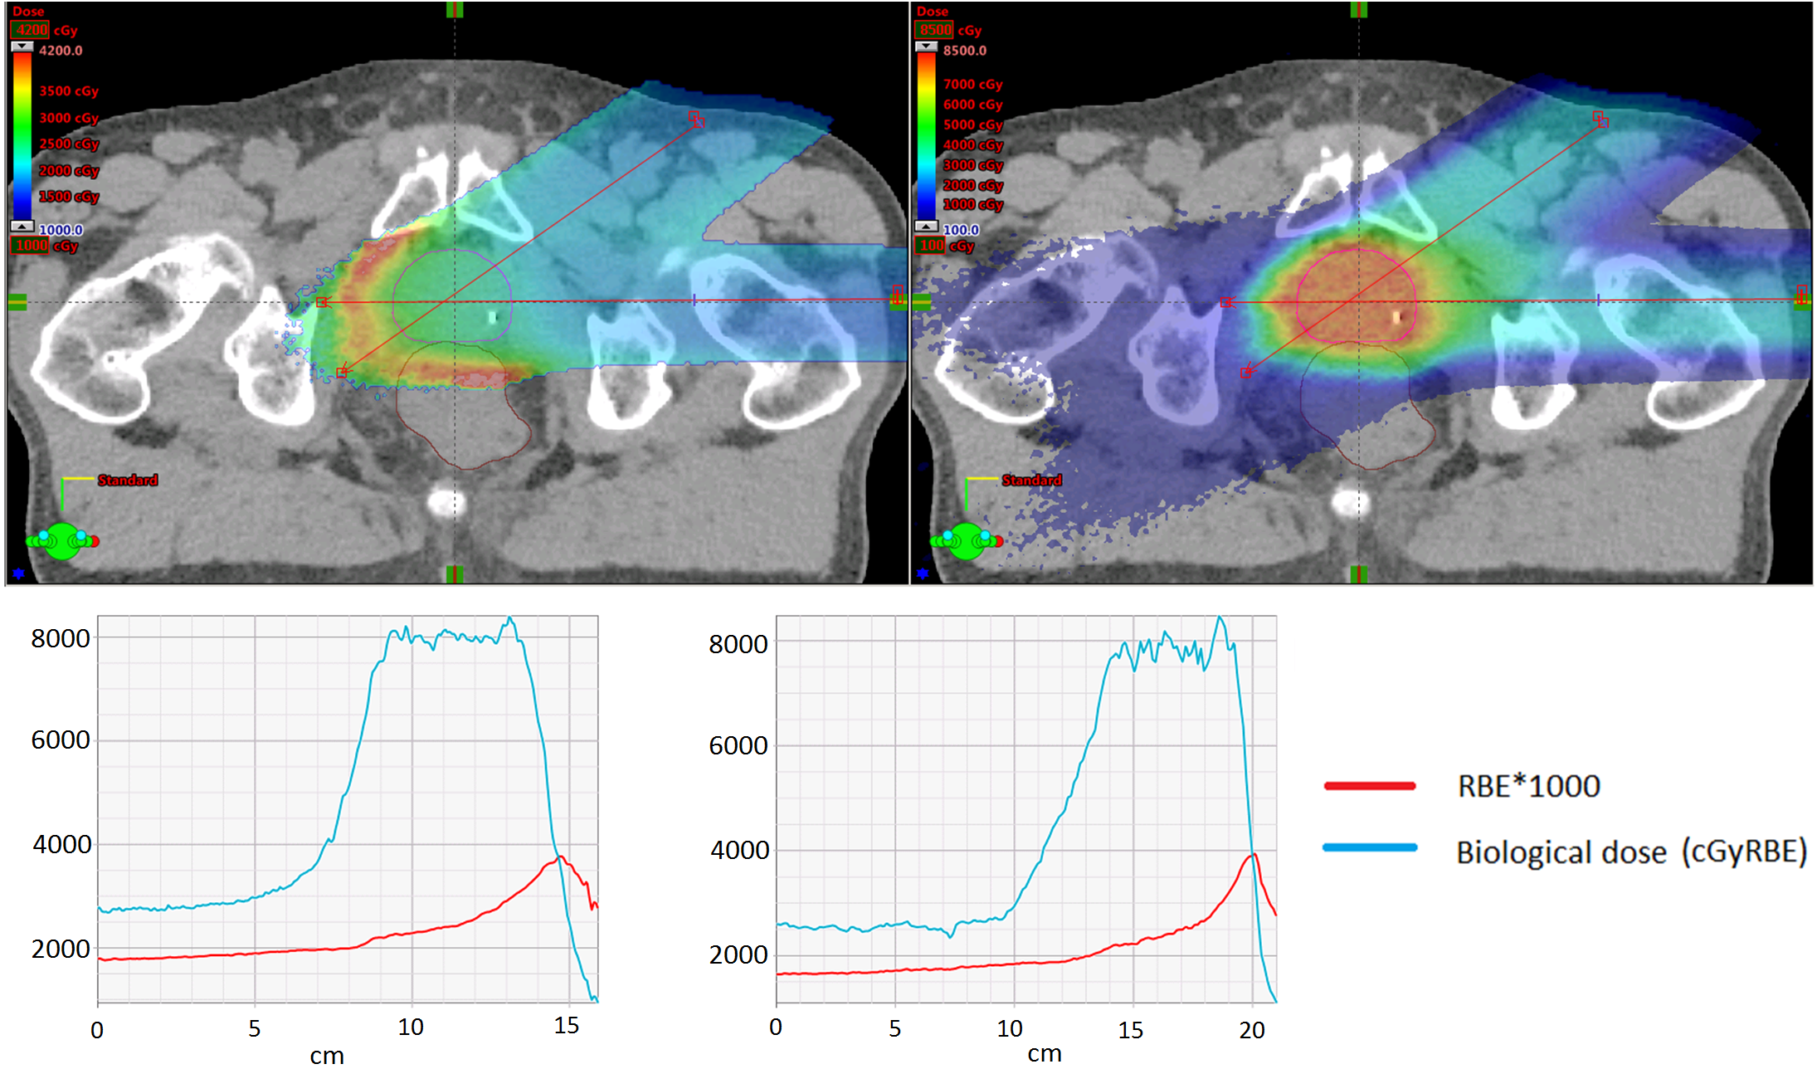
Optimized to biological dose
RBE*1000
Biological dose
Notes:
Describe plots as it is first shown!!!. RBE defiend as the ratio of photon equivalent biological dose and physical dose. Then state the fragmentation tail and the bullet point in slide.

Slide 35
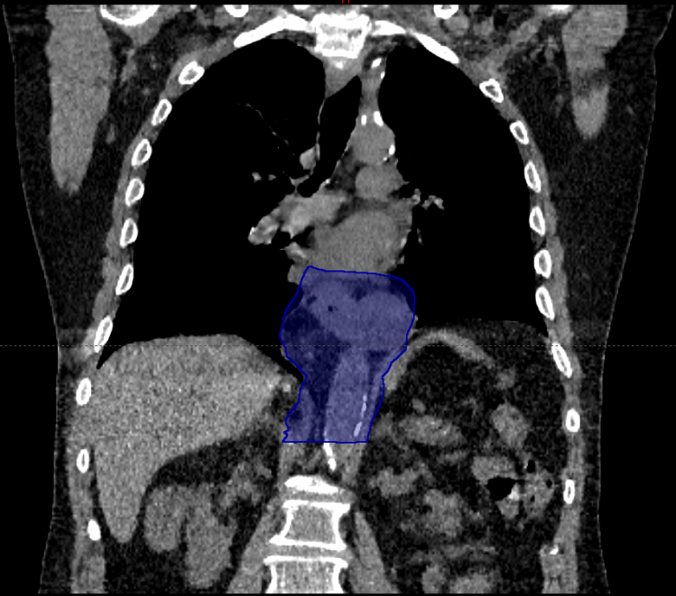

Slide 36
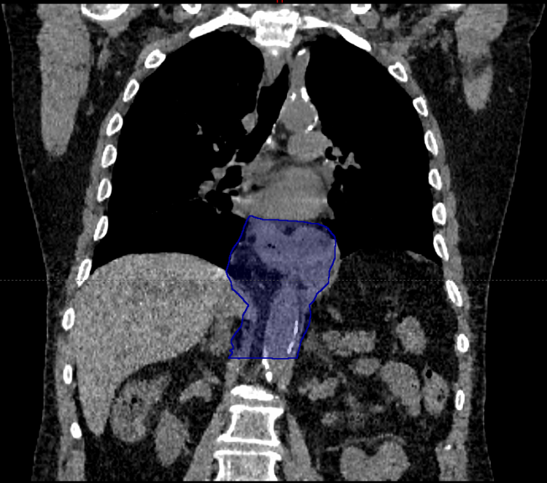

Slide 37
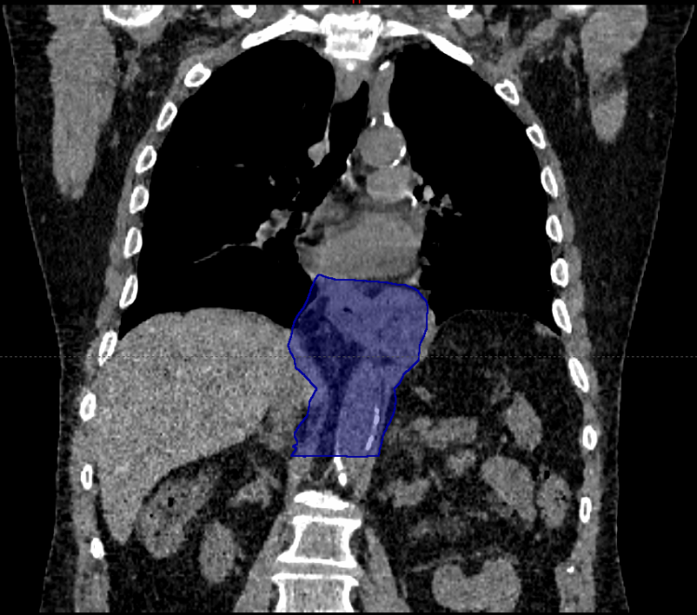

Slide 38


Slide 39
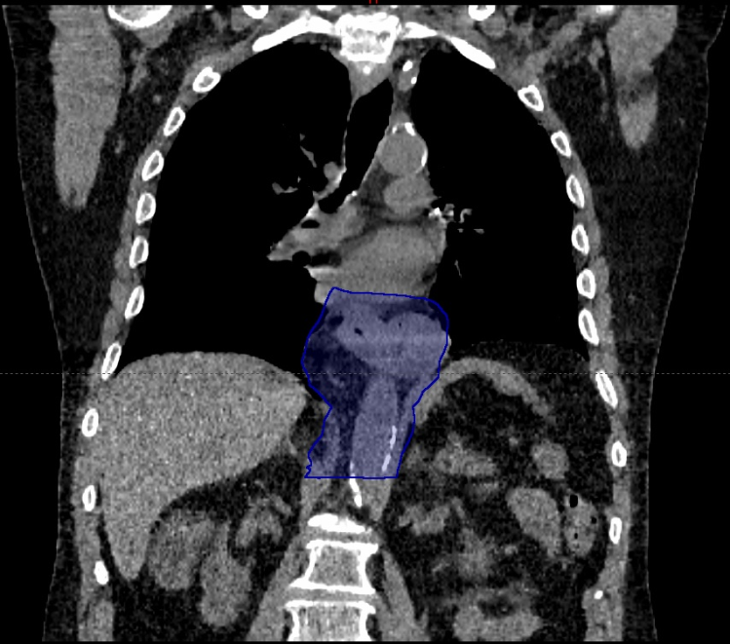

Slide 40
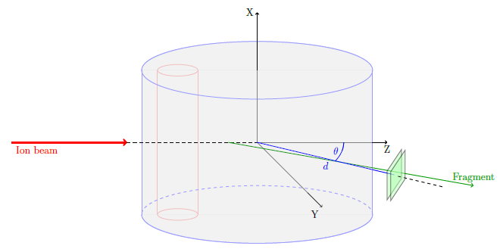
Detecting fragments in carbon beam therapy

Slide 41
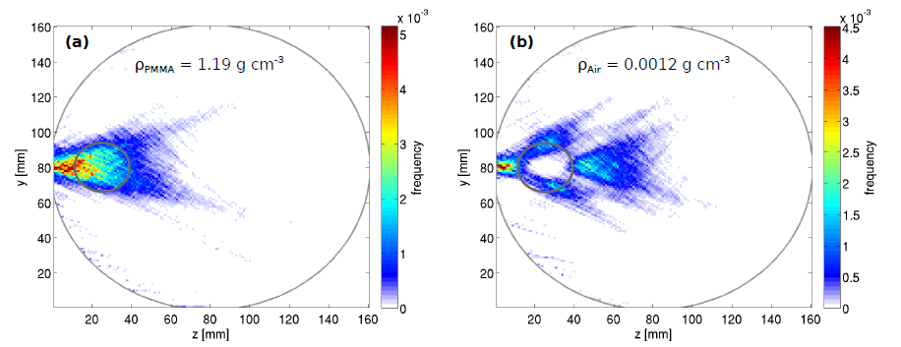
Fragments helped to look into phantoms
Reinhart, et al, PMB 62 2017 4884-4896

Slide 42
Conclusion
A clinically viable, GPU-accelerated, robust optimization system is developed for intensity modulated proton and particle beam therapy treatment planning. It has been in clinical use at Mayo Clinic.
Biologically motivated planning is achievable, and can be of clinical interest.
Possible application of particle detectors in patient motion management.
Notes:
The talk is more like a tour, an old domain that still have room for improvement especially in together with immunotherapy.

