Slide 1
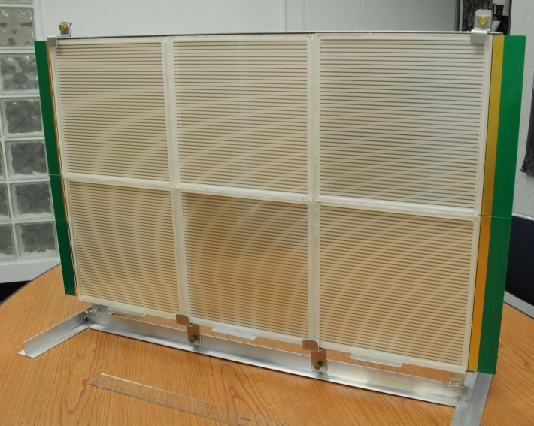
Progress in developing large-area high resolution photo-detectors (LAPPD)
Henry Frisch
Enrico Fermi Institute, Univ. of Chicago
and HEPD, Argonne National Laboratory

Slide 2
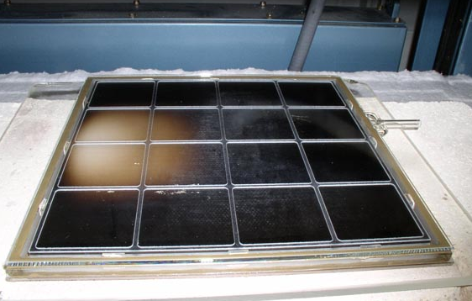
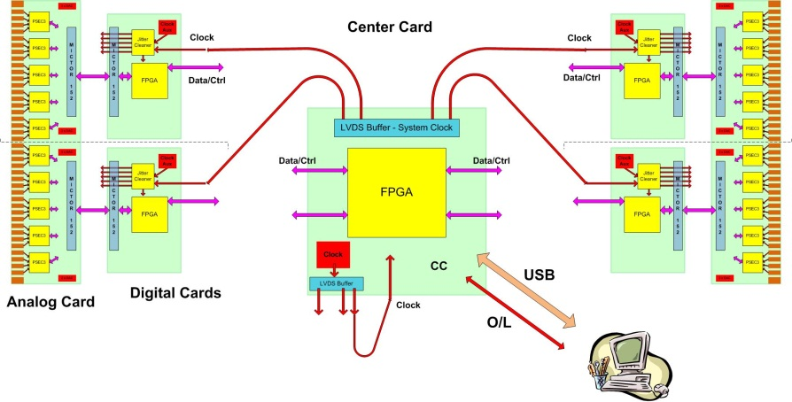
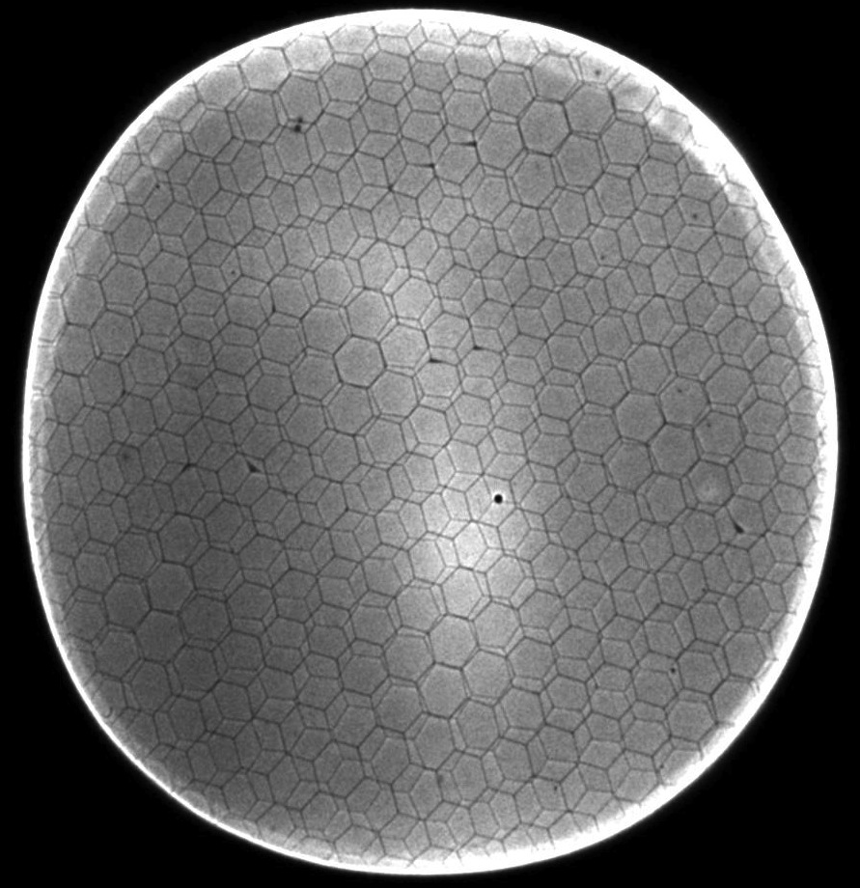
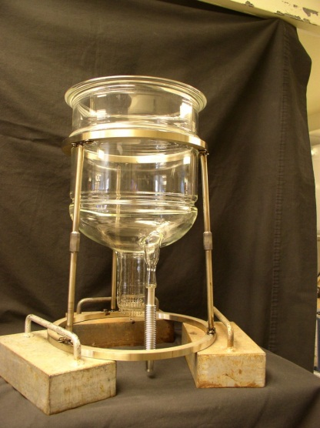
The 4 `Divisions’ of LAPPD
CV
CV
Hermetic Packaging
Electronics/Integration
See (hear) Eric Oberla’s talk
CV
CV
MicroChannel Plates
Photocathodes
See (hear) Klaus Attenkofer’s talk

Slide 3
The Large-Area Psec Photo-Detector Collaboration

Slide 4
Parallel Efforts on Specific Applications
.
Explicit strategy for staying on task-
Multiple parallel cooperative efforts
PET
(UC/BSD, UCB, Lyon)
Collider
(UC, ANL,Saclay.
LAPD Detector Development
Muon Cooling
Muons,Inc
(SBIR)
ANL,Arradiance,Chicago,Fermilab, Hawaii,Muons,Inc,SLAC,SSL/UCB, UIUC, Wash. U
K->πνν
JPARC
Drawing Not To Scale (!)
ANT11 audience
Mass Spec
Andy Davis, Mike Pellin, Eric Oberla
Neutrinos
(Matt, Mayly, Bob, John, ..; Zelimir)
Non-proliferation
LLNL,ANL,UC
All these need work- naturally tend to lag the reality of the detector development

Slide 5
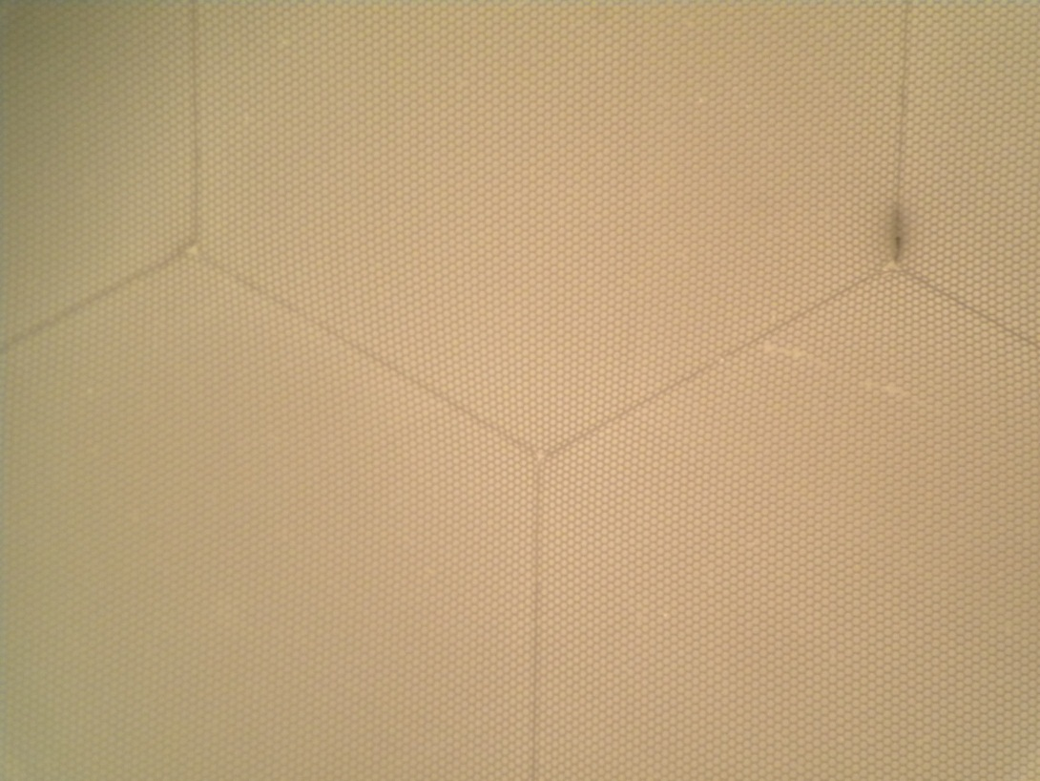
Microchannel Plates-1
Incom Glass Substrates- Hard (untreated) glass
0.077” Multi
2 working formats:
20-micron pores
Micro-photograph of the pore/multi structure
mm Disc
(Development)
8”-square (the `Tile’)

Slide 6
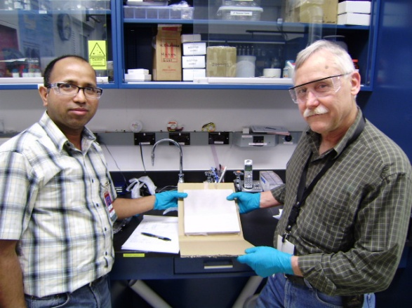
Microchannel Plates-2
Argonne ALD and test Facilities
In situ measurements of R (Anil)
Femto-second laser time/position measurements (Matt, Bernhard, Razib, Sasha)
33 mm development program
8” anode injection measurements
Anil Mani and Bob Wagner

Slide 7
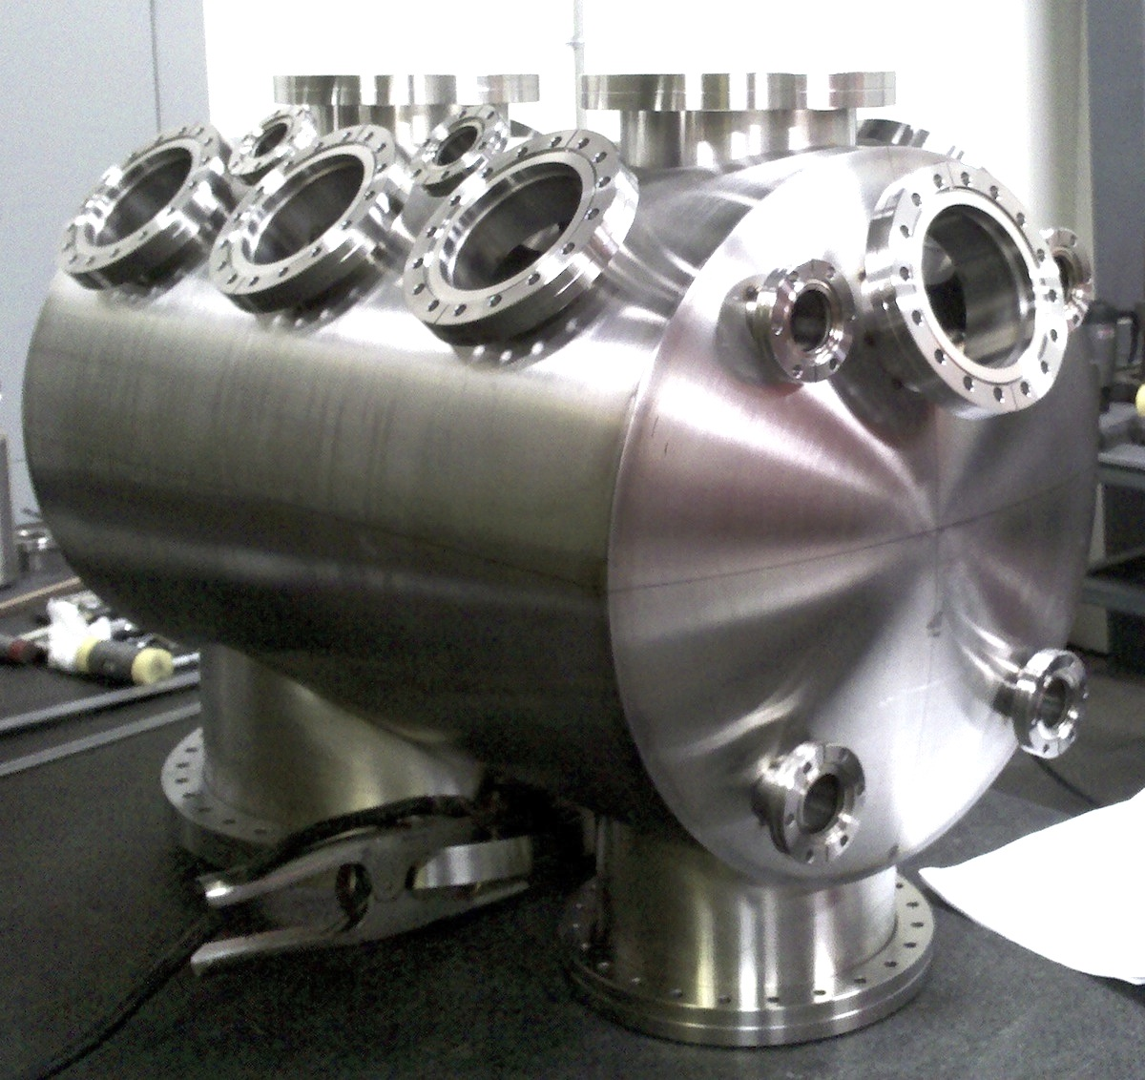
Microchannel Plates-3
SSL (Berkeley) Test/Fab Facilities
Ossy Siegmund, Jason McPhate, Sharon Jelenski, and Anton Tremsin-
Decades of experience
(some of us have decades of inexperience?)

Slide 8
Microchannel Plates-4a
Performance: First, the gain. We see gains > 10⁷ in a chevron-pair;
> 10⁵ in a single plate (attractive possibility for cost/simplicity)
Ossy Siegmund, Jason McPhate, Sharon Jelinsky, SSL/UCB

Slide 9
Microchannel Plates-4b
Performance:
Noise (bkgd rate).
<=0.1 counts/cm²/sec; factors of few > cosmics (!)
Ossy Siegmund, Jason McPhate, Sharon Jelinsky, SSL/UCB

Slide 10
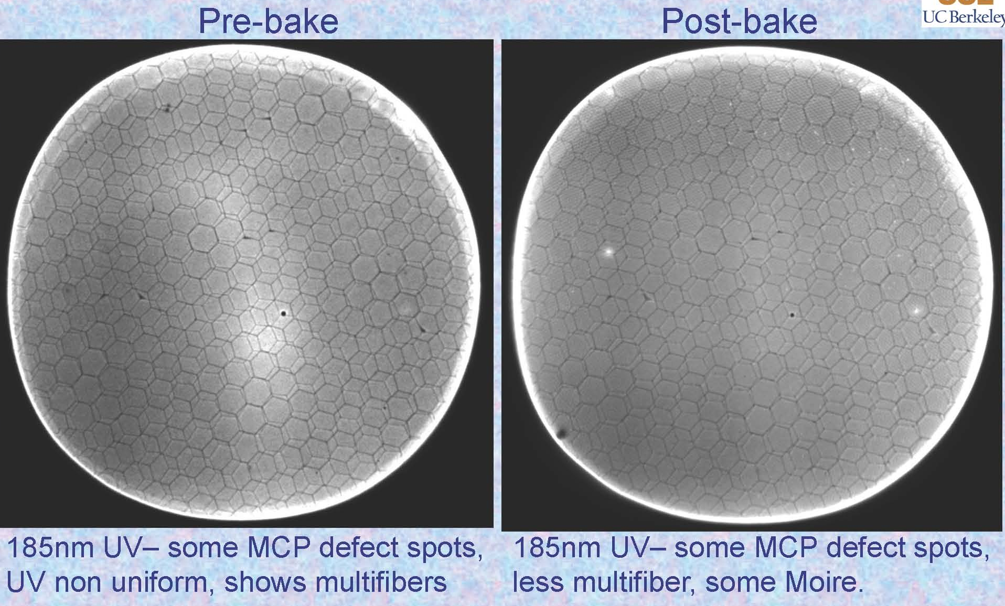
Microchannel Plates-4c
Performance: Image quality, spatial resolution, uniformity:
Good uniformity; can resolve the multi boundaries in top plate (20microns)
Ossy Siegmund, Jason McPhate, Sharon Jelinsky, SSL/UCB

Slide 11
Microchannel Plates-4d
Performance: burn-in (aka `scrub’)
Measured ANL ALD-MCP behavior
(ALD by Anil Mane, Jeff Elam, ANL)
Measurements by
Ossy Siegmund,
Jason McPhate,
Sharon Jelinsky, SSL/UCB
Typical MCP behavior- long scrub-times

Slide 12
First Pulses From an 8” MCP (!)
Caveats- this is the first time…
TDIITDs- don’t over analyze this
Pulses from the 2 ends of an 8” anode strip
Matt Wetstein, Bernhard Adams, Razib Obaid, Sasha Vostrikov (ANL and UC)

Slide 13
First Pulses From an 8” MCP
Matt Wetstein, Bernhard Adams, Razib Obaid, Sasha Vostrikov (ANL and UC)
TOA (psec)
TrueError bar prob.
like this
(ask Matt)
Note
c= 0.3mm/ps
1/c=3.3 psec/mm
From the time difference of the 2 ends of the strip one gets the longitudinal position, from the average of the 2 ends the time (and of course from which strip(s) one gets the transverse position) => so have 2D at wall plus Time-of-Arrival
Position of laser (mm)

Slide 14
MCP Prognosis
Incom has made great strides in making substrates- the 3-pt joint of the multis seems solved; some cleaning issues remain and are being worked on
Strong UHV test facilities have been constructed at SSL and ANL (this was a big effort- UHV isn’t fast or easy- requires real infrastructure)
ALD development has a 1st-generation baseline that shows high gain, low noise, and short burn-in (ALD: Anil Mane and Jeff Elam, ANL)
Transferring knowledge gained from hundreds of 33mm plates to 8” plates and Beneq machine now (Anil Mane and Jeff Elam, ANL)
Fast turn-around electroding has turned out to be an issue- we have attacked now on parallel fronts (this was a surprise)
We have started a program with Incom to produce more blocks to get enough 8” plates for a first-round of users in the field (see slide 4 for the customers)

Slide 15
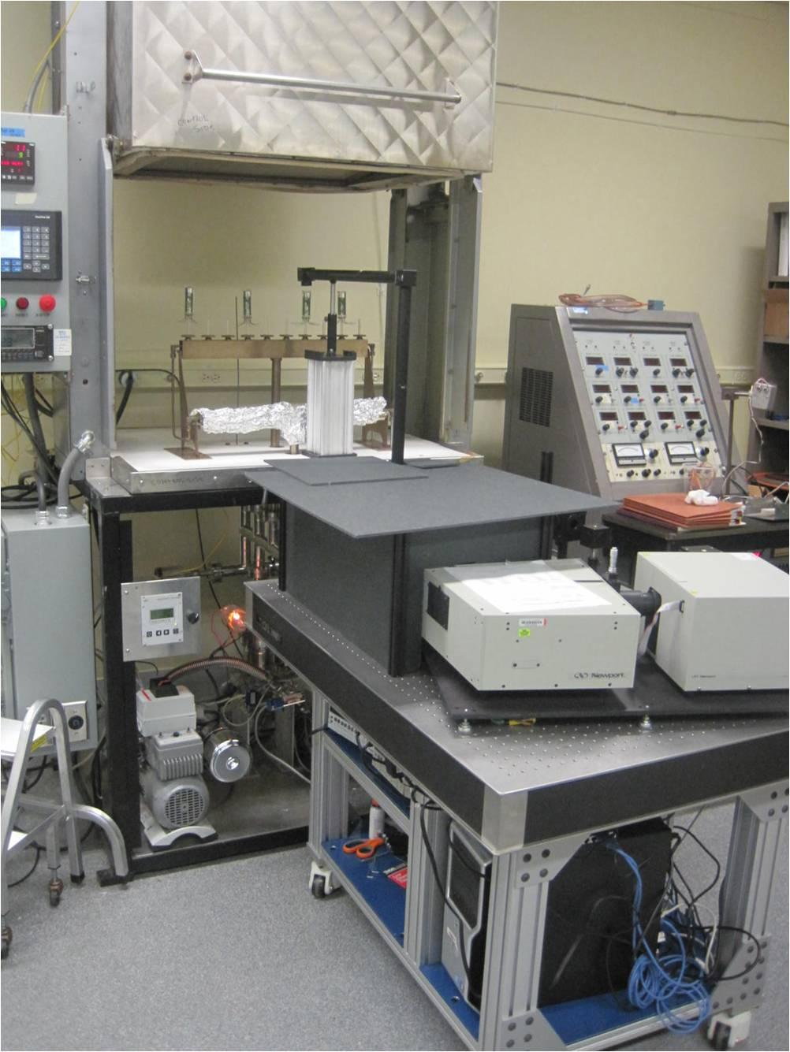
Photocathodes Subject of next talk by Klaus- touch on here only briefly
LAPPD goal- 20-25% QE, 8”-square
2 parallel efforts: SSL (knows how), and ANL (learning)
ANL
Optical stand
Burle commercial
equipment
First cathodes made at ANL

Slide 16
Photocathodes- 2 Subject of next talk by Klaus
SSL has years of experience making bialkali photocathodes-
They are our treasury bonds (Swiss francs?) in the LAPPD `portfolio of risk’

Slide 17
Photocathodes
But longer-term, we have started a broadly collaborative program outside of LAPPD on high QE (goal: > 50% QE) cathodes and tuning spectral response (LDRD funds now- ideal flagship for a (the) Natl. Detector Center
Ultra (UBA)-40%@400nb
Hamamatsu
bialkalis
Super(SBA)-34%@400nb
Conv. BA-25%@400nb
Q
Note shift in peak
QE from conventional
BA to SBA and UBA

Slide 18
Photocathodes
An obvious question to this audience is:
What are the economics of QE vs PMT area at constant bang-for-buck in a) CPV, and b) proton?
For example, going from 25%QE to 50%QE would allow going from a 7” tube to a 5” tube at constant photons*
Alzo, a Winston cone for a 5” tube is easier and smaller than one for a 7” tube (tho not for a wavelength-shifting plate?)
* Note `constant photons ‘doesn’t apply to time-position-sensitive detectors like LAPPD
Q
Crudely, put, “what’s QE worth to you in $?”

Slide 19
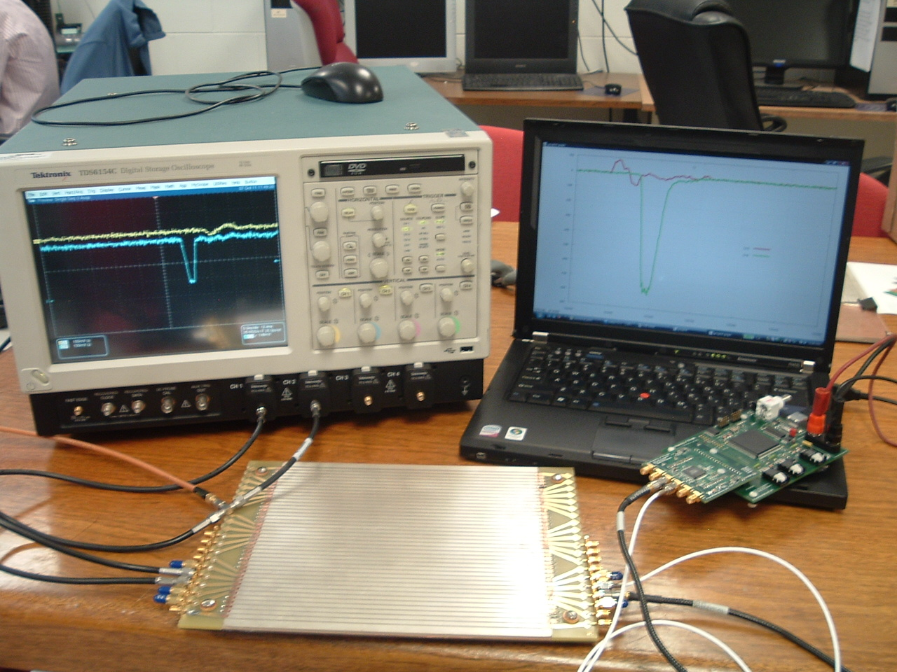
Electronics and Integration Subject of next talk by Eric - touch on here only briefly
Real digitized traces from anode
20 GS/scope
4-channels (142K$)
17 GS/PSEC-4 chip
6-channels ($130 ?!)

Slide 20
Hermetic Packaging
Have moved to a tile/tray design: tray has all the electronics; only connections to tiles are HV and ground
Tiles are glued with spray glue to tray
HV divider chain is made with ALD
No pins through glass
Tile is plate glass
Anode strips connect
Modular; simple
Top seal is cold (ANL)
Hot (SSL)

Slide 21
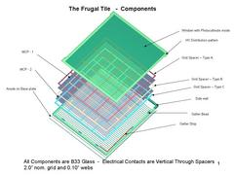
Hermetic Packaging
ANL/UC Glass Package
Glass package showing ALD-coated 8” MCP, grid spacer, bottom seal
(apologies for blurriness)

Slide 22
Hermetic Packaging
SSL Ceramic Package (2 parallel paths)

Slide 23
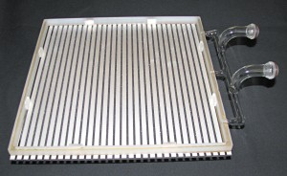
Hermetic Packaging
We have solved sealing over the anode strips
Bottom seal by Joe Gregar, ANL master glass-blower with help from Michael Minot (Minotech, Incom) and Ferro Corp

Slide 24
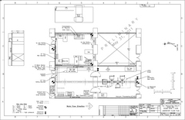
Hermetic Packaging
Top Seal and Photocathode- this year’s priority
3 parallel paths
Tile Development Facility at ANL
Production Facility at SSL/UCB
Commercial RFI for 100 tiles
(Have had one proposal for 7K- 21K tiles/yr)

Slide 25
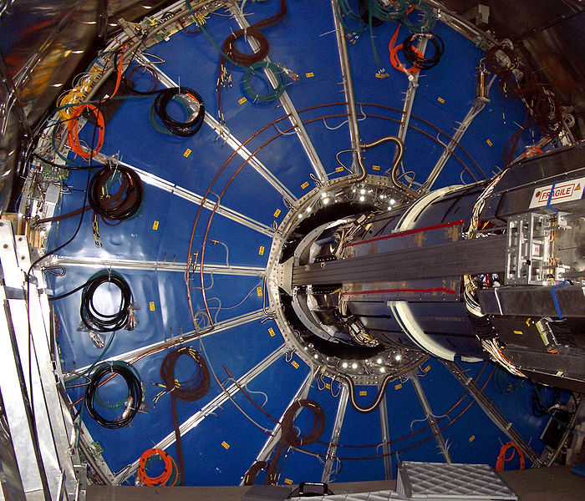
Some Neutrino specific aspects
The ALICE TPC:
Drift electrons onto wires that measure where and when for each electron.
We drift photons-good time resolution would buy nothing if one integrated over a whole (blue) TPC sector- ie didn’t correlate when and where
when and where
Same holds with water cherenkov-see matt’s talk

Slide 26
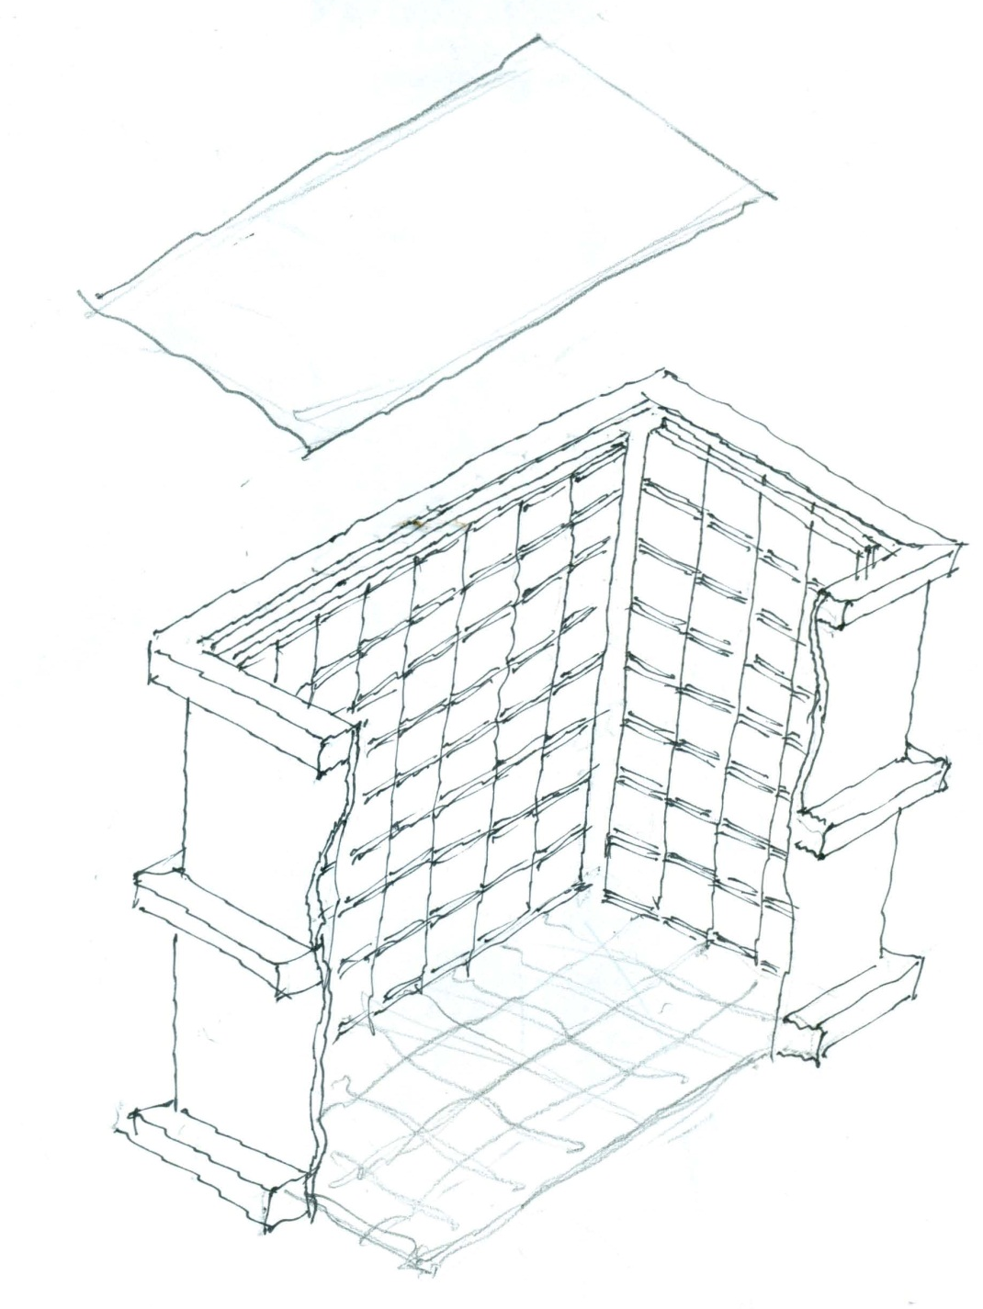
Daniel Boone
Proposal (LDRD) to build a little proto-type to test photon-TPC ideas and as a simulation testbed
`Book-on-end’ geometry- long, higher than wide
Close to 100% coverage so bigger Fid/Tot volume
Δx, Δy << 1 cm
Δt < 100 psec
Idea: to reconstruct vertices, tracks, events as in a TPC (or, as in LiA).
2 m
ν
2 m
See Matt’s talk tomorrow
1 m

Slide 27
The End
Pulses from the 2 ends of an 8” anode strip

Slide 28
Backup slides

