Slide 1
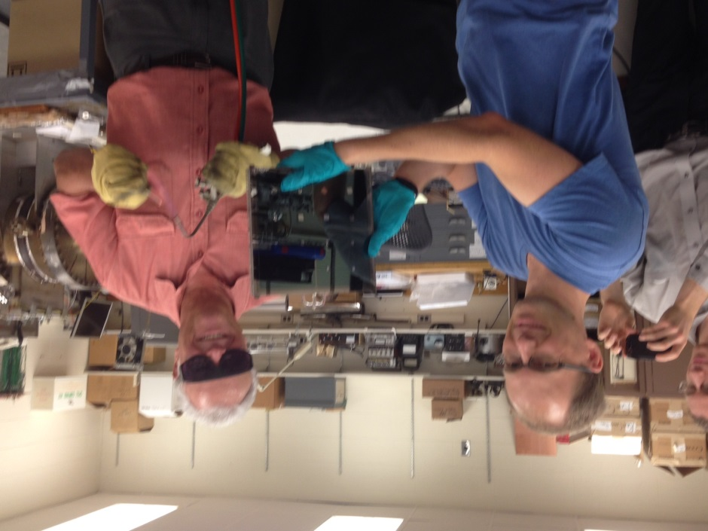
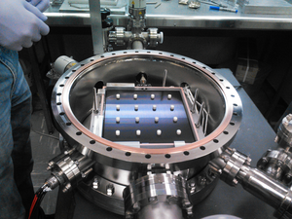
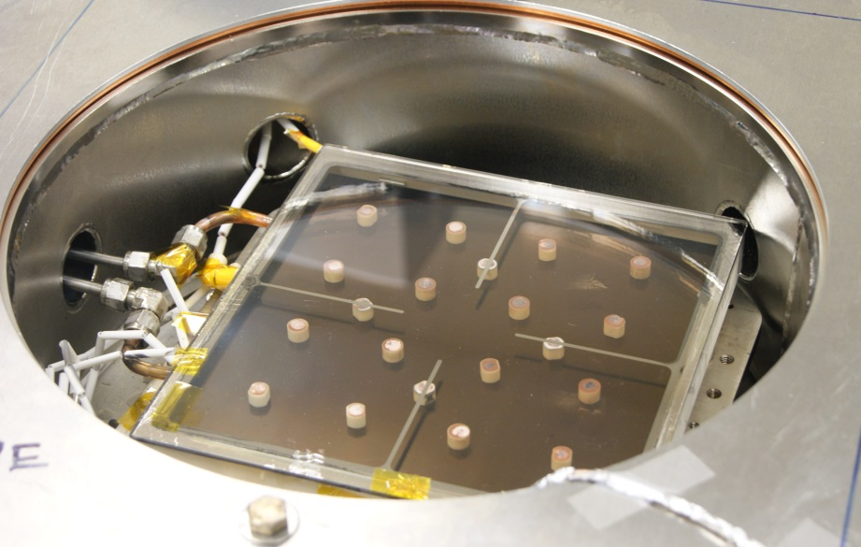
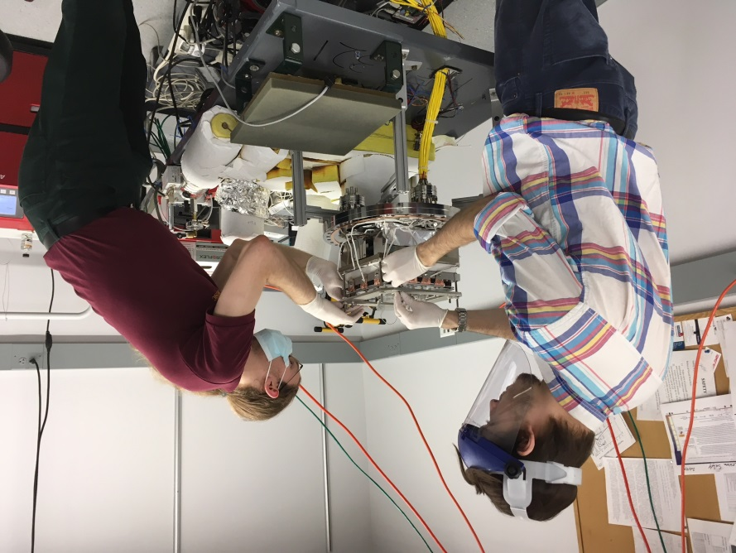
Psec timing/LAPPD program at Chicago
Evan Angelico, Andrey Elagin, HJF, Rich Northrop, Carla Pilcher, Eric Spieglan
plus Eric Oberla (emeritus) and Mircea Bogdan on electronics
plus 12 (!) HS and undergrad students last summer

Slide 2
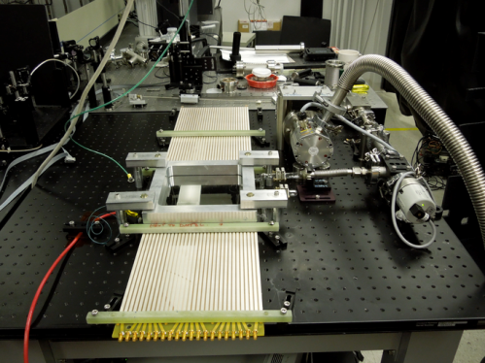
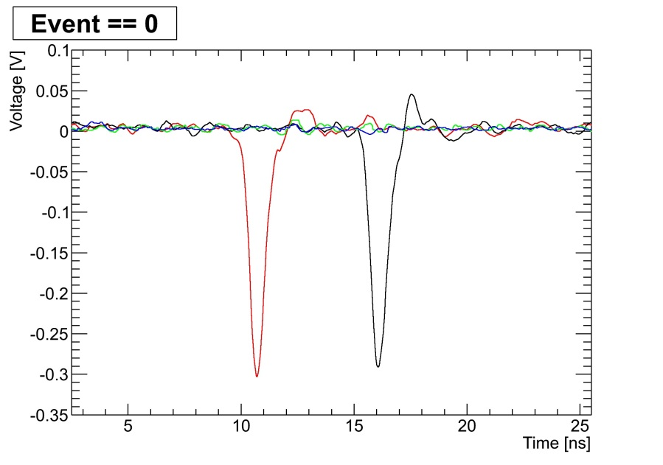
Our (UC) LAPPDTM ‘Tile’
8” x 8” active area (MCP size)
Amplification: a pair of MgO MCPs in a chevron config.
Measured gain typically ≥ 10⁷
Space resolution 700 microns in 2D (strips); 300 microns with ½” pads if signals are shared
Time resolution: < 50 psec single photon measured, goal of a < a few (or one) for charged particles traversing window (50 PE) or high energy photons (i.e. large pulses)
B.W. Adams, A. Elagin, H. Frisch, R. Obaid,E. Oberla, A. Vostrikov, R. Wagner, J. Wang, M. Wetstein;{\it Timing Characteristics of Large Area Picosecond Photodetectors};Nucl. Inst. Meth. Phys. Res. A. , Vol. 795, pp 1-11 (Sept. 2015);

Slide 3
Topics
Photodetector development (R&D with Incom Inc)
Indium window-to-tilebase seal
Application-independent anode (pads or strips)– metal resistive capacitive coupling
Ceramic robust high-bandwidth 1-piece body
PMT-process batch production: facilities, process
Theory-based photocathodes (with RMD, Smedley, Attenkofer)
Electronics (Eric Oberla, Mircea Bogdan, ANNIE)
Multibuffer 130nm CMOS 10 GS/sec ASIC developmnt
Scalable FPGA-based DAQ readout/control for ANNIE
Goals- expand physics reach via psec timing frontier: testbeam and simulation studies (PhD students, Elagin):
Optical Time Project Chamber for double-beta decay
Collider photon/ch vertexing and track quark content

Slide 4
Recent papers (see lappddocs.uchicago.edu)
E. Angelico, T. Seiss, B. W, Adams, A. Elagin, H. J. Frisch, E. Spieglan;\\{\it Capacitively coupled pickup in MCP-based photo-detectors using a conductive, metallic anode};\\Nucl. Inst. Meth. Phys. Res. A. (Oct. 2016)
A. Elagin, H. J. Frisch, B. Naranjo, J. Ouellet, L. Winslow, T. Wongjirad;\\{\it Separating Double-Beta Decay Events from Solar NeutrinoInteractions in a Kiloton-Scale Liquid Scintillator Detector By Fast Timing};Nucl. Inst. Meth. Phys. Res. A. (Sept. 2016)
E. Oberla and H.J. Frisch;\\ {\it Charged particle tracking in a water Cherenkov optical time-projection chamber};\\ Nucl. Inst. Meth. Phys. Res. A. Volume 814, 19-32, (April 2016)% ISSN 0168-9002. arXiv:1510.00947
Andrey and Evan will give talks at Light 2017 next week on tile production and OTPC.

Slide 5
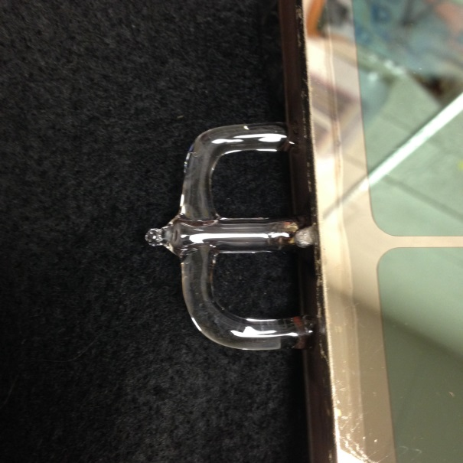
Photodetector Development
1: TOP SEAL: glass sidewall to window- consider proven
Recipe (lots of characterization, vendor/Ossy input)
Very clean glass surfaces
200 nm of Nichrome
200 nm of Cu w no vacuum break
.9999 Indium wire sized for volume
Etch Indium wire in 5% HCl
Thermal cycle 100C above melting
Press down on window edges w DOF
What happens: (Andrey Elagin FIB/SEM/ studies) (ITT story)
Nichrome layer will provide tie layer
Cu provides protection against oxide on NiCr
Indium wire gets squished--oxide broken (Walters)
Cu diffuses into bulk Indium (Ossy said so)
Nickel and Chrome diffuse into bulk Indium (!)
A very thin layer containing chrome on the glass forms the bond to the indium.

Slide 6
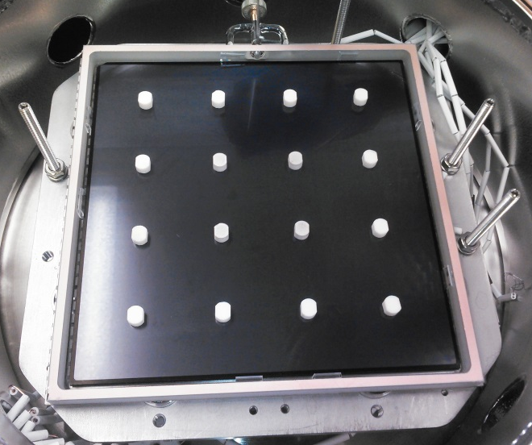
Photodetector Development
TOP SEAL- continued
The LAPPD size introduces 3 serious problems not experienced in making smaller tubes:
Uniform metalization, indium distribution, and cleanliness over a much longer length (~36”)
Uniform pressure and heating over that length
In a transfer process base sealing surface level to a mil or less (?-number I don’t know, as we use wire captured in place between the window and sidewall)
And, a precise STACK HEIGHT over entire tile.
FEA and many trials dictate a stack height low by 0.002±0.0005” over the tile interior
Each button spacer has to be custom shimmed to meet the above
Pressing uniformly on the edges over the seal area on all 4 sides is essential
Note buttons make stack height a discrete problem

Slide 7
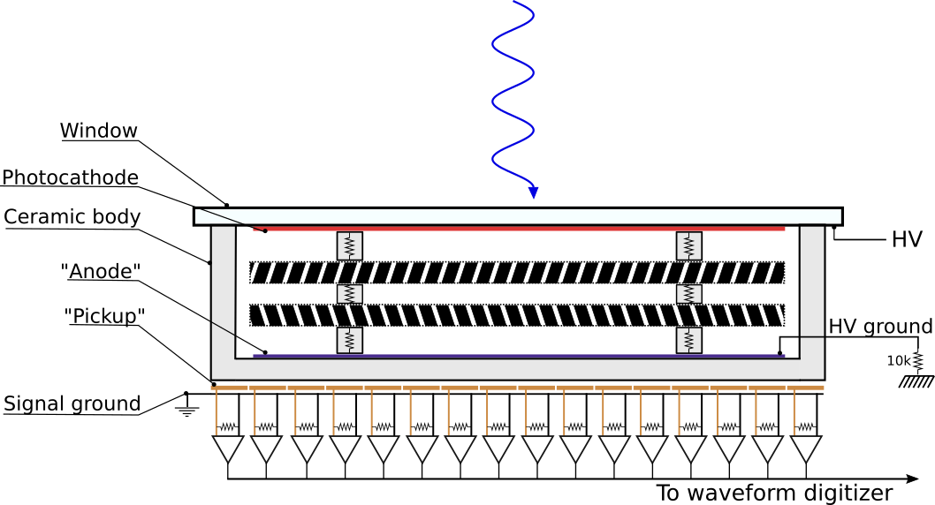
Photodetector Development
2: Capacitively coupled anode w. external signal pickup
Metal layer rather than thick-film for production during seal layer coating (also realities of thick-film)
10nm of NiCr is resistive enough for RC (capacitive) coupling

Slide 8
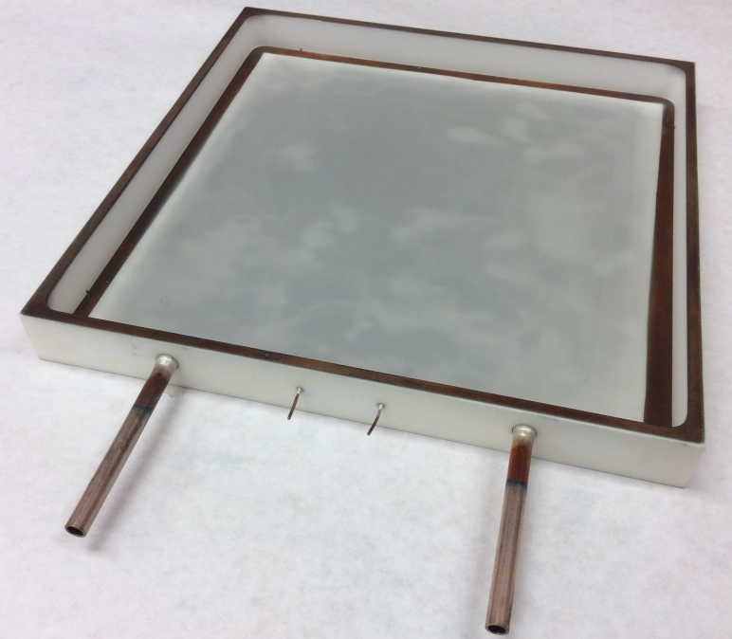
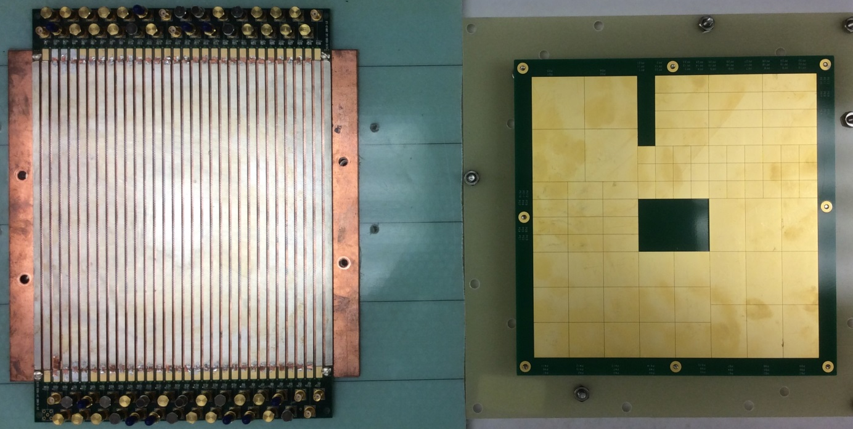
Photodetector Development
2: Capacitively coupled anode w. extrnl signal pickup
10 nm-thick NiCr anode plane (DC ground)
50-ohm stripline readout
(E. Angelico)
LHC Pad test pattern readout
(T. Seiss)

Slide 9
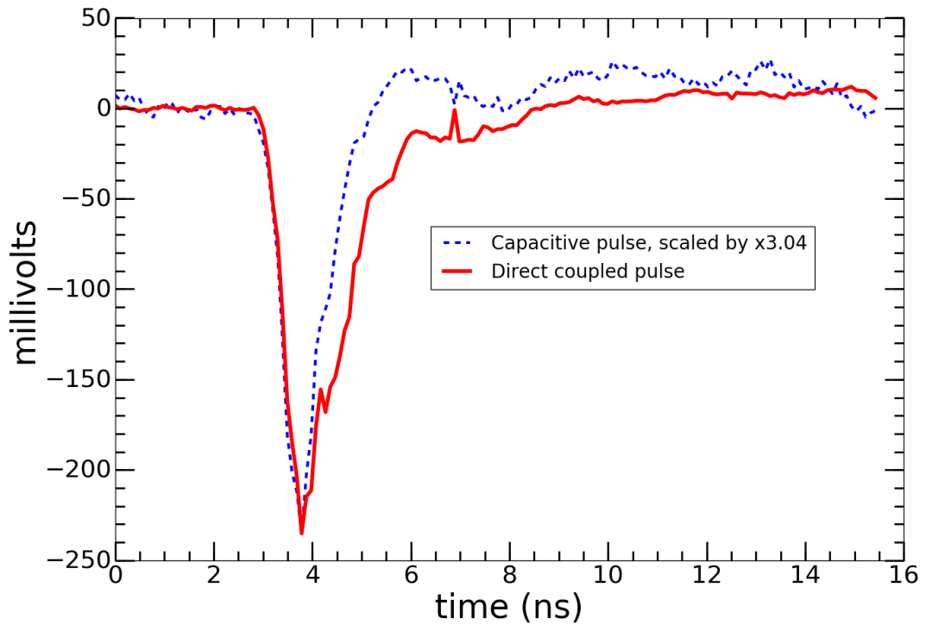
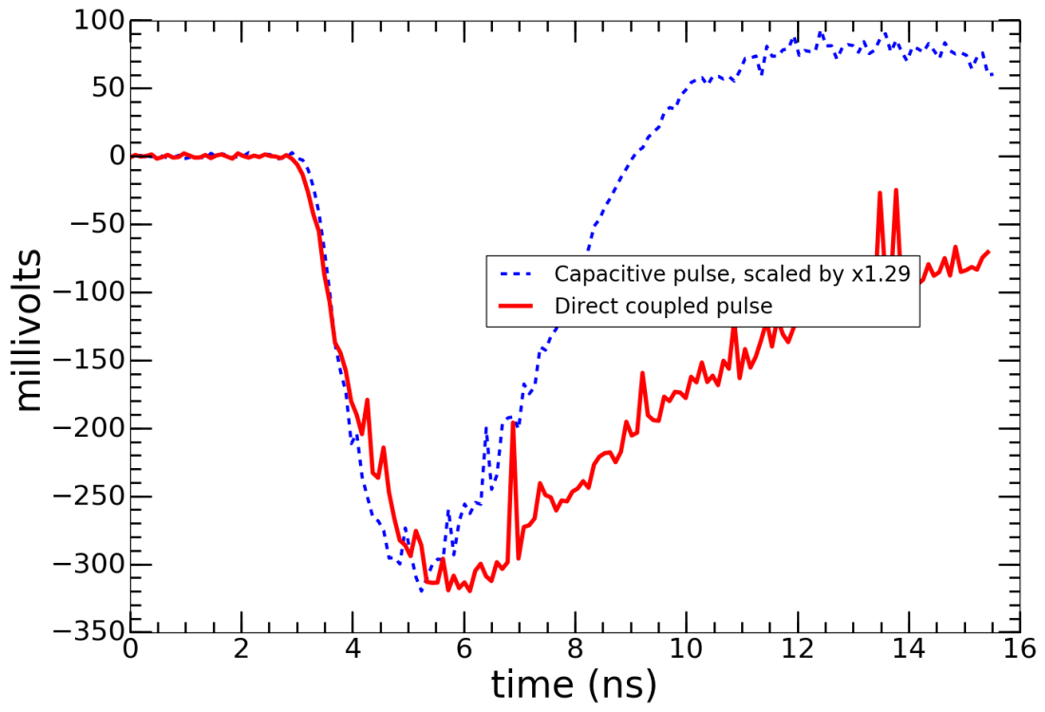
Photodetector Development
Capacitively coupled anode w. extrnl signal pickup
Comparison of risetimes direct vs capacitively coupled on strip readout PC-card
Comparison of risetimes direct vs capacitively coupled on pad readout PC-card

Slide 10
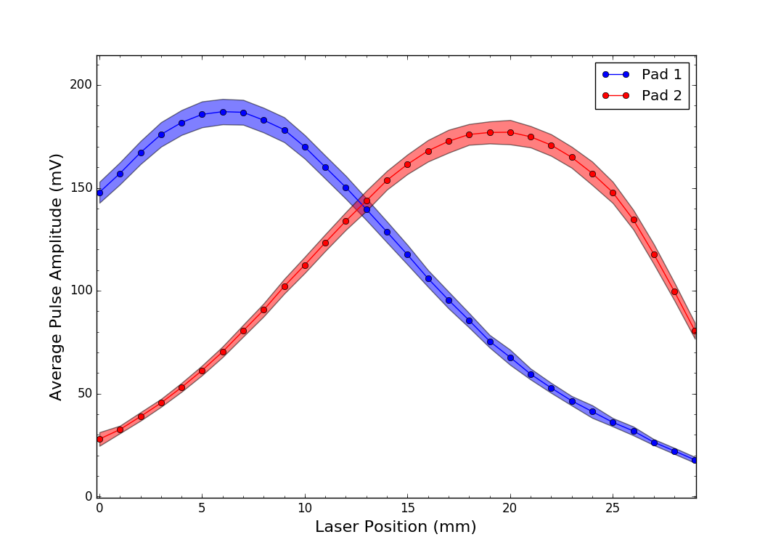
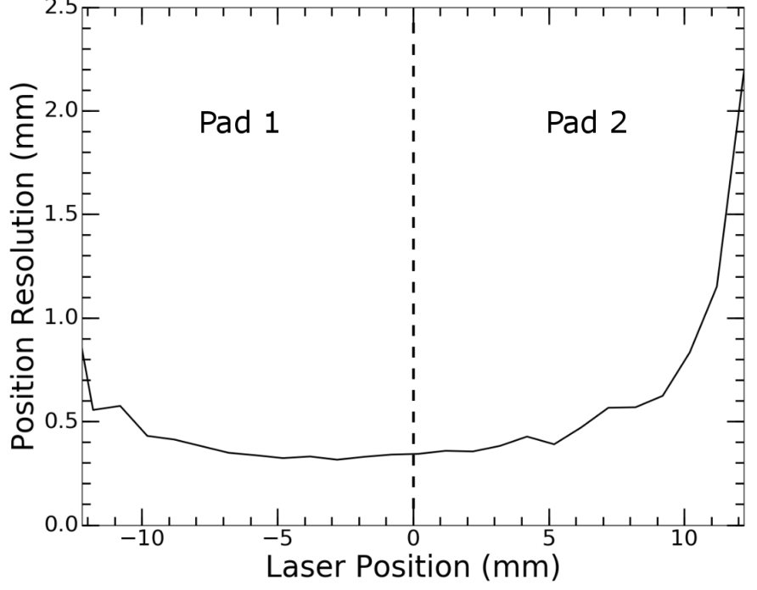
Photodetector Development
Sharing of the signal across two adjacent ½” pads
Position resolution with ½” pads and large signals (256 pads per LAPPD).
Advantage for Incom in they make 1-design tube; user defines readout pattern, resolution, band-width on card

Slide 11
Photodetector Development
3: Ceramic robust high-bandwidth 1-piece tile base
Our university group complement s Incom’s commercial focus on production of their glass tile design in 2 ways:
Develop physics applications (e.g. OTPC; later in talk)
Evolutionary design options- (but don’t get in their way on the Gen-I glass tile while working on Gen-II!)
Have developed a `Green-trimmed’ ceramic tile base with the following advantages:
One piece- no assembly of sidewall and base w. frit
Hotter bake-out possible as no frit or silver ink anode
Higher bandwidth than glass (also no ion migration)
More robust than glass
Working closely with Mike Foley of Incom under a DOE Nuclear Physics SBIR
Disadvantages: long lead-times, no experience (vs glass)

Slide 12
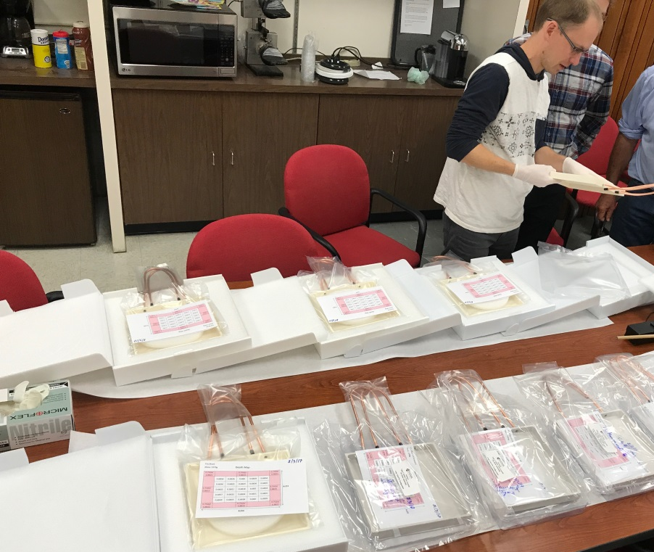
Photodetector Development
3: Ceramic robust high-bandwidth 1-piece tile base
Sidewall and anode plane are green-trimmed and then ground to spec after full fire- no fritted or brazed large (long) joint
Ceramic tile bases from 4 vendors- have 5 from each

Slide 13
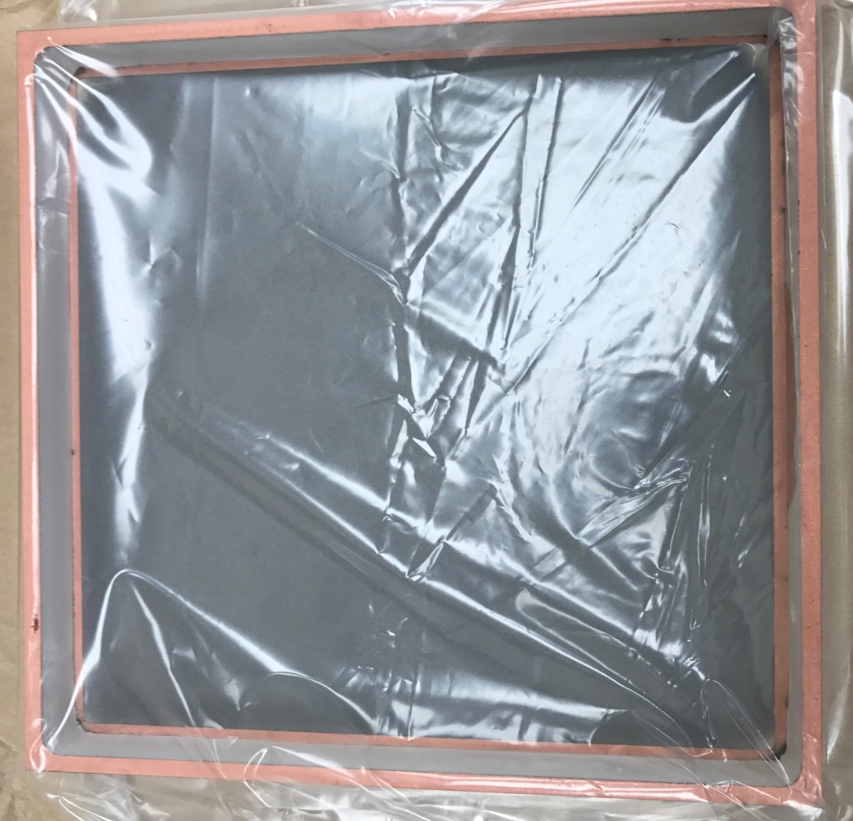
Photodetector Development
3: Ceramic robust high-bandwidth 1-piece tile base Multipurpose metallizing (‘coating’) glass or ceramic
Major roadblock for both glass and ceramic (surprise!)- source of a lot of delay working out
Expert territory only: Eileen Hahn (Fermilab), Sharon Jelinsky (SSL), Bing Xu (ANL), commercial precision optical coaters (2 vendors)
Here we use coating for sealing surfaces, capacitively-coupled anode, and connection to pins to interior- single process (no vacuum break between sealing layers)
Now have 2 good vendors+
200/200 nm NiCr/Cu seal surface
10 nm NiCr anode
NiCr/Cu anode border

Slide 14
Photodetector Development
4: Batch production process/facility development (w. Incom)
Conventional PMTs are (usually) made in batches, using the hermetic package as the UHV environment
PMT Process Characteristics
Many tubes on one pump
Very poor external vacuum- Oring seal on tubulation, small long path to small pump. Internal getter+alkali provide the UHV pumping
External oven heating only tube (not vessel)
Alkali source internal or external (Brits)
Tubes are accessible during photocathod synthesis

Slide 15
Photodetector Development
Batch production process/facility development (w. Incom)
Schedule from a serious proposal by industry at the time of DUSEL
For HEP use we estimate industry needs to make 50/week (2000/yr; 6000/postdoc). Not nuts- had a serious proposal for DUSEL-from a large company making a similar photodevice . However went down with DUSEL as well.
Necessary to get price down, adequate availablity.

Slide 16
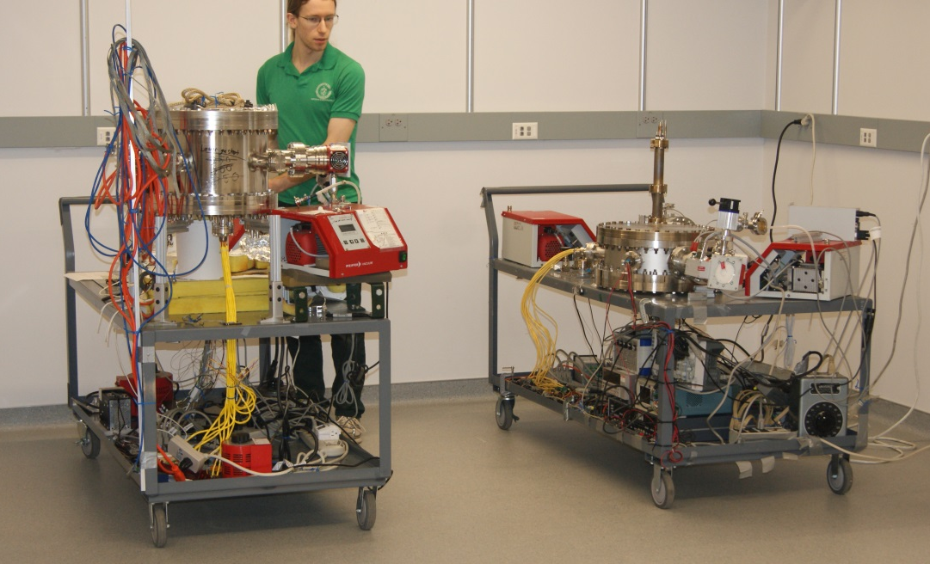
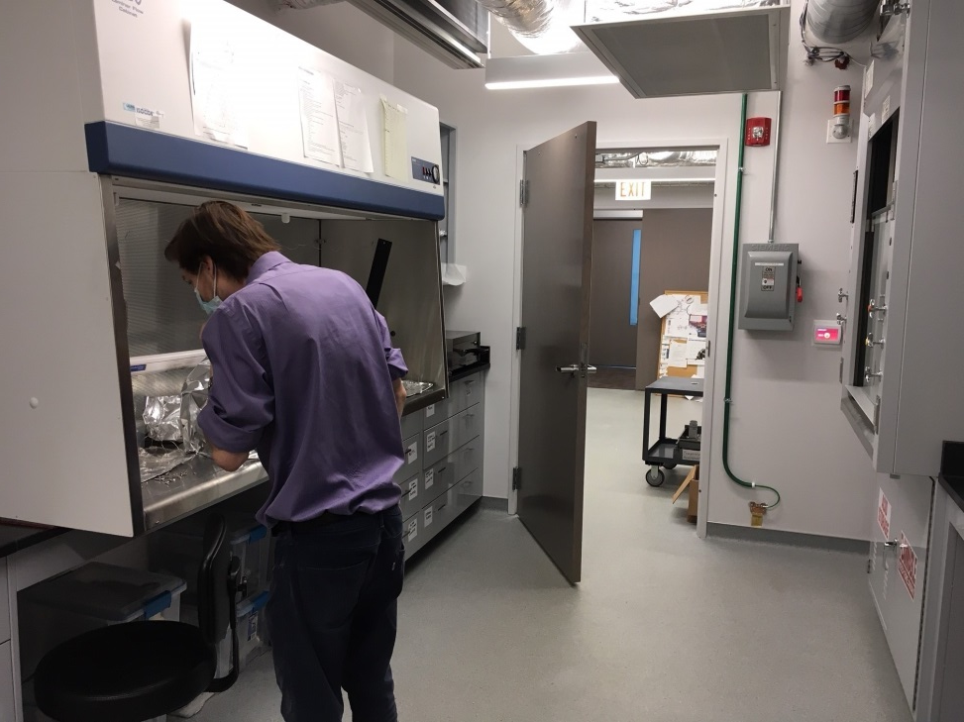
Photodetector Development
Batch production process/scaleable facility development (w. Incom NP SBIR )- replicable
Margherita I
New lab (!)
Wet lab (!!)
Margherita II (improved)

Slide 17
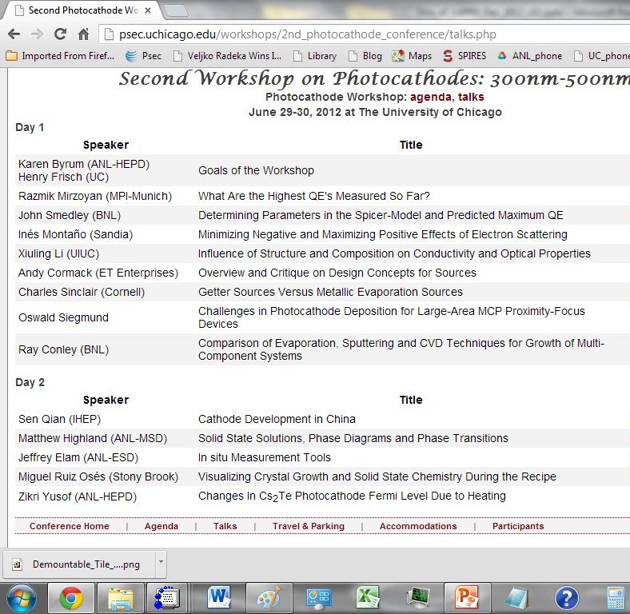
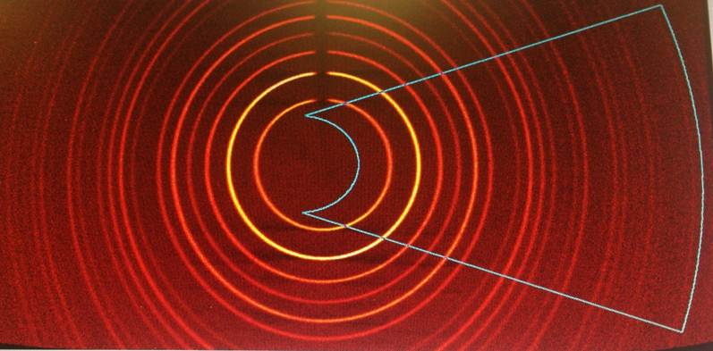
Photodetector Development
5: Theory-based photocathodes (w. RMD, Smedley, Attenkofer ; Luca Cultrera)
K2CsSb powder diffraction of RMD cathode material taken at UC
Agenda of 2nd cathode workshop at UC
Collaboration with BNL and RMD, and also Cornell, on `theory-based’ cathodes and workshops led to: a) ties to the cathode community , and the in-situ initiative

Slide 18
Photodetector Development
In-situ photocathode synthesis (Springer, Sinclair)
Idea is to emulate RCA/Burle PMT production
Steps:
Coat (NiCr/Cu) border and electrode fingers on window
Pre-deposit a 10nm Antimony (Sb) layer overlapping border and fingers
Seal window to tile base with a bake-out/sealing thermal cycle: dual vacuum- 1) tile and 2) vessel
Bring vessel to air, leaving sealed tile on its pump
Introduce alkali vapor through tubulation while measuring QE of (exposed) window and resistance of MCP plates and stack
Pinch off tubulation when photocathode is done
We have used a `GodParent Committee’ (CDF) to guide us: Klaus Attenkofer (BNL), Luca Cultrera (Cornell), Jeff Elam (ANL), Mike Pellin (ANL), Matt Poelker (JLAB), Charlie Sinclair (Cornell, SLAC), John Smedley (BNL),Gary Varner (Hawaii, Chair)

Slide 19
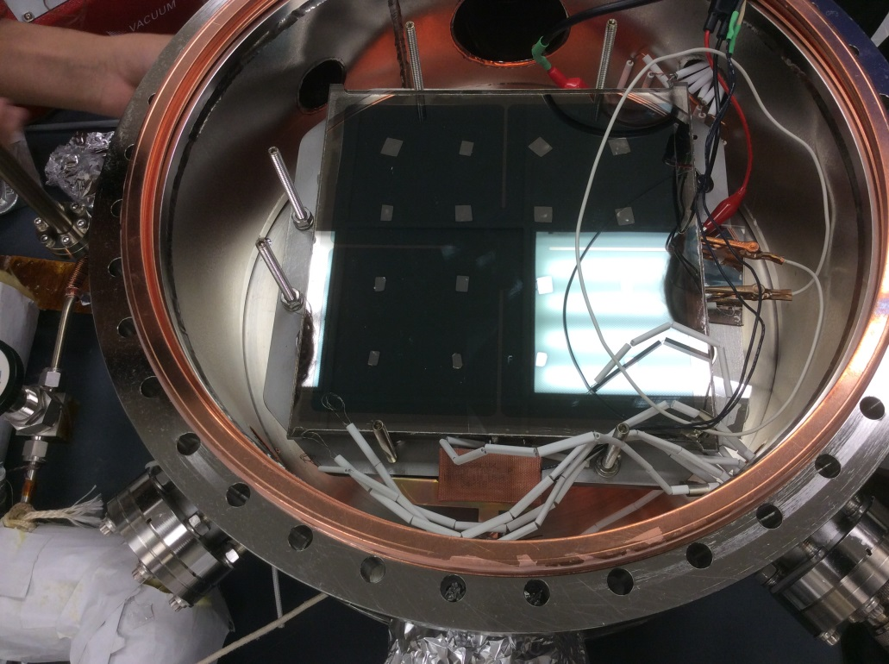
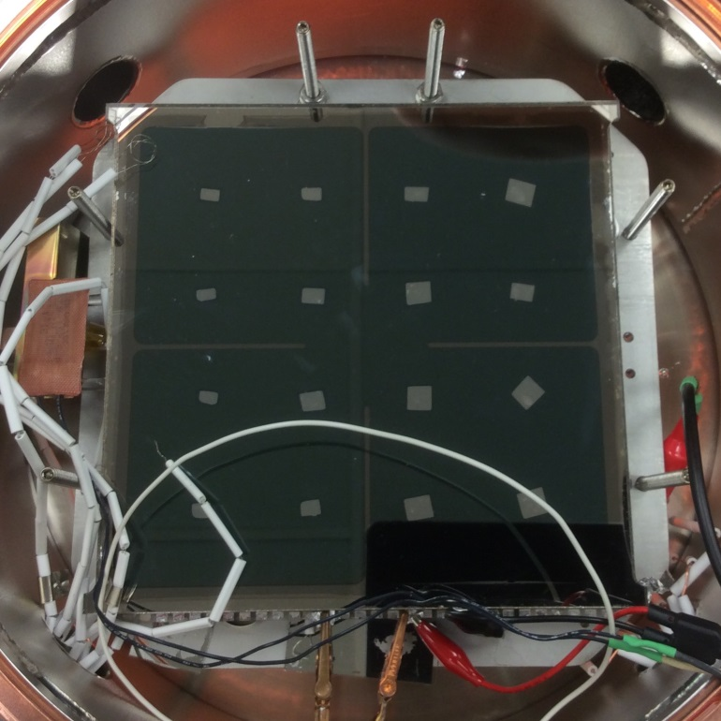
Photodetector Development
In-situ photocathode synthesis (Springer, Sinclair)
GPs recommended doing only Cs first
Expect uniformity to be determined by thickness of Sb layer- should very uniform

Slide 20
Photodetector Development
In-situ photocathode synthesis (Springer, Sinclair)
Successes
We have learned how to manipulatethe movement of Cs around inside the system (remember we’re beginners)
Vapor reached everywhere on the window- uniform
Chemical reaction between Cs and Sb seems to be `self-limiting’ as expected- reaches a defined end-point
QE seems to be consistent with reasonable Cs3Sb cathode, but we cannot measure it precisely yet (subtlety I missed completely- can explain if asked in questions)
MCP plates are not permanently damaged/changed
Problems discovered:
MCP plates go to lower resistance (recoverable in air)
We had exposed Cu on the window- Indium wet it. Cs interacts with Indium to form a black powder.
Resistive buttons interact with Cs (new buttons yesterday)
Measuring QE is made more difficult by our internal HV divider (can’t get current across first gap directly).

Slide 21
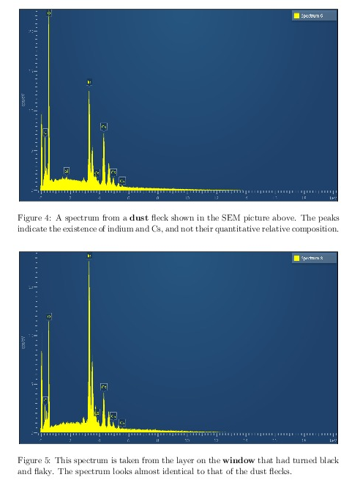
In-Situ Cathode Synthesis Trials in Progress
E.g. The black powder from cesiating excess indium
Sealing surface on top of sidewall
Black powder
Evan (FIB/SEM) and Andrey (SEM)
NiCr anode
Analysis showing it’s a CsIn compound
(New windows will have no exposed Cu- few weeks away)

Slide 22
Electronics
Eric Oberla’s Ph.D thesis; Mircea Bogdan, John Podczerwinski, Horatio Li, Evan Angelico;
John Porter of Sandia funded PSEC4A Mosis run; Jonathan Eisch, Miles Lucas,, .. (ANNIE)
We have a new Central Card- Mircea Bogdan
Now 64 bds (1920 channels)
Now +SFP and VME
We (Porter, Sandia) have the new PSEC4A ASIC
Now +SFP and VME

Slide 23
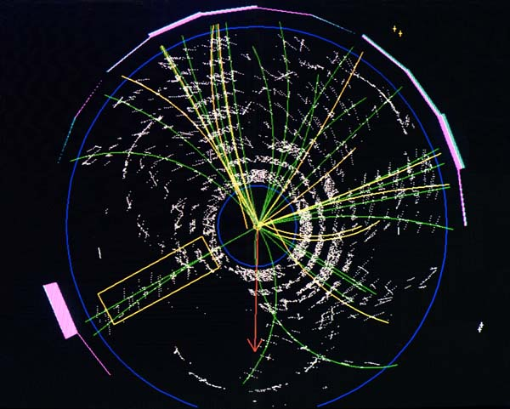
The Original Motivation: I GotTired of @#$! Jets
Goals: 1) Measure all 4-vectors– can reconstruct masses
2) assign tracks to vertices (e.g. CMS forward Ecal.)
3) vertex photons at colliders (4-vectors!) ;
Aside: Use photons (and electrons) as reference time- i.e. do differential timing of tracks from the same vertex to eliminate external clock jitter
CDF top quark event
See Aspen talk, Jan 2003 (hep.uchicago.edu/~frisch

Slide 24
Three Timing Cases to Distinguish
The factors limiting the ultimate timing resolution are different in each of the following cases:
Single optical photons (Scintillation or Cherenkov)
Charged Particles above Cherenkov Threshold(H2O,glass)
Electromagnetic showers from High Energy photons
I will focus on #2 and #3, relativistic charged particles and high energy photons, for which psec or sub-psec time resolutions I believe are plausible given certain detection criteria are met.
Note: In what follows I treat time and space distances in the same units, i.e. c=1, and 1 psec =300 microns; 1 nsec =1000 psec; 1 nsec =1 foot

Slide 25
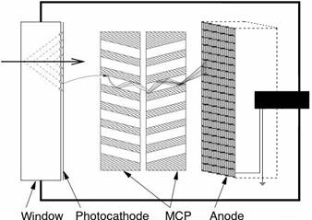
Criteria for Sub-Psec Timing-1
Fast Source: A psec source in time-space of many photons in a time-space interval (example: Cherenkov light from a charged particle traversing a radiator or the entrance window of a photodetector );
e, mu, pi, K, p,…
Cherenkov photons
( Or early in an electromagnetic shower such as in a pre-radiator or EM calorimeter ( separate discussion));

Slide 26
Criteria for Sub-Psec Timing-2
Psec-level pixel size (example: 10-20 micron pores in an MCP plate)
e, mu, pi, K, p,…
10-20 micron pore

Slide 27
Criteria for Sub-Psec Timing-3
High gain: The gain has to be high enough that a single photon triggers, i.e. the first photon ‘in’ determines the leading edge of the pulse and consequently the timing.
N.B. NOT 1/sqrt(N)
e, mu, pi, K, p,…
Amplification section: Gain-bandwidth, Signal-to-Noise, Power, Cost (eg: two-stages of MgO MCPs give gain >10⁷)

Slide 28
Signal-to-Noise, Rise-time Dependences
Long discussions at UC/ANL /France workshops of dependence on analog bandwidth, gain, noise, digitization methods, etc. ;
Answer (S. Ritt) is that at the level of present performance, using waveform sampling, the achievable time resolution is well-described by three parameters: 1) analog band-width (aka rise-time); 2) signal-to-noise; and 3) the sampling rate (assuming sufficient number of bits not to limit).
Show Stefan Ritt’s Rule-of-Thumb. For a sampling rate proportional to analog bandwidth it’s only 2 parameters.

Slide 29
Breaking the 1-Psec Barrier?
Stefan Ritt (PSI) table from 2nd Chicago Photocathode Workshop (annotated) (see psec.uchicago/edu/library)
Signal Noise Sampling Bandwidth Resolution
!
LAPPD: 1V
0.7 mv
15 GS/sec
1.5 GHz
?
??
Before 100 fsec something else will surely bite us, but still…

Slide 30
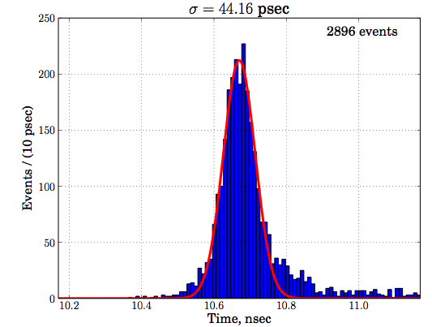
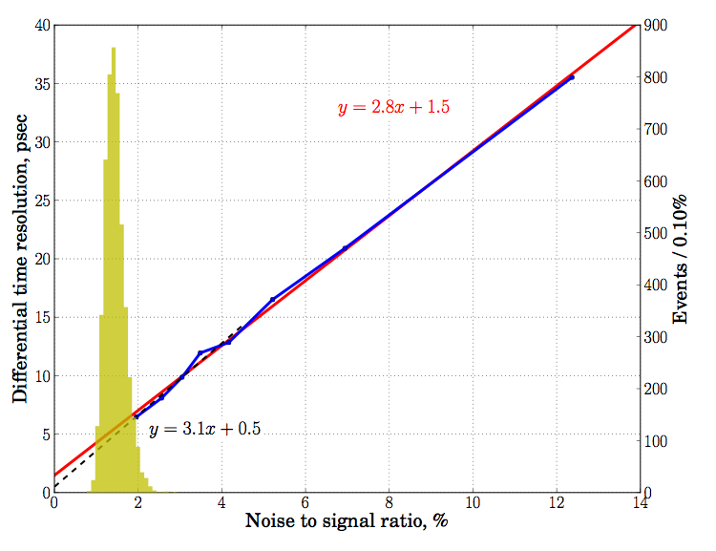
Present (now old) Time Resolution
Single Photo-electron
PSEC4 Waveform sampling
Sigma=44 psec
Differential Time Resolution
Large signal Limit
Oscilloscope Readout
Black line is y=3.1x+0.5 (ps)
Red line is y=2.8x +1.5 (ps)
Where the constant term represents the large S/N limit (0.5-1.5 ps)
Highly non-optimized system (!)- could do much better

Slide 31
Timing res. agrees with MC
< 6 psec
Time resolution on 2 ends of 8”-anode strip vs (S/N)⁻¹ in psec (pair of 8” MCP’s)
Laser spot
size
M. Wetstein, B. Adams, A. Elagin, R. Obaid, A. Vostrikov, …

Slide 32
Next round of big collider detectors
Opinion, pure and simple (why not)
Should measure 4-vectors of all tracks up to (say ) P_{T}= 25 GeV using ultra-fast TOF
Should vertex all particles using ultra-fast TOF, including photons
For ultra-fast TOF need small pixels, high gain, and lots of photons in a coherent localized pulse.

Slide 33
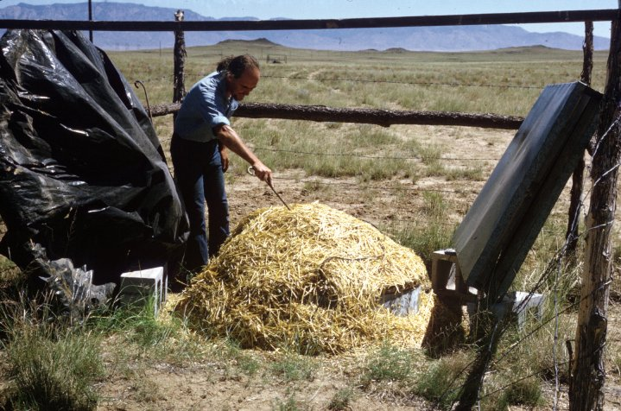
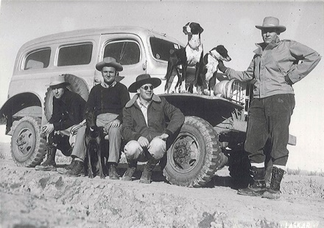
The End
John Lindsley (air-shower array pioneer, with Bruno Rossi at MIT). Volcanos in background. Very primitive and wonderful- amazing summer for a 15-yr old
Volcano ranch group car: predecessor of the WWII Navy Weapons carrier we drove out in the morning (summer, 1960)

Slide 34
Acknowledgements
H. Marsiske, H. Nicholson and the US DOE Office of Science
Staff and management at Incom and Arradiance
Colleagues and collaborators at ANL , SSL, and Hawaii
Others in the field of fast-timing , with special thanks to T. Ohshima and J. Vavra; and waveform sampling, with special thanks to E. Delagnes, J.F.-Genat, S. Ritt, and G. Varner
This work supported by U. S. Department of Energy, Office of Science, Office of Basic Energy Sciences and Offices of High Energy Physics and Nuclear Physics under contracts DE-SC0008172 and DE-SC0015367; the National Science Foundation under grant PHY-1066014; and the Physical Sciences Division of the University of Chicago.

Slide 35
Backup Slides

Slide 36
Goals- 1) huge liquid tracking detectors
Eric Oberla’s PhD thesis demonstration of track reconstruction in water- one mirror bounce
Evan Angelico’s simulation of higher mirror/cathode geometry and longer path lengths for dispersion studies- also Fermilab testbeam. Hits on a fully silvered sphere- 20 track jet toward lower left. (M/C=∞)

Slide 37
Photodetector Development
Joe Gregar (master glassblower Argonne) and Andrey
Ceramic tile bases from 4 vendors
Second Margherita for ceramic in our brand-new lab; new wet lab (!)

Slide 38
A Plea
As money gets tight we naturally pull back from risk and disruptive technologies. However the big gains in our exploratory capabilities have come from new things- often not easy- e.g. the TPC and silicon vertex detectors (I was on a godparent committee that approved Aldo Menzione’s for CDF). We should aim for ‘a portfolio’ of risk’– judiciously and thoughtfully chosen; but we should fight the shutting down either new initiatives or career paths for young physicists interested in new ideas.
(N.B. not a plea for my program per se- much broader and more important to the future of US basic science)

