Slide 1
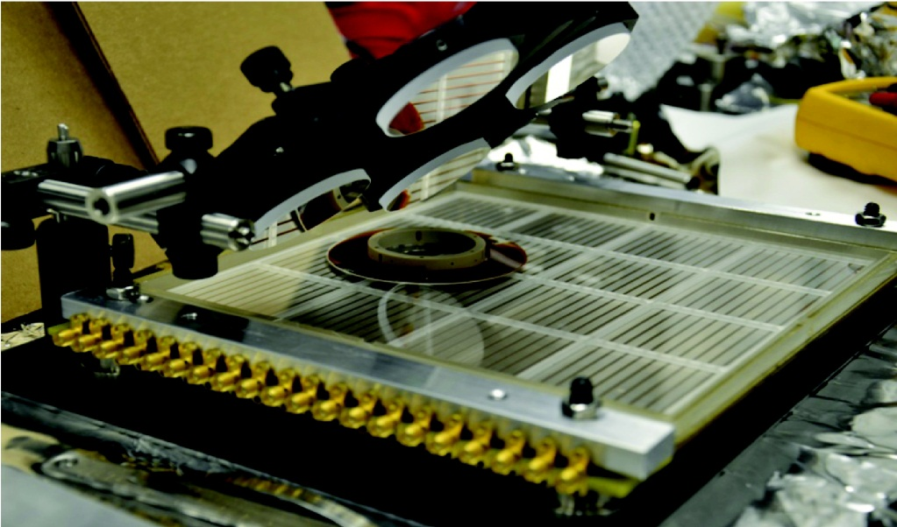
The University of Chicago PSEC Group Goals, Status, and Requests
Andrey Elagin, Henry Frisch, Carla Grosso-Pilcher, Mary Heintz, Rich Northrop,
Eric Oberla, Matt Wetstein; Brooke Adams, SiYang Ling , Eric Spieglan (undergrads)
Enrico Fermi Institute and Physics Department
University of Chicago

Slide 2
The Large-Area MCP-PMT
A Transformational Technology
No competition in time resolution, gain-bandwidth, number of pixels per area, noise
No competition in scalability to large areas
Intrinsically simple and components are cheap
Millions (almost a billion) of pixels per m² each with psec time resolution opens up opportunities that have never been considered.
WE HAVE FOUND NO SHOW-STOPPERS AND THERE IS NO COMPETITION IN PERFORMANCE
However it is not easy…we have both successes & challenges

Slide 3
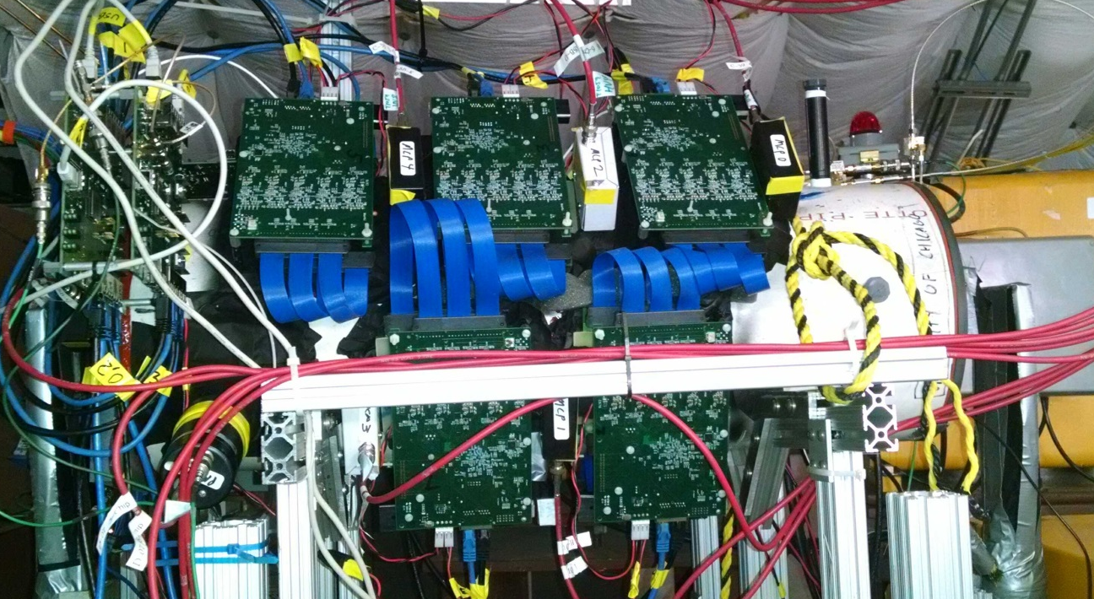
Part I. The Optical Time Projection Chamber
(great name – thanks to Howard Nicholson, who also suggested applying LAPPDs to neutrino detectors)
Ph.D Thesis of Eric Oberla- July 31. (to be a NIM paper)
The OTPC installed in the LArIAT beamline in Mcenter at Fermilab
Demonstration device for a new kind of detector- reconstructing tracks using precise measurements of light transit times and arrival locations. Related to possible uses in HEP, nuclear, and security – intended to demonstrate that one can reconstruct tracks in a simple small water volume.

Slide 4
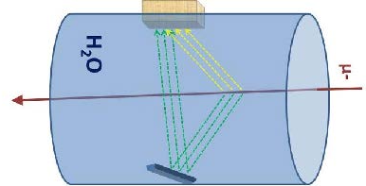
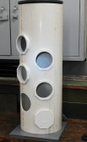
The First Optical Time Projection Chamber
Ph.D Thesis of Eric Oberla- July 31. NIM paper
11”
ReflectedCherenkov Light (1000 psec later)
Direct Cherenkov Light (prompt)
30”
Muons from LArIAT Beam
Water
radiator
Mirror for each Planacon (5)
Ports for Planacon MCP-PMTs(3 normal, 2 stereo)
equal spacing in z
Ack. Home Depot

Slide 5
The OTPC exploits 3 ideas possible only with fast (“psec”) photodetectors
‘Drift’ photons by measuring the arrival times. Measures the distance to photon origin (3D point vs the 2D arrival position)
Multiply effective photocathode area x QE by using mirrors. The prototype design conservatively gains a factor of 2. Exploits the ‘room’ in the time dimension.
Use 50-Ohm transmission-line readout with only half the number of electronics channels by using the ‘bounce’ of unterminated delay lines on the anode (EO)

Slide 6
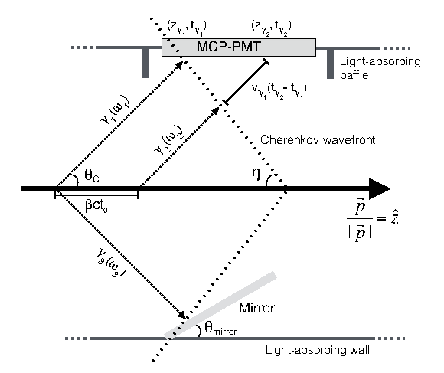
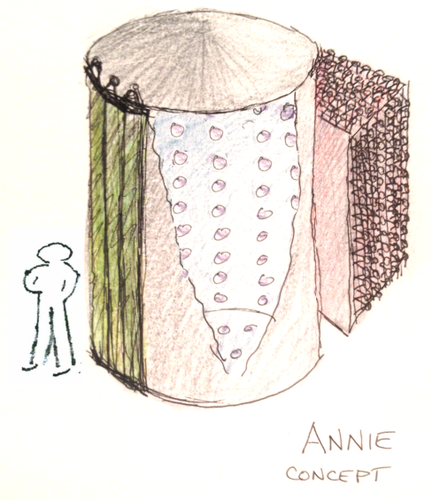
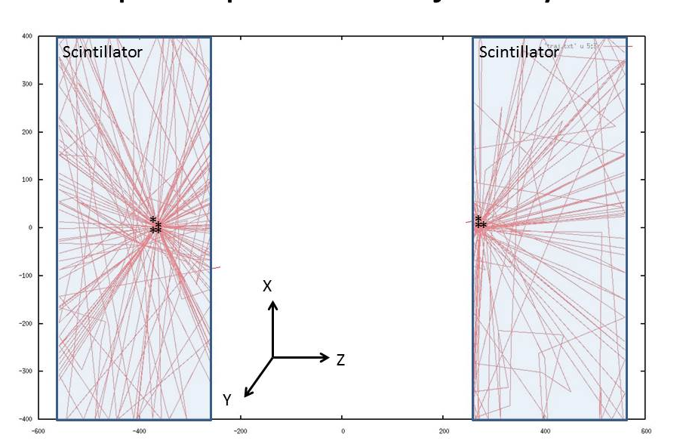
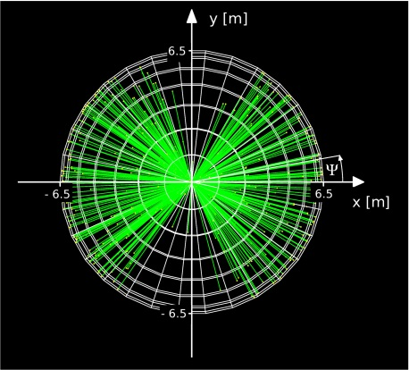
`Drifting’ Photons- exploit Cherenkov rad.
The principle of reconstructing the track position and direction is the same in HEP neutrino physics (ANNIE), nuclear neutrino-less double-beta decay (JINST paper), and TOF-PET imaging (prov. patent).
ANNIE
Double-beta decay
TOF-PET

Slide 7
Longitudinal vs Transverse Phase Space
Each photodetector, in both normal and stereo views, in the OTPC prototype has a corresponding flat mirror that reflects the light going diametrically opposite back onto the detector. Photons can arrive at the same point but are distinguishable by the difference in arrival times. This extra ‘room’ in phase space:
Economically doubles the effective photocathode area (mirrors are much cheaper than tubes);
Measures points on the track via the difference in the arrival times of direct and reflected photons (one gets earlier and the other later for transverse displacements)
May allow some clever designs for large detectors by exploiting the presence of both longitudinal (time) and transverse (position at the photocathodes) phase space to increase coverage more than just twice, and to cover less simple geometries (emittance manipulations like those in accelerators).

Slide 8
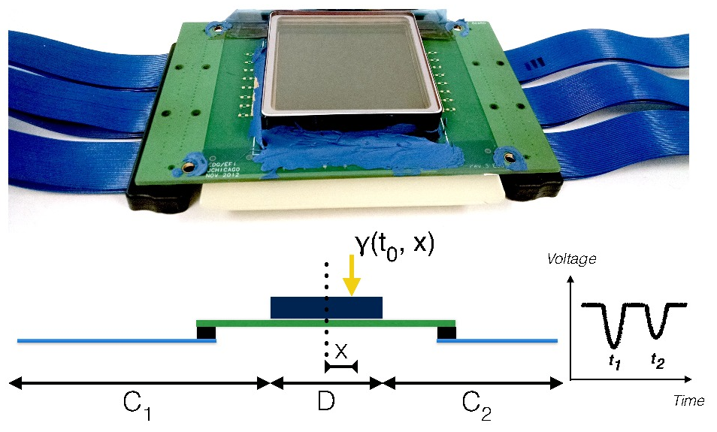
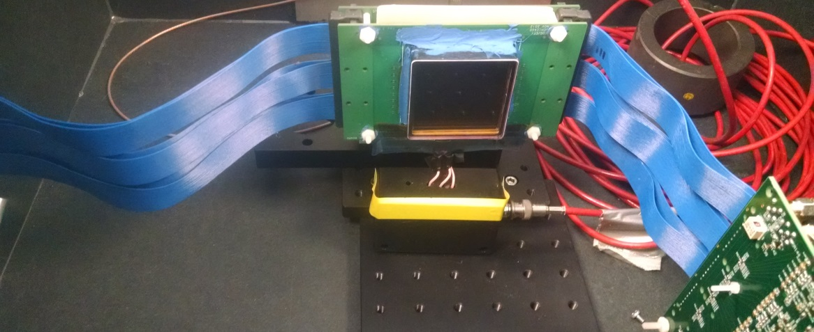
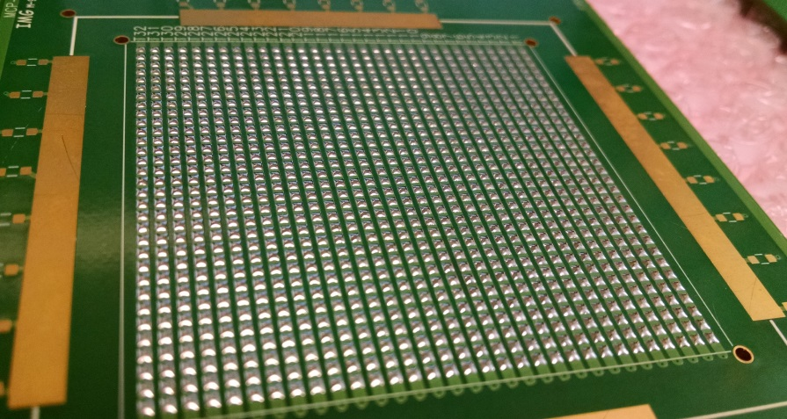
Exploiting the GHz Transmission Line Anode
Eric Oberla
1 end of 50 Ohm TL is unterminated stub
This end read out by PSEC4 ASICS
which see the pulses from both ends of the TL on the same channel- do the autocorrelation read out by PSEC4 ASICS
unterminated stub
PSEC4 ASICS
1024 Planacon pads to 30 TLs

Slide 9
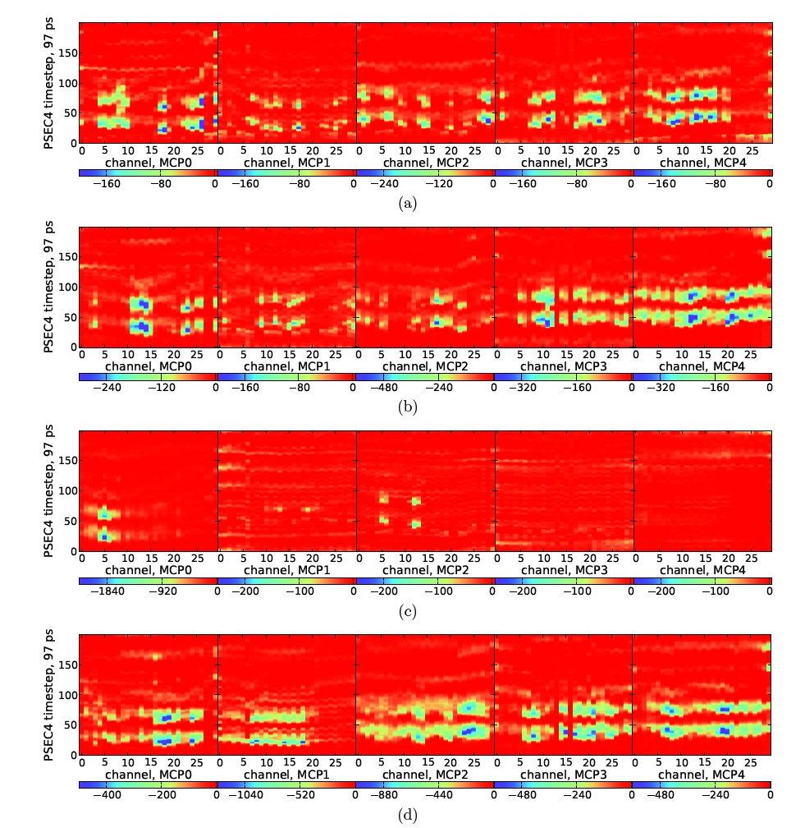
We see tracks in the water. `Typical Events’
N1
S1
N2
S2
N3
Through
Front-back Trigger
Time
Front-back Trigger
Time
Showering?
Front-only Trigger
Time
Big splat (?)
Front-only Trigger
Through
Time
Front
Back
Z position along OTPC
Note: this is pedestal-subtracted raw data . Scale is 0 to -3000 counts
Eric Oberla

Slide 10
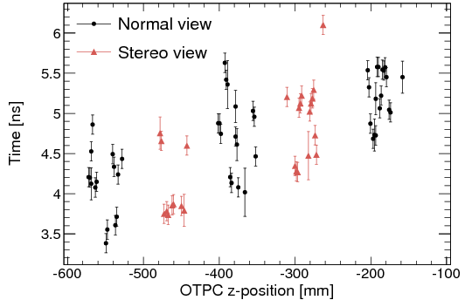
Preliminary Analysis –Tracks
Eric Oberla
4”
1 nsec
Front
Back

Slide 11
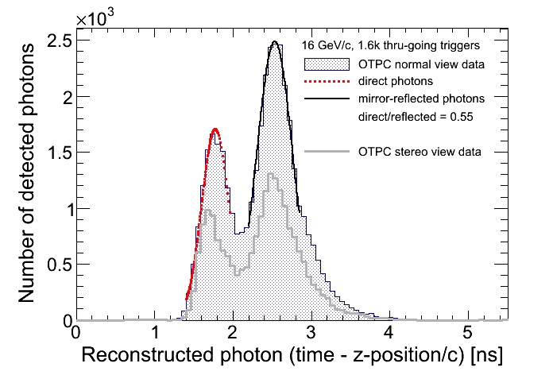
Resolving the Direct and Reflected Photons
Eric Oberla
1 nsec
Normal
Stereo

Slide 12
Preliminary Conclusions
These data were taken May 19- Eric has written the analysis programs between then and now, so all is preliminary
The hit-finding efficiency is >=75% of predicted- a victory. The loss is consistent with the deficiency seen in the direct view, consistent with light cut off by the baffle of the MCP-PMT housing (i.e. fixable).
It looks nice. The Demountable LAPPDTM data have ~10X the gain of these Planacons, and should work at least as well over 16X the area/photodetector.
Eric has done a remarkable job- he built the detector basically single-handedly. Detector development makes for good students!* Ph.D thesis and NIM paper next.
*(Steinberger’s question at CERN-
Why do Americans build such lousy detectors and have such good students?)

Slide 13
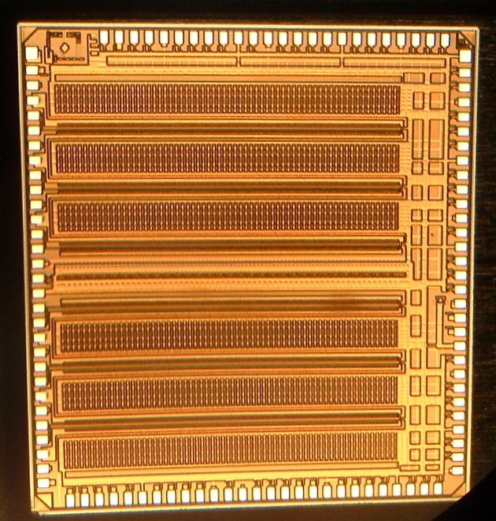
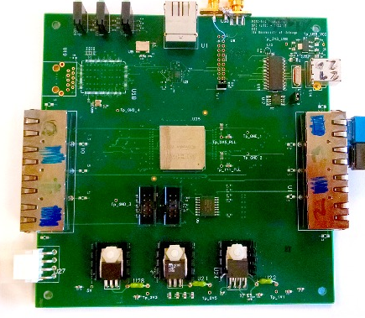
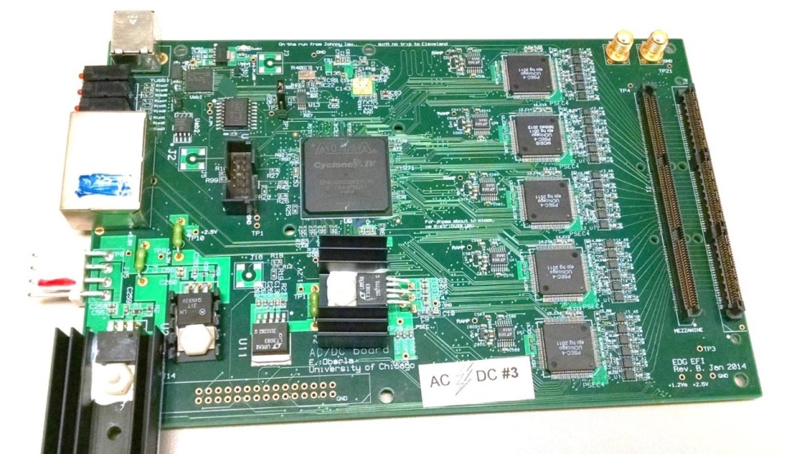

Part II. UC Electronics and Readout Systems
PSEC-4 ASIC
Central Card (4-ACDC;120ch)
30-Channel ACDC Card (5 PSEC-4)
180-channel OTPC system

Slide 14
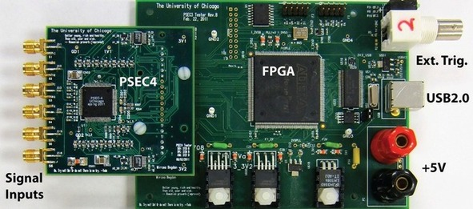
PSEC4 evaluation board
6-channel, 1.5 GHz, 10-15 GSa/s evaluation module
USB 2.0 / powered over USB
For best results, put in an RF box
Motherboard designed by M. Bodgan (EFI/eshop)
Eric slide (mostly)

Slide 15
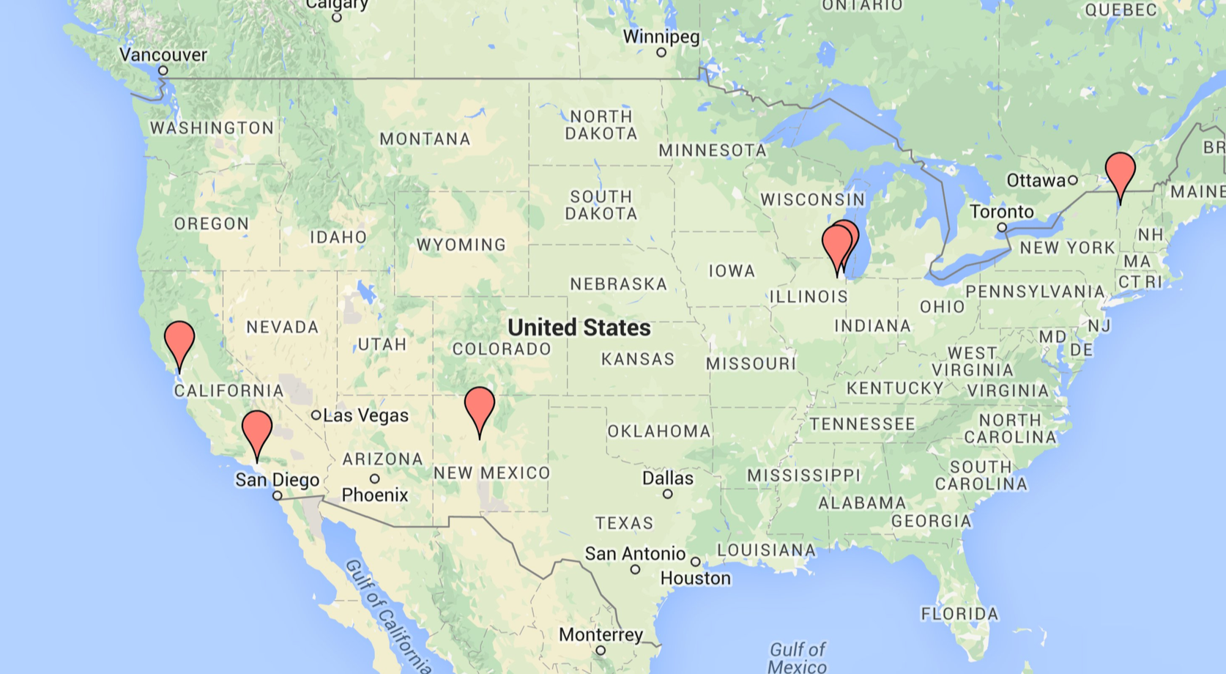
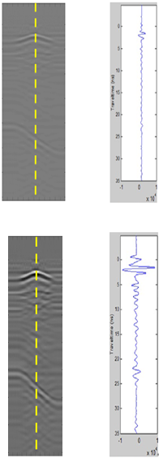
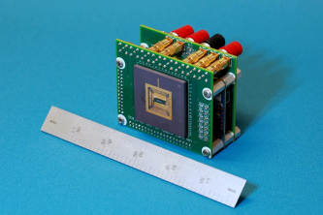
PSEC4 evaluation board
Recent additions: Iowa State, LLNL, … (5 new bds by Sandia)
U. Vermont :: ground penetrating radar studies for ‘real-time’ civil infrastructure analysis
Sandia Nat’l Lab: high density readout for fast x-ray diodes
Map by Eric O.

Slide 16
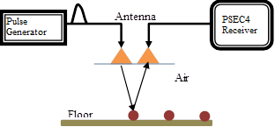
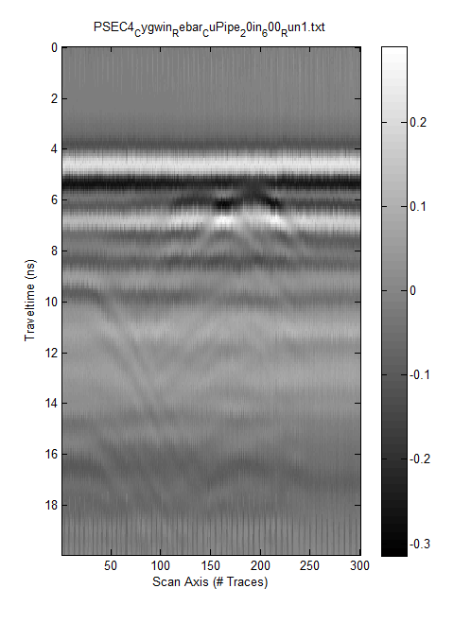
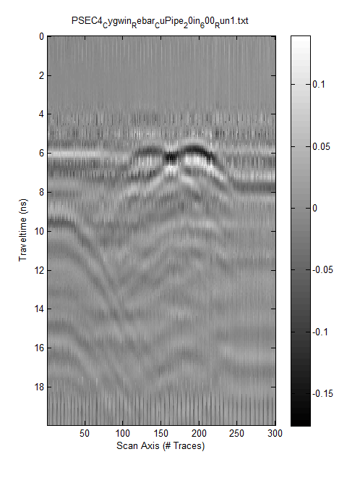
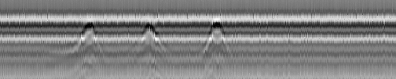
Ground penetrating radar: Development of a High Speed UWB GPR for Rebar Detection
Advantages in cost, size, power, scalability
Example of PSEC4 Adoption for Road and Bridge Infrastructure: D. Huston’s GPR group at Vermont
Operate at road speeds (60 mph)
Capture and process real-time data
Multi-channel
  Physical coverage across width of roadway
Meet or exceed FCC mask requirements
  FCC 02-48 compliant
Compact, modular design
Rebar
Copper pipe
Tests using metal bar as a reflection target using the WFS-ASIC system. The goal is to be able to measure reflections from subsurface objects, such as steel reinforcing in concrete and buried utilities.
E. Oberla slide (mostly)

Slide 17
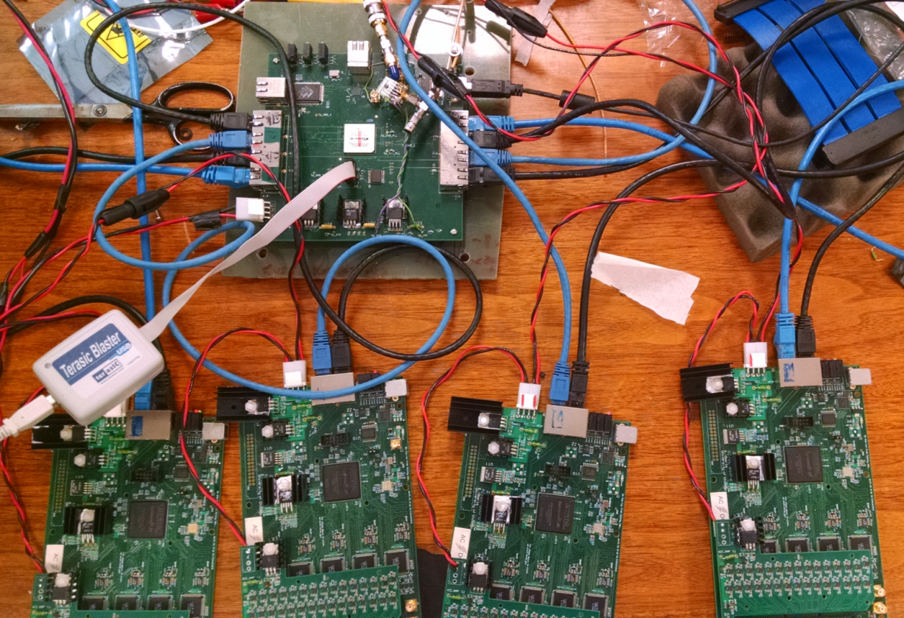
Multichannel systems
60-channel Demountable at the APS Laser Lab
( ANL X-ray Science Division)- dismantled
180-channel self-triggered OTPC at Fermilab
Current Central Card supports 240 channels
Central Cards can be `daisy-chained’ for 480 …

Slide 18
Working on Gen-II Central Card
Design by Mircea Bogdan on Watchman funds: reuses blocks from Wah’s JPARC and other working boards by Mircea
Higher-speed and more options for readout:- USB, Ethernet, & 6Gbps/fiber QSFP+;
Can handle 8 ACDC cards for a total of 240 channels per module (twice 1st Gen)- multiple modules can be daisy-chained;
Expanded system, trigger, signal interfaces for flexibility in use:
  one RJ45 connector with LVDS for system integration;
  8 RJ45 connectors with LVDS for Front End Cards (FE)communication.
  SMA inputs to FPGA I/O on front-panel for trigger or optional clock input
  several other SMA inputs on board for app-specific signals
  inputs/outputs from FPGA
Implemented in a widely-used standard: VME32/64X

Slide 19
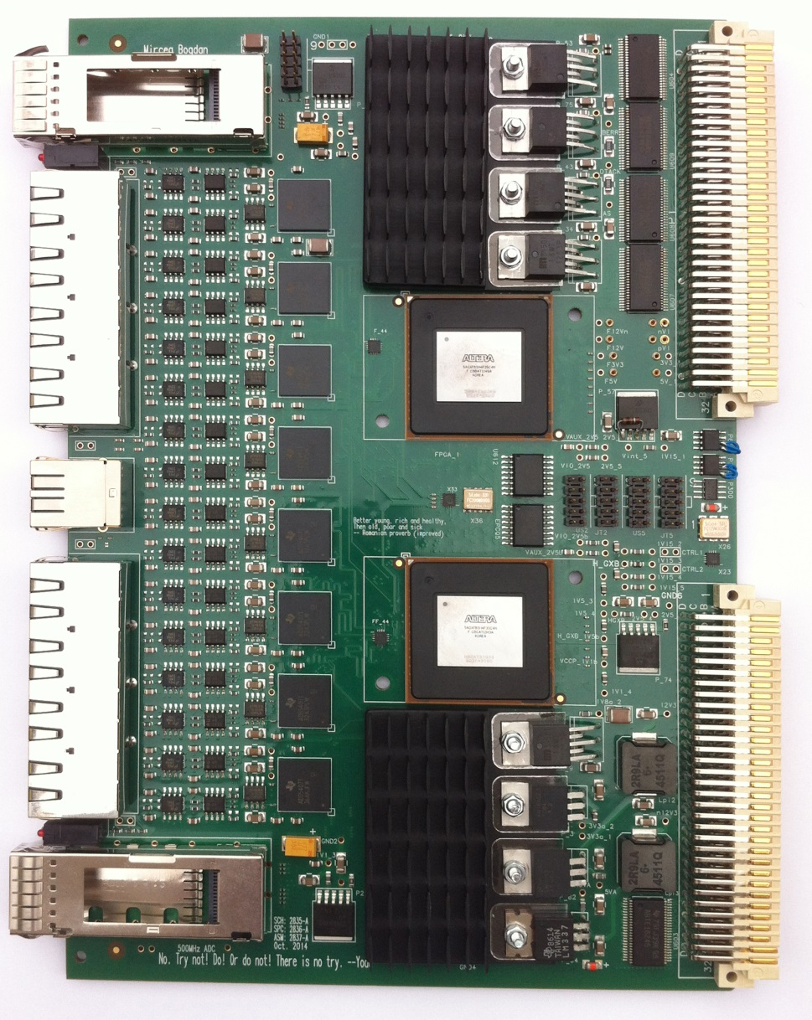
Gen-II Central Card (Mircea Bogdan)
A 500 MHz sampling VME board by Mircea for KOTO - many of the blocks/components will be re-used in the Gen-II Central Card

Slide 20
New PSEC-4 MOSIS Run
Although PSEC-4 has short-comings, it works well, is well-documented (long NIM paper), and can sample up to 15 GS/sec with a bandwidth of 1.6 GHz;
ASICs are not easy- decided to double-down on the investment in PSEC-4’s speed and bandwidth;
Sandia (NM) paid the NRE and bought a 2nd run from MOSIS- we piggy-backed and bought 2 lots of 40 chips for 10K$ each (standard price);
MOSIS offered us a deal of 3K$/batch (reduced from 10K) after the NRE if we bought 135K$ total; Iowa, MIT, Sandia-NM, Sandia-CA, and UC have jointly ordered it (1200 chips);
ANNIE, Nu-DOT, Sandia use in short-term--other trials of psec -(<5) resolution wave-form sampling in progress

Slide 21
Beyond PSEC-4
(See Kurtis’s talk on the Hawaii/UC coordinated effort )
Main limitation of PSEC-4 is the 256-cell buffer- Eric has gotten the self-triggering to work, so that a global trigger can come in after the signals, but it incurs deadtime and isn’t applicable to high occupancy or high rate applications
We and Gary’s group have been working on PSEC-5, a joining of the PSEC-4 sampling design with Gary’s deep buffer design, but moved from IBM to TSMC. We’ve done much of the front-end, but had to stop as the 2014 ARL funding for this task was cut.
Gary and Innosys (SLC) and us have an SBIR for PSEC-5 development- Hawaii playing the leading role;
Eric has proposed a PSEC-4A that makes minimal changes (sic) to PSEC-4 beyond adding multiple buffering of hits so that it’s deadtimeless for typical neutrino experiments (e.g. ANNIE). Attractive to me (in parallel to PSEC-5) .

Slide 22
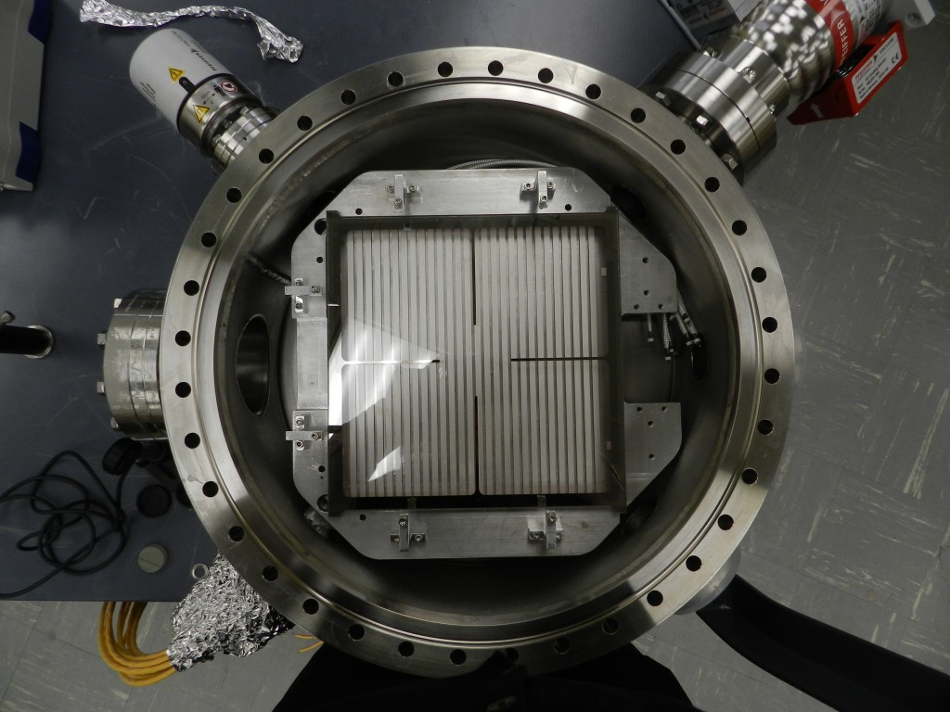
Part III. Advanced Designs and Fabrication
IMO all the performance parameters and single steps have been proven (and published) by the collaboration; the main problems we face are related to manufacturability.

Slide 23
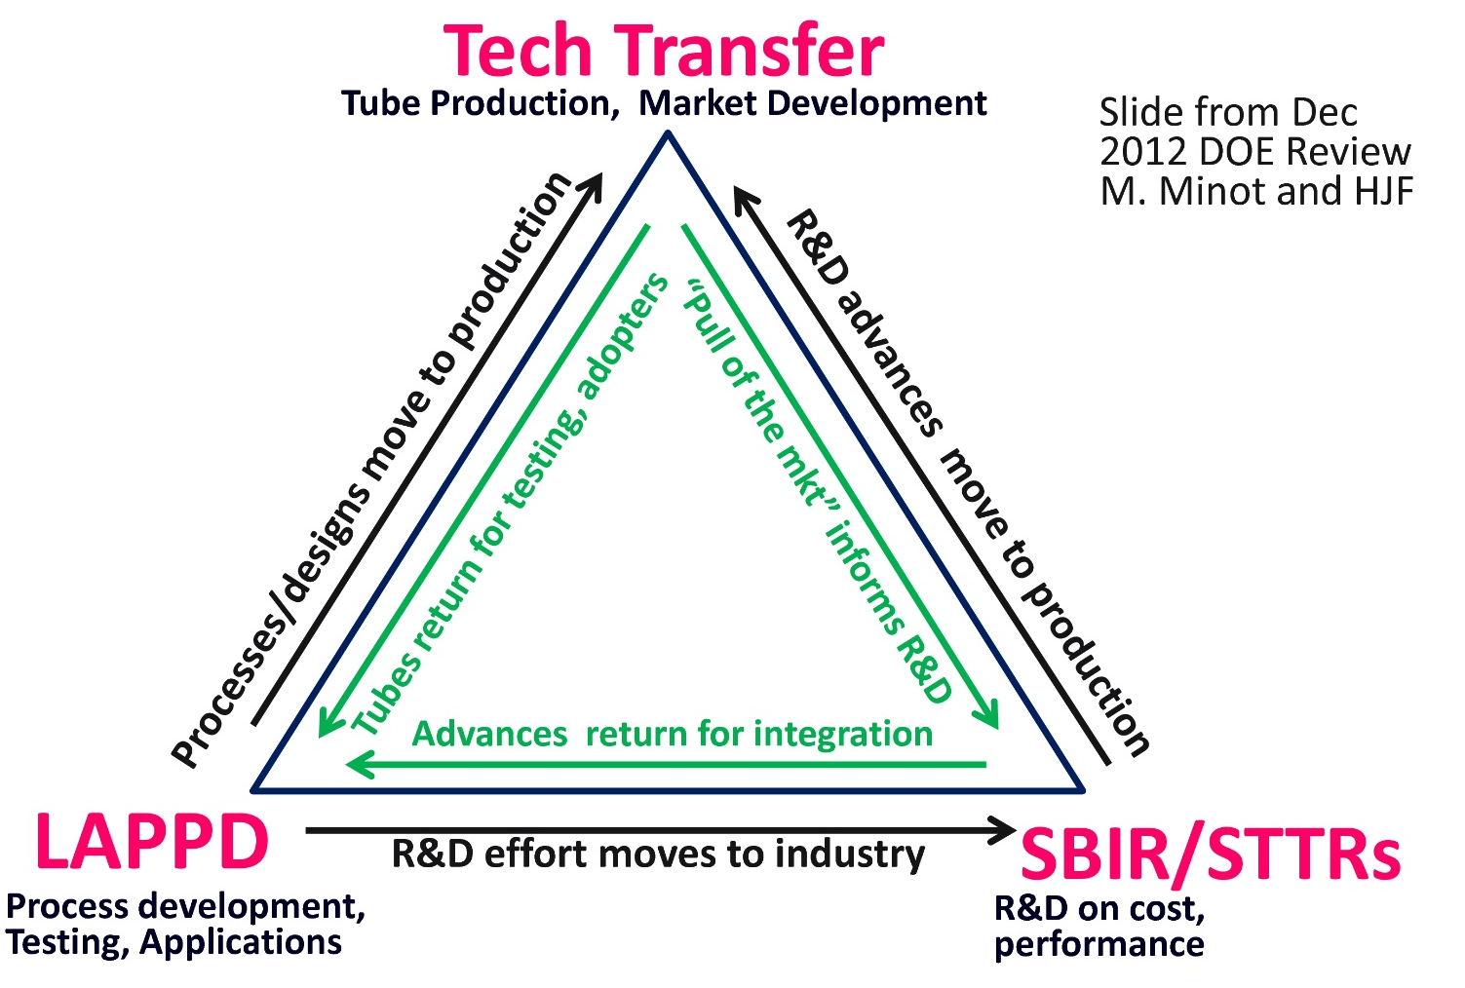
Rationale for Gen-II
For LAPPDTMs to be useful to the HEP, Nuclear, and security communities they have to be affordable- IMO at or less than a Planacon. All the cost at present is in the fabrication- the packaging components are cheap. Need to look ahead to competition.

Slide 24
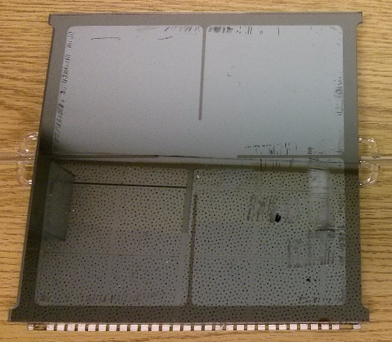
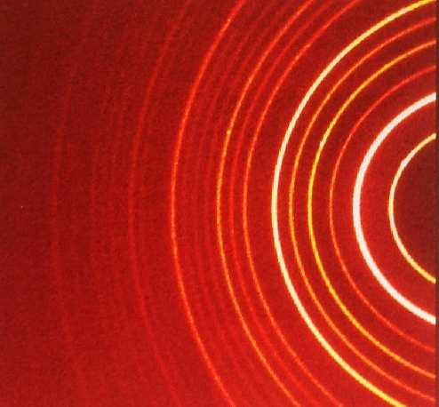
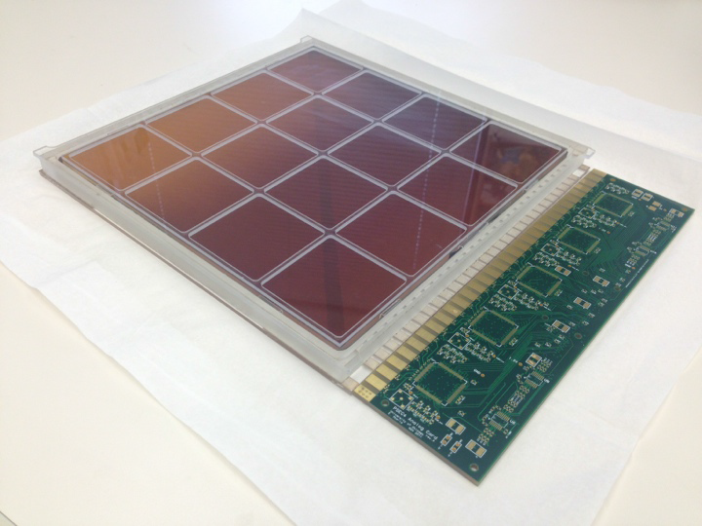
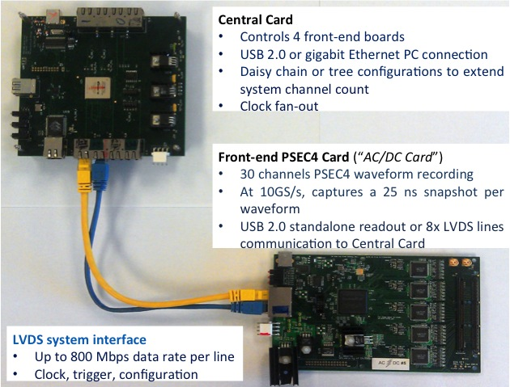
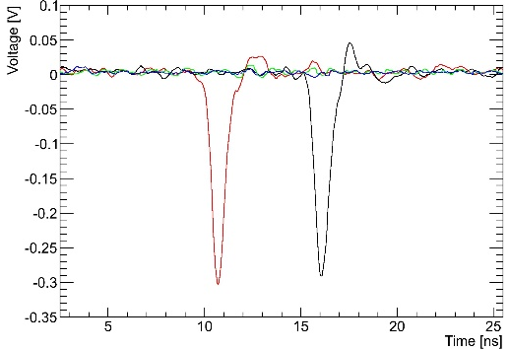
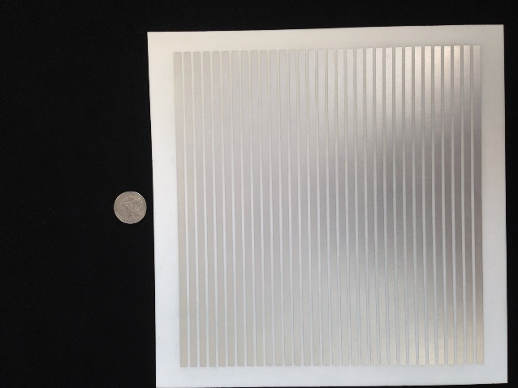
Toward an Affordable Gen-II Design
Gen-I LAPPDTM
Flat Top Seal
High QE Photocathode
(patent with BNL, RMD)
Performance:
HV and signal
(NIM-A,RSI papers, patent)
Psec Electronics system
(NIM-A paper)
High-BW ceramic pkg

Slide 25
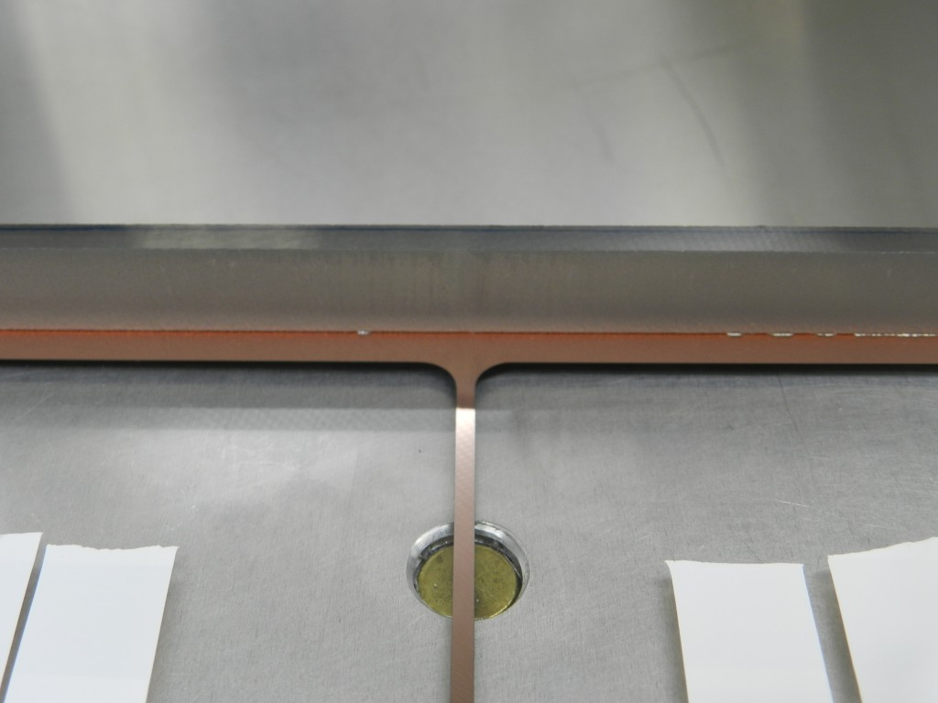
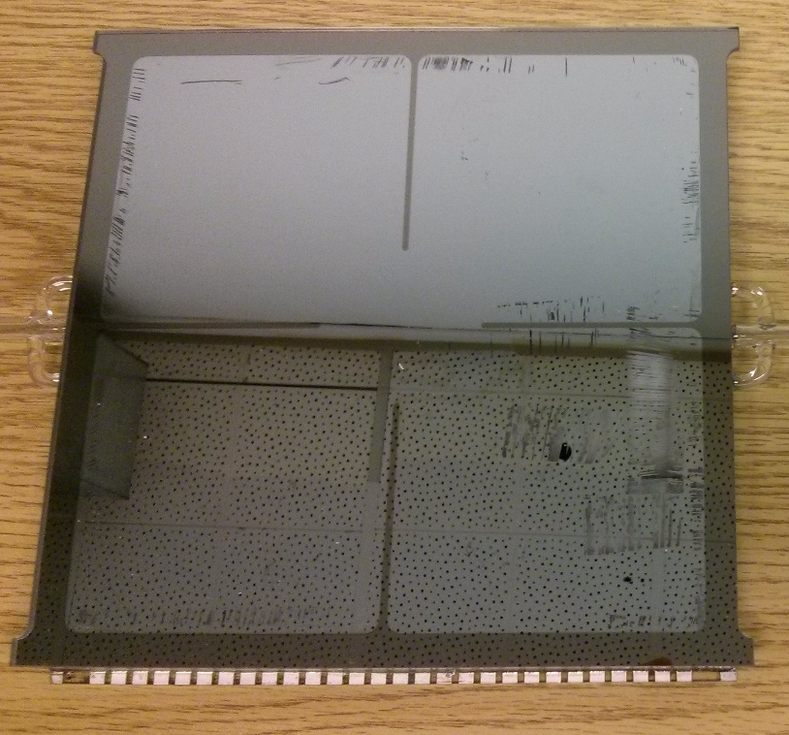
Flat Indium Solder Seal
Sidewall seal seen through window
Andrey Elagin, Eric Spieglan, Matt Wetstein
Sealed LAPPDTM
No machining of glass groove
No bulk flow if not level over 8”
No manipulation of window
HOWEVER
Easiest with PMT-like cathode fabrication (‘in situ’)
We do not completely understand the metallurgy yet

Slide 26
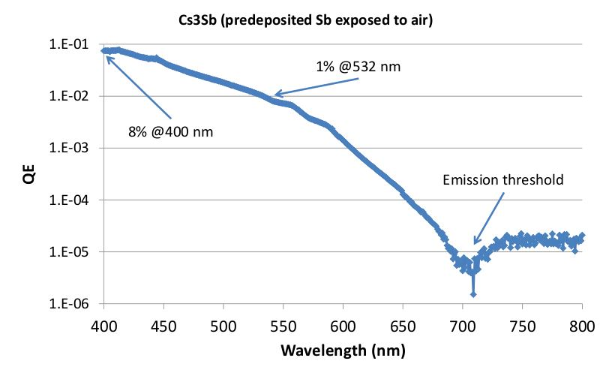
Advanced Photocathode R&D
I. With RMD and BNL (SBIR) we have synthesized the stoichiometric compound K2Cs Sb.
Powder diffraction Xray taken with new UC Bruker- 15nm nanocrystals of >99% pure K2CsSb. Currently learning to sputter it. New kind of bulk material- semiconductor.
II. PMT-process production of photocathodes (with Luca Cultrera, Ivan Bazarov, Cornell)
  Exposure of predeposited Sb layer to Cs-K2 vapor makes a good K2CsSb cathode (Singer, Sinclair)
  Cultrera has shown that air-exposed Sb produces a competitive Cs3Sb photocathode.
Credit: Luca Cultrera

Slide 27
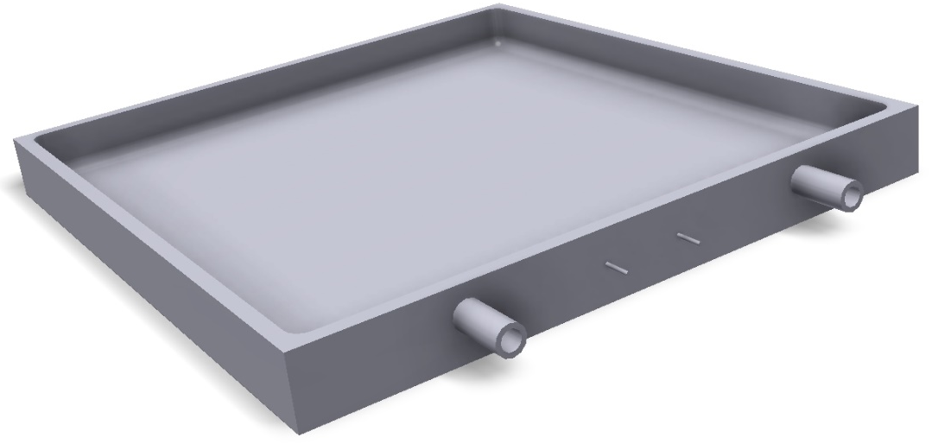
Monolithic Capacitively-Coupled Ceramic LAPPDTM
Resistive or thin Conductive inner ground layer
Green-trimmed full-fire monolithic ceramic LAPPDTM tile base assembly
2D array of pads for readout on bottom (outside) layer
UC Gen-I design uses internal HV divider with HV applied through metalized window border and anode strips that extend through the bottom frit seal for DC gd and signal outputs - no external pins
We are exploring a Gen-II ceramic design that allows pads for high-occupancy applications to solve the ‘disambiguation’ problem and that should have X3 the bandwidth, and requires no fritting. (Ceramic is also much stronger than glass) Could be used with Incom mini-SSL transfer process. In the middle of specifying for quotes- present status:
Quote Unit Price (100) NRE
Company A $314 $2150
Company B $218 $700

Slide 28
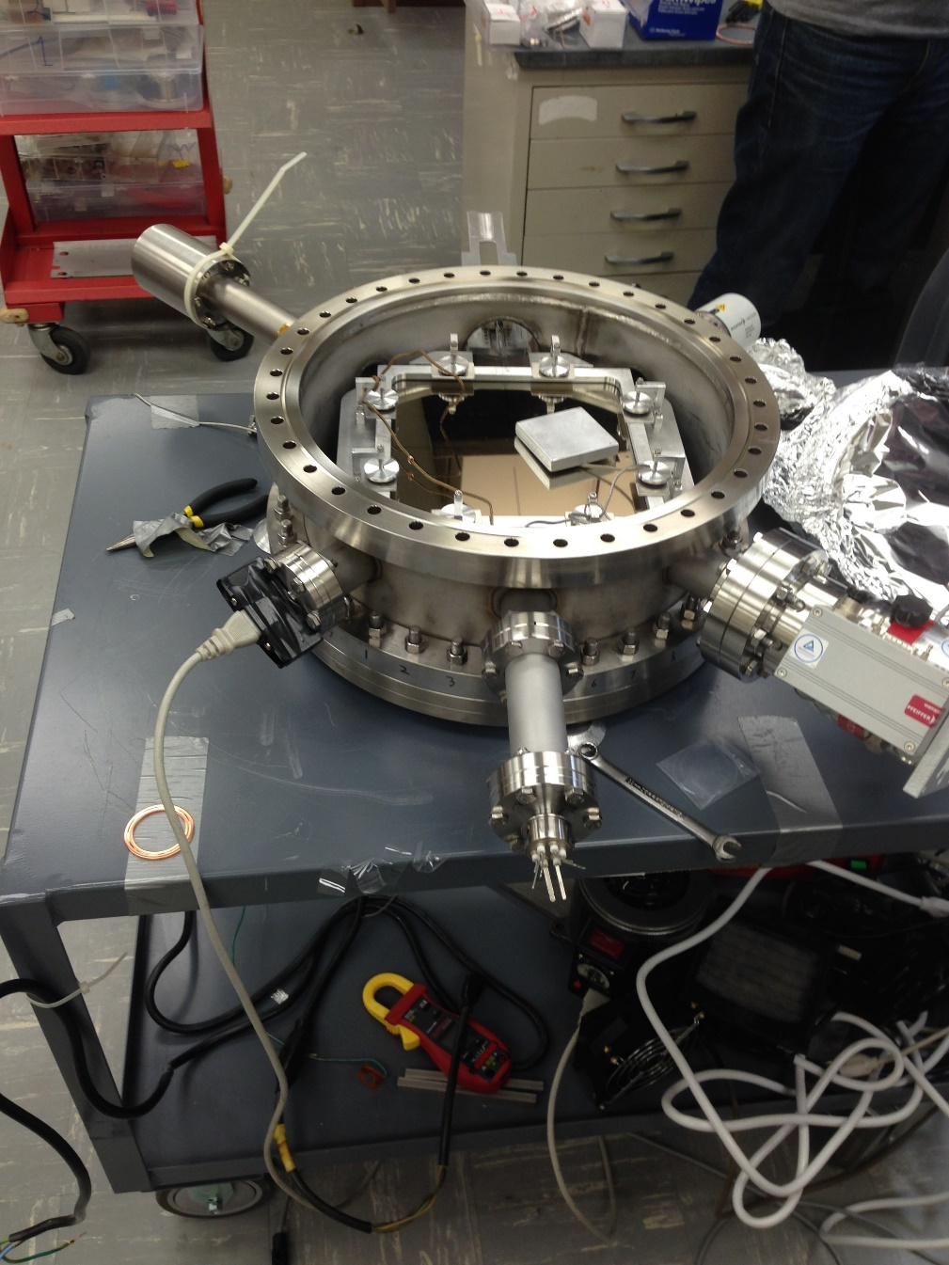
‘Ultralight’ R&D Fabrication Facility
Outer vacuum for seal process
Sealed tile (no getter this shot)
Standard 16.5” ConFlat flange
Precision load and positioning fixture for seal
Tile fixture heated (350C) by quartz lamps underneath
RGA on outer vacuum (for now)
Raspberry Pi process data logger- temperatures (10), pressures, RGA,…
Inner vacuum to tile and for bi-alkali vapor
NAIP:Arrows are messed up- don’t believe them.
Radical and risky, but scaleable, fast thermal cycle, and based on commercial PMT production process (Burle)

Slide 29
UC Needs post-2015-ARL SOW &Budget
There have been two rapid technical developments since we submitted the 2015 SOW and Budget to ARL:
  Eric has proposed PSEC-4A (deadtimeless) as an intermediate step to PSEC-5 , and available sooner;
  With ceramics vendors we are developing a design the green-trim ceramic tile base assembly and it’s surprisingly economical, higher performance, and seems viable.
We would like to ask in the near future for additional funds to do the exploratory work for each of these. We are in the middle of getting bids on the latter and Eric is deep in writing his thesis—at this point can only estimate the budgets:
Estimated Requests
PSEC-4A: 3 mo. Elec. Eng. 48K$
Ceramic LAPPDTM TBA’s: 4 iterations 24K$

Slide 30
Brief Summary
The water-based Optical Time Projection Chamber concept works nicely and the results agree with Monte-Carlo-based expectations;
PSEC-4 has been adopted by several groups and a number of others have Eval Cards; Iowa/MIT/Sandia-NM/Sandia-CA/UC have ordered 1200 more chips.
We are progressing making the glass LAPPDT^{Ms} in the Ultralight scalable tile facility . We can consistently make flat hot seals for the LAPPDTM tiles; working with Indium Corp on intermetallic issues (confidential).
Cornell has promising results on the photocathode process needed for the Ultralight facility ; separately with RMD and BNL we have synthesized the stoichimetric compounds and sputtered alkali cathodes;
We are still in early stages of developing the Gen-II ceramic Tile Base Assembly, but it looks very attractive.

Slide 31
MCP Timing Performance : B.W. Adams, A. Elagin, H. Frisch, R. Obaid,E. Oberla, A. Vostrikov, R. Wagner, J. Wang, M. Wetstein; Timing Characteristics of Large Area Picosecond Photodetectors Nucl. Inst. Meth. Phys. Res. A. , Vol. 795, pp 1-11 (tbp Sept. 2015); pub.online June 5, 2015.
Our Published PSEC Papers-p1
Fast Timing in Searches for Double Beta Decay C. Aberle, A. Elagin, H.J. Frisch, M. Wetstein, L. Winslow. Measuring Directionality in Double-Beta Decay and Neutrino Interactions with Kiloton-Scale Scintillation Detectors; JINST 9 P06012 doi:10.1088/1748-0221/9/06/ (June 2014) P06012arXiv:1307.5813
No-pin Internal HV Circuit B. W. Adams, A. Elagin, J. W. Elam, H. J. Frisch, J.-F. Genat,J. S. Gregar, A. U. Mane, M. J. Minot, R. Northrop, R. Obaid,E. Oberla, A. Vostrikov, M. Wetstein; An Internal ALD-Based High Voltage Divider and Signal Circuit for MCP-based Photodetectors}Nucl. Instr. Meth. Phys. Res. A; Vol. 780, Pages 107-113 (April 2014)
PSEC-4 Waveform Sampling Chip E. Oberla, J.-F. Genat, H. Grabas, H. Frisch, K. Nishimura, and G Varner
A 15 GSa/s, 1.5 GHz Bandwidth Waveform Digitizing ASIC;
Nucl. Instr. Meth. A735, Jan., 2014, http://dx.doi.org/10.1016/j.nima.2013.09.042; http://arxiv.org/abs/1309.4397

Slide 32
Microstrip Anode RF Performance H. Grabas, R. Obaid, E. Oberla, H. Frisch J.-F. Genat, R. Northrop, F. Tang, D. McGinnis, B. Adams, and M. Wetstein;
RF Strip-line Anodes for Psec Large-area MCP-based Photodetectors,
Nucl. Instr. Meth. A71, pp124-131, May 2013
Our Published PSEC Papers –p2
MCP Testing and Pulse Performance : B. Adams, M. Chollet, A. Elagin, A. Vostrikov, M. Wetstein, R. Obaid, and P. Webster
A Test-facility for Large-Area Microchannel Plate Detector Assemblies using a Pulse Sub-picosecond Laser;
Review of Scientific Instruments 84, 061301 (Oct. 2013)
In Preparation
The OTPC E. Oberla et al.
Performance of a Prototype Optical Time Projection Chamber; to be submitted to
Nucl. Instr. Meth. summer 2015

Slide 33
Many Thanks to:
Our Collaborators at ANL-ESD, ANL-XSD, ANL-MSD, UC-Berkeley SSL, Hawai’i, BNL and Cornell (esp. Joe Gregar, Ossy, Gary, Klaus, Bernhard, and Luca)
Staff and management at Incom, Arradiance, InnoSys, and RMD corporations (esp. Michael)
The Fermilab Mcenter Test Beam Crew and LArIAT (esp. JJ)
Others in the field of fast-timing , with special thanks to T. Ohshima and J. Vavra; and waveform sampling, (special thanks here to D. Breton, E. Delagnes, J.F.-Genat, S. Ritt, and G. Varner)
Howard Nicholson and the US DOE Office of HEP; Shawn, John, and the ARL staff
Our EFI staff (!) - Rich Northrop, Mircea Bogdan, Fukun Tang, Mary Heintz, Bob Metz, and Holly Hernandez

Slide 34

The End

Slide 35
Backup Slides

