Slide 1
History of the LAPPD Collaboration July 2009- Dec. 2012
Henry Frisch
Enrico Fermi Institute, University of Chicago
Apologia-
As in all history written by a participant, this is only my account. I’ve done my best to go back to the original documents, but apologize in advance for errors, omissions and unintended slights.
The LAPPD Collaboration of 3 national labs, 3 universities, and 3 US companies was funded in July/Aug 2009 as detector R&D by the DOE thanks to Howard Nicholson and Glenn Crawford. The Collaboration ended after 3 ½ years, followed by the transition from R&D to technology transfer.
A proposal for R&D was submitted April 2009 – the next slide listing the Collaboration was shown at a DOE visit to ANL in early May 2009*.
*Note: in hindsight, there is an error on the 2009 slide. Space Sciences Laboratory was counted as a National Laboratory; it is part of UC Berkeley, so the initial count should be 3 rather than 4 National Labs and 3 rather than 2 universities. We also worked with 6 ANL Divisions

Slide 2
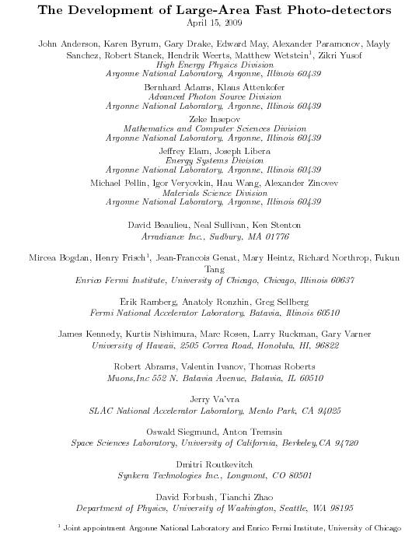
Plans to Implement This
Have formed a collaboration to do this in 3 years. 4 National Labs, 5 Divisions at Argonne, 3 companies, electronics expertise at UC and Hawaii
R&D- not for sure, but we see no show-stoppers
(2009 slide)

Slide 3
The Large-Area Psec Photo-Detector Collaboration-2010
(2010 slide)

Slide 4
Parallel Efforts on Specific Applications
.
Explicit strategy for staying on task
PET
(UC/BSD, UCB, Lyon)
Collider
(UC, ANL,Saclay.
LAPD Detector Development
Muon Cooling
Muons,Inc
(SBIR)
ANL,Arradiance,Chicago,Fermilab, Hawaii,Muons,Inc,SLAC,SSL/UCB, Synkera, U. Wash.
K->πνν
(UC(?))
Drawing Not To Scale (!)
DUSEL
(Matt, Mayly, Bob, John, ..)
Mass Spec
Security
(TBD)
All these need work- naturally tend to lag the reality of the detector development
Old Slide

Slide 5
Organization of the Collaboration
The primary institution was ANL; funding from the DOE Office of High Energy Physics was managed by the HEP Division (HEPD), with subcontracts to the universities and companies.
As Spokesperson I was offered a Joint Appointment with ANL/HEPD, with some R&D funds and a postdoc position (I hired Matt)- a natural alliance as UC manages ANL. I reported to Harry Weerts, the Director of HEPD.
Bob Wagner (ANL) was Project Physicist, and was our interface to the ANL financials management system.
We divided the R&D effort into 4 areas, each with 2 leaders (typ.) and its own `Godparent Committee’- a review committee comprising both outside experts and critics, and internal collaborators from the 3 areas not being reviewed and that met twice a year (i.e. 8 reviews per year total). The GP’s were charged with making a written-report; we requested that the area leaders write a written response to the report (these are on the psec web page).
We reviewed work and planned next steps by having two Collaboration Meetings per year (also on the psec web page- tho some ANL links are broken).
We (Klaus Attenkofer was invaluable) organized workshops (Chicago,France) on specific problems-assigned talks to experts, even if we didn’t know them.
(see web site).
*Note: in internal discussions even before talking with the DOE we favored this model over individual DOE contracts to the universities for coherence of effort and better accounting.

Slide 6
R&D used complementary strengths of Natl. Labs, Universities, Industry
Natl Labs have extraordinary facilities, expertise- ANL is especially strong in MSD (M. Pellin, I. Veryovkin), ESD (Jeff Elam), XSD (Klaus Attenkofer, Bernhard Adams, APS lab).
Universities have world-class facilities and expertise in specific areas– SSL (Ossy), Hawaii (Gary).
Industry has a complementary set of facilities and expertise, and also a discipline and methodology that neither the Labs nor the Universities have.
Three other factors were crucial for LAPPD:
All the senior management worked hands-on (no high salaries for only oversight of a small group)
All the senior management had extensive technical experience (Ossy (SSL), Gary (UH), Michael (Incom)
We had world-class expertise (I claimed the best in the world) in each area: Ossy, Gary, Jeff Elam, Michael)

Slide 7
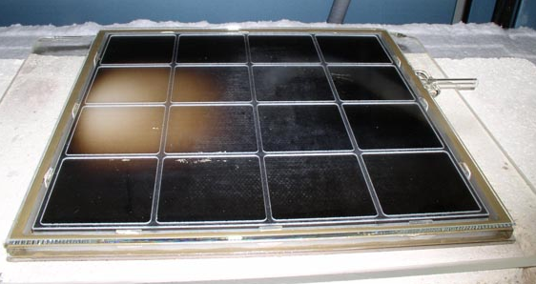
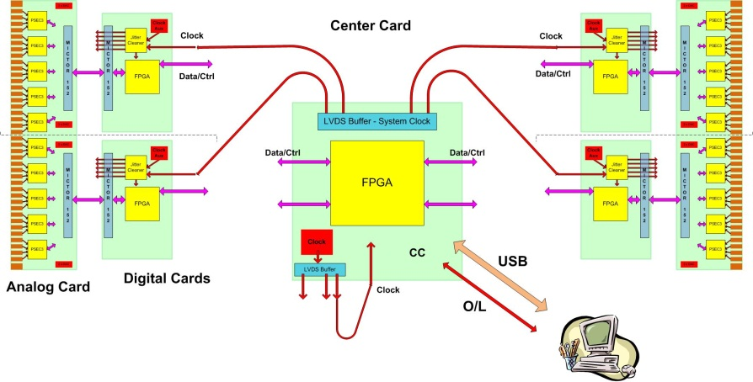
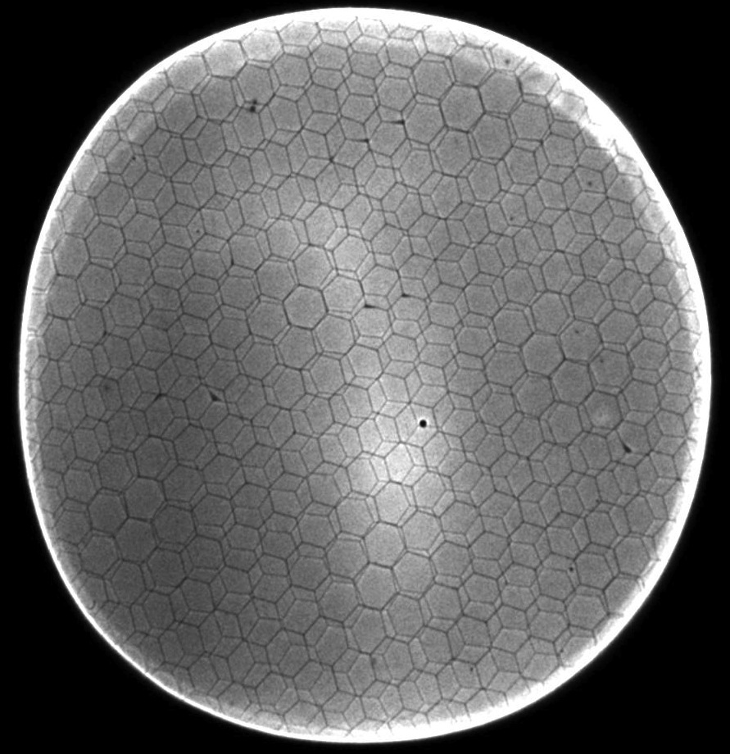
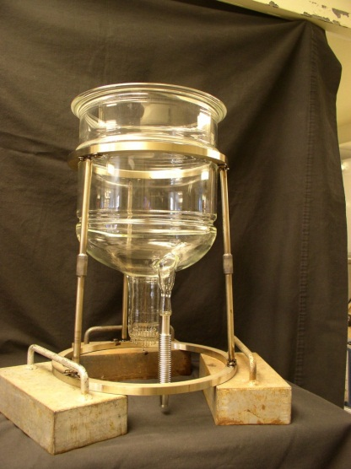
The 4 `Divisions’ of glass LAPPD
CV
CV
Hermetic Packaging
Electronics/Integration
CV
CV
MicroChannel Plates
Photocathodes
Old Slide

Slide 8
2010 GodParent Review Panels
Packaging Group
MCP Group
Photocathode Group
Electronics Group
Karen Byrum
K.Arisaka
J. Elam
D. Ferenc
J.F. Genat
P. Hink
A. Ronzhin
Bob Wagner
K.Attenkofer
Bross
Z. Insepov
Tremsin
J. Va’vra
A. Zinovev
Gary Varner
J. Buckley
K. Harkay
V. Ivanov
Lyashenko
T. Prolier
M. Wetstein
Zikri Yusof
B. Adams
M. Demarteau
G. Drake
T. Liu
I. Veryovkin
S. Ross
Note added: note that the Chair was internal to LAPPD but from a different area

Slide 9
‘Portfolio of Risk’- Parallel Efforts
Two parallel but intertwined efforts at different levels of risk, reward:
SSL/Hawaii (Siegmund)- ceramic package based on Planacon experience, NaKSb cathode, higher cost, smaller area, lower throughput, lower risk due to fewer innovations, more experience;
ANL/UC (Wagner, Byrum,Frisch)- glass package, KCsSb cathode, lower cost, larger area, higher throughput, higher risk, but more innovation and use of new technologies.
Reduce risk and enhance reward by diversification onto the 2 paths. Has proved very beneficial to both efforts (much cross-fertilization, and shared MCP development)
Old slide (2010?)

Slide 10
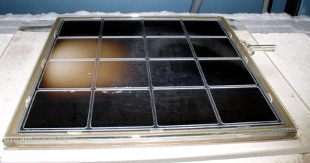
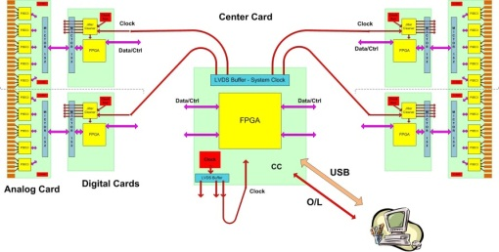
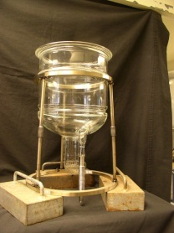
Achievements of DOE R&D
CV
CV
Hermetic Packaging
Electronics/Integration
`Frugal ‘(Tshirt) 1.6-GHz glass anode
`Frugal’ no-pin B33 glass package
ALD-based internal voltage divider
`Frugal’ Frit glass bottom seal
Large-area Multi-tile Supermodule
`
15 Gs/sec 6-channel `scope-in-a-chip’
Full DAQ design – 2 layers of FPGA
Test setups at Hawaii and Chicago
Student leadership on ASICs,firmware
CV
Photocathodes
MicroChannel Plates
CV
High-quality 8” 20μ substrates (Incom)
Proprietary ALD coatings with <0.1 cts/cm²/s, gains> 10⁷, `no’ aging
Multiple test stations at ANL, SSL
8” SbKNa cathode (SSL)
Cathode facility/lab (ANL)
SbKCs cathode with 24% QE (ANL)
InGaN development (WashU)
Started high-QE cathode collaboration
Old Slide

Slide 11
Key R&D Questions have been resolved
Substrate: glass or AAO (downselect made-AAO patented)
Secondary-emission layer- measure SEY’s from ALD
ALD resistive layer on micropores
MCP performance: gain, uniformity, stability, lifetime
Good QE uniform 20-cm photocathode deposition
Photocathode lifetime on B33 glass
Smaller feature (130nm process) analog wave-form ASIC
Psec level system development (clock, multichannel)
High bandwidth low channel-count readout system
Packaging- anode to sidewall seal (fritting)
Packaging- sidewall to window seal (top seal)
Many of these could have been a showstopper. All of these have been done.
* There are R&D questions for alternative, possibly better, solutions, but an adequate solution has been demonstrated for each of these individually

Slide 12
Example of key R&D from the ANL-MSD MCP group
Slade Jokela (ANL)
(2011? slide)

Slide 13
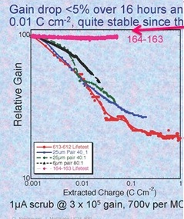
Example of key R&D from Ossy’s group
Industry has taken note of the unscrubulous (sic) property of ALD-functionalized plates- has a very large effect on the throughput, and hence the economics, of MCP-based tube production.
Old slide

Slide 14
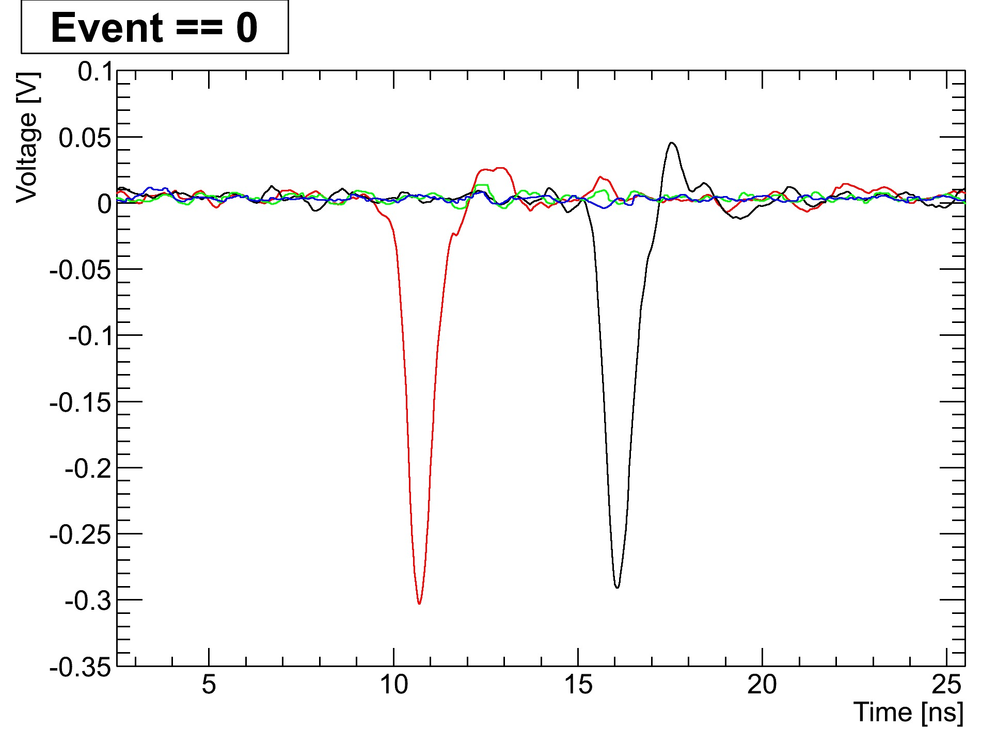
Example of key R&D from the UC ANL-XSD group
B. Adams, A. Elagin, R. Obaid, E. Oberla, M. Wetstein et al.
Pulses from a pair of 8” MCP Al2O3 plates
Left end of strip
Right end of strip
(Note-to-self: forward-reference Eric Oberla’s single-ended readout)
Old slide

Slide 15
Lastly, pushing the boundaries
pico-seconds
Old slide (2012?)

Slide 16
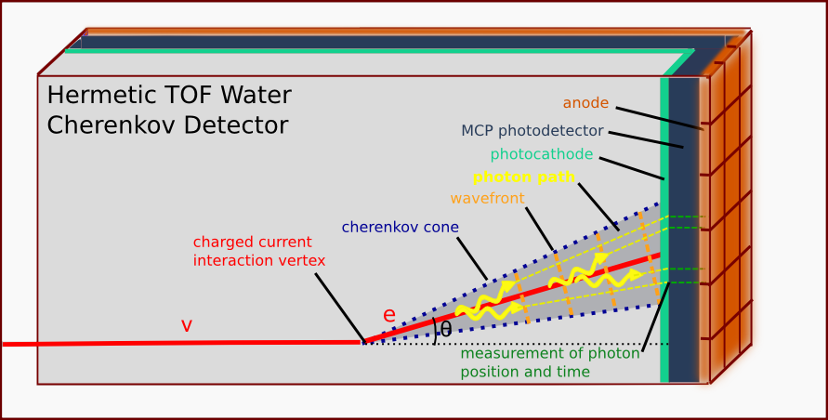
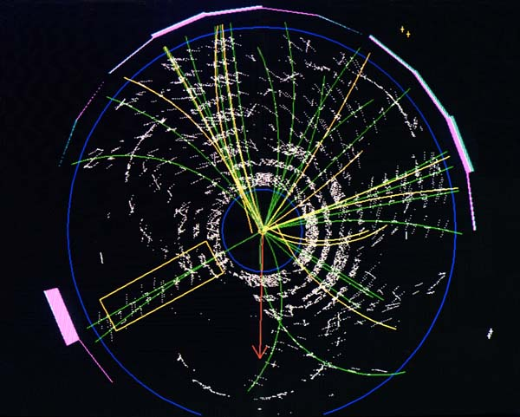
DUSEL Detector Motivation vs Collider
Howard Nicholson (DOE) recognized that these detectors could be used in large water-Cherenkov ν detectors
DUSEL plan was 150-300 M$ for PMT”s, all non-US
Howard advocated high-risk high-return (see PCAST report);
Ancillary benefits-
Non-implosive (low volume, can be thick glass)
Insensitive to Earth’s magnetic field
Howard spoke of a 4’x8’ panel with a single fiber readout (!).
The LAPPD R&D addressed both large-area and fast time resolution applications – good time resolution is intrinsic.
(2010 slide)

Slide 17
DUSEL-driven Tech Transfer Proposal
What follows, although now dated, is confidential. I would like to show it as this commercial proposal and its context played a big role in the history and is relevant to the question of manufacturability, but we should not show it if there is concern from any of the participants.
These following slides are from a proposal in 2010 to make 100,000 LAPPD Tiles by a large company experienced in making phototubes.

Slide 18
Slide from Confidential Company-X Proposal

Slide 19
Slide from Confidential Proposal

Slide 20
Slide from Confidential Proposal
!

Slide 21
LAPPD Papers, Patents, and Trademark
Our papers, patents, notes are available at the Document Library on the PSEC web page (psec.uchicago.edu/library)-
Searchable by category (e.g. Published, author, subject,..)- thanks to Mary Heintz

Slide 22
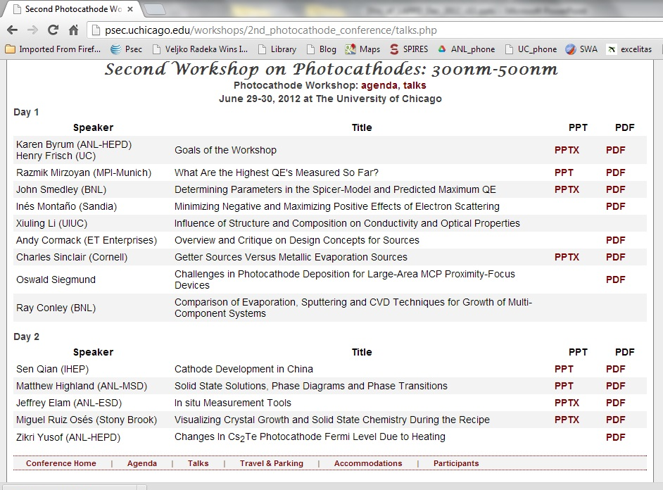
Other Impacts
We may have had influence in interesting industry in probing the limits of high QE for photocathodes
Lots of Industrial folks at the workshop- recent big advances by ADIT, Hamamatsu and Photonis; still don’t know the limit. (R&D component of our program.)

Slide 23
Other Impacts
Giving young talented people (future Ypsilantis’s, Charpaks, Cronins, Nygrens, ..) the opportunity to work on instrumentation with a big impact (attractive to academic departments, e.g. UC).
Tim Credo, IMSA HS student, came in 2nd in the Intel Science talent search (did our first anodes- gave a talk at IEEE in Rome in 2004
Matt Wetstein- Grainger Postdoctoral Fellowship in UC Physics Dept.
Eric Oberla- Grainger Graduate Student Fellowship in UC Physics Dept.
Mayly Sanchez- Early Career Award (LAPPD and nu’s)
Plus several superb students who have been mentored at ANL and elsewhere: Mark Kupfer (UIC), Razib Obaid (IIT/UC),…
Old Slide

Slide 24
Beyond LAPPD- Transition to PreProduction
The LAPPD Collaboration ended with the Dec 12 DOE Review at ANL- the following plan was shown:
(blue arrow added)
(blue arrow added)
Dec 12 DOE review slide

Slide 25
Making a Sealed Functional Tile
The one LAPPD milestone that wasn’t met was the integration of the R&D into a
sealed functional tile.
In hindsight, unlike the integration of electronics into a system or the development of the ALD-coated substrates, this milestone was different in nature from the focused R&D that we successfully did- it was a mistake (buck stops with me) to treat it as R&D.
The 3 ½ years of R&D was not atypical; the next step in developing a new technology is typically ~5 years. We have found no show-stoppers, but even given that all the steps have been proven individually, it is not a simply-connected linear task– it takes time and immense expertise.

Slide 26
My Own Questions For the Committee and Collaborators
(Asked at the risk of slings and arrows, but also as one of the initiators and former Spokesperson of LAPPD- lots of skin invested. I have my own answers, but it could help a lot to know the opinions of experts from the larger community.).
Is the technology viable? (i.e. are there showstoppers?)
Would the technology be transformative in security, and scientific use, in particular High Energy and Nuclear Physics?
If yes, are we comfortable to have it developed by non-US companies (other nations have shown great interest in our R&D), or should we make a sustained effort in the US?

Slide 27
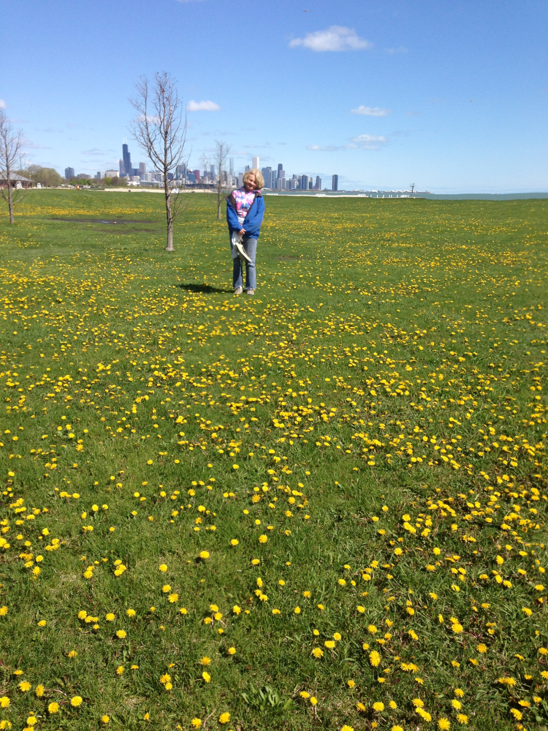
The End

Slide 28
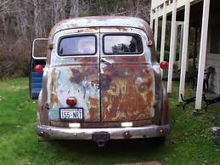
Backup slides

Slide 29
The Transition from 3 Years of R&D to Applications: Roles of SBIR/STTR and TTO
Tech Transfer
Tube Production, Market Development
Processes/designs move to production
Tubes return for testing, adopters
R&D advances move to production
“Pull of the mkt” informs R&D
Advances return for integration
LAPPD
R&D effort moves to industry
SBIR/STTRs
Process development, Testing, Applications
R&D on cost, performance

Slide 30
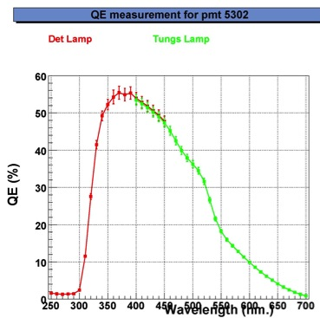
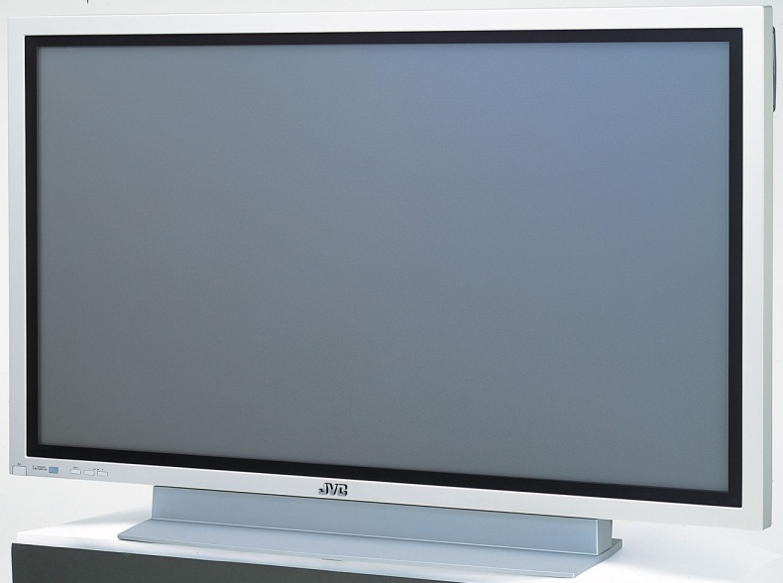
A Vision of the Upside of the Technology
Each of the 4 Areas of LAPPD has
an unknown limit on development
R. Mirzoyan
2nd PC Workshop
Chicago
50%
Photocathodes: VHQE
Ultra-low TTS MCP development
Electronics: Deep Sub-psec Time Resolution
Packaging: sealed flat-panel

Slide 31
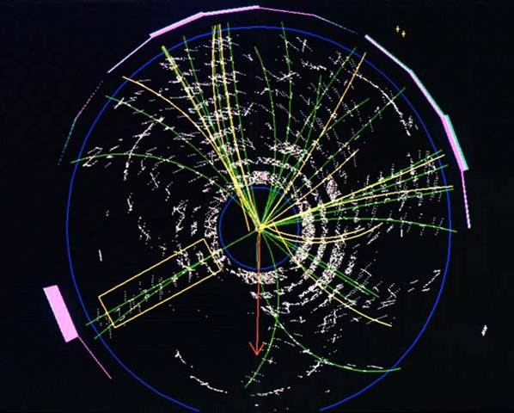
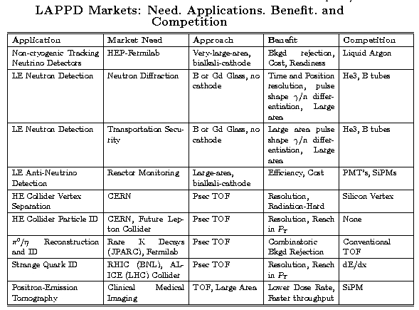
The Relationship of SBIR/STTR/TTO to Needs
Pizero-electron separation on water Ch. cters
Collider TOF for vertex sep., family flow
Higher performance
Or
Lower Cost
Are
The main benefits
(“F,B,C-
pick any two”)

Slide 32
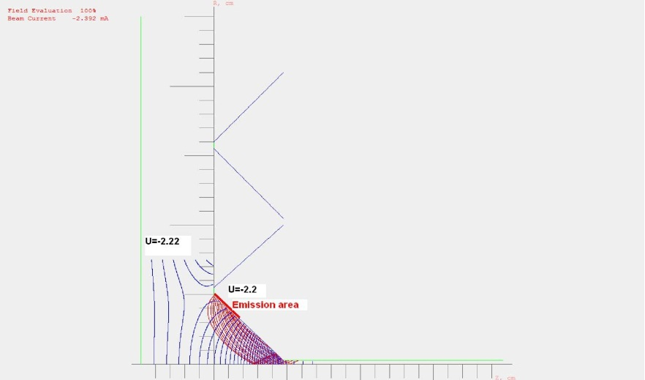
Simulation (crosses all groups) Valentin Ivanov, Zeke Insepov, Zeke Yusof, Sergey Antipov
10μm pore
40μm spacing
Funnel (!)
Large Area Photodetector Development Collaboration
32

Slide 33
Status of ARRA Milestones
Done
Done
Done
Done
Done
Done
One milestone remains from Year 1: an 8” top seal
(SSL hot seal, and ANL top and cold seals in progress)

Slide 34
Work Planned but Slowed/Stopped
Substrate development at Incom- large L/D for 1 vs 2 MCP’s for large-area apps; 100% Open Area Ratio
Providing more effort for ALD development
Glass Top Seal Development at ANL and UC (engineering effort and equipment )
Glass Tile package optimization (parts and labor)
Photocathode effort at ANL (effort)
Electronics: cut ASIC orders, improved versions
Building ANL detector group ( replacing postdocs, material science expertise, 1 senior hire for Single Tile Facility, photocathodes)

