Slide 1
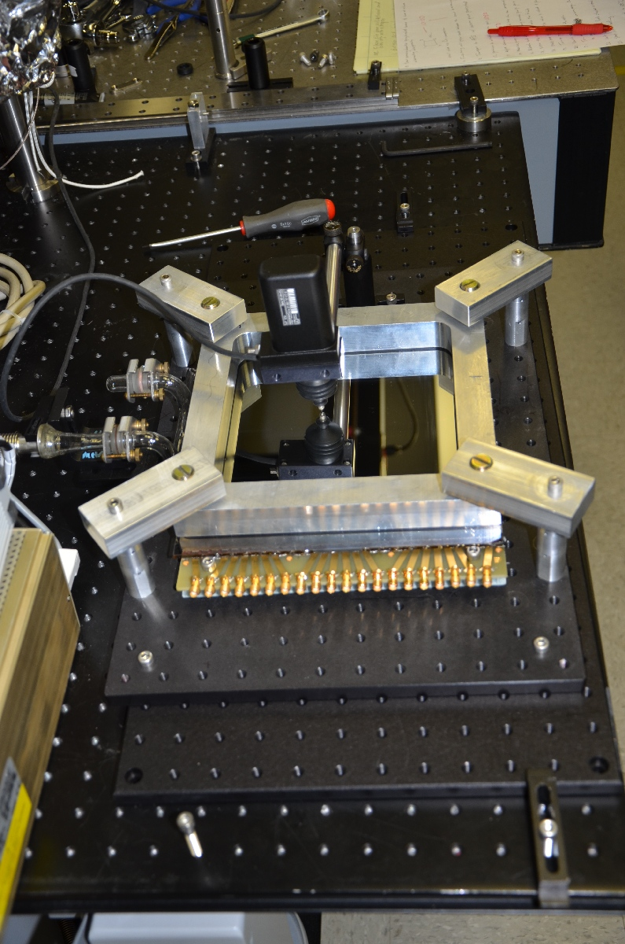
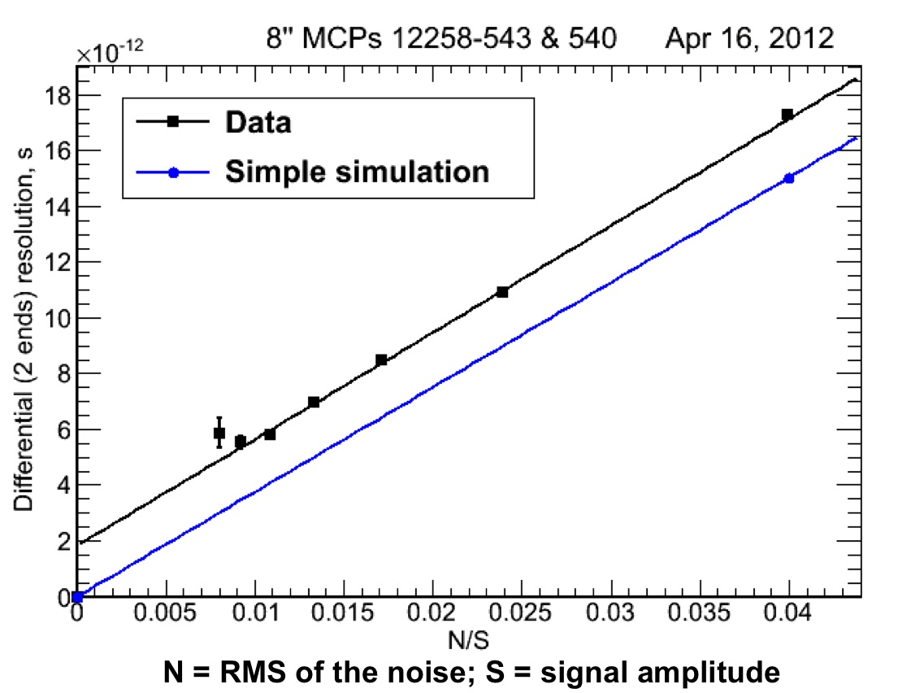
The Development of Large-Area Pico-second Photodetectors
Henry Frisch, Enrico Fermi Institute, Univ. of Chicago
For the LAPPD Collaboration

Slide 2
Outline
New Types of Detectors Can Change Whole Areas of Science, Medical Imaging, Nuclear Non-proliferation
Technical details of LAPPD: Surface Physics, GigaHz E&M, Glass, Circuit (ASIC) design, Tech Transfer to Industry
Photocathodes- learning SS physics (!)
Opportunities – many PhD theses in many fields- a broad collaborative effort, including industry
Acknowledgements- LAPPD collaborators, Howard Nicholson and the DOE HEP, ANL Management, and the NSF.

Slide 3
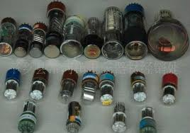
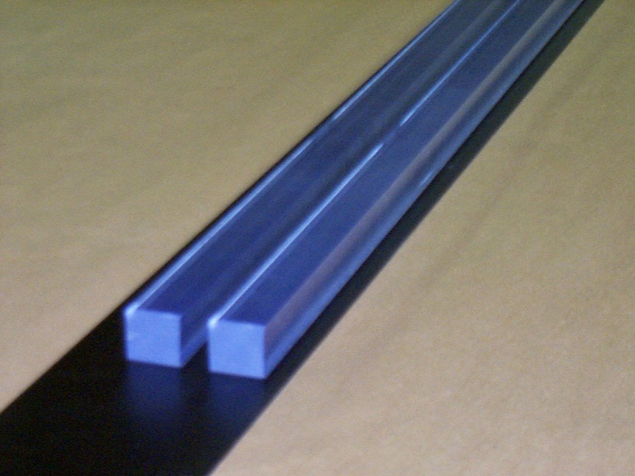
Why has 100 psec been the # for 60 yrs?
Typical path lengths for light and electrons are set by physical dimensions of the light collection and amplifying device.
These are on the order of an inch. One inch is 100 psec. That’s what we measure- no surprise! (LH picture from T. Credo)
Typical Light Source (With Bounces)
Typical PMT’s (With Long Path Lengths)

Slide 4
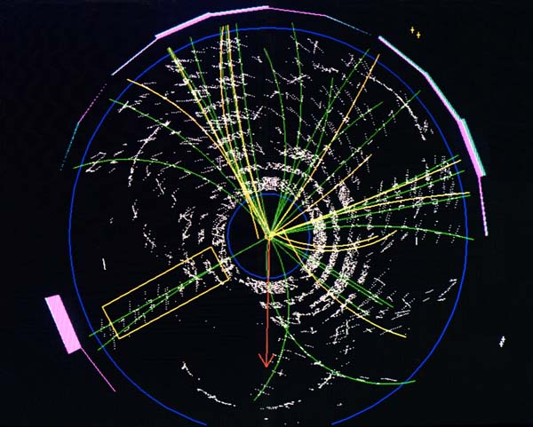
Colliders:
1) Identify the quark content of charged particles;
2) Vertex photons ; 3) Separate vertices; 4) Discovery
Light source is Cherenkov light in the window or radiator.
Extract all the information in each event (4-vectors) – only spins remain…
Differential TOF: measure the difference in arrival times of photons and charged particles which arrive a few psec later (gives precise local time-dependent calibration
Will come back to this at the end…

Slide 5
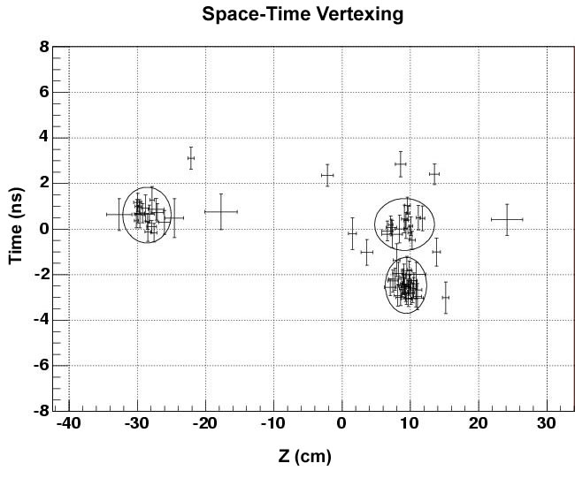
Major problem coming up at LHC- vertexing at high luminosity (e.g. Joe Incandela’s UC seminar on CMS)
3 different interactions in one beam crossing
Time (ns)
Multi-vertex event at CDF (Tevatron)
Vertex position along beam line (cm)
Need, e.g.- Higgs to gamma-gamma at the LHC - tie the photons to the correct vertex, and more precisely reconstruct the mass of the pair

Slide 6
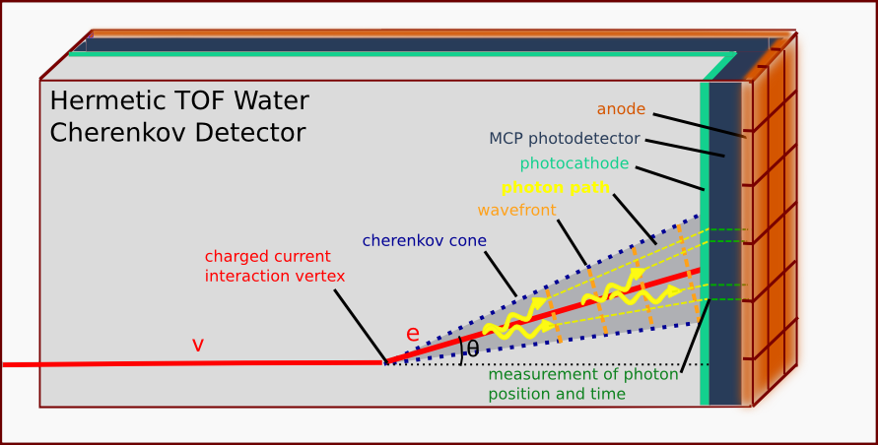
Neutrino Physics
Need: lower the cost and extend the reach of large neutrino detectors
H. Nicholson
Approach: measure the arrival times and positions of photons and reconstruct tracks in water
Benefit: Factor of 5 less volume needed, cost.
Competition- large PMT’s, Liquid Argon

Slide 7
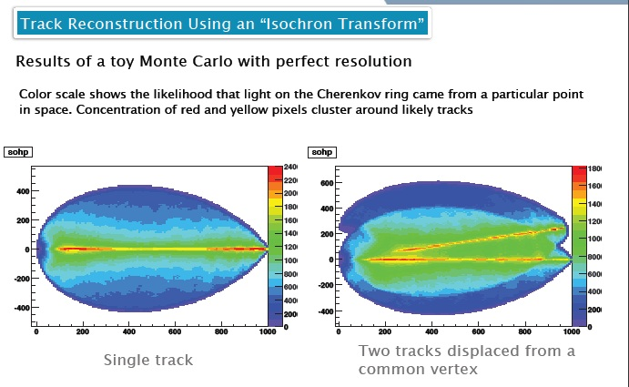
A Photon Time-Projection Chamber
Work of Matt Wetstein (Argonne,&Chicago) in his spare time (sic)

Slide 8
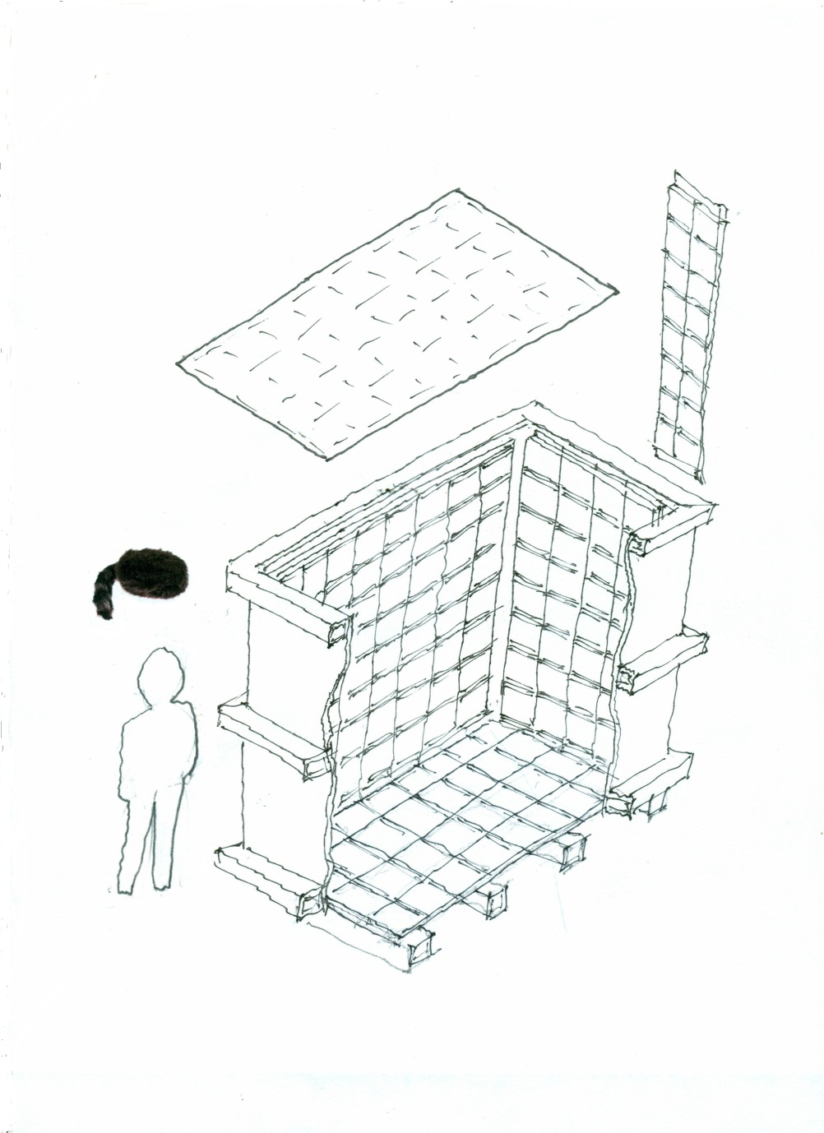
Daniel Boone*
Proposal (LDRD) to build a little proto-type to test photon-TPC ideas and as a simulation testbed
`Book-on-end’ geometry- long, higher than wide
Close to 100% coverage so bigger Fid/Tot volume
Δx, Δy << 1 cm
Δt < 100 psec
Magnetic field in volume
Idea: to reconstruct vertices, tracks, events as in a TPC (or, as in LiA).
* Think MiniBoone, etc
caps
2 m
ν
2 m
Daniel
1 m
Also ANNIE- Bob Svoboda

Slide 9
Rare Kaon Decays- backgd rejection by reconstructing π⁰ vertex space point:
E.g. for KOTO (Yau Wah, JPARC)-beat down combinatoric π⁰ bkgds
Detector Plane
Photon 1
(T₁, X₁, Y₁ )
Vertex (e.g. π⁰->γγ)
T_{v}, X_{v}, Y_{v}, Z_{v}
(t1-tv)c
Photon 2
One can reconstruct the vertex from the times and positions- 3D reconstruction
(t2-tv)c
(T₂, X₂, Y₂ )

Slide 10
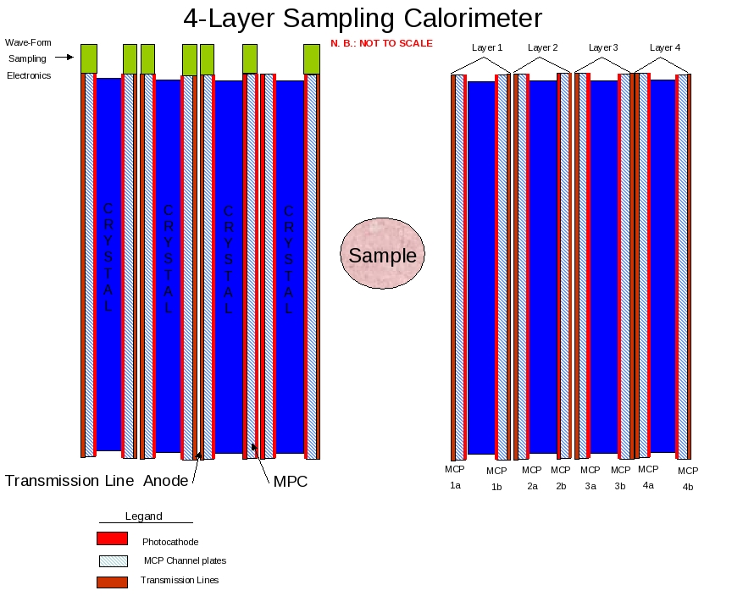
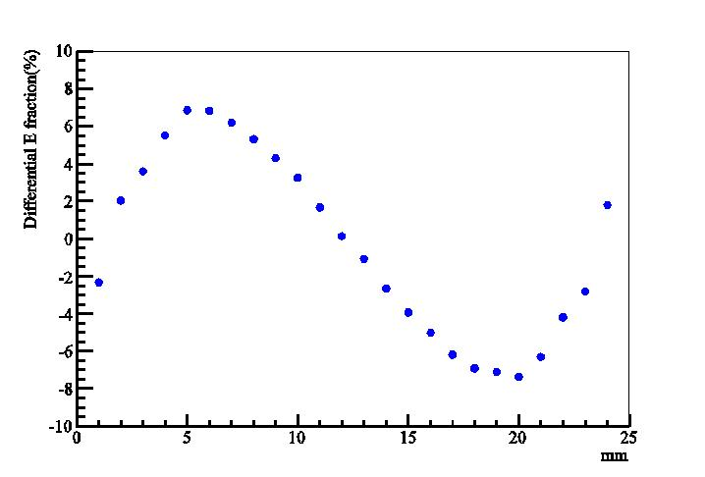
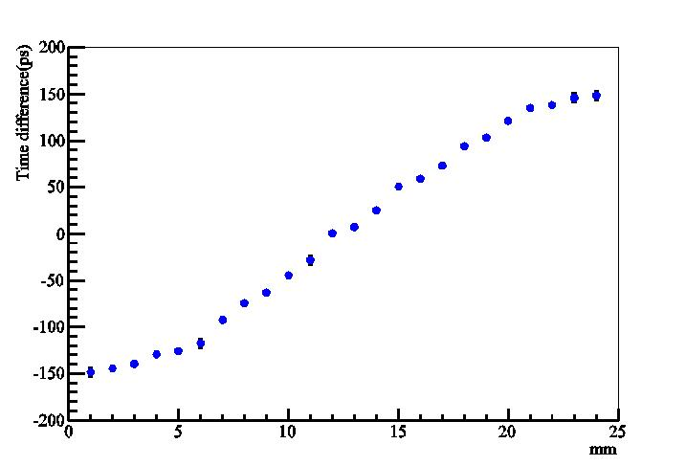
Sampling Calorimetry in PET (1B$ Mkt)
Alternating radiator and cheap 30-50 psec planar mcp-pmt’s on each side
Can we solve the depth-of-interaction problem and also use cheaper faster radiators?
Simulations by Heejong Kim (Chicago)
Heejong Kim
Heejong Kim
Depth in crystal by time-difference
Depth in crystal by energy- asymmetry

Slide 11
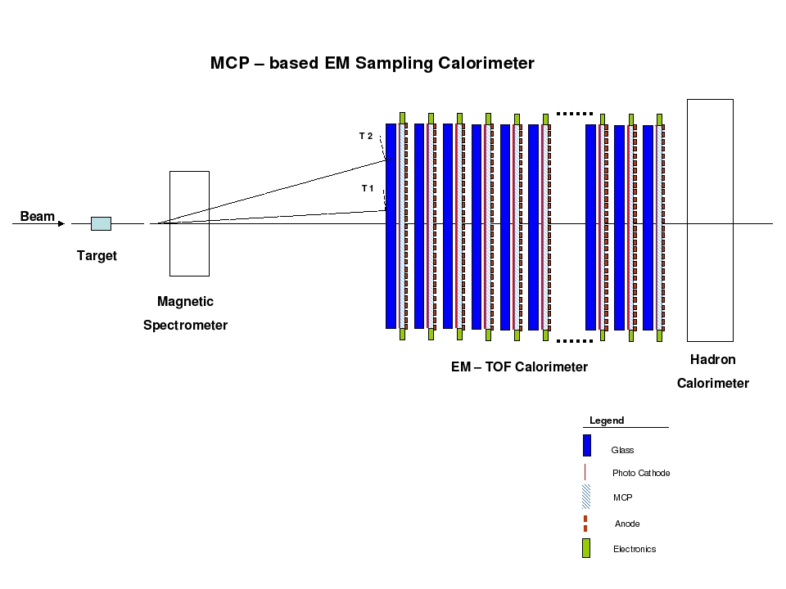
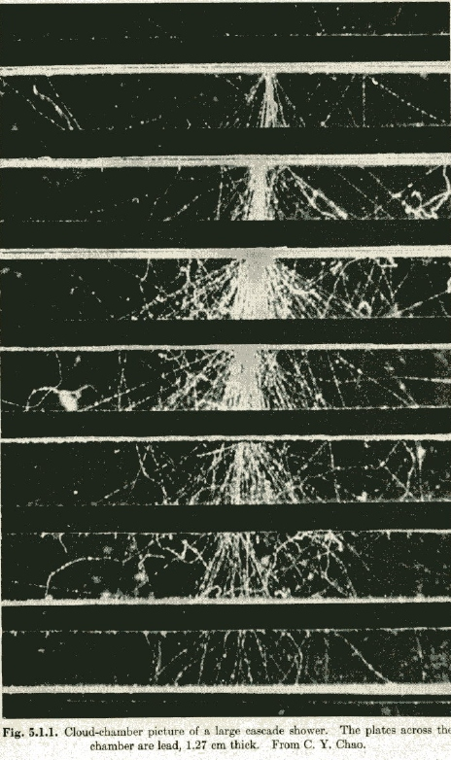
Cherenkov-sensitive Sampling Quasi- Digital EM/Had-separating Calorimeters
A picture of an em shower in a cloud-chamber with ½” Pb plates (Rossi, p215- from CY Chao)
A `cartoon’ of a fixed target geometry such as for JPARC’s KL-> pizero nunubar (at UC, Yao Wah) or LHCb

Slide 12
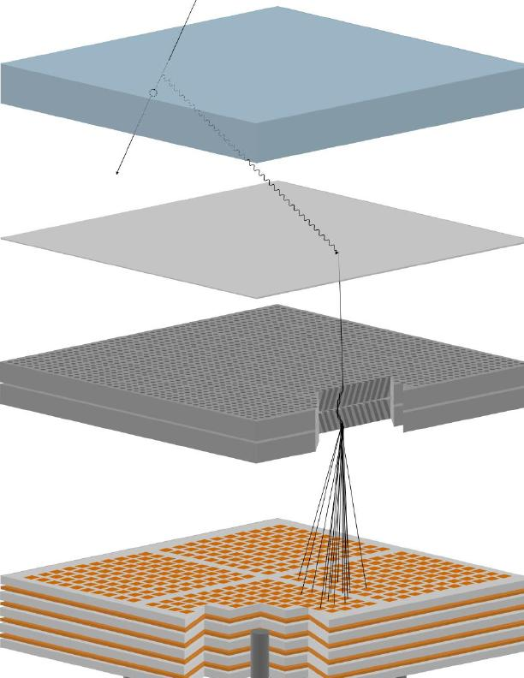
How Does it Work?
Requires large-area, gain > 10⁷, low noise, low-power, long life,
σ(t)<10 psec, σ(x) < 1mm, and low large-area system cost
Realized that an MCP-PMT has all these but large-area, low-cost:
(since intrinsic time and space scales are set by the pore sizes- 2-20µ)
Incoming charged particle
window
Radiated Cherenkov photon
Photocathode on inside of window
Photo-electron
from cathode
Pair of micro-channel plates
Output pulse of 10⁷ electrons
RF strip-line anode

Slide 13
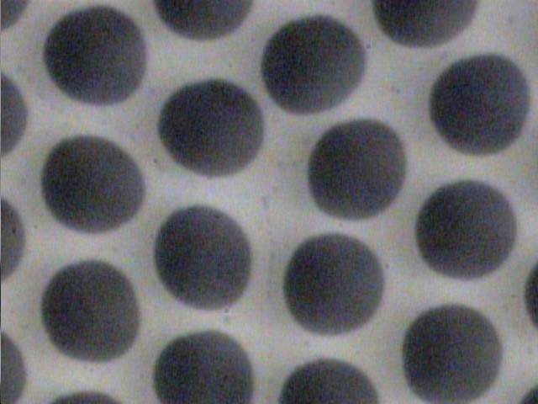
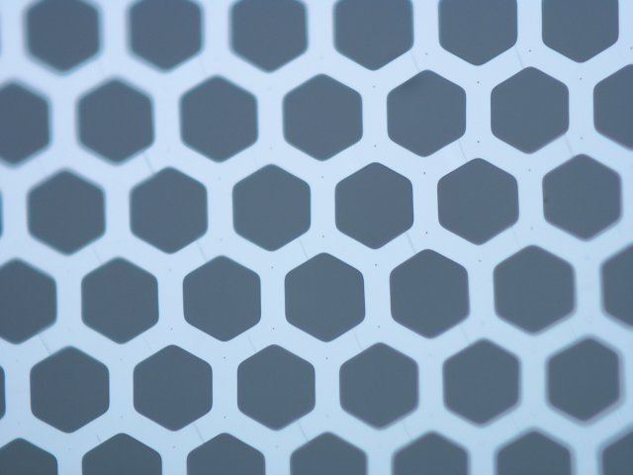
Simplifying MCP Construction
Conventional Pb-glass MCP
OLD
Incom Glass Substrate
NEW
Chemically produced and treated Pb-glass does 3-functions:
Provide pores
Resistive layer supplies electric field in the pore
Pb-oxide layer provides secondary electron emission
Separate the three functions:
Hard glass substrate provides pores;
Tuned Resistive Layer (ALD) provides current for electric field (possible NTC?);
Specific Emitting layer provides SEE

Slide 14
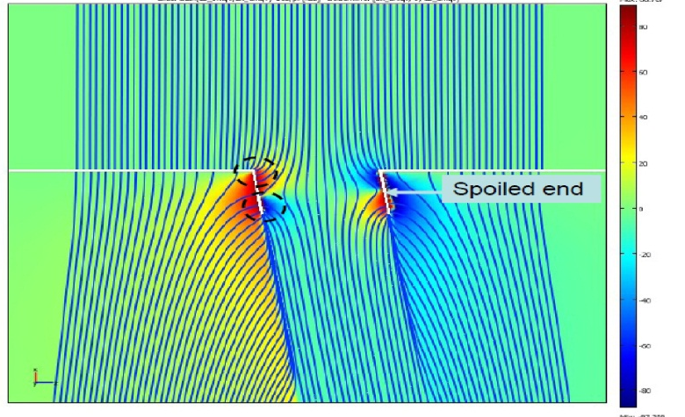
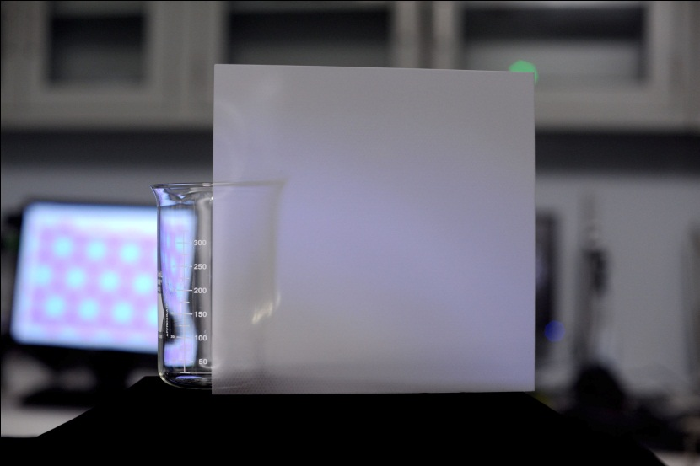
Micro-Channel Plate Development
Simulation of electric field in 1 or several pores- with endspoiling; (attempted) comparison with data
Incom 8”-sq high-quality MCP plate with > 65% OAR

Slide 15
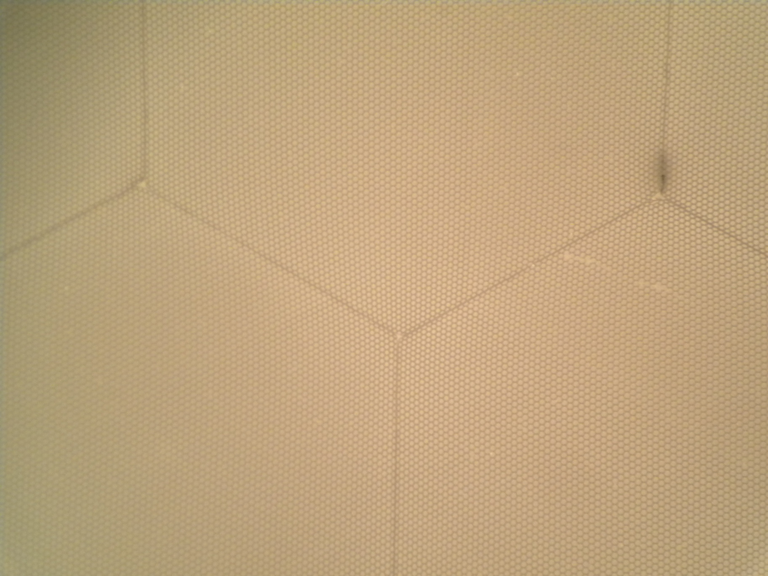
Incom Micropore Substrate
.075”
~150 20μ pores
INCOM glass substrate
80 million 20-micron pores in an 8”-sq plate
65% open-area ratio; 1.2mm thick (L/D=60)
Incom.inc, Charlton Mass

Slide 16
New MCP Structure (not to scale)
pore
1 KV
resistive coating (ALD)
emissive coating (ALD)
conductive coating (thermal evaporation or sputtering)
Jeff Elam
16
Notes:
Very schematic – not correct open area ratio
Might need to do Au before Al2O3 for better contact
Add HV leads
16

Slide 17
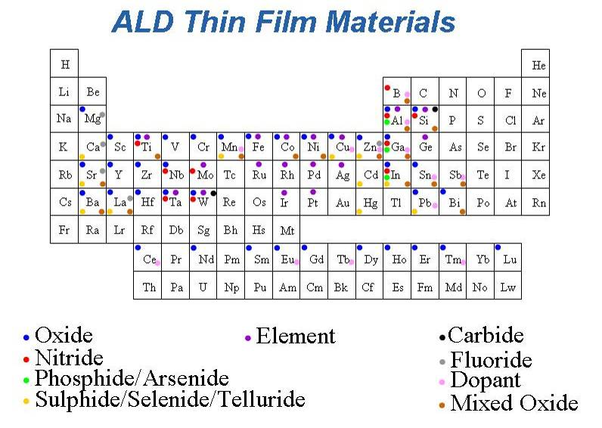
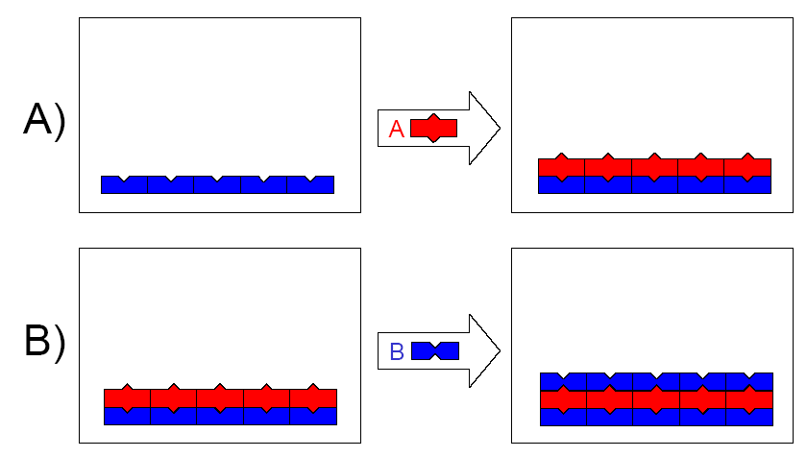
Atomic Layer Deposition (ALD) Thin Film Coating Technology
Atomic level thickness control
Deposit nearly any material
Precise coatings on 3-D objects (JE)
Lots of possible materials => much room for higher performance
Jeff Elam pictures
Notes:
17
For the technologies that I’ll be describing today, ALD has attributes that uniquely suit it

Slide 18
Slade Jokela (ANL)

Slide 19
ALD-Coated Incom 8” by 8” Microchannel Plate
Anil Mane and Jeff Elam (ANL)
80,000,000 pores
A commercial 2”-square plate is more than $1000 and isn’t as good in many ways

Slide 20
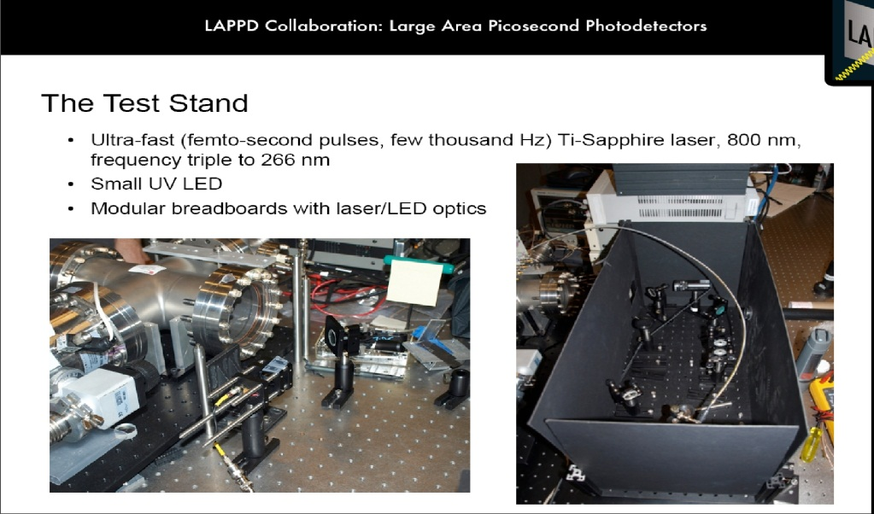
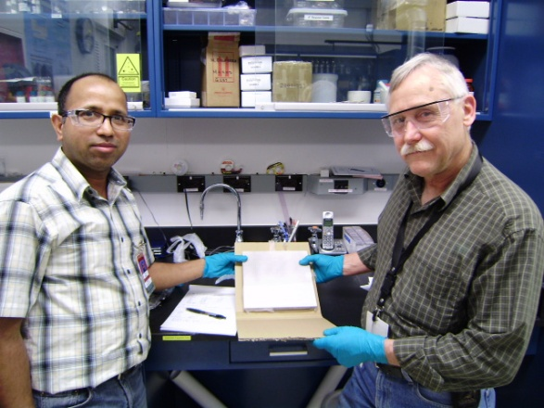
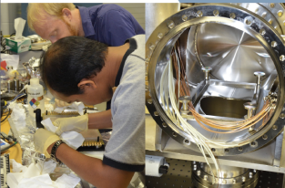
ALD &Integration tests at ANL
Bernhard Adams, Andrei Elagin, Razib Obaid, Eric Oberla, Matt Wetstein
Using <100 Femtosec laser, lots of vacuum (sic)
ALD-coated MCP plate (Anil)
Anil Mani and Bob Wagner
Razib Obaid and Matt Wetstein
20

Slide 21
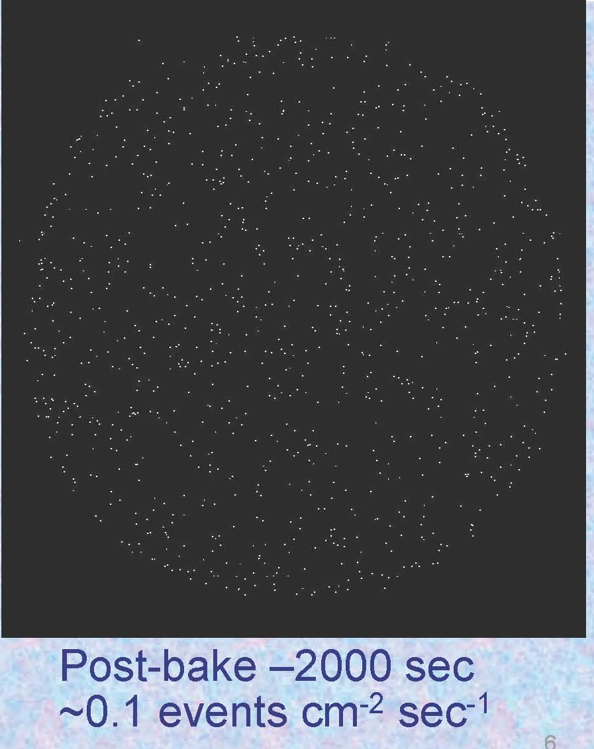
Microchannel Plates-4b
Performance:
Noise (bkgd rate).
<=0.1 counts/cm²/sec; factors of few > cosmics (!)
Ossy Siegmund, Jason McPhate, Sharon Jelinsky, SSL/UCB

Slide 22
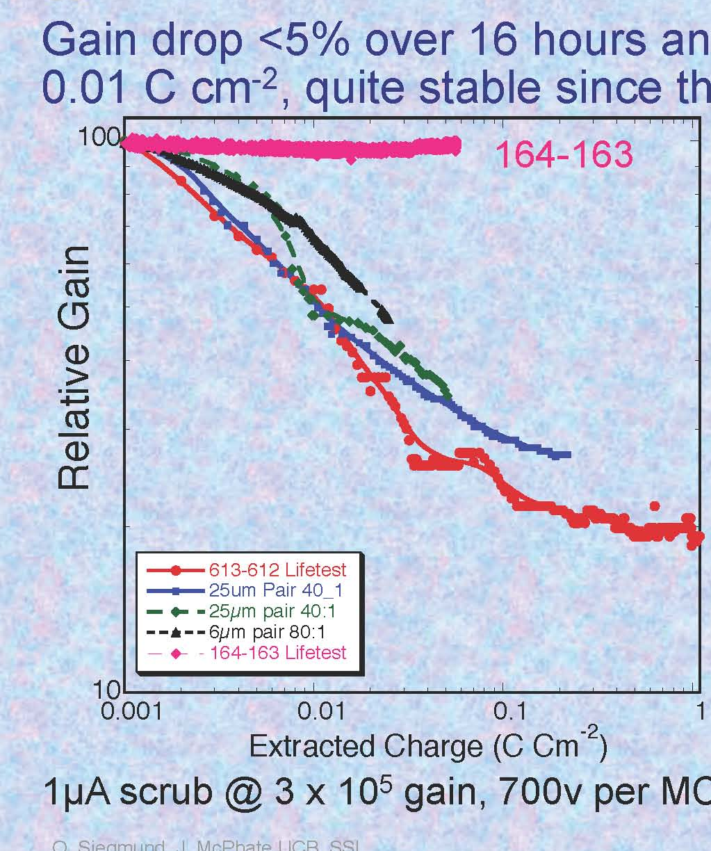
Microchannel Plates-4d
Performance: burn-in (aka `scrub’)
Measured ANL ALD-MCP behavior
(ALD by Anil Mane, Jeff Elam, ANL)
Measurements by
Ossy Siegmund,
Jason McPhate,
Sharon Jelinsky, SSL/UCB
(Big deal commercially?)
Typical MCP behavior- long scrub-times

Slide 23
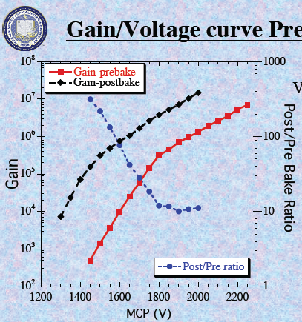
Signal- want large for S/N
We see gains > 10⁷ in a chevron-pair
Ossy Siegmund, Jason McPhate, Sharon Jelinsky, SSL/UCB
ALD by Anil Mane and Jeff Elam, ANL

Slide 24
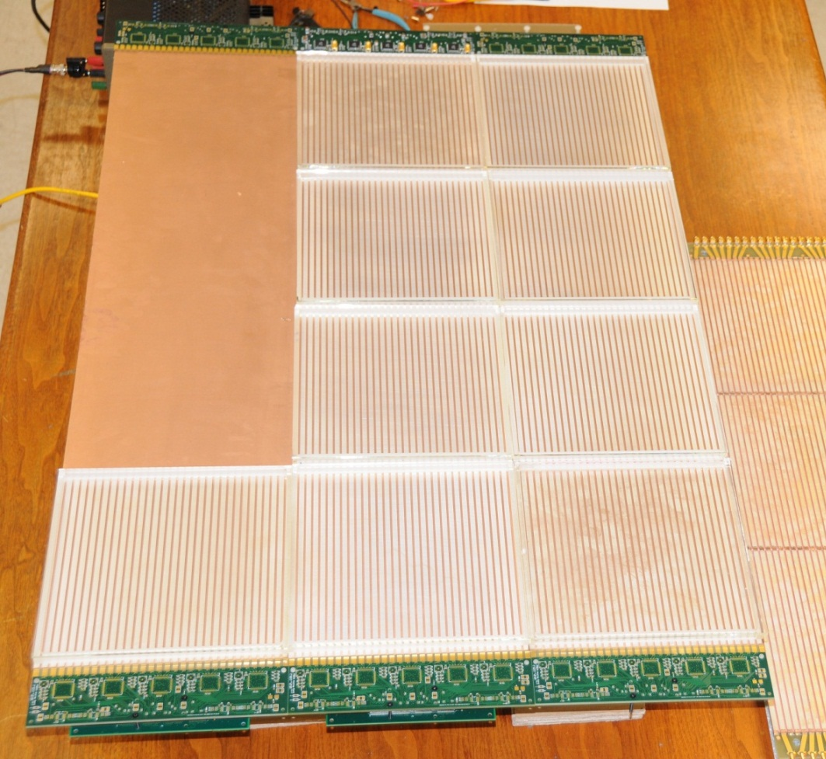
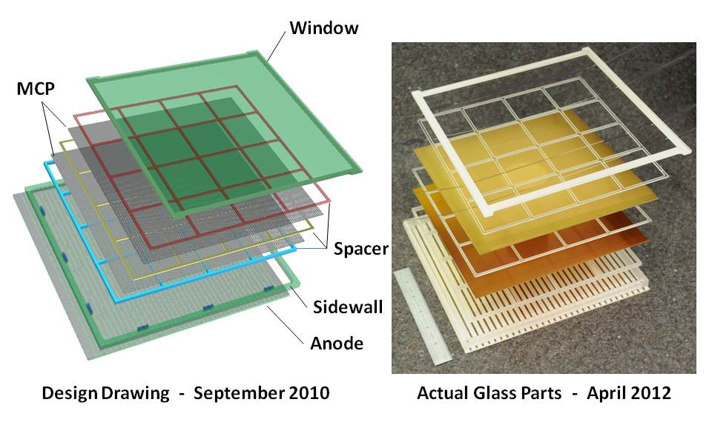
The Half-Meter-Squared SuperModule
A SuperModule holds 12 tiles in 3 tile-rows. 15 waveform sampling ASICS on each end of the tray digitize 90 strips. 2 layers of local processing (Altera) measure extract charge, time, position, goodness-of-fit
A `tile’ is a sealed vacuum-tube with cathode, 2 MCP’s, RF-strip anode, and internal voltage divider
HV string is made with ALD

Slide 25
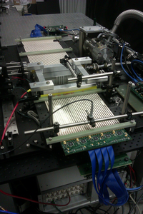
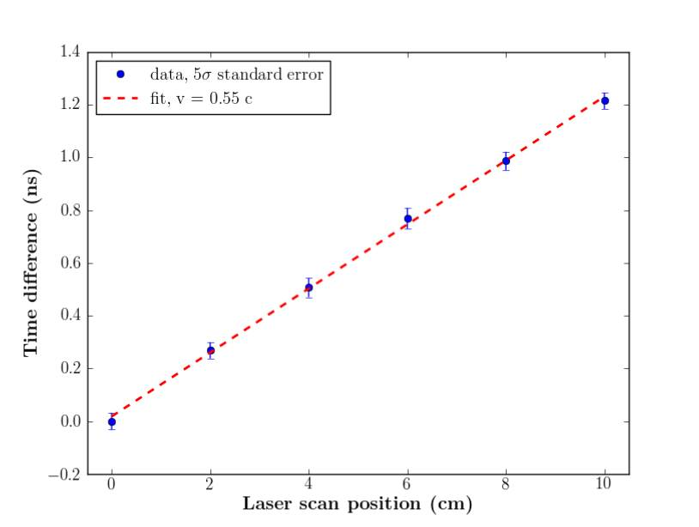
Demonstrated Position Sensitivity
Razib’s scanning stage
4-tile `tile-row’
of Supermodule
Time difference of 2 ends vs laser position

Slide 26
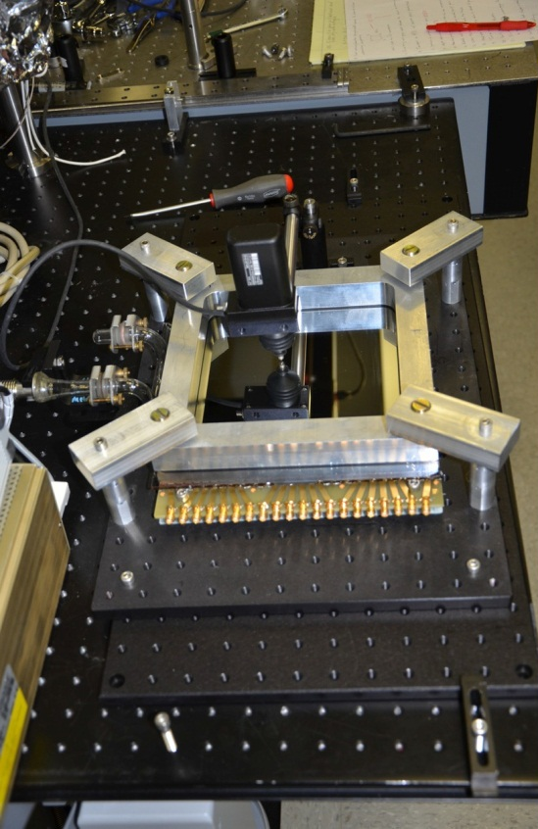
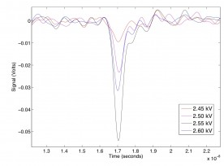
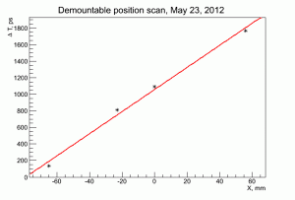
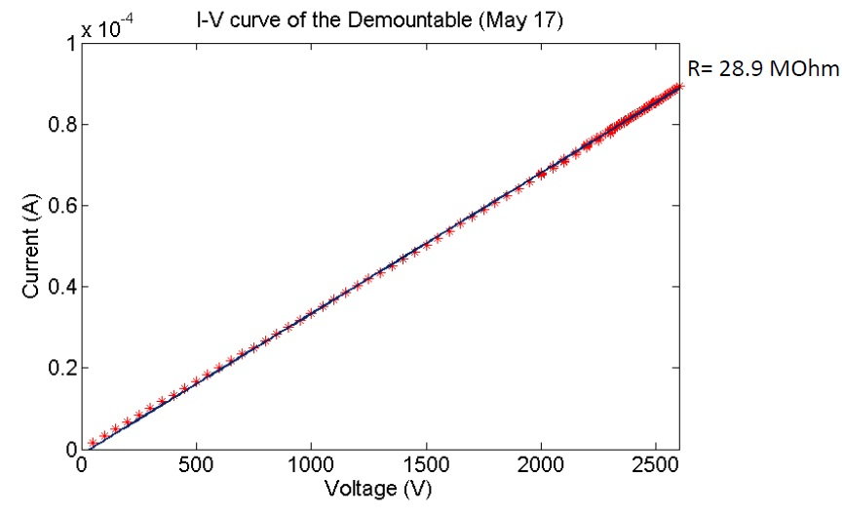
Demonstration of the Internal ALD HV Divider in the Demountable Tile
Demountable at APS
Average pulse shape vs HV
Scanning the laser: t vs x
IV Curve (expected 32 Megs)

Slide 27
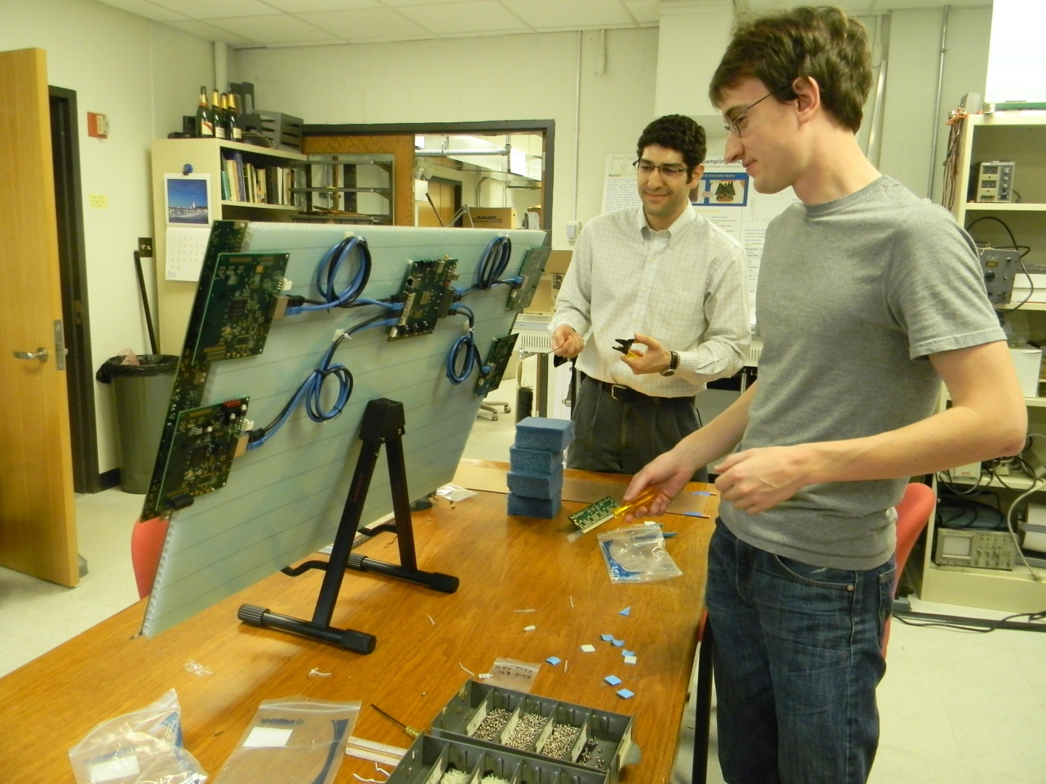
Developing and Testing the Electronics, Anodes, and DAQ
Eric Oberla (grad student) and Craig Harabedian (engineer) working on the Tray layout and cabling

Slide 28
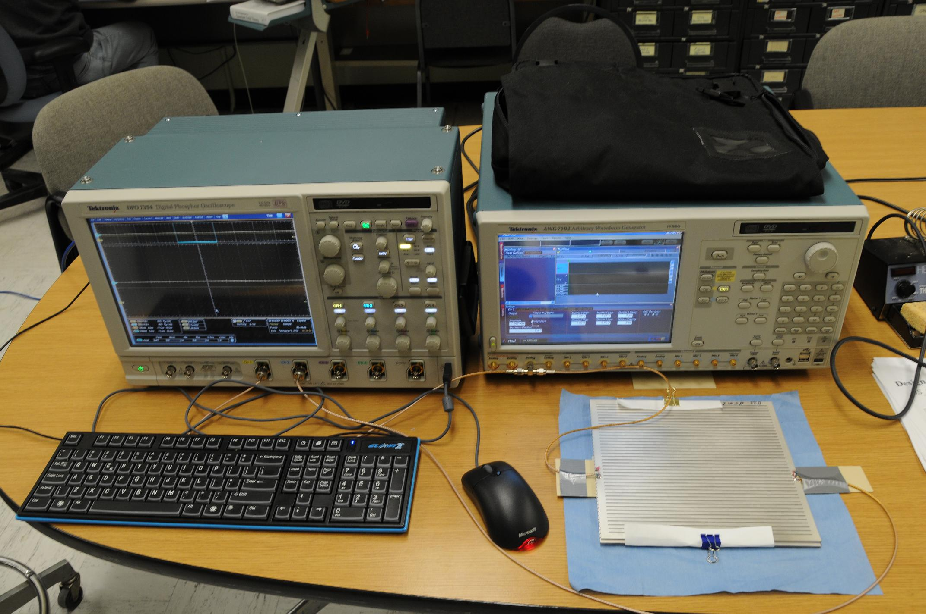
Anode Testing for ABW, Crosstalk,..
Herve’ Grabas, Razib Obaid, Dave McGinnis
Network Analyzer Tile Anode

Slide 29
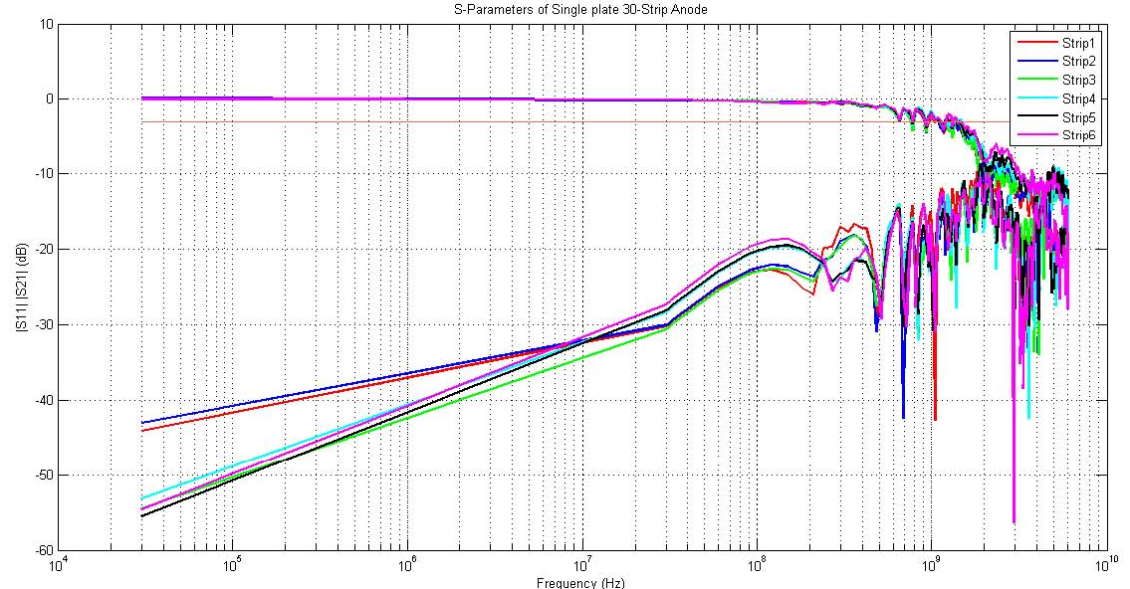
Anode Testing for ABW, Crosstalk,..
ABW
Crosstalk
Razib Obaid

Slide 30
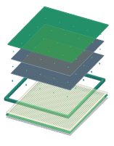
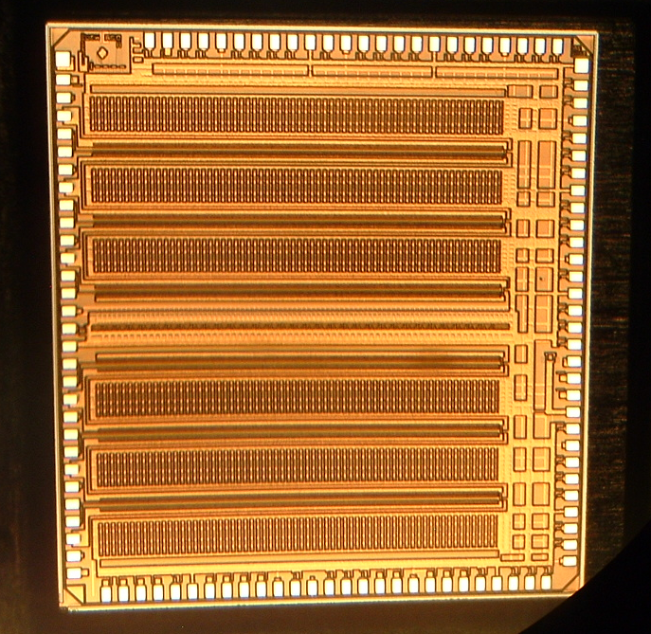
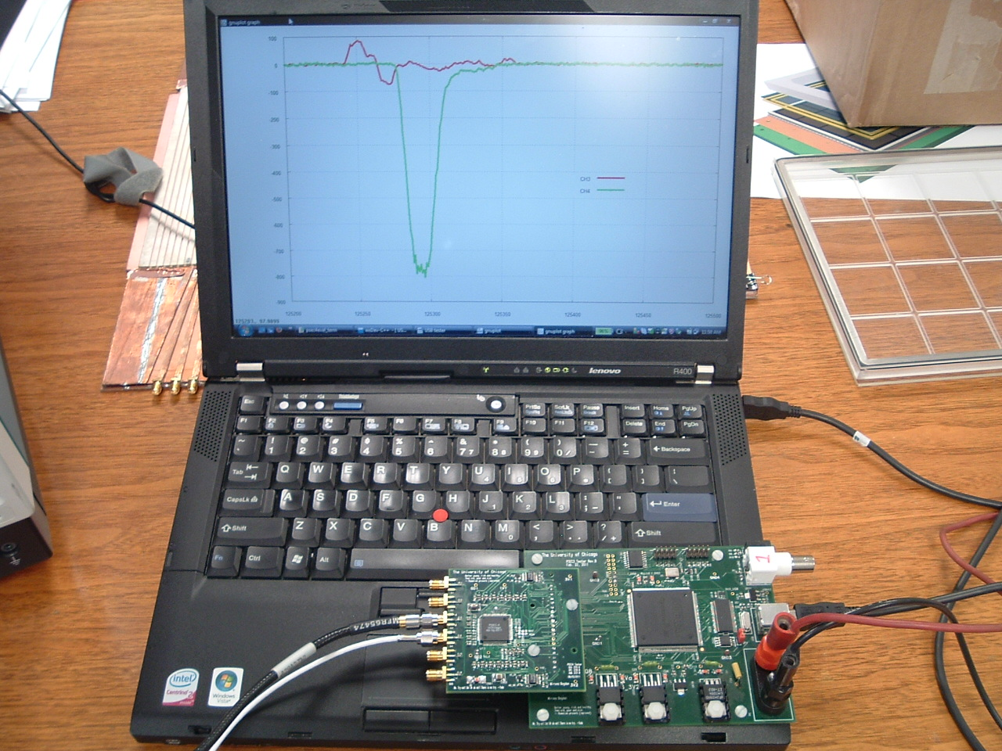
PSEC-4 ASIC
LAPPD Collaboration
Eric Oberla, ANT11
6-channel “oscilloscope on a chip” (1.6 GHz,10-15 GS/s)
Evaluation board uses USB 2.0 interface + PC data acquisition software

Slide 31
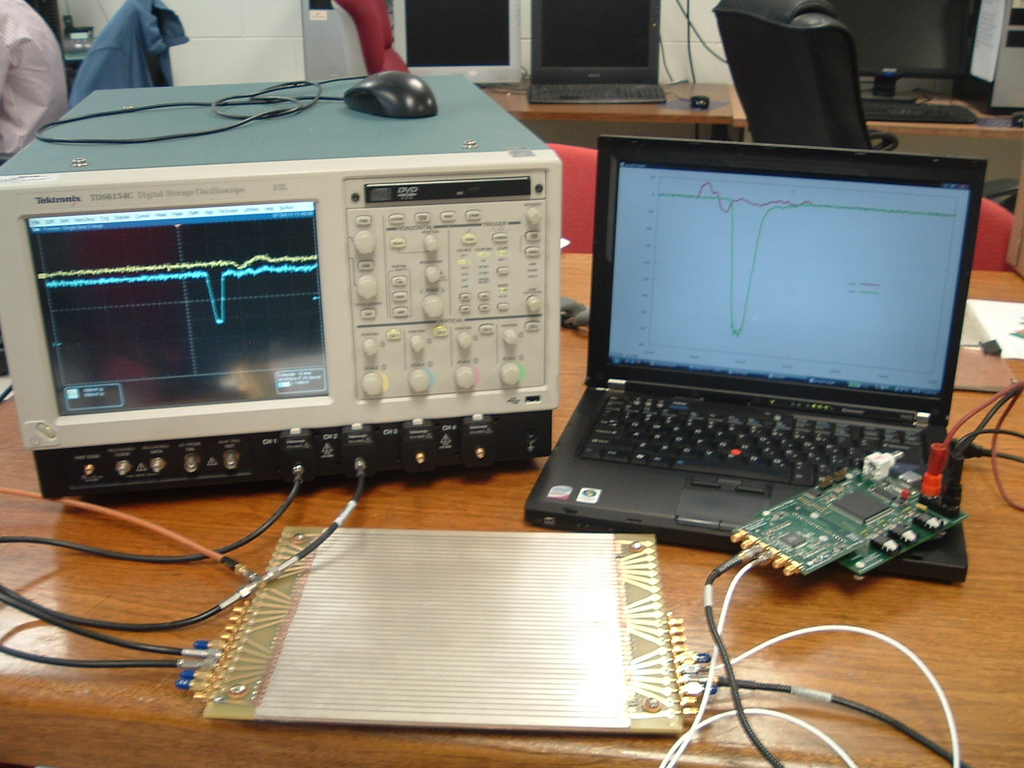
6-channel `Scope-on-a-chip’
Designed by Eric Oberla (UC grad student)
working in EDG
with EDG tools and engineers
(H. Grabas, J.F. Genat)
Real digitized traces from anode
20 GS/scope
4-channels (142K$)
17 GS/PSEC-4 chip
6-channels ($130 ?!)

Slide 32
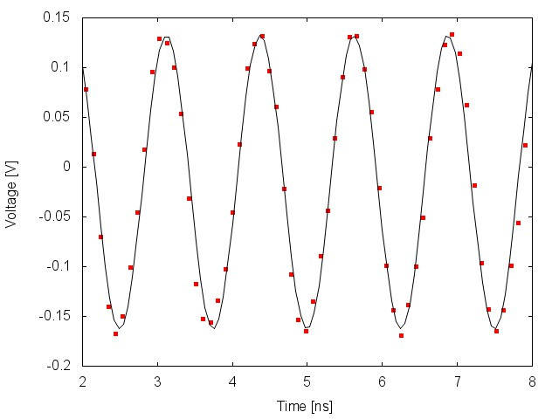
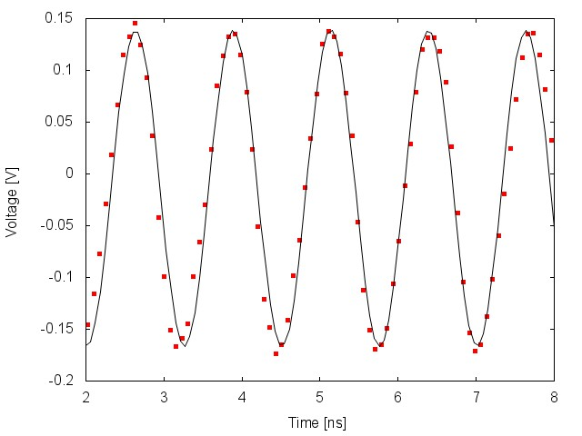
PSEC-4 Performance
Eric Oberla, ANT11
Digitized Waveforms
Input: 800MHz, 300 mV_{pp} sine
Sampling rate : 10 GSa/s
Sampling rate : 13.3 GSa/s
Only simple pedestal correction to data
As the sampling rate-to-input frequency ratio decreases, the need for time-base calibration becomes more apparent (depending on necessary timing resolution)

Slide 33
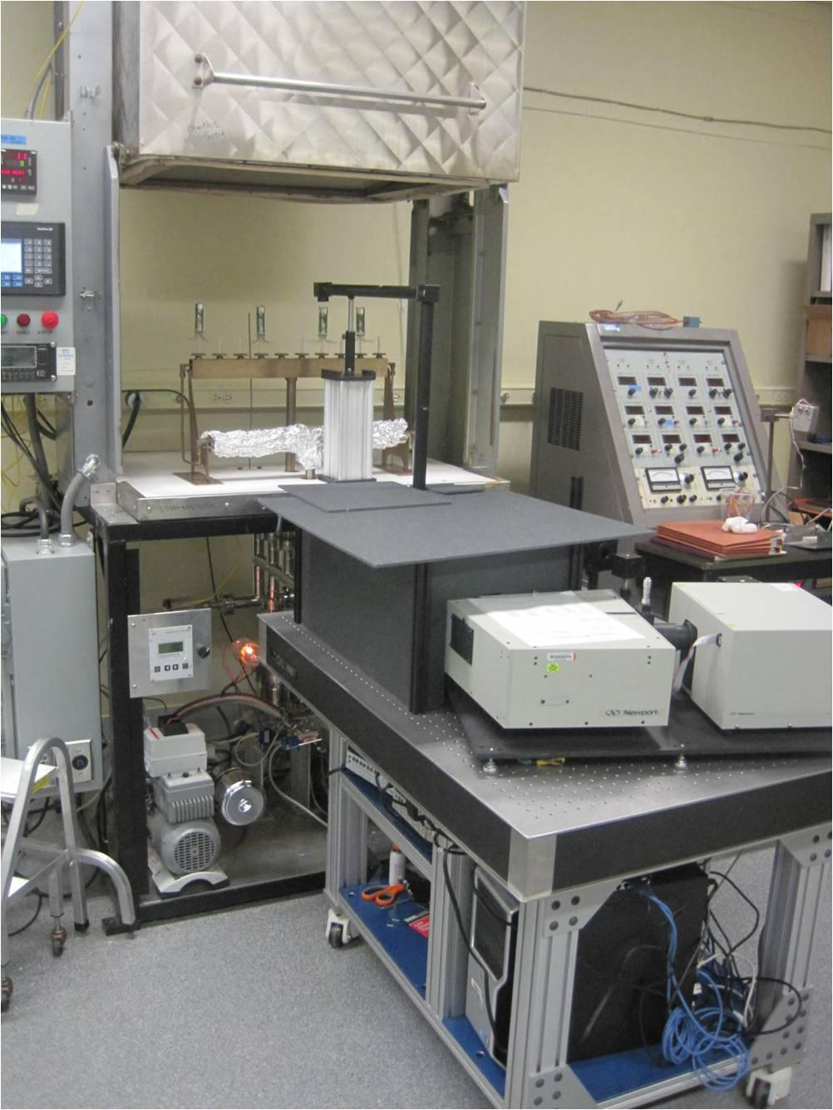
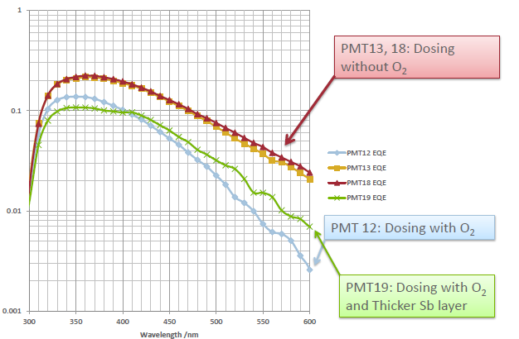
Photocathodes
LAPPD goal- 20-25% QE, 8”-square- conv. alkali
2 parallel efforts: SSL (knows how), and ANL (learning)
ANL
Optical stand
Burle commercial
equipment
First cathodes made at ANL

Slide 34
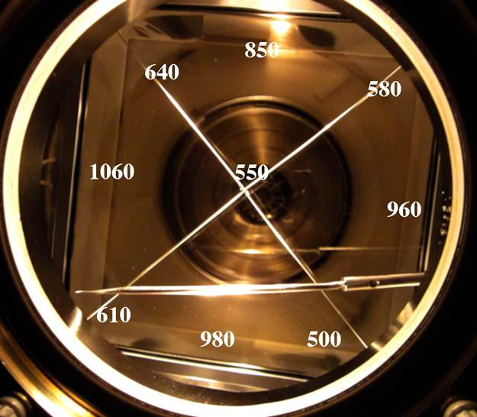
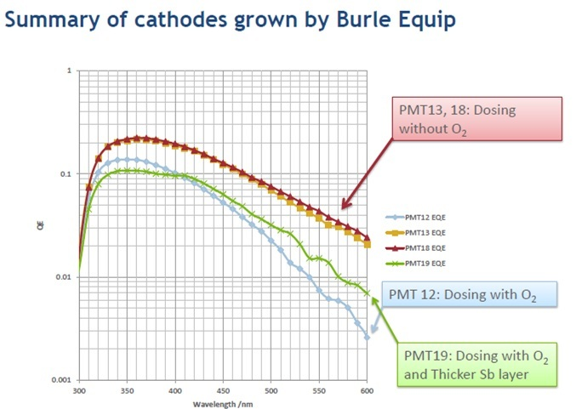
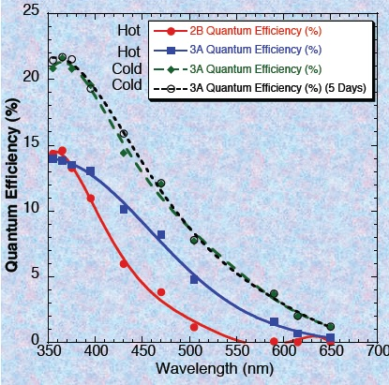

Status of PhotoCathodes
Have made >20% 8”PC at SSL; 25% small PC’s at ANL, 18% 4” (larger underway)
ANL
SSL 8” SbNaK cathode
QE of ANL small SbKCs cathodes
4” cathode: Chalice in Burle oven
QE of SSL 8” SbNaK cathode
ANL

Slide 35



PhotoCathode Research
Ongoing collaboration with BNL, UCB, UC, ANL for `Theory-Based Photocathodes
Xray diffraction while growing
Razib, Carlos, and Junqi put a PMT into
an APS Xray beam (you should ask them any questions…)

Slide 36
Conclusions

Slide 37


8”-MCP Pair and Strip Anode Work
Laser mirrors and 8” anode for 8” MCP tests
Pulses from one strip of 8” anode with 8” MCP pair
Matt Wetstein, Bernhard Adams, Andrey Elagin, Razib Obaid, Sasha Vostrikov, Bob Wagner

Slide 38
Demonstrated Position Sensitivity
Razib’s scanning stage
4-tile `tile-row’
of Supermodule
Time difference of 2 ends vs laser position

Slide 39

Timing res agrees with MC
< 6 psec
Time resolution on 2 ends of 8”-anode strip vs (S/N)⁻¹ in psec (pair of 8” MCP’s)
Laser spot
size
M. Wetstein, B. Adams, A. Elagin, R. Obaid, A. Vostrikov, …

Slide 40

Going Another Order-of-Magnitude
Stefan Ritt slide, doctored
(agrees with JF MC)
For 100 fsec
1.0
0.7
17
1.6
17
100 Femtosec (!)
Achieved by LAPPD
Subject of a 2013 SBIR with Innosys, SLC
Δt: γ e π K p
(ps) 0 10⁻⁶ 0.13 1.6 6.25
Differential TOF:
1.5m path

Slide 41

What’s the limit? (2009 cartoon)
Funnel pore with reflection cathode, dynode rings, ceramic anode,…
N.B.- this is a `cartoon’- working on workable designs-join us…
Front Window and Radiator
Photocathode
Pump Gap
High Emissivity Material
Low Emissivity Material
`Normal’ MCP pore material
Gold Anode
50 Ohm Transmission Line
Rogers PC Card
Capacitive Pickup to Sampling Readout

Slide 42

Comparison with existing detectors
K. Arisaka; UCLA
Psec
Cm²

Slide 43
More Information on LAPPD:
Main Page: http://psec.uchicago.edu (has the links to the Library and Blogs)
Library: Workshops, Godparent Reviews, Image Library, Document Library, Links to MCP, Photocathode, Materials Literature, etc.;
Blog: Our log-book- open to all (say yes to certificate Cerberus, etc.)- can keep track of us (at least several companies do);

Slide 44
The End

