Slide 1
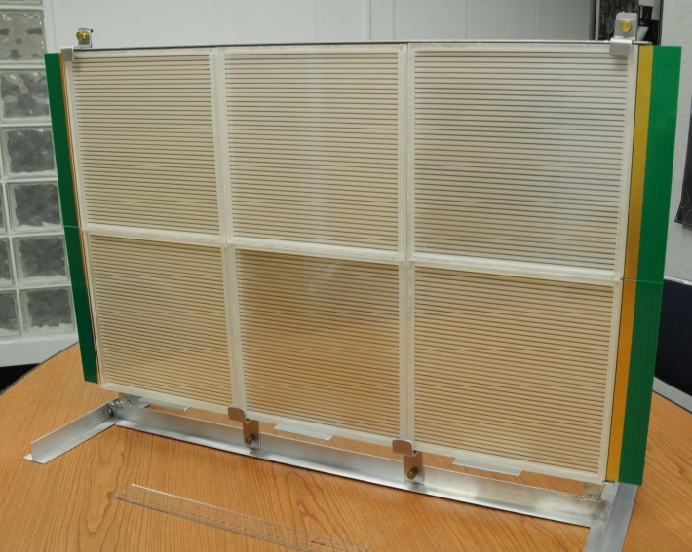
Large-area MCP-based Photo-detectors, Ultra-fast timing, and sub-mm Spatial Resolution (LAPPD)
Henry Frisch
Enrico Fermi Institute, Univ. of Chicago
and HEPD, Argonne National Laboratory

Slide 2
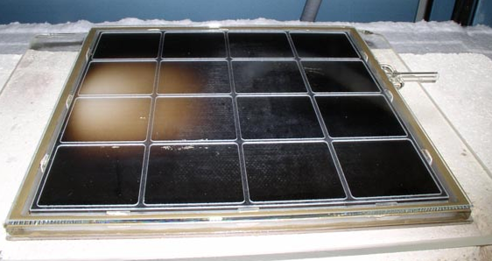
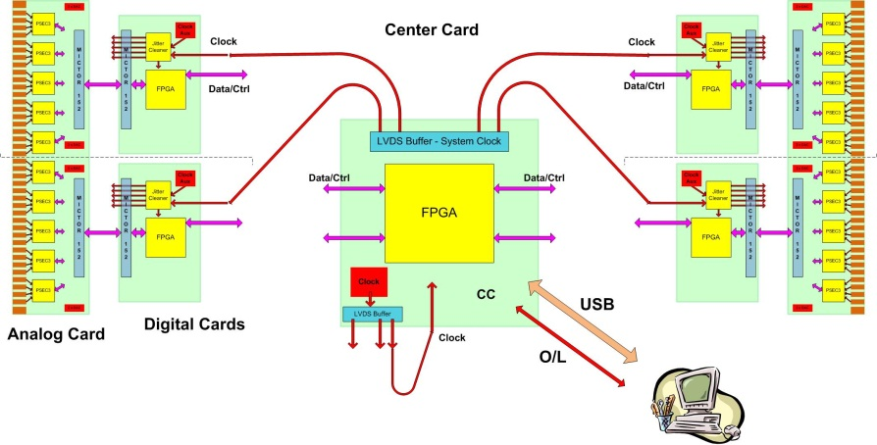
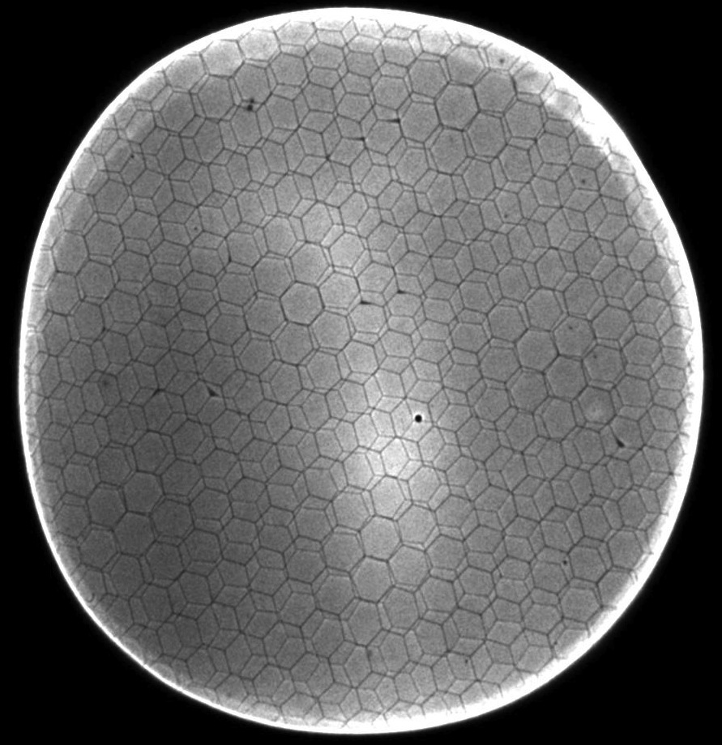
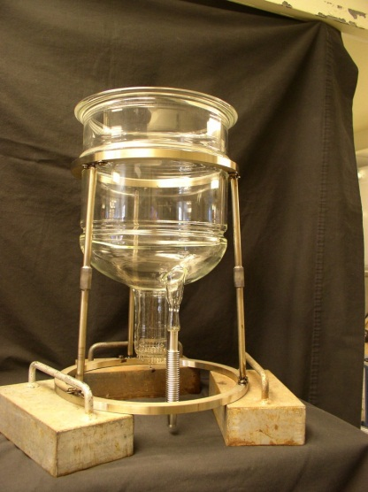
The 4 `Divisions’ of LAPPD
CV
CV
Hermetic Packaging
Electronics/Integration
See Bob Wagner’s talk
This talk
CV
CV
MicroChannel Plates
Photocathodes
See Ossy’s talk
See (hear) Klaus Attenkofer’s talk

Slide 3
Outline
The Power of Correlated Time/Space Points
MCP’s, Transmission Lines, and Waveform Sampling
The 4 Determinants of Time Resolution
Signal/Noise (S/N)
Analog Band-width (ABW)
Sampling Rate
Signal statistics
What is the ultimate resolution at decent area & cost?
Water Cherenkov Counters; PET Cameras; TOF at Colliders; TOF for Fixed Target; Security; and New Ideas

Slide 4
MCP+Transmission Lines Sampled at Both Ends Provide Time and 2D Space
Field Programable Gate Arrays
(not as shown- PC cards will be folded behind the panel- not this ugly…
Single serial Gbit connection will come out of panel with time and positions from center of back of panel
10-15 GS/sec Waveform Sampling ASICS
8” Tiles

Slide 5
Time and Space Points
Pulses from the 2 ends of an 8” silk-screened cheap-glass anode strip
5 nsec/div
50 psec/pt

Slide 6
Reconstructing the vertex space point: Simplest case- 2 hits (x,y) at wall
Detector Plane
Vertex (e.g. π⁰->γγ)
T_{v}, X_{v}, Y_{v}, Z_{v}
T₁, X₁, Y₁
Photon 1
Photon 2
One can reconstruct the vertex from the times and positions- 3D reconstruction
T₂, X₂, Y₂

Slide 7
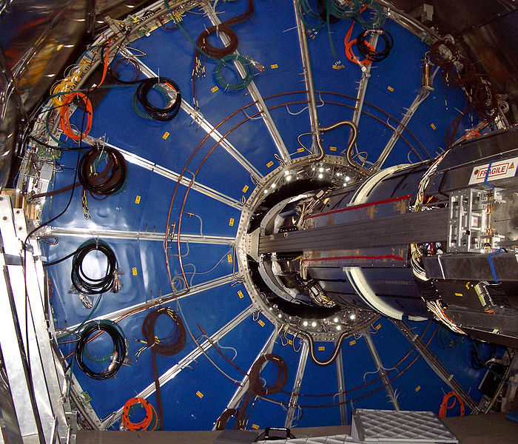
Good timing alone doesn’t do it-
The ALICE TPC:
Drift electrons onto wires that measure where and when for each electron.
Good time resolution would buy nothing if one integrated over a whole (blue) TPC sector- ie didn’t correlate when and where
when and where
Correlated time and space points allow 3D reconstructions

Slide 8
Waveform Sample On Ends of Strips
Eric Oberla slide from ANT11

Slide 9
Extract time, charge, shape each end
Eric Oberla slide from ANT11

Slide 10
Extract time, position of pulse using time from both ends
Eric Oberla slide from ANT11

Slide 11
The 4 Determinants of Time Resolution
Signal/Noise (S/N)
Analog Band-width (ABW)
Sampling Rate
Signal statistics
5 nsec/div
50 psec/pt
J.F. Genat, F. Tang, H. Frisch, and G. Varner; Picosecond Resolution Timing Measurements, Nucl. Instr. Meth A607, 387 (2009);
Workshop on The Factors that Limit Time Resolution in Photo-detectors, University of Chicago, April 28-29, 2011

Slide 12
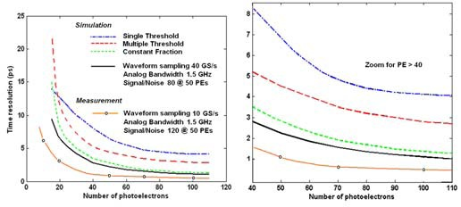
Simulation of Resolution vs abw
Jean-Francois Genat
1 ps
This (brown) line
This (brown) line
Brown line: 10 Gs/sec (we’ve done >15);
1.5 GHz abw ( we’ve done 1.6); S/N 120 (N=0.75mv, S is app specific)

Slide 13
Anode Testing for ABW, Crosstalk,..
Herve’ Grabas, Razib Obaid, Dave McGinnis
Network Analyzer Tile Anode

Slide 14
Anode Testing for ABW, Crosstalk,..
Herve’ Grabas, Razib Obaid, Dave McGinnis
Tile row assembly of 3 tile anodes – abw >500 MHz

Slide 15
Anode Testing for ABW, Crosstalk,..
ABW
Crosstalk
Razib Obaid

Slide 16
The PSEC4 Waveform Sampling ASIC
PSEC4: Eric Oberla and Herve Grabas; and friends…
Eric Oberla, ANT11

Slide 17
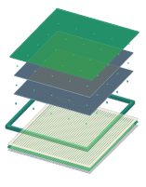
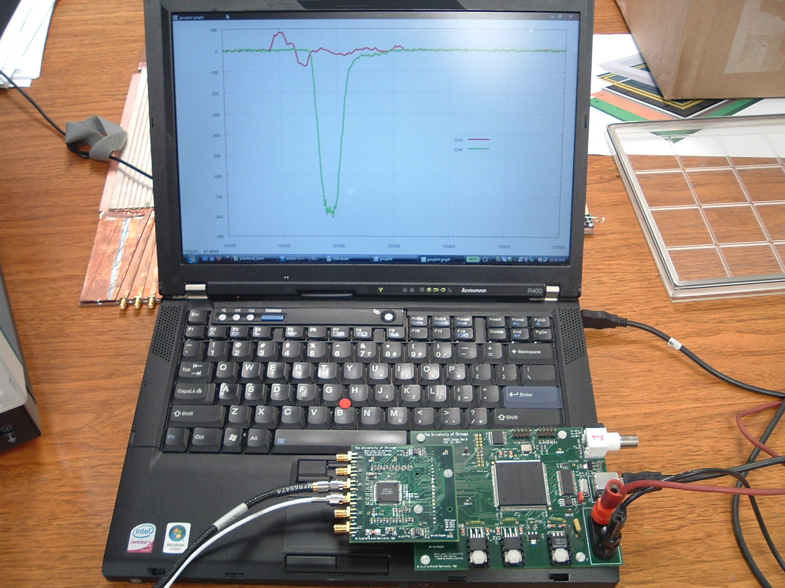
PSEC-4 ASIC
LAPPD Collaboration
Eric Oberla, ANT11
6-channel “oscilloscope on a chip” (1.6 GHz,10-15 GS/s)
Evaluation board uses USB 2.0 interface + PC data acquisition software

Slide 18
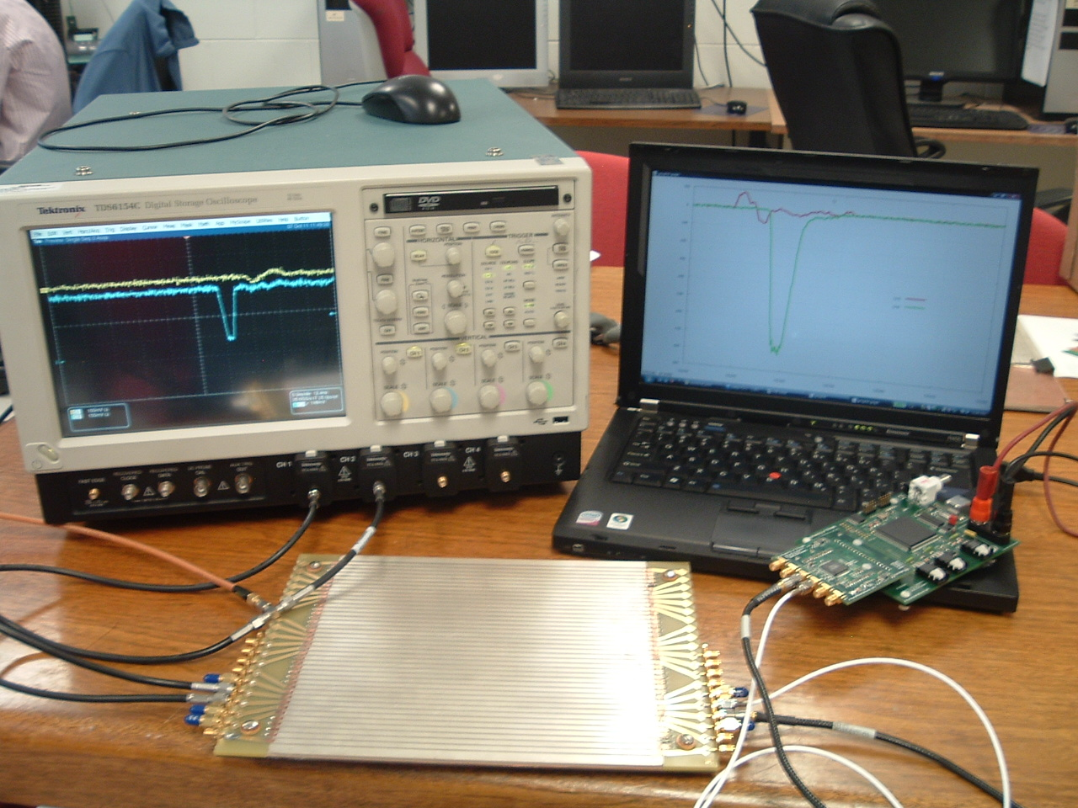
6-channel `Scope-on-a-chip’
Eric Oberla
(grad student)
Real digitized traces from anode
20 GS/scope
4-channels (142K$)
17 GS/PSEC-4 chip
6-channels ($130 ?!)

Slide 19
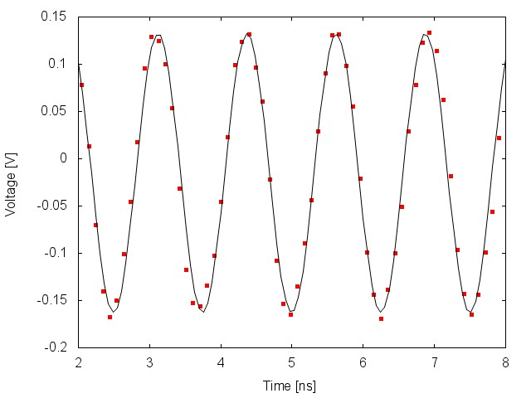
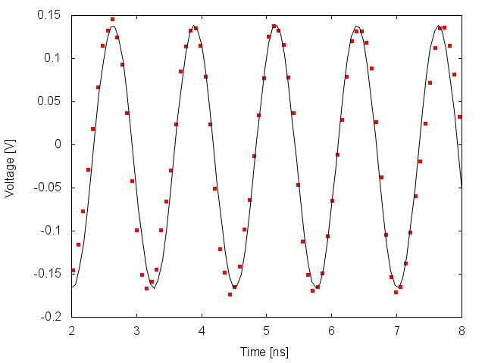
PSEC-4 Performance
Eric Oberla, ANT11
Digitized Waveforms
Input: 800MHz, 300 mV_{pp} sine
Sampling rate : 10 GSa/s
Sampling rate : 13.3 GSa/s
Only simple pedestal correction to data
As the sampling rate-to-input frequency ratio decreases, the need for time-base calibration becomes more apparent (depending on necessary timing resolution)

Slide 20
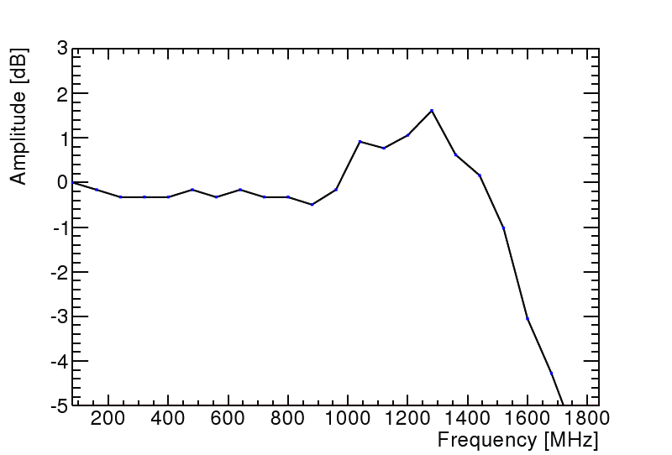
Digitization Analog Bandwith
Eric Oberla, ANT11
ABW~1.6GHz
3 db loss
PSEC4: Eric Oberla and Herve Grabas+ friends…

Slide 21
Noise (unshielded)
PSEC4: Eric Oberla and Herve Grabas+ friends…
RMS=755 microvolts
Full-Scale ~1.2 volts (expect S/N>=100, conservatively)
Eric Oberla, ANT11

Slide 22
Signal- want large for S/N
We see gains > 10⁷ in a chevron-pair
Ossy Siegmund, Jason McPhate, Sharon Jelinsky, SSL/UCB
ALD by Anil Mane and Jeff Elam, ANL

Slide 23
Can we go deep sub-picosec?: the Ritt Parameterization (agrees with JF MC)
Stefan Ritt slide, doctored
100 femtosec
S/N, f_{Z}: DONE
abw: NOT YET

Slide 24
Parallel Efforts on Specific Applications
.
Explicit strategy for staying on task-
Multiple parallel cooperative efforts
PET
(UC/BSD, UCB, Lyon)
Collider
(UC, ANL,Saclay.
LAPD Detector Development
Muon Cooling
Muons,Inc
(SBIR)
ANL,Arradiance,Chicago,Fermilab, Hawaii,Muons,Inc,SLAC,SSL/UCB, UIUC, Wash. U
K->πνν
JPARC
Drawing Not To Scale (!)
Mass Spec
Andy Davis, Mike Pellin, Eric Oberla
Neutrinos
(Matt, Mayly, Bob, John, ..; Zelimir)
Non-proliferation
LLNL,ANL,UC
All these need work- naturally tend to lag the reality of the detector development

Slide 25
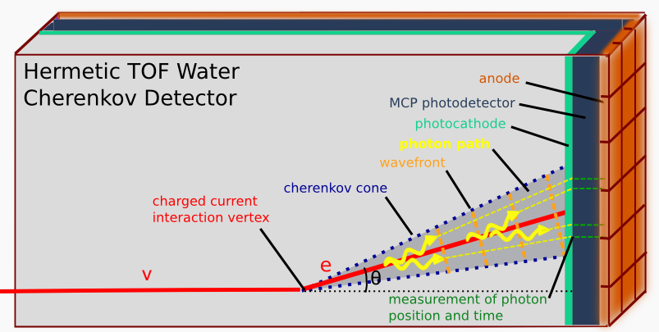
Neutrino Physics
(Howard Nicholson)
Spec: signal single photon, 100 ps time, 1 cm space, low cost/m2 (5-10K$/m2)*

Slide 26
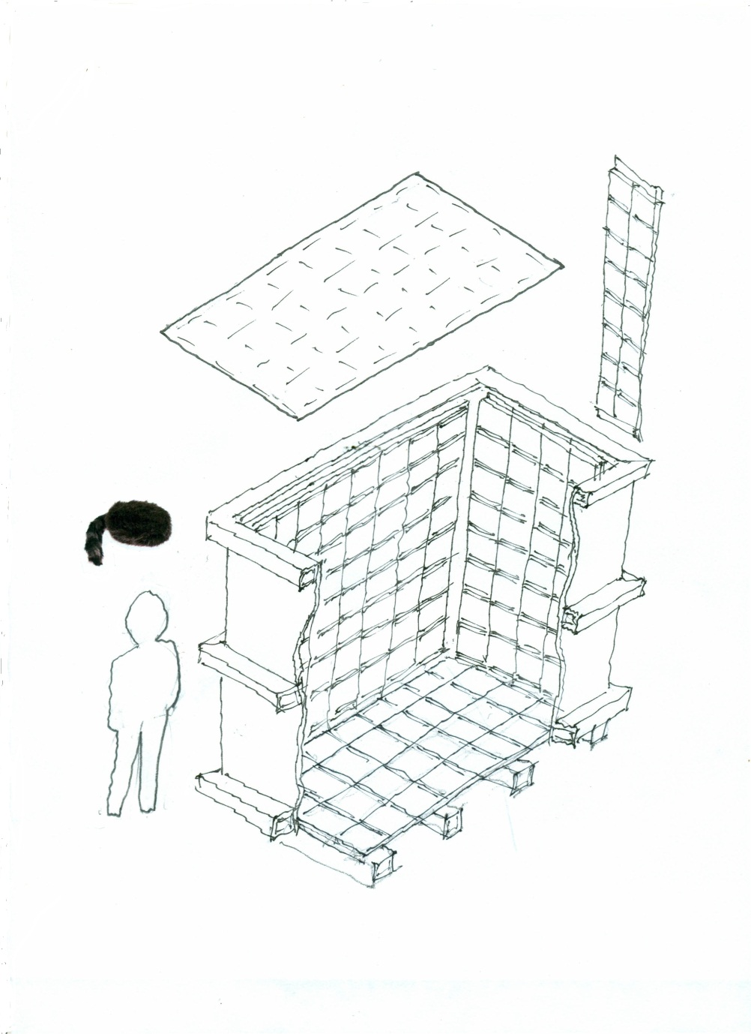
Daniel Boone
Proposal (LDRD) to build a little proto-type to test photon-TPC ideas and as a simulation testbed
`Book-on-end’ geometry- long, higher than wide
Close to 100% coverage so bigger Fid/Tot volume
Δx, Δy << 1 cm
Δt < 100 psec
Magnetic field in volume
Idea: to reconstruct vertices, tracks, events as in a TPC (or, as in LiA).
caps
2 m
ν
2 m
1 m

Slide 27
Can we build a photon TPC?
Work of Matt Wetstein (Argonne,&Chicago) in his spare time (sic)

Slide 28
Matt Wetstein; ANL&UC
Works on GEANT events too

Slide 29
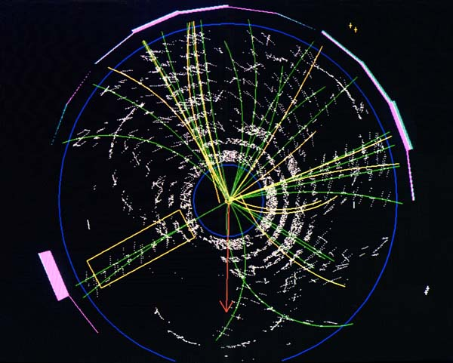
Application to Colliders
At colliders we measure the 3-momenta of hadrons, but can’t follow the flavor-flow of quarks, the primary objects that are colliding. 2-orders-of-magnitude in time resolution would all us to measure ALL the information=>greatly enhanced discovery potential.
A top candidate event from CDF- has top, antitop, each decaying into a W-boson and a b or antib. Goal- identify the quarks that make the jets.
Specs:
Signal: 50-10,000 photons
Space resolution: 1 mm
Time resolution 1 psec
Cost: <100K$/m2:
t-tbar -> W⁺bW⁻bbar-> e+ nu+c+sbar+b+bbar

Slide 30
2003- Aspen Exptl Summary Talk
Invitation from Joe Lykken and Maria Spiropulu- led to psec TOF

Slide 31
Colliders: Differential TOF
Rather than use the Start time of the collision, measure the difference in arrival times at the beta=c particles (photons, electrons and identified muons) and the hadrons, which arrive a few psec later.

Slide 32
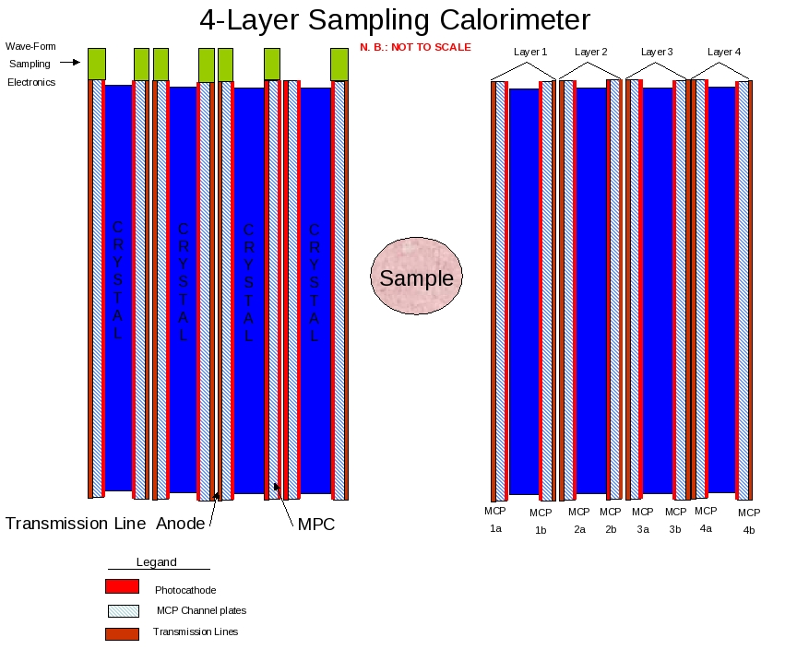
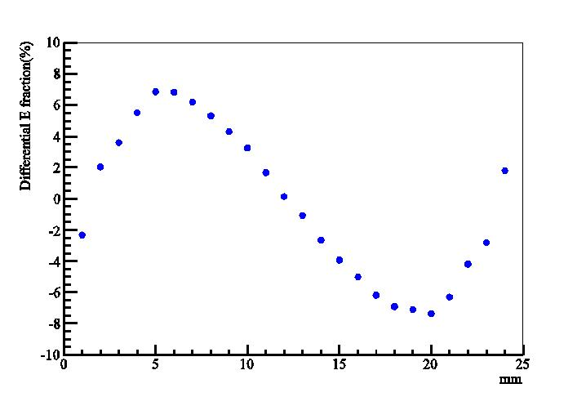
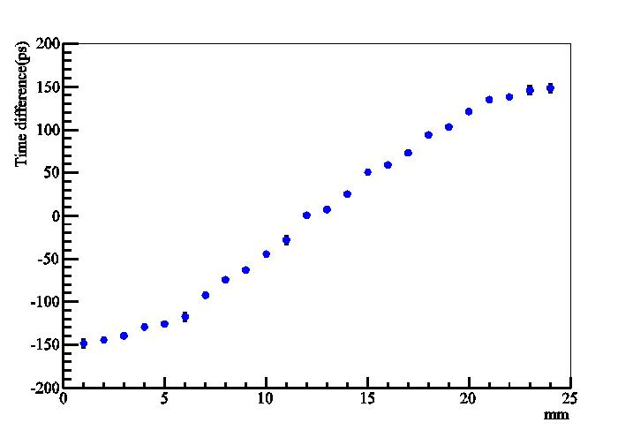
Medical Imaging (PET)
Alternating radiator and cheap 30-50 psec planar mcp-pmt’s on each side
Can we solve the depth-of-interaction problem and also use cheaper faster radiators?
Simulations by Heejong Kim (Chicago)
Heejong Kim
Heejong Kim
Depth in crystal by energy- asymmetry
Depth in crystal by time-difference

Slide 33
Sampling calorimeters based on thin cheap photodetectors with correlated time and space waveform sampling
Bill Moses (Lyon)
Proposal: Alternating radiator and cheap 30-50 psec thin planar mcp-pmt’s on each side (needs simulation work)

Slide 34
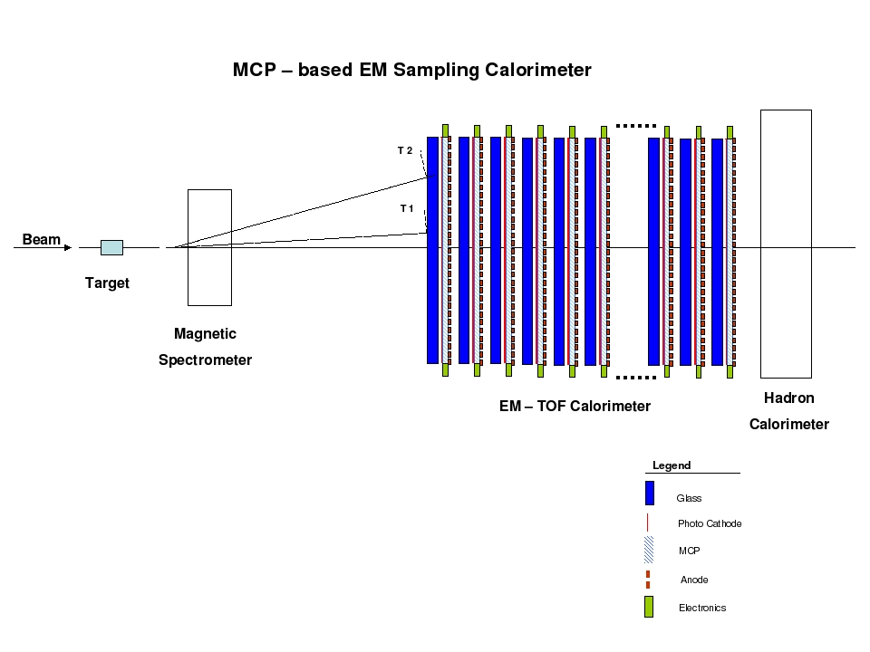
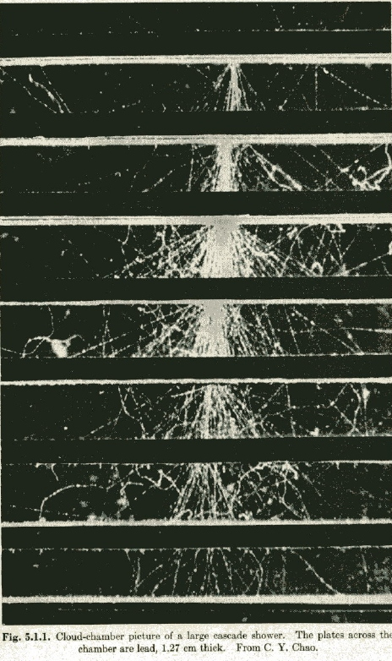
Cherenkov-sensitive Sampling Quasi- Digital Calorimeters
A picture of an em shower in a cloud-chamber with ½” Pb plates (Rossi, p215- from CY Chao)
A `cartoon’ of a fixed target geometry such as for JPARC’s KL-> pizero nunubar (at UC, Yao Wah) or LHCb

Slide 35
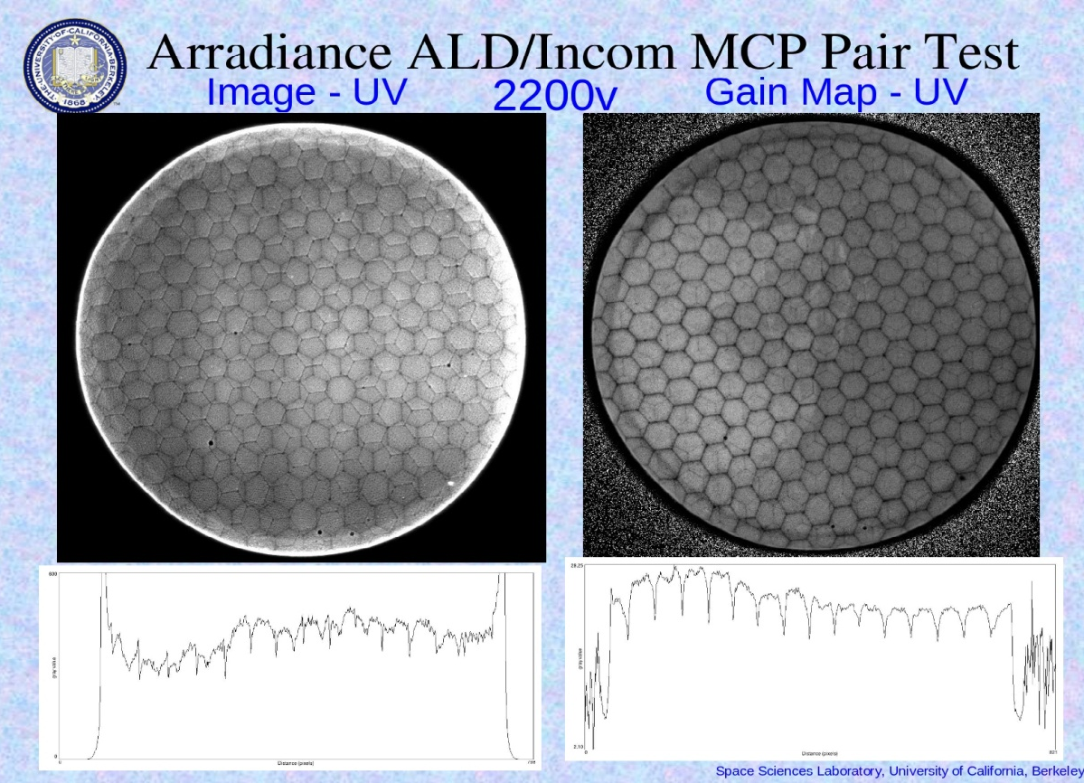
A `Quasi-digital’ MCP-based Calorimeter
Idea: can one saturate pores in the the MCP plate s.t.output is proportional to number of pores. Transmission line readout gives a cheap way to sample the whole lane with pulse height and time- get energy flow.
Oswald Siegmund, Jason McPhate, Sharon Jelinsky, SSL (UCB)
Note- at high gain the boundaries of the multi’s go away
Electron pattern (not a picture of the plate!)- SSL test, Incom substrate, Arradiance ALD. Note you can see the multi’s in both plates => ~50 micron resolution

Slide 36
More Information:
Main Page: http://psec.uchicago.edu
Library: Workshops, Godparent Reviews, Image Library, Document Library, Links to MCP, Photocathode, Materials Literature, etc.;
Blog: Our log-book- open to all (say yes to certificate Cerberus, etc.)- can keep track of us (at least several companies do);
The End

Slide 37
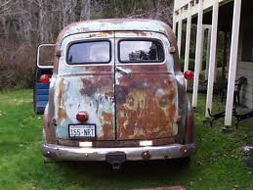
Backup slides

Slide 38
The 4 `Divisions’ of LAPPD
CV
CV
Hermetic Packaging
Electronics/Integration
See Bob Wagner’s talk
This talk
CV
CV
MicroChannel Plates
Photocathodes
See (hear) Bob Wagner’s talk
See (hear) Klaus Attenkofer’s talk

Slide 39
The Large-Area Psec Photo-Detector Collaboration

Slide 40
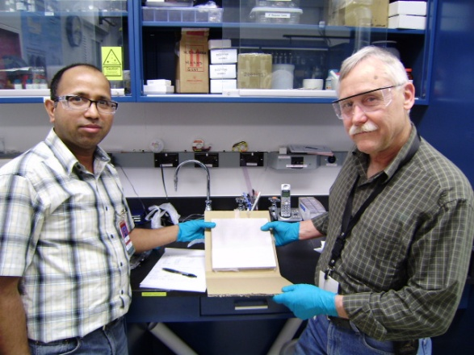
Microchannel Plates-2
Argonne ALD and test Facilities
In situ measurements of R (Anil)
Femto-second laser time/position measurements (Matt, Bernhard, Razib, Sasha)
33 mm development program
8” anode injection measurements
Anil Mani and Bob Wagner

Slide 41
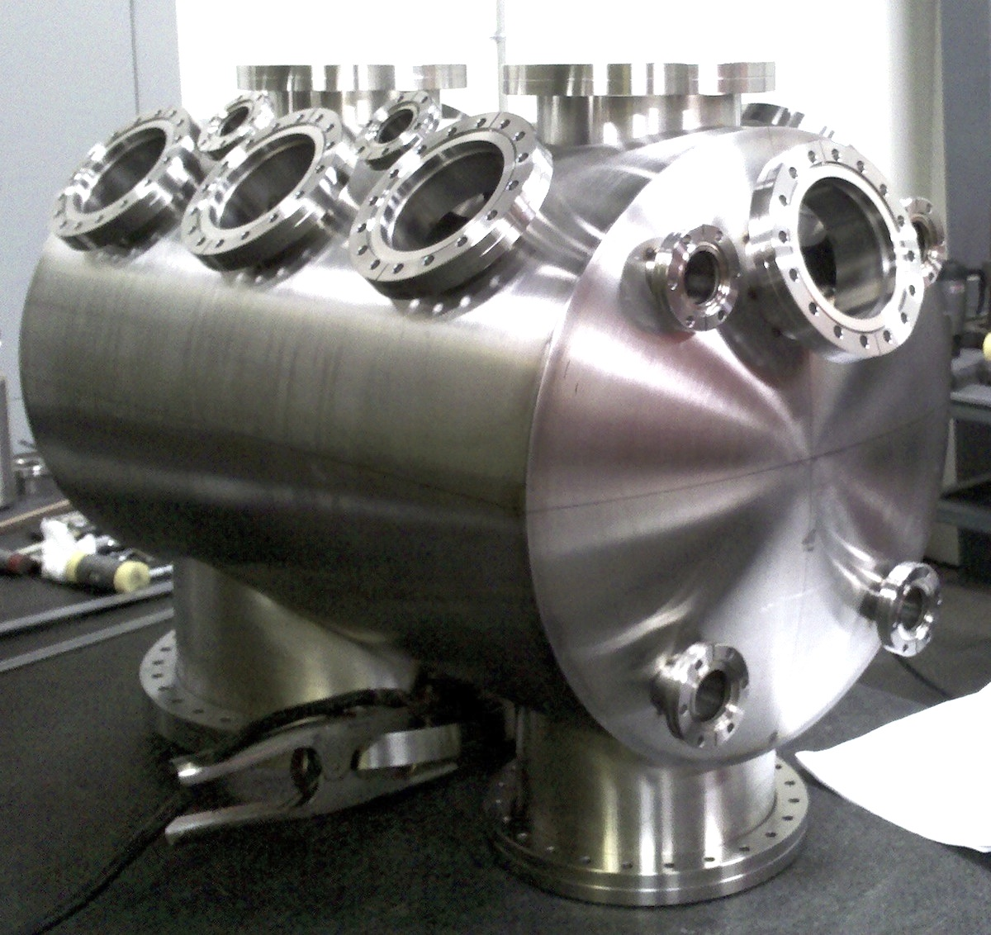
Microchannel Plates-3
SSL (Berkeley) Test/Fab Facilities
Ossy Siegmund, Jason McPhate, Sharon Jelenski, and Anton Tremsin-
Decades of experience
(some of us have decades of inexperience?)

Slide 42
Microchannel Plates-4b
Performance:
Noise (bkgd rate).
<=0.1 counts/cm²/sec; factors of few > cosmics (!)
Ossy Siegmund, Jason McPhate, Sharon Jelinsky, SSL/UCB

Slide 43
Microchannel Plates-4d
Performance: burn-in (aka `scrub’)
Measured ANL ALD-MCP behavior
(ALD by Anil Mane, Jeff Elam, ANL)
Measurements by
Ossy Siegmund,
Jason McPhate,
Sharon Jelinsky, SSL/UCB
Typical MCP behavior- long scrub-times

Slide 44
First Pulses From an 8” MCP
Matt Wetstein, Bernhard Adams, Razib Obaid, Sasha Vostrikov (ANL and UC)
TOA (psec)
TrueError bar prob.
like this
(ask Matt)
Note
c= 0.3mm/ps
1/c=3.3 psec/mm
From the time difference of the 2 ends of the strip one gets the longitudinal position, from the average of the 2 ends the time (and of course from which strip(s) one gets the transverse position) => so have 2D at wall plus Time-of-Arrival
Position of laser (mm)

Slide 45
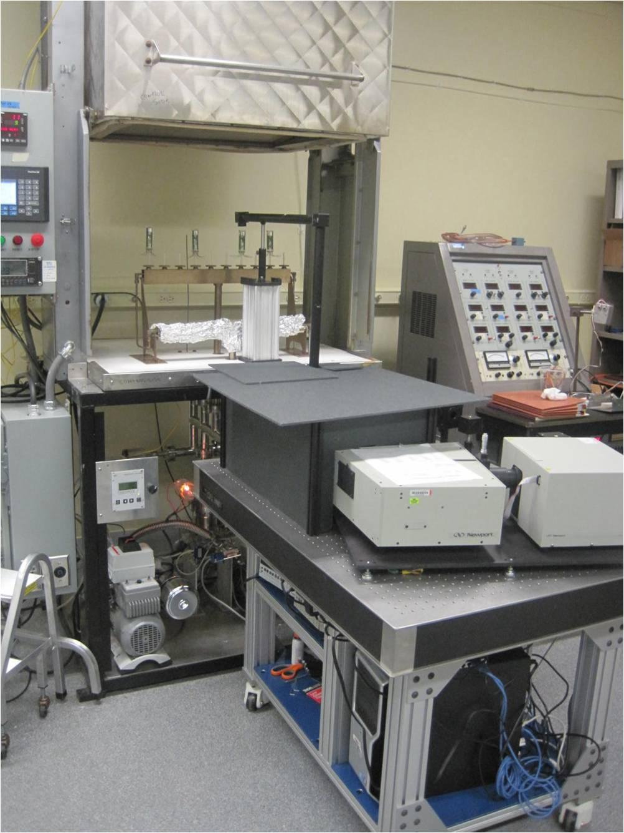
Photocathodes Subject of next talk by Klaus- touch on here only briefly
LAPPD goal- 20-25% QE, 8”-square
2 parallel efforts: SSL (knows how), and ANL (learning)
ANL
Optical stand
Burle commercial
equipment
First cathodes made at ANL

Slide 46
Photocathodes- 2 Subject of next talk by Klaus
SSL has years of experience making bialkali photocathodes-
They are our treasury bonds (Swiss francs?) in the LAPPD `portfolio of risk’

Slide 47
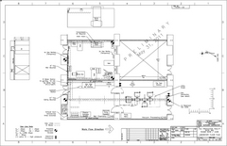
Hermetic Packaging
Top Seal and Photocathode- this year’s priority
3 parallel paths
Tile Development Facility at ANL
Production Facility at SSL/UCB
Commercial RFI for 100 tiles
(Have had one proposal for 7K- 21K tiles/yr)

Slide 48
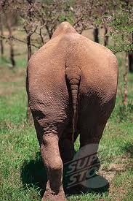
The End

