Slide 1
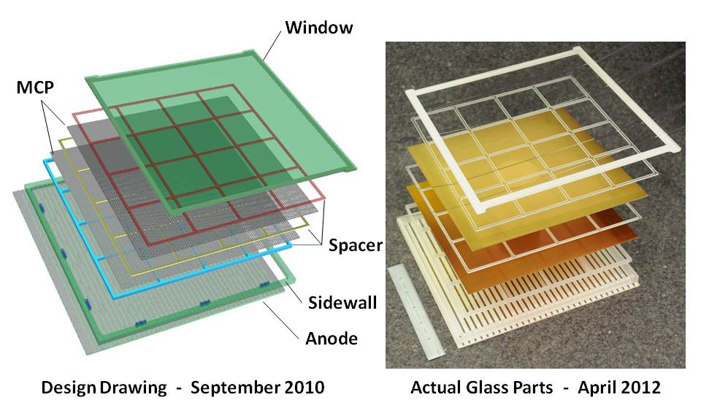
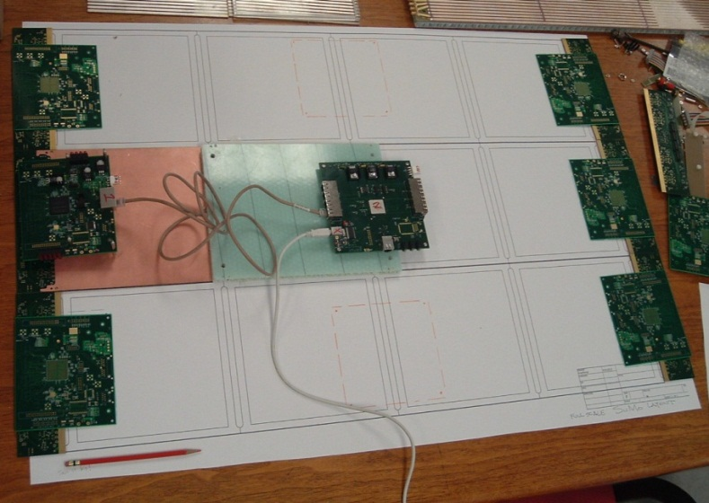
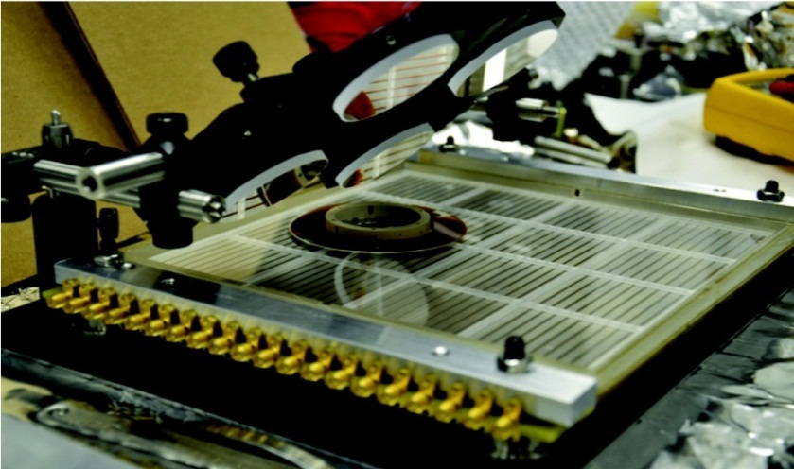
The Development of Large-Area Pico-second Photodetectors
Henry Frisch, Enrico Fermi Institute, Univ. of Chicago
For the LAPPD Collaboration
Acknowledgements- LAPPD collaborators, Howard Nicholson and the DOE HEP,
ANL Management, and the NSF.

Slide 2
Using New Technologies to Exploit Fundamentally Simple Ideas To probe new things

Slide 3
Motivation(s)
Apologies if it seems obvious or didactic- it turns out to be powerful

Slide 4
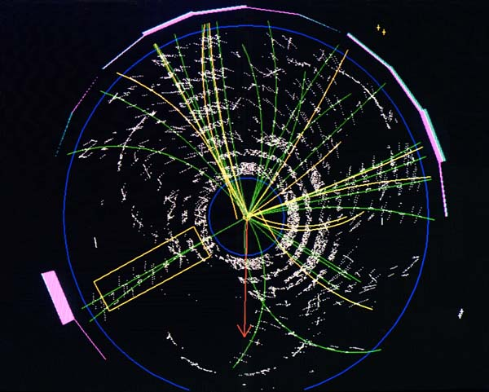
Colliders:
Need: 1) identify the quark content of charged particles
2) vertex photons
Theme: extract all the information in each event (4-vectors)
Approach: measure the difference in arrival times of photons and charged particles which arrive a few psec later.
Light source is Cherenkov light in the window/radiator.
Benefit: Discoveries in signatures not possible now
(Note: conventional TOF resolution is 100 psec -factor of 100 worse than our goal= 1” is 100 psec, so need a small scale-length).

Slide 5
The bizarre structure of basic matter
Nico Berry (nicoberry.com)
Charge +2/3e
Charge -1/3e
M~2 MeV
M=1750 MeV
M=175,000 MeV
M=300 MeV
M=4,500 MeV
Distinguishable only by mass (and possibly lifetime)- hence measure velocity (v) and momentum (gmv) of the parent particle to find out m and thus the quark content.

Slide 6
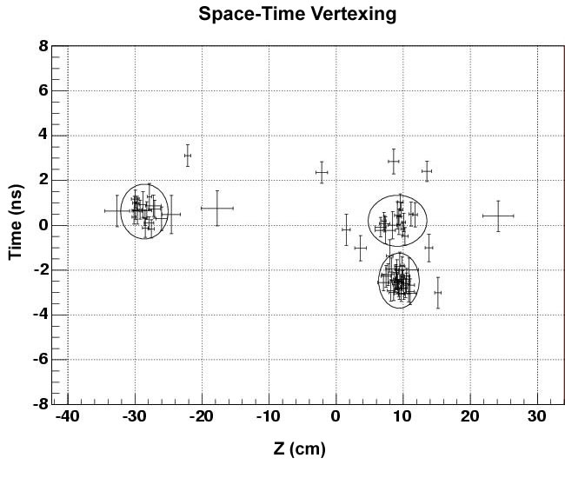
Major problem coming up at LHC- vertexing at high luminosity (quote Joe Incandela, CMS)
3 different interactions in one beam crossing
Time (ns)
Multi-vertex event at CDF (Tevatron)
Vertex position along beam line (cm)
Need, e.g.- Higgs to gamma-gamma at the LHC - tie the photons to the correct vertex, and more precisely reconstruct the mass of the pair

Slide 7
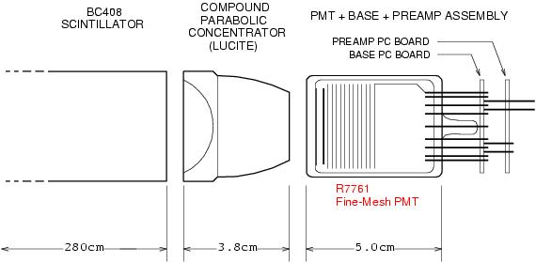
Why has 100 psec been the # for 60 yrs?
Typical path lengths for light and electrons are set by physical dimensions of the light collection and amplifying device.
These are on the order of an inch. One inch is 100 psec. That’s what we measure- no surprise! (pictures from T. Credo)
Typical Light Source (With Bounces)
Typical Detection Device (With Long Path Lengths)

Slide 8
Preview- LAPPD (rel) timing
< 6 psec
Laser spot
size
Time resolution on 2 ends of 8”-anode strip vs (S/N)⁻¹ in psec (pair of 8” MCP’s)
M. Wetstein, B. Adams, A. Elagin, R. Obaid, A. Vostrikov, …

Slide 9
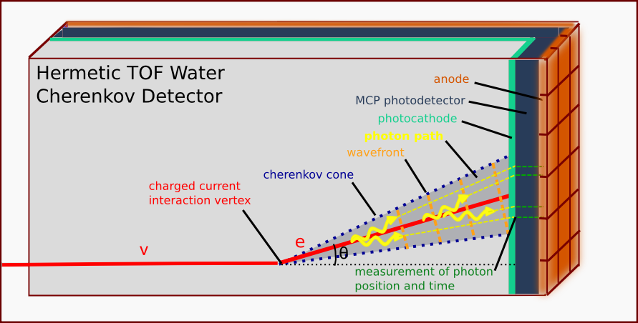
Neutrino Physics
Need: lower the cost and extend the reach of large neutrino detectors
H. Nicholson
Approach: measure the arrival times and positions of photons and reconstruct tracks in water
Benefit: Factor of 5 less volume needed, cost.
Competition- large PMT’s, Liquid Argon

Slide 10
Can we build a photon TPC?
Work of Matt Wetstein (Argonne,&Chicago) in his spare time (sic)

Slide 11
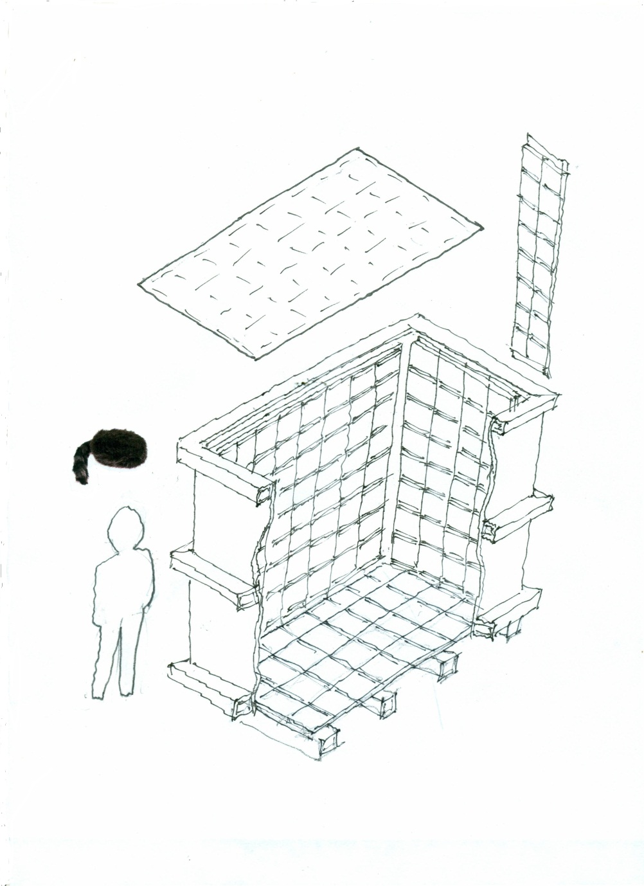
Daniel Boone
Proposal (LDRD) to build a little proto-type to test photon-TPC ideas and as a simulation testbed
`Book-on-end’ geometry- long, higher than wide
Close to 100% coverage so bigger Fid/Tot volume
Δx, Δy << 1 cm
Δt < 100 psec
Magnetic field in volume
Idea: to reconstruct vertices, tracks, events as in a TPC (or, as in LiA).
caps
2 m
ν
2 m
Daniel
1 m

Slide 12
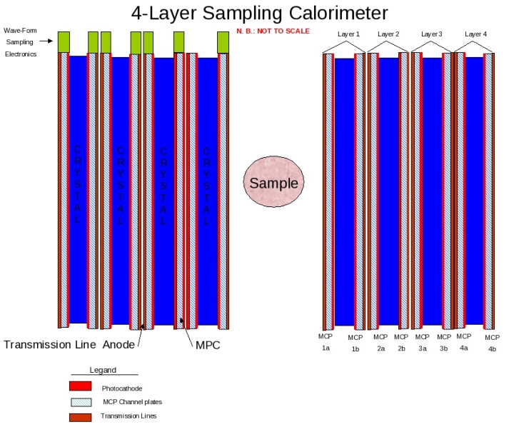
Medical Imaging (PET)
Need: 1) much lower dose rate
2) faster through-put
3) real-time feedback (therapy as well as diagnosis)
Approach: precise Time-of-Flight, sampling, real-time adaptive algorithms in local distributed computing, use much larger fraction of events and information
Benefit: higher resolution, lower dose to patient, less tracer production and distribution, new hadron therapy capabilities
Competition: Silicon PMT’s

Slide 13
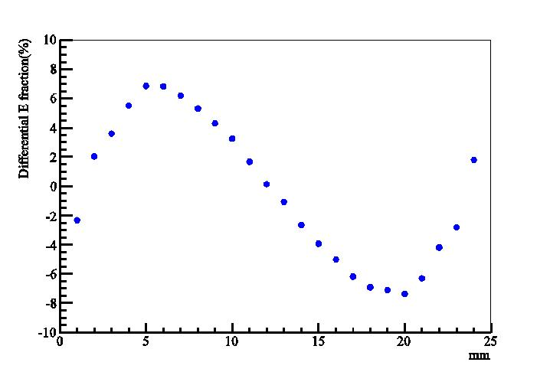
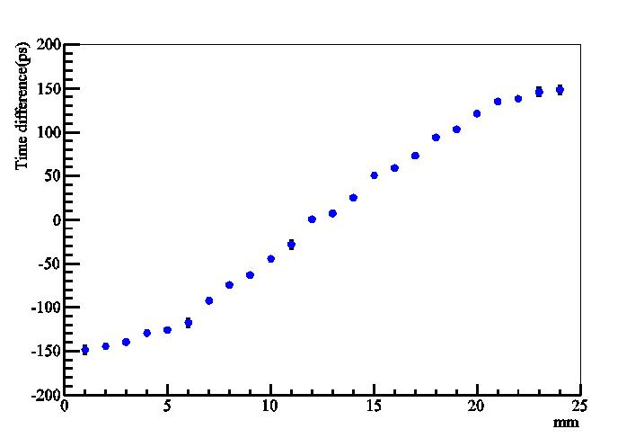
Sampling Calorimetry in PET?
Alternating radiator and cheap 30-50 psec planar mcp-pmt’s on each side
Can we solve the depth-of-interaction problem and also use cheaper faster radiators?
Simulations by Heejong Kim (Chicago)
Heejong Kim
Heejong Kim
Depth in crystal by time-difference
Depth in crystal by energy- asymmetry

Slide 14
Reconstructing the vertex space point: Simplest case- 2 hits (x,y) at wall
Detector Plane
E.g. for KOTO (Prof. Wah’s expt at JPARC)
Vertex (e.g. π⁰->γγ)
T_{v}, X_{v}, Y_{v}, Z_{v}
T₁, X₁, Y₁
Photon 1
Photon 2
One can reconstruct the vertex from the times and positions- 3D reconstruction
T₂, X₂, Y₂

Slide 15
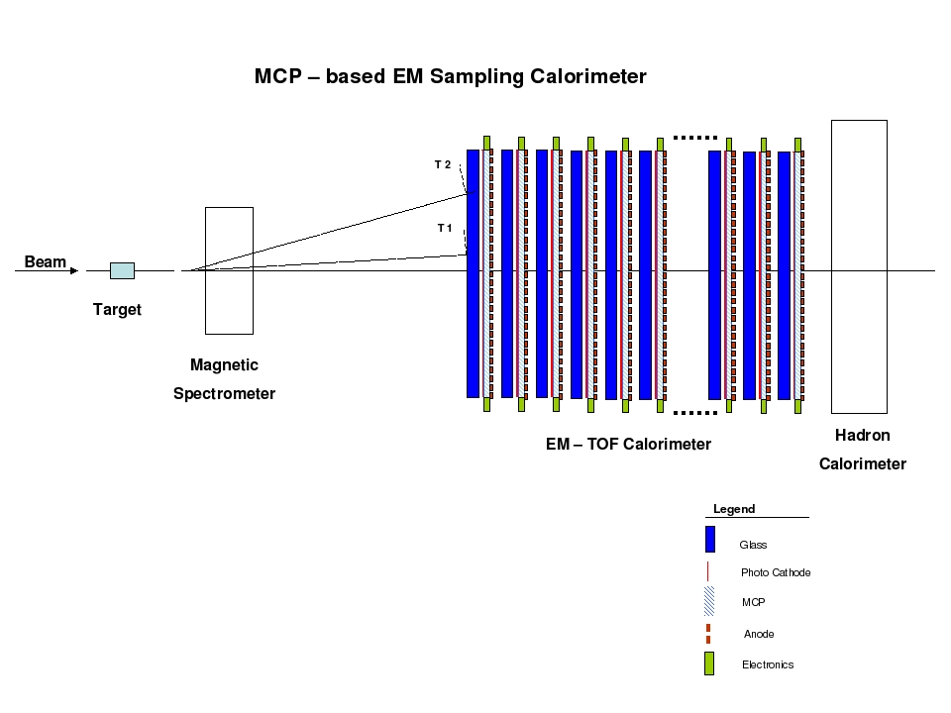
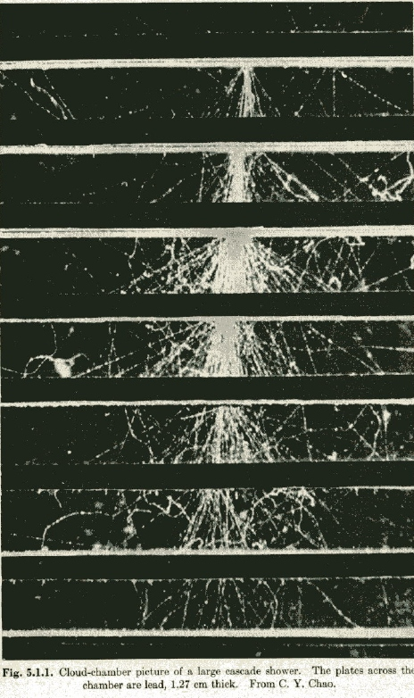
Cherenkov-sensitive Sampling Quasi- Digital Calorimeters
A picture of an em shower in a cloud-chamber with ½” Pb plates (Rossi, p215- from CY Chao)
A `cartoon’ of a fixed target geometry such as for JPARC’s KL-> pizero nunubar (at UC, Yao Wah) or LHCb

Slide 16
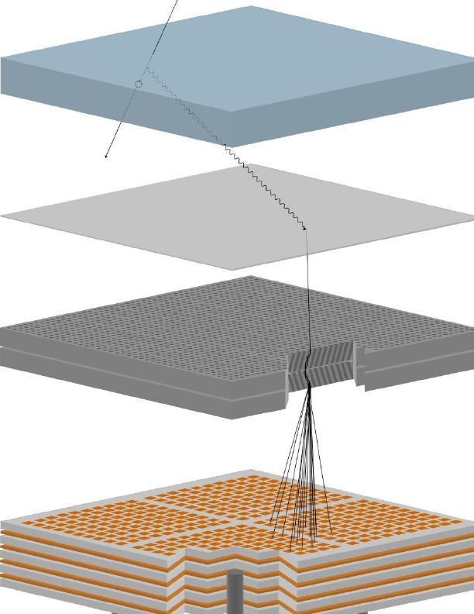
How Does it Work?
Requires large-area, gain > 10⁷, low noise, low-power, long life,
σ(t)<10 psec, σ(x) < 1mm, and low large-area system cost
Realized that an MCP-PMT has all these but large-area, low-cost:
(since intrinsic time and space scales are set by the pore sizes- 2-20µ)
Incoming charged particle
window
Radiated Cherenkov photon
Photocathode on inside of window
Photo-electron
from cathode
Pair of micro-channel plates
Output pulse of 10⁷ electrons
RF strip-line anode

Slide 17
Collaboration with SSL/UCB
Two parallel but intertwined efforts :
SSL/Hawaii (Siegmund)- ceramic package based on Planacon experience, NaKSb cathode, higher cost, smaller area, lower throughput;
ANL/UC (Wagner, Byrum,Frisch)- glass package, KCsSb cathode, lower cost, larger area, higher throughput;
Reduce risk and enhance reward by diversification onto the 2 paths. Has proved very beneficial to both efforts (much cross-fertilization, and shared MCP development). Not a competition, but a shared collegial effort that has worked, and is working, very well.

Slide 18
So what are the new technologies?
Glass capillary substrates (Incom)
Atomic Layer Deposition (Arradiance, ANL)
RF transmission line anodes (Tang, UC..)
Waveform Sampling (Hawaii, MPI, Orsay,Saclay, UC)
Cheap plate glass, frit seals, silk-screened anodes, home-brew indium seals, …
However- there are areas where we have only old technologies and need new ones-
Challenges and opportunities (have some fun while you’re mostly typing in deathless C++)

Slide 19
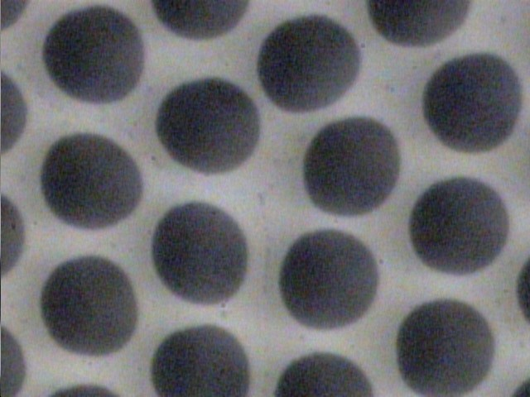
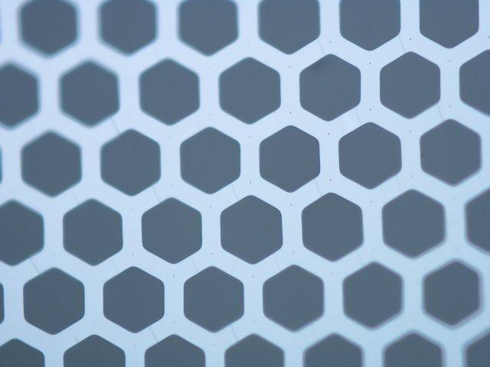
Simplifying MCP Construction
Conventional Pb-glass MCP
OLD
Incom Glass Substrate
NEW
Chemically produced and treated Pb-glass does 3-functions:
Provide pores
Resistive layer supplies electric field in the pore
Pb-oxide layer provides secondary electron emission
Separate the three functions:
Hard glass substrate provides pores;
Tuned Resistive Layer (ALD) provides current for electric field (possible NTC?);
Specific Emitting layer provides SEE

Slide 20
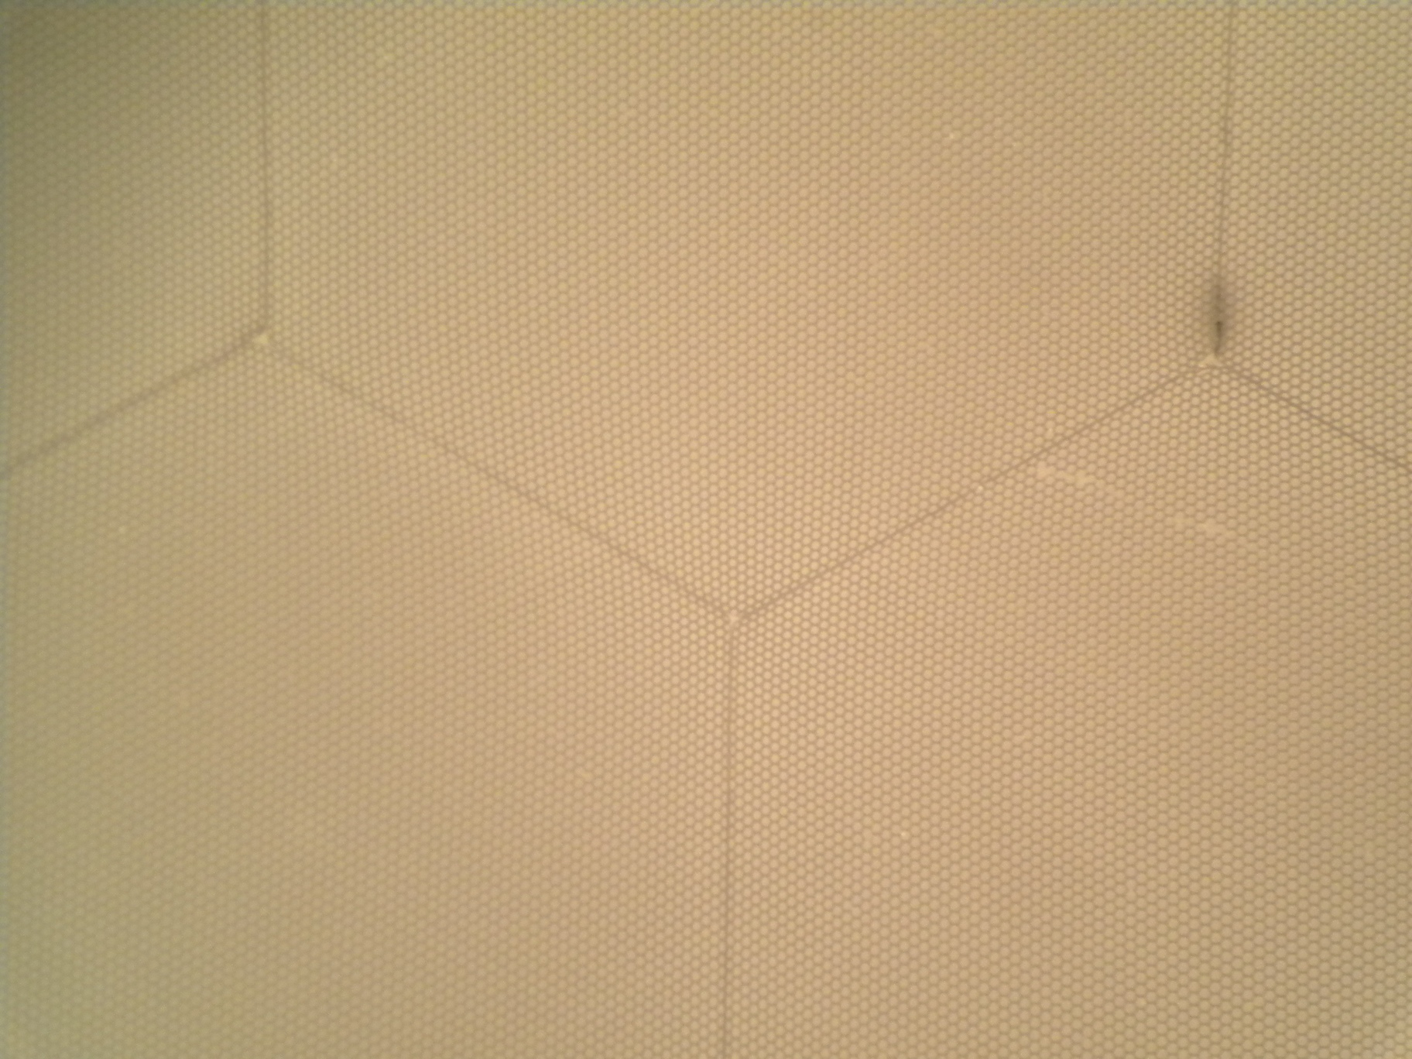
Latest Incom Micropore Substrate
.075”
~150 20μ pores
INCOM glass substrate
80 million 20-micron pores in an 8”-sq plate
65% open-area ratio; 1.2mm thick (L/D=60)
Incom.inc, Charlton Mass

Slide 21
New MCP Structure (not to scale)
pore
1 KV
resistive coating (ALD)
emissive coating (ALD)
conductive coating (thermal evaporation or sputtering)
Jeff Elam
21
Notes:
Very schematic – not correct open area ratio
Might need to do Au before Al2O3 for better contact
Add HV leads
21

Slide 22
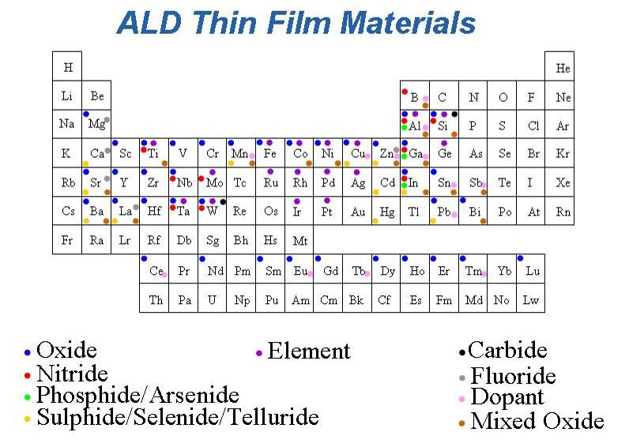
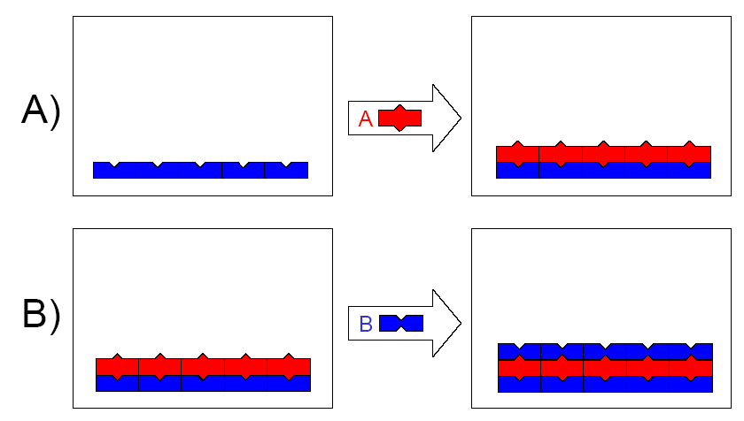
Atomic Layer Deposition (ALD) Thin Film Coating Technology
Atomic level thickness control
Deposit nearly any material
Precise coatings on 3-D objects (JE)
Lots of possible materials => much room for higher performance
Jeff Elam pictures
Notes:
22
For the technologies that I’ll be describing today, ALD has attributes that uniquely suit it

Slide 23
Slade Jokela (ANL)

Slide 24
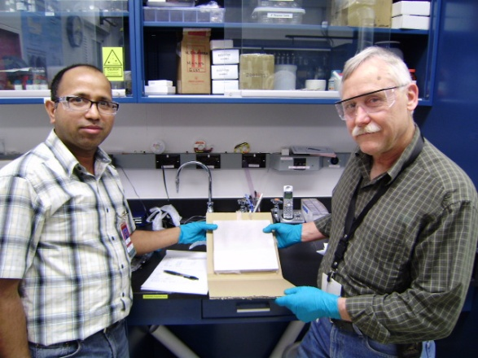
ALD &Integration tests at ANL
Argonne Atomic Layer Deposition and Test Facilities
In situ measurements of R (Anil)
Femto-second laser time/position measurements (Matt, Bernhard, Andrey, Razib, Sasha, Bob, Eric)
33 mm development program
8” anode injection measurements
Anil Mani and Bob Wagner
24

Slide 25
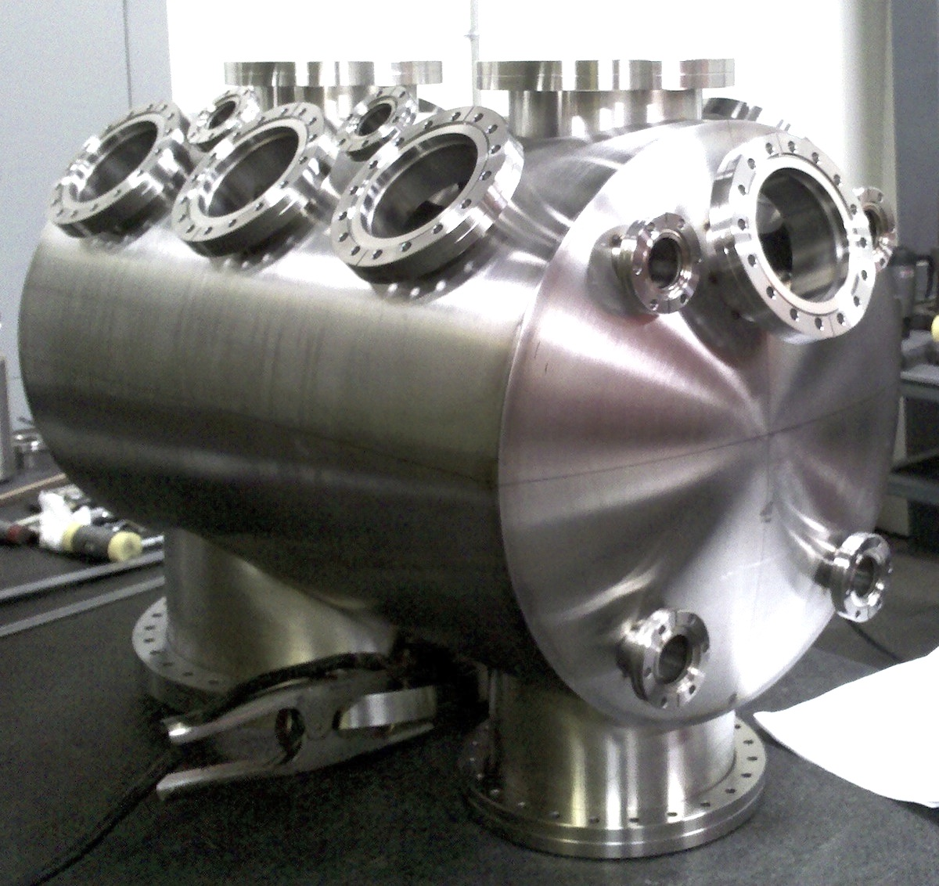
SSL (Berkeley) Test/Fab Facilities
Ossy Siegmund, Jason McPhate, Sharon Jelenski, and Anton Tremsin-
Decades of experience
(some of us have decades of inexperience?)

Slide 26
Microchannel Plates-4b
Performance:
Noise (bkgd rate).
<=0.1 counts/cm²/sec; factors of few > cosmics (!)
Ossy Siegmund, Jason McPhate, Sharon Jelinsky, SSL/UCB

Slide 27
Microchannel Plates-4d
Performance: burn-in (aka `scrub’)
Measured ANL ALD-MCP behavior
(ALD by Anil Mane, Jeff Elam, ANL)
Measurements by
Ossy Siegmund,
Jason McPhate,
Sharon Jelinsky, SSL/UCB
(Big deal commercially?)
Typical MCP behavior- long scrub-times

Slide 28
Signal- want large for S/N
We see gains > 10⁷ in a chevron-pair
Ossy Siegmund, Jason McPhate, Sharon Jelinsky, SSL/UCB
ALD by Anil Mane and Jeff Elam, ANL

Slide 29
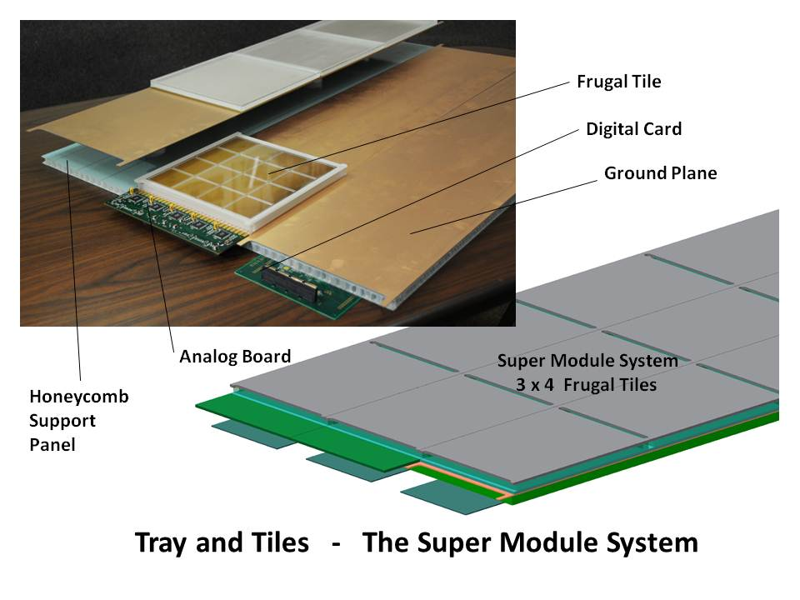
Tile-Tray Integrated Design
Because this is an RF-based readout system, the geometry and packaging are an integral part of the electronic design
The design is modular, with 8”-square MCP sealed vacuum tubes (`tiles’) with internal strip-lines capacitively coupled to a ground plane (tray) that also holds the electronics.

Slide 30
The Half-Meter-Squared SuperModule
A `tile’ is a sealed vacuum-tube with cathode, 2 MCP’s, RF-strip anode, and internal voltage divider
HV string is made with ALD
A `tray’ holds 12 tiles in 3 tile-rows
15 waveform sampling ASICS on each
end of the tray digitize 90 strips
2 layers of local processing (Altera)
measure extract charge, time,
position, goodness-of-fit

Slide 31
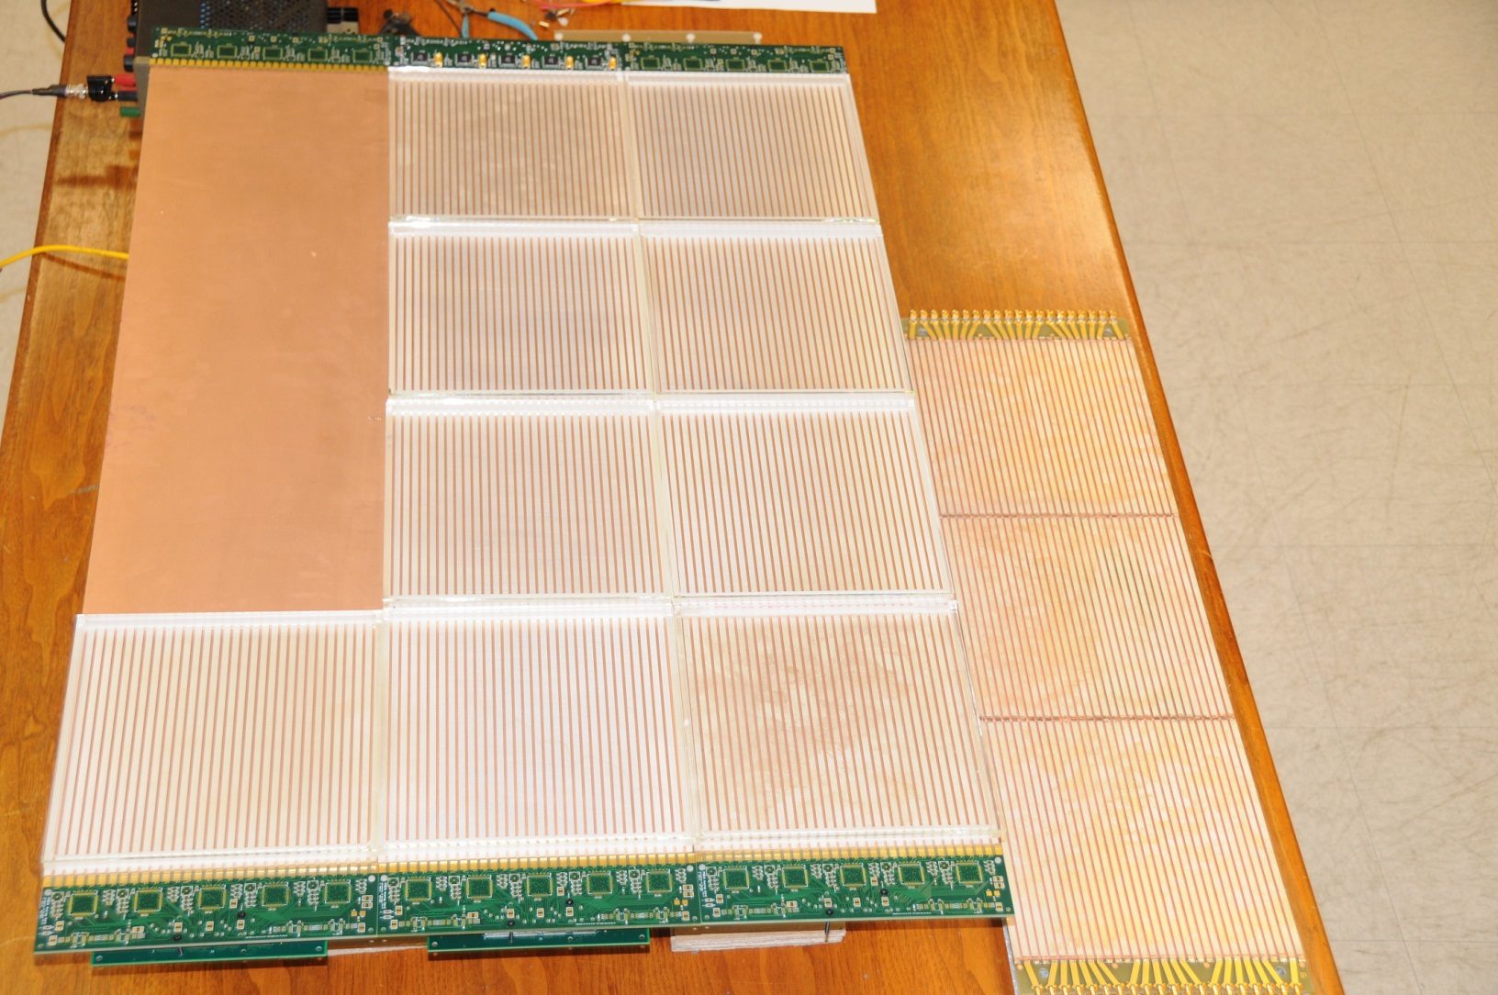
SuperModule Mockup: ½-m² of cathode
Real 8” glass tile package parts- anode, side-wall, window (sic)
`Innards’ stack of 2 MCP’s +3 spacers+anode+window under test
Have read out through from AC card through full DAQ chain to PC

Slide 32
Extract time, position of pulse using time from both ends
Eric Oberla slide from ANT11

Slide 33
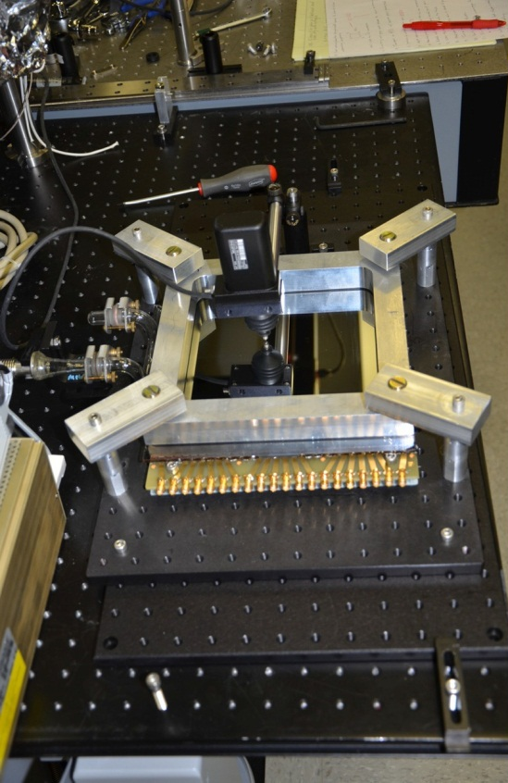
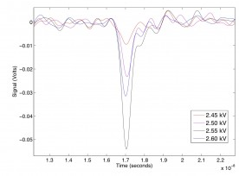
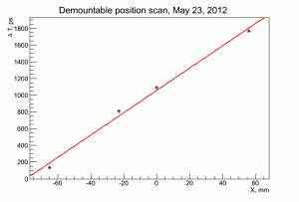
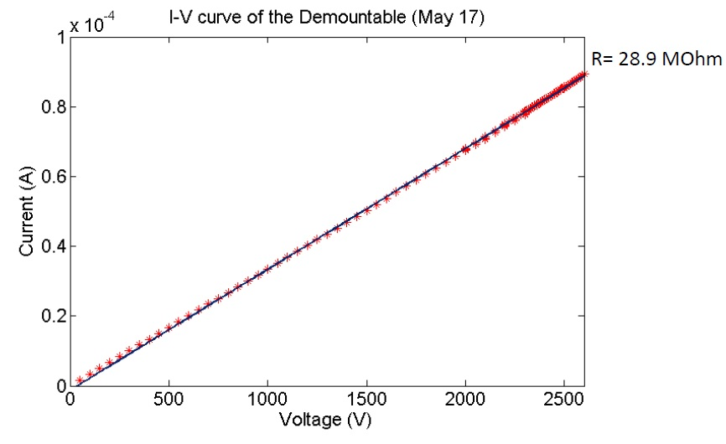
Demonstration of the Internal ALD HV Divider in the Demountable Tile
Demountable at APS
Average pulse shape vs HV
Scanning the laser: t vs x
IV Curve (expected 32 Megs)

Slide 34
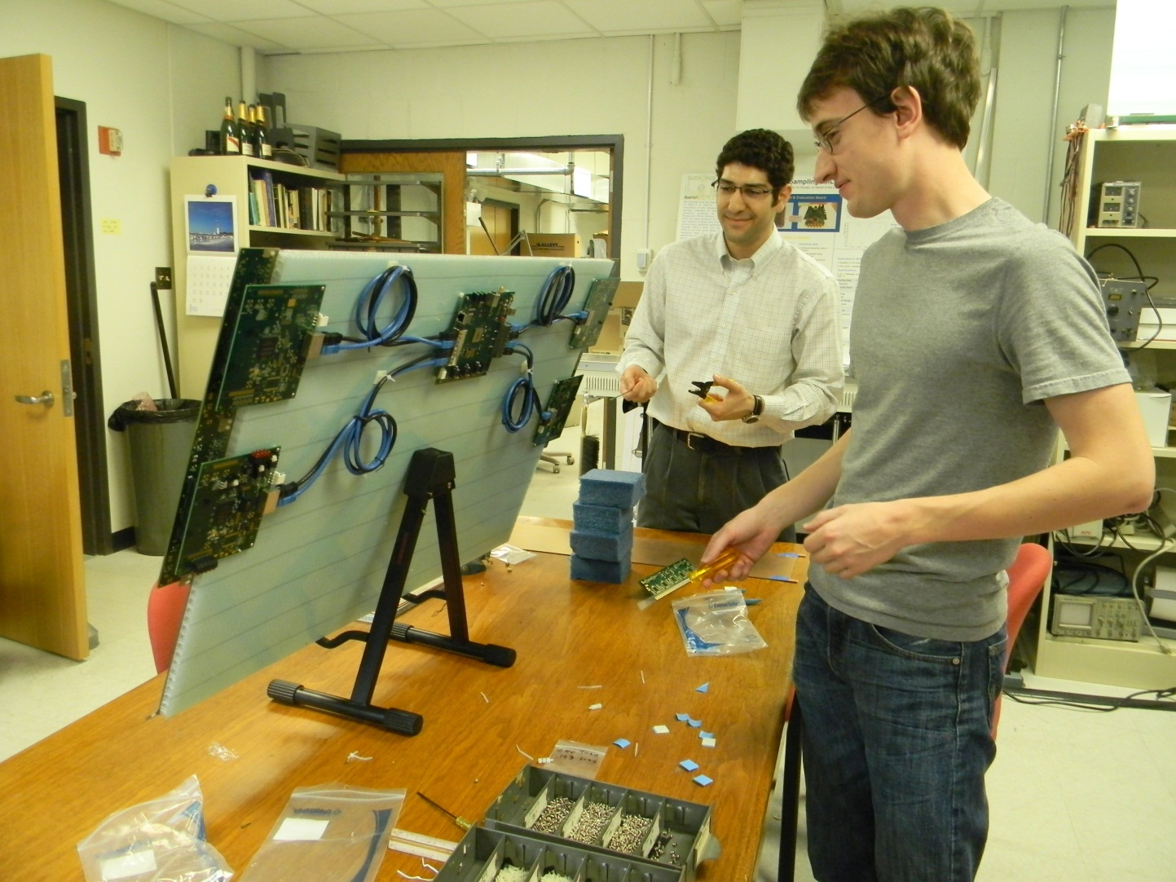
Developing and Testing the Electronics, Anodes, and DAQ
Eric Oberla (grad student) and Craig Harabedian (engineer) working on the Tray layout and cabling

Slide 35
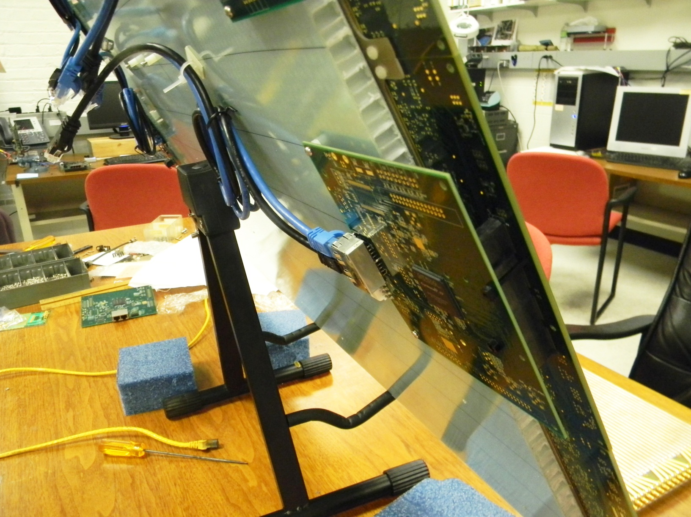
Analog Card to Digital Card
Can be direct connection (shown) or cable

Slide 36
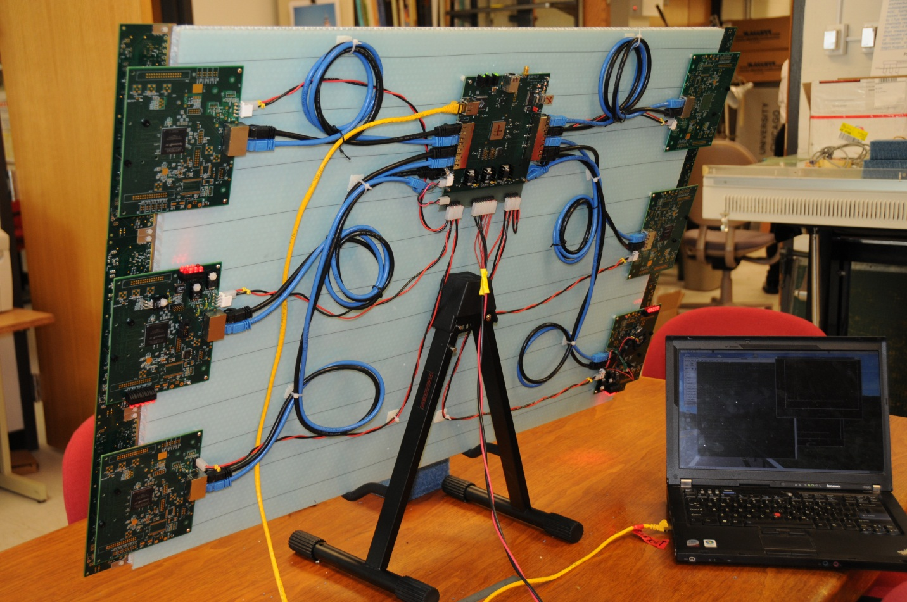
Digital Cards and Central Card
Present readout to PC and Nvidia GPU is via USB;
Ethernet hardware is on boards- later

Slide 37
Anode Testing for ABW, Crosstalk,..
Herve’ Grabas, Razib Obaid, Dave McGinnis
Network Analyzer Tile Anode

Slide 38
Anode Testing for ABW, Crosstalk,..
ABW
Crosstalk
Razib Obaid

Slide 39
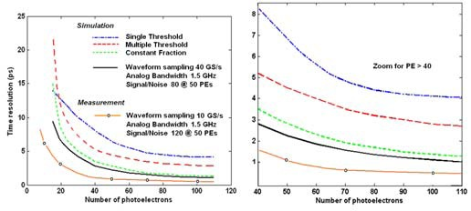
Simulation of Resolution vs abw
Jean-Francois Genat (NIM)
1 ps
This (brown) line
This (brown) line
Brown line: 10 Gs/sec (we’ve done >15);
1.5 GHz abw ( we’ve done 1.6); S/N 120 (N=0.75mv, S is app specific)

Slide 40
The PSEC4 Waveform Sampling ASIC
PSEC4: Eric Oberla and Herve Grabas; and friends…
Eric Oberla, ANT11

Slide 41
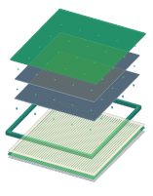
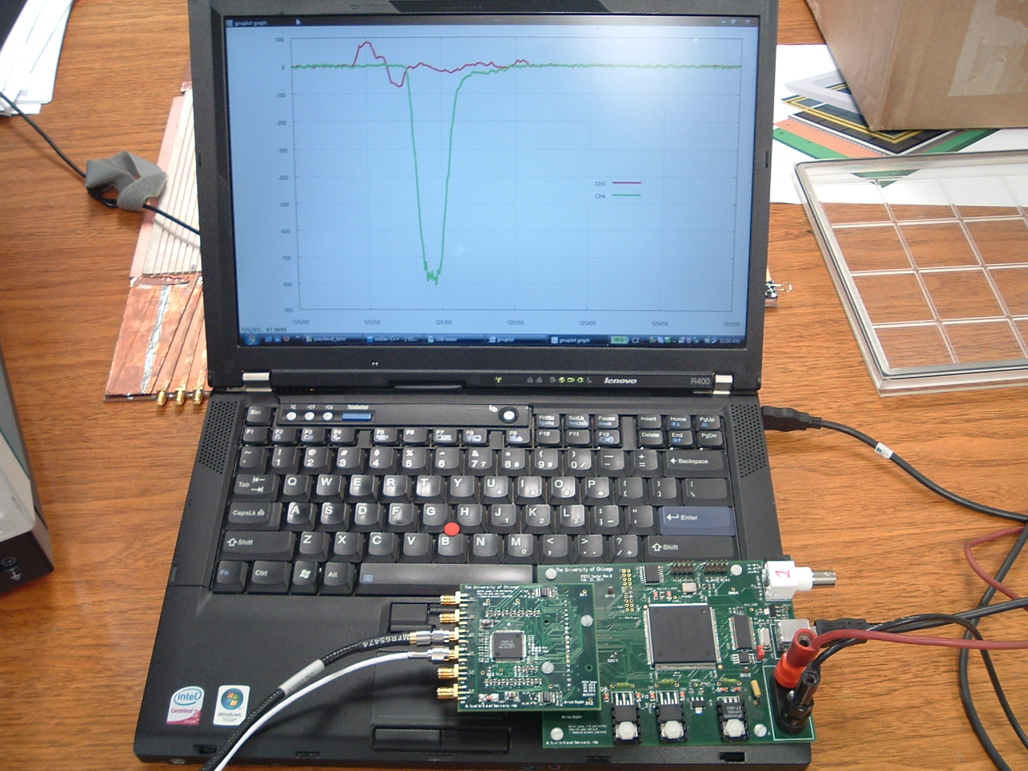
PSEC-4 ASIC
LAPPD Collaboration
Eric Oberla, ANT11
6-channel “oscilloscope on a chip” (1.6 GHz,10-15 GS/s)
Evaluation board uses USB 2.0 interface + PC data acquisition software

Slide 42
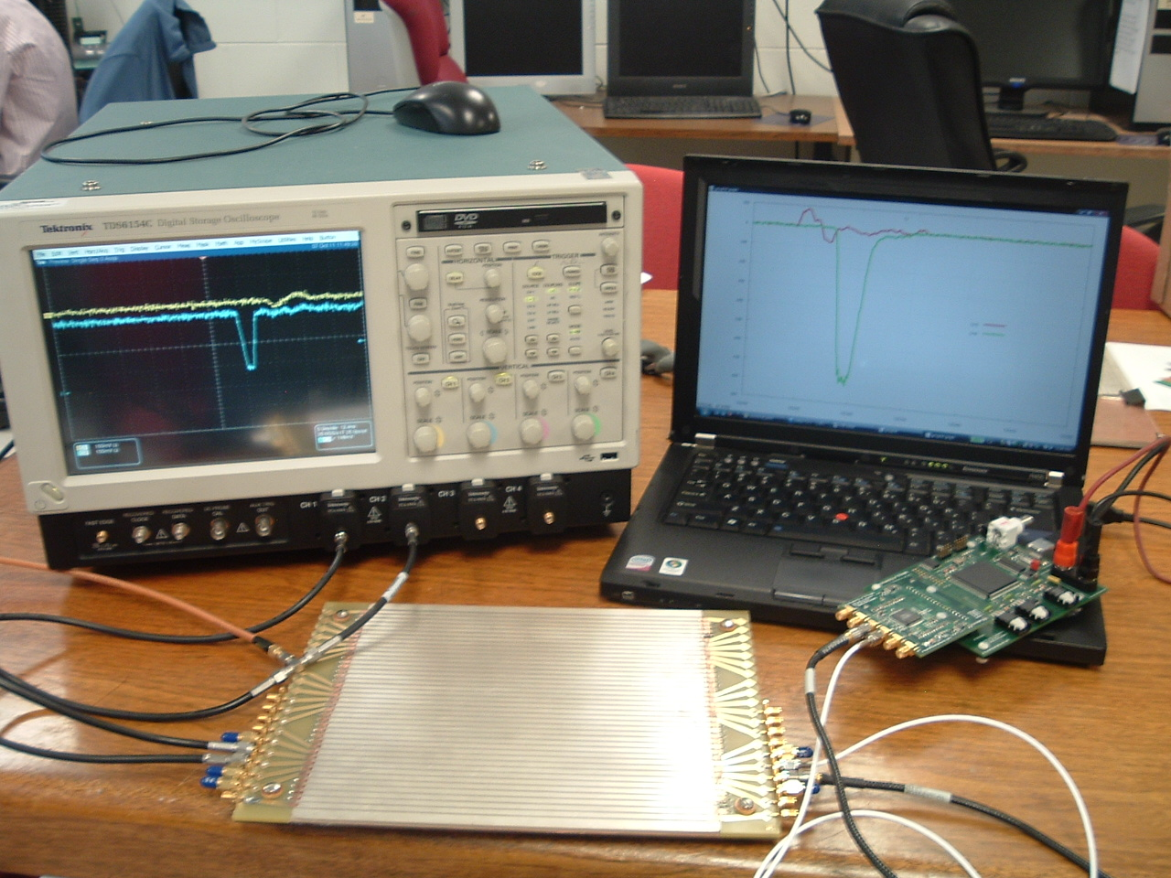
6-channel `Scope-on-a-chip’
Designed by Eric Oberla (UC grad student)
working in EDG
with EDG tools
and zeitgeist
Real digitized traces from anode
20 GS/scope
4-channels (142K$)
17 GS/PSEC-4 chip
6-channels ($130 ?!)

Slide 43
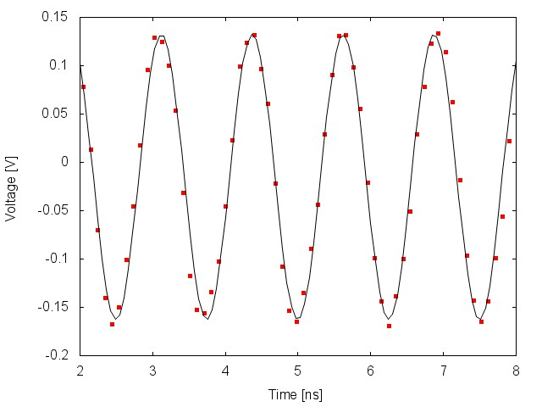
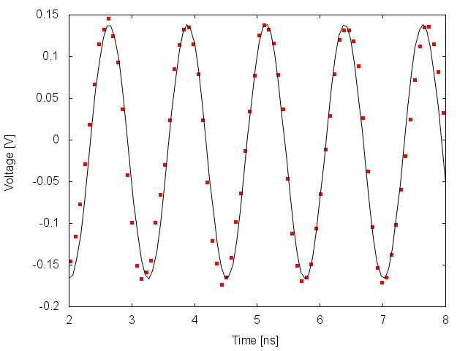
PSEC-4 Performance
Eric Oberla, ANT11
Digitized Waveforms
Input: 800MHz, 300 mV_{pp} sine
Sampling rate : 10 GSa/s
Sampling rate : 13.3 GSa/s
Only simple pedestal correction to data
As the sampling rate-to-input frequency ratio decreases, the need for time-base calibration becomes more apparent (depending on necessary timing resolution)

Slide 44
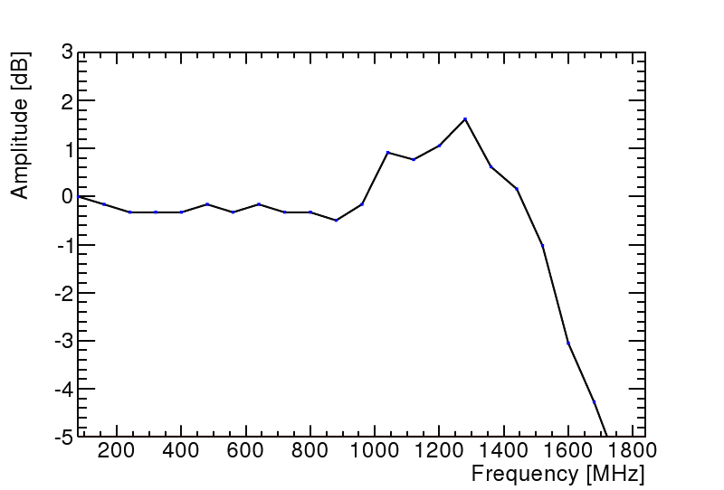
Digitization Analog Bandwith
Eric Oberla, ANT11
ABW~1.6GHz
3 db loss
PSEC4: Eric Oberla and Herve Grabas+ friends…

Slide 45
Noise (unshielded)
PSEC4: Eric Oberla and Herve Grabas+ friends…
RMS=755 microvolts
Full-Scale ~1.2 volts (expect S/N>=100, conservatively)
Eric Oberla, ANT11

Slide 46
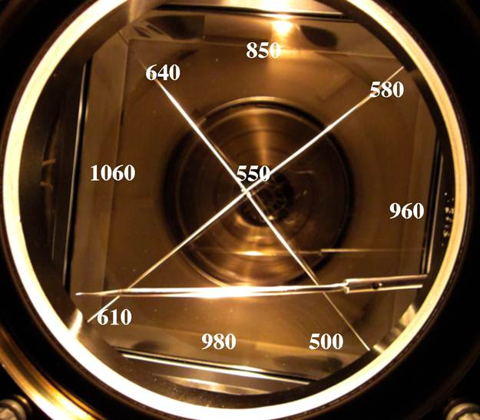
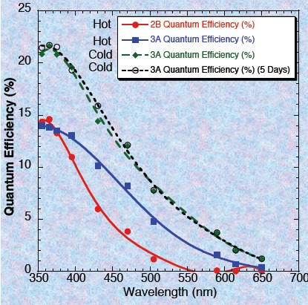
Status of PhotoCathodes
Have made >20% 8”PC at SSL; 25% small PC’s at ANL, 18% 4” (larger underway)
ANL
SSL 8” SbNaK cathode
QE of ANL small SbKCs cathodes
4” cathode: Chalice in Burle oven
QE of SSL 8” SbNaK cathode
ANL

Slide 47
Opportunities:Can we go deep sub-picosec?: the Ritt Parameterization (agrees with JF MC)
Stefan Ritt slide, doctored
100 femtosec
S/N, f_{Z}: DONE
abw: NOT YET

Slide 48
What’s the limit? (2009 cartoon)
Funnel pore with reflection cathode, dynode rings, ceramic anode,…
N.B.- this is a `cartoon’- working on workable designs-join us…
Front Window and Radiator
Photocathode
Pump Gap
High Emissivity Material
Low Emissivity Material
`Normal’ MCP pore material
Gold Anode
50 Ohm Transmission Line
Rogers PC Card
Capacitive Pickup to Sampling Readout

Slide 49
Opportunities
Sub psec timing –e.g. Ritt 100 fsec extrp.
Tight pulse height (high SEY 1st strike)
Photocathode- QE’s >45%
Non-vacuum transfer assembly
Simpler top seal- (incl. metal for neutrons)
Commercialization (SBIR/STTR)

Slide 50
Truth in Advertising- Current Problems (remember we’re only in 3rd yr)
Uniformity of ALD (parallel efforts at ANL, Arradiance)- will be solved…
Vacuum transfer assembly- ceramic in progress (SSL); several years for glass package most likely…
`Frugal’ top seal for glass package (progress)
Optimization for specific applications (e.g. Collider, KOTO, HE and LE neutrinos, PET
Lack of simulation for applications (help?)

Slide 51
More Information on LAPPD:
Main Page: http://psec.uchicago.edu (has the links to the Library and Blogs)
Library: Workshops, Godparent Reviews, Image Library, Document Library, Links to MCP, Photocathode, Materials Literature, etc.;
Blog: Our log-book- open to all (say yes to certificate Cerberus, etc.)- can keep track of us (at least several companies do);

Slide 52
The End

Slide 53
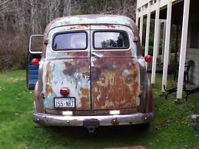
Backup slides

Slide 54
Parallel Efforts on Specific Applications
.
Explicit strategy for staying on task-
Multiple parallel cooperative efforts
PET
(UC/BSD, UCB, Lyon)
Collider
(UC, ANL,Saclay.
LAPD Detector Development
Muon Cooling
Muons,Inc
(SBIR)
ANL,Arradiance,Chicago,Fermilab, Hawaii,Muons,Inc,SLAC,SSL/UCB, UIUC, Wash. U
K->πνν
JPARC
Drawing Not To Scale (!)
Mass Spec
Andy Davis, Mike Pellin, Eric Oberla
Neutrinos
(Matt, Mayly, Bob, John, ..; Zelimir)
Non-proliferation
LLNL,ANL,UC
All these need work- naturally tend to lag the reality of the detector development

Slide 55
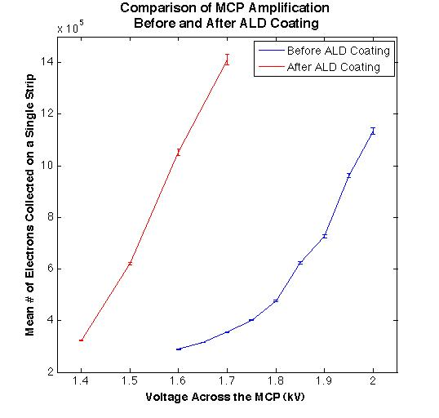
First measurements of gain in an ALD SEE layer at the APS laser test setup (Bernhard Adams, Matthieu Cholet, and Matt Wetstein)
MCP and Photocathode Testing
Testing Group: Bernhard Adams, Matthieu Cholet, and Matt Wetstein at the APS, Ossy Siegmund’s group at SSL
N. B.!
LAPPD Preliminary
(very)

Slide 56
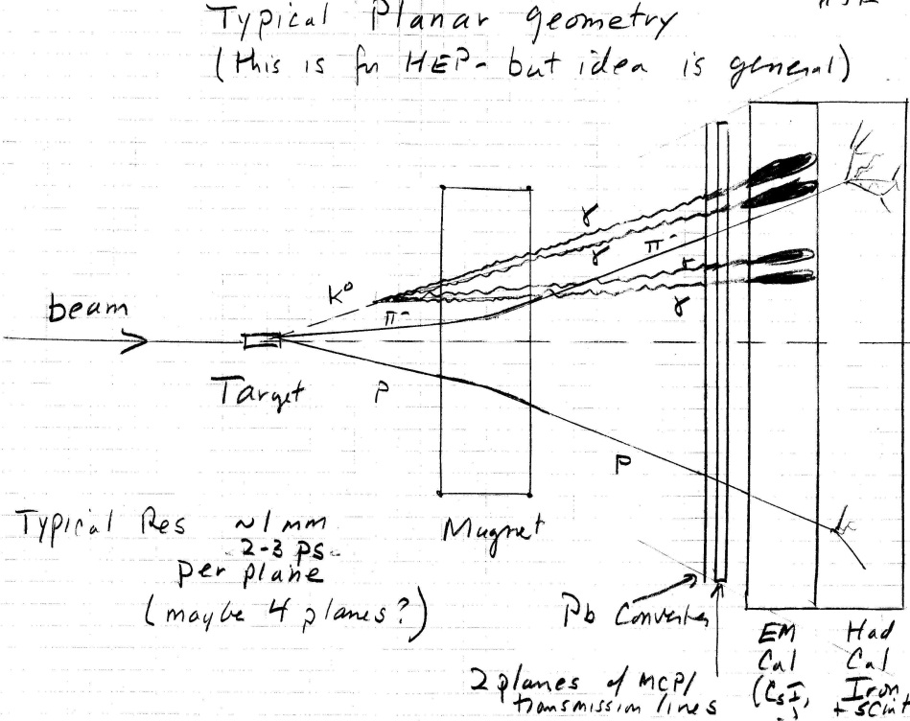
K_{L} to pizero nu-nubar

Slide 57
The Large-Area Psec Photo-Detector Collaboration

Slide 58
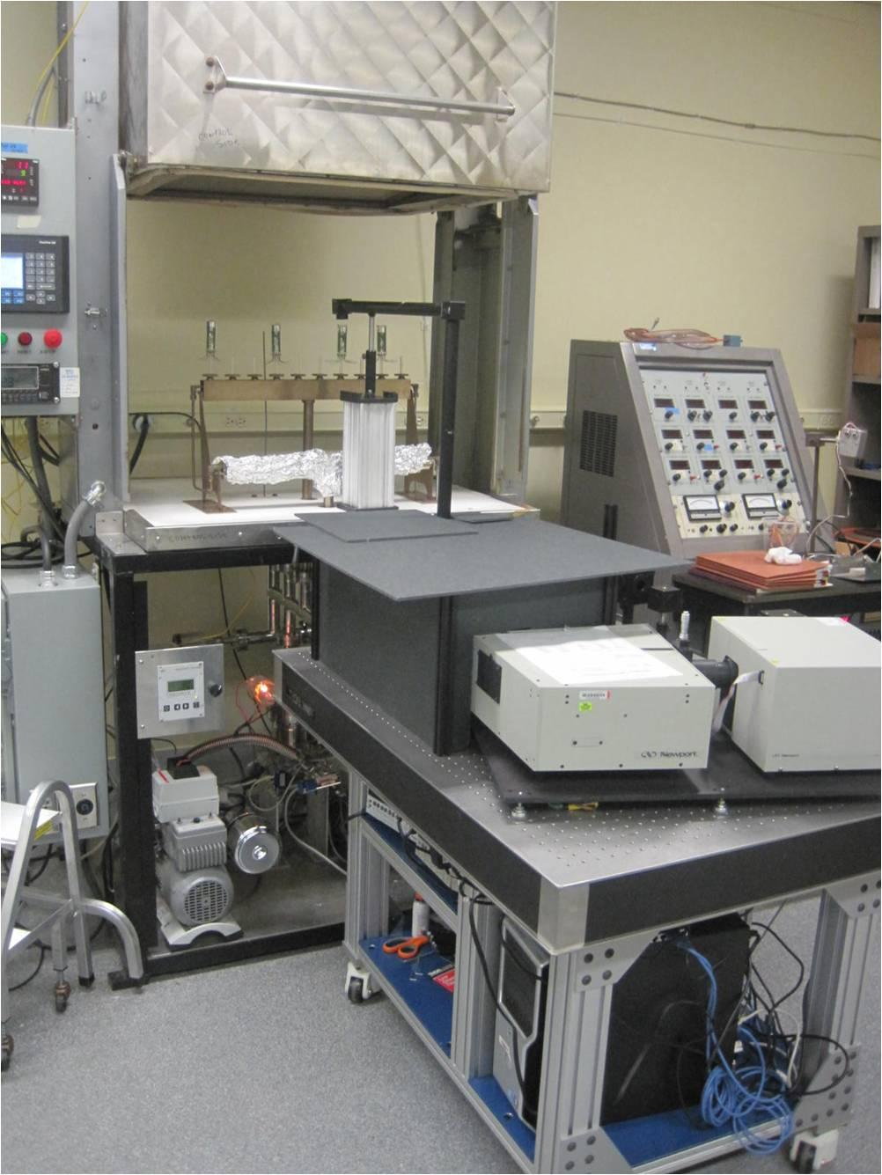
Photocathodes Subject of next talk by Klaus- touch on here only briefly
LAPPD goal- 20-25% QE, 8”-square
2 parallel efforts: SSL (knows how), and ANL (learning)
ANL
Optical stand
Burle commercial
equipment
First cathodes made at ANL

Slide 59
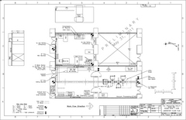
Hermetic Packaging
Top Seal and Photocathode- this year’s priority
3 parallel paths
Tile Development Facility at ANL
Production Facility at SSL/UCB
Commercial RFI for 100 tiles
(Have had one proposal for 7K- 21K tiles/yr)

Slide 60
Matt Wetstein; ANL&UC
Works on GEANT events too

Slide 61
Sampling calorimeters based on thin cheap photodetectors with correlated time and space waveform sampling
Bill Moses (Lyon)
Proposal: Alternating radiator and cheap 30-50 psec thin planar mcp-pmt’s on each side (needs simulation work)

Slide 62
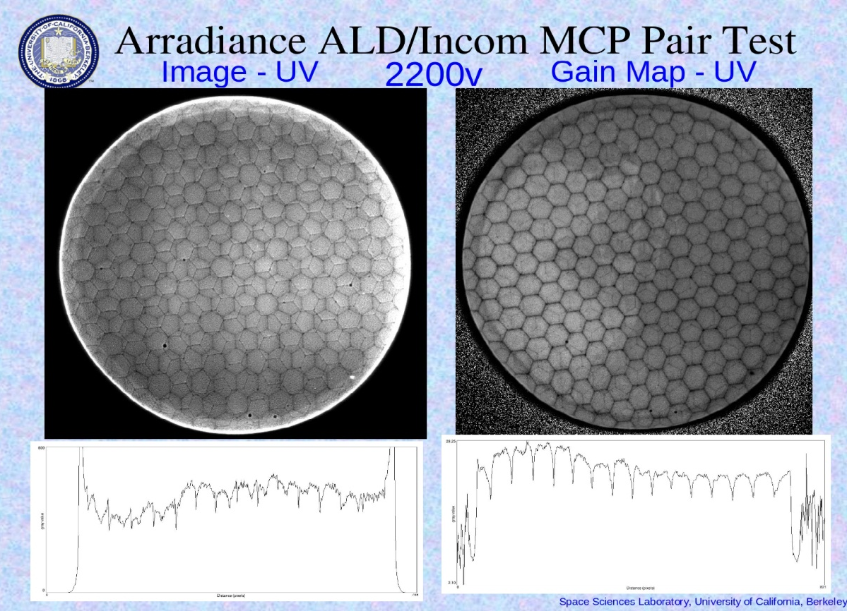
A `Quasi-digital’ MCP-based Calorimeter
Idea: can one saturate pores in the the MCP plate s.t.output is proportional to number of pores. Transmission line readout gives a cheap way to sample the whole lane with pulse height and time- get energy flow.
Oswald Siegmund, Jason McPhate, Sharon Jelinsky, SSL (UCB)
Note- at high gain the boundaries of the multi’s go away
Electron pattern (not a picture of the plate!)- SSL test, Incom substrate, Arradiance ALD. Note you can see the multi’s in both plates => ~50 micron resolution

Slide 63
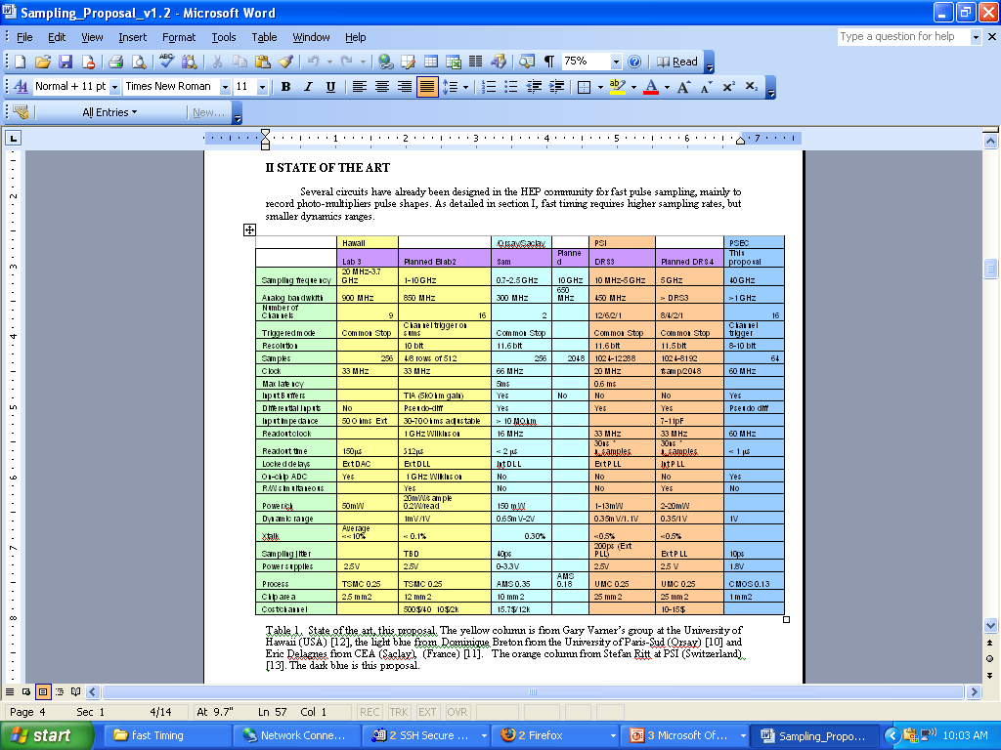
FY-08 Funds –Chicago Anode Design and Simulation (Fukun Tang)

Slide 64
MCP+Transmission Lines Sampled at Both Ends Provide Time and 2D Space
Field Programable Gate Arrays
(not as shown- PC cards will be folded behind the panel- not this ugly…
Single serial Gbit connection will come out of panel with time and positions from center of back of panel
10-15 GS/sec Waveform Sampling ASICS
8” Tiles

Slide 65
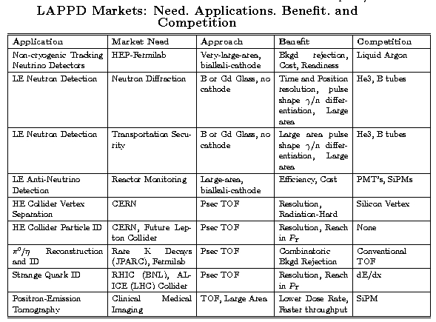
Applications
SRI’s NABC Approach http: //www.itu.dk/~jeppeh/DIKP/NABC.pdf (sic- Denmark?)

Slide 66
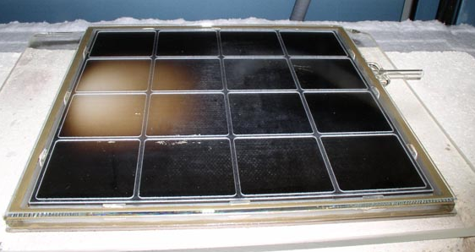
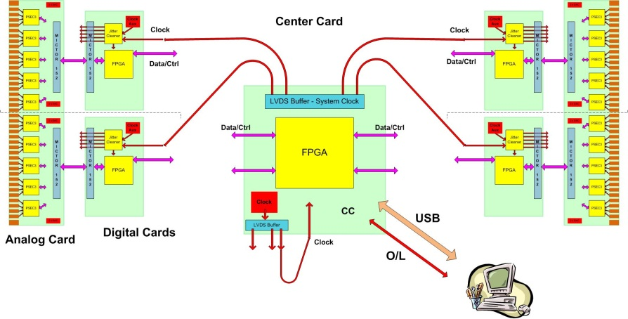
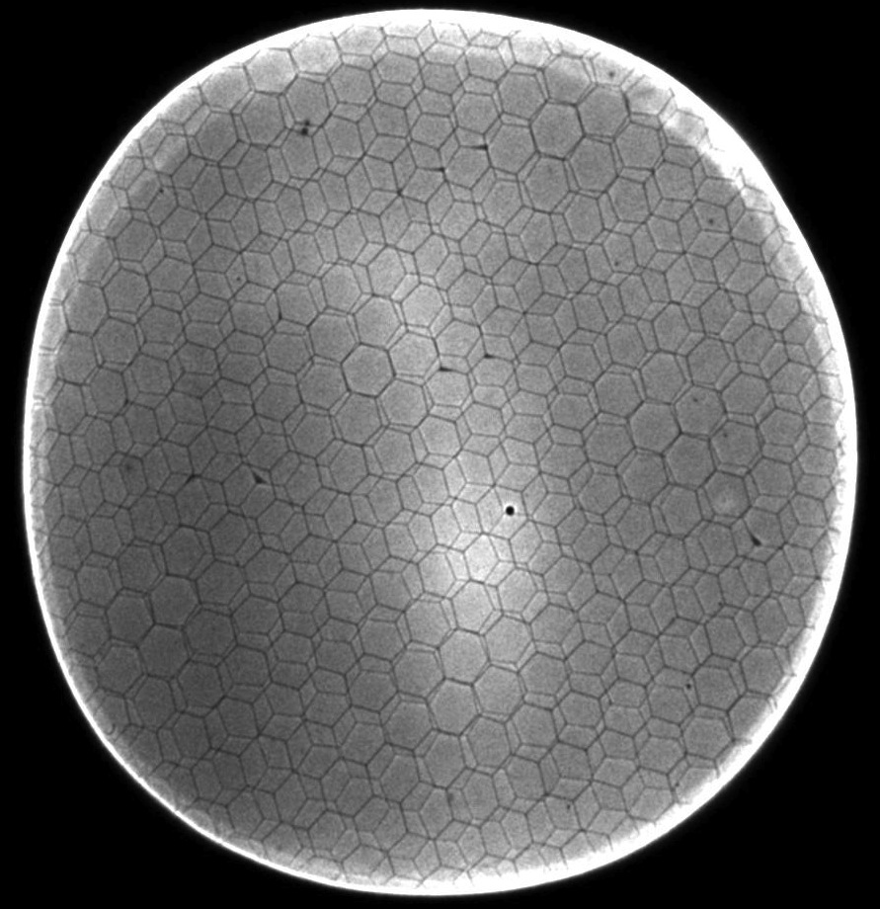
The 4 `Divisions’ of glass LAPPD
CV
CV
Hermetic Packaging
Electronics/Integration
See Bob Wagner’s talk
This talk
CV
CV
MicroChannel Plates
Photocathodes
See Ossy’s talk
See (hear) Klaus Attenkofer’s talk

Slide 67
LAPPD Performance
Fast Preconditioning
Low noise
High Gain (>10⁷)
400 micron resolution
(8” plate, anode, PSEC-4)

Slide 68
Application 4- Cherenkov-sensitive Sampling Calorimeters
Idea: planes on one side read both Cherenkov and scintillation light- on other only scintillation.
I
A picture of an em shower in a cloud-chamber with ½” Pb plates (Rossi, p215- from CY Chao)
A `cartoon’ of a fixed target geometry such as for JPARC’s KL-> pizero nunubar (at UC, Yao Wah) or LHCb

Slide 69
Detector Development- 3 Prongs
MCP development- use modern fabrication processes to control emissivities, resistivities, out-gassing
Use Atomic Layer Deposition for emissive material
(amplification) on cheap inert substrates (glass capillary arrays, AAO). Scalable to large sizes; economical; pure – i.e. chemically robust and (it seems- see below) stable
Readout: Use transmission lines and modern chip technologies for high speed cheap low-power high-density readout.
Anode is a 50-ohm stripline. Scalable up to many feet in length ; readout 2 ends; CMOS sampling onto capacitors- fast, cheap, low-power (New idea- make MCP-PMT tiles on single PC-card readout- see below)
Use computational advances -simulation as basis for design
Modern computing tools allow simulation at level of basic processes- validate with data. Use for `rational design’ (Klaus Attenkofer’s phrase).

Slide 70
Micro-channel Plates PMTs
Satisfies small feature size and homogeneity
Photon and electron paths are short- few mm to microns=>fast, uniform Planar geometry=>scalable to large areas

Slide 71
ALD for Emissive Coating
Conventional MCP’s:
Alternative ALD Coatings:
(ALD SiO₂ also)
Many material possibilities
Tune SEE along pore (HF- possible discrete dynode structure (speed!)
Jeff Elam , Zeke Insepov, Slade Jokela
71
Notes:
71

Slide 72
Front-end Electronics/Readout Waveform sampling ASIC
Electronics Group: Jean-Francois Genat, Gary Varner, Mircea Bogdan, Michael Baumer, Michael Cooney, Zhongtian Dai, Herve Grabas, Mary Heintz, James Kennedy, Sam Meehan, Kurtis Nishimura, Eric Oberla, Larry Ruckman, Fukun Tang
First have to understand signal and noise in the frequency domain
A typical MCP signal (Planacon)
Frequency spectra of signal and noise (JF Genat)

Slide 73
Application 3- Medical Imaging (PET)
TOF adds 3rd dimension to Positron-Emission Tomography
Slides from Bill Moses’s talk at the Clermont Workshop
(see our library page, under workshops: http:hep.uchicago.edu/psec)
Clinical flat-bed scanner?
Low-density multi-layer sampling gamma detectors?
Cheap robust electronics
Real-time imaging?

Slide 75
What sets the 1 psec goal for HEP?

Slide 76
Electronics- Integration & Performance
Eric Oberla and Craig Harabedian cabling SuMo digital and central FPGA cards
PSEC-4 sampling at 13.3 Gsamples/sec with > 65% OAR
This is the `money’ plot
Analog Bandwidth of strip-line anode
Time resolution on 2 ends of anode strip vs (S/N)⁻¹ in psec

