Slide 1
The Challenges and Applications of Sub-Psec Large-area Detectors
Henry Frisch
Enrico Fermi Institute and Physics Department
University of Chicago
Abstract
The precision of large-area spatial measurements has improved dramatically over the last 50 years due to the invention of silicon strip and pixel detectors. The ultimate time resolution of large-area devices is not yet known, but can be much better than the 1” (100 psec) resolution typical of large time-of-flight sensors or the 12” (1 nsec) typical of large neutrino detectors. I will discuss the status of the development of large-area micro-channel-plate-based photodetectors, for which the characteristic distance scale that determines the time resolution is 10’s of microns. There is good reason to believe that time resolutions well below 1 psec are achievable with developments currently underway.

Slide 2
Outline
Quick Survey of Unique Applications
  The Optical Time Projection Chamber (OTPC)
  Directionality in Neutrinoless Double Beta Decay
  Low-Energy Antineutrino Reconstruction (Reactors)
  Pizero Vertexing in K⁰->π⁰νν (e.g. KOTO at JPARC)
  Vertexing at High Luminosity at the LHC
  TOF in the Central Region at the LHC (BSM, PID)
  Medical Imaging (e.g. PET, Proton Therapy)
Basic Principles and the Limiting Factors
Some Details of an Example- the LAPPD `tile/tray’
Some efforts towards 1-psec/sub-psec timing

Slide 3
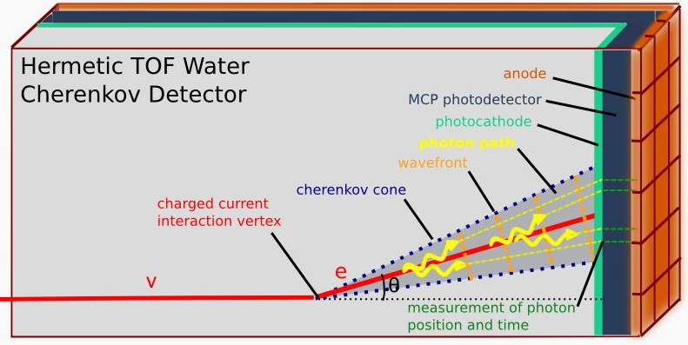
  The Optical Time Projection Chamber (OTPC)
Like a TPC but drift photons instead of electrons (no B needed)
Exploits precise location and time for each detected photon
Would allow track /vertex reconstruction in large liquid counters
Photon Drift Velocity is 0.225 mm/psec
First suggestion of LAPPD’s for DUSEL and the name (OTPC) due to Howard Nicholson

Slide 4
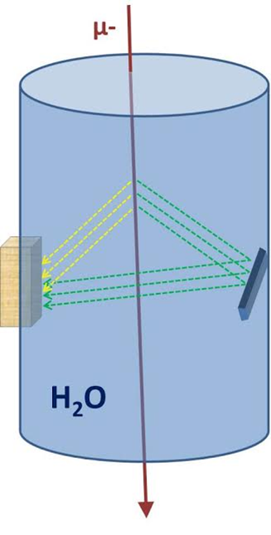
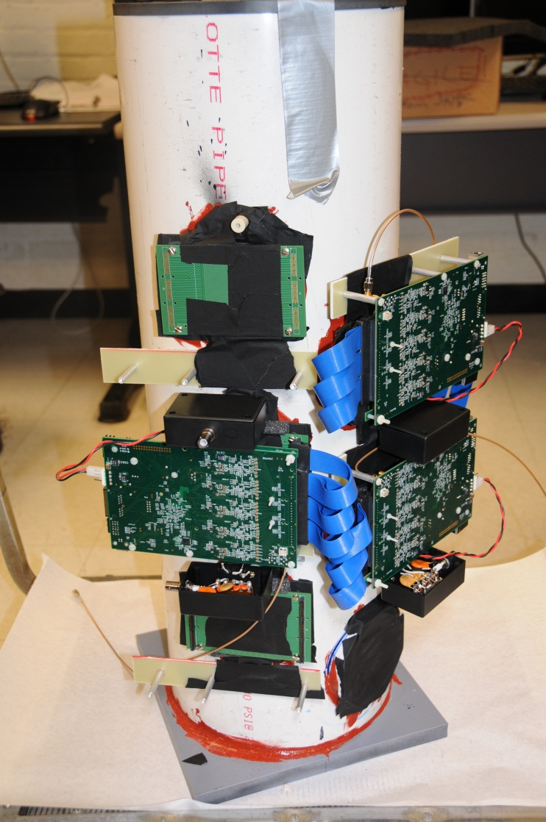
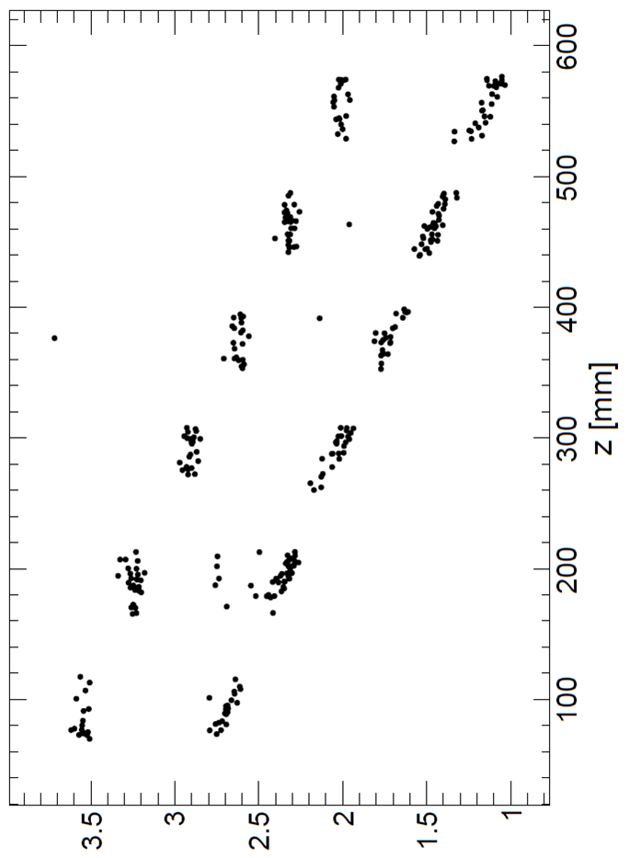
  The Optical Time Projection Chamber (OTPC)
Eric Oberla’s thesis (see his talk)- proof-of-principle 1D-OTPC
Uses mirrors (yes!) to exploit time resolving to increase coverage
Chroma/G4 Simulation
Planacon
(Photonis)
Reflected light
Direct light
Mirror
Time (nsec)
Planacons
(Photonis)
1-15 GS/sec
120-channel
PSEC4 readout

Slide 5
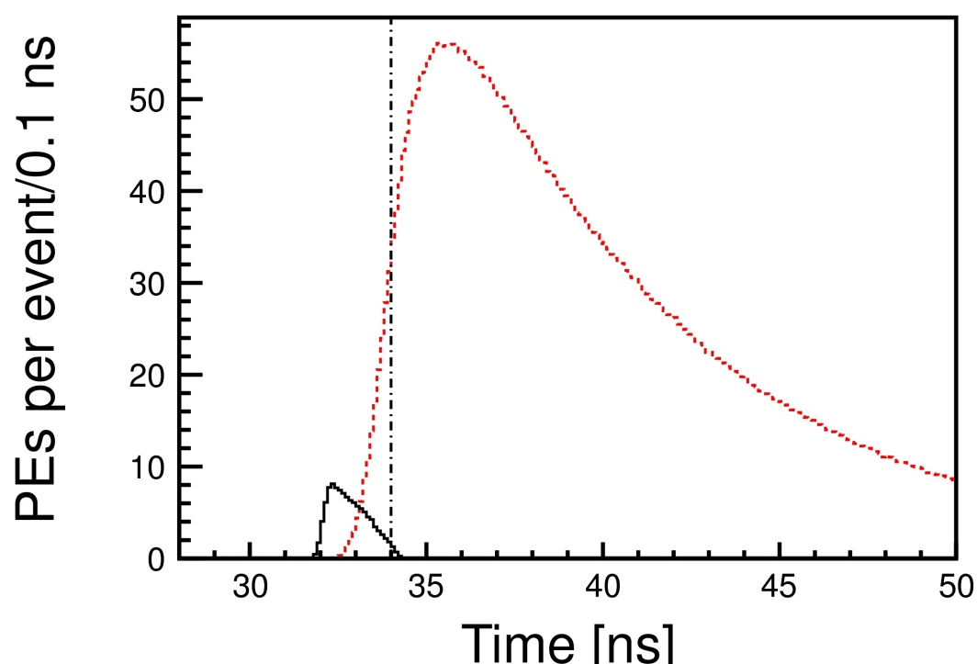
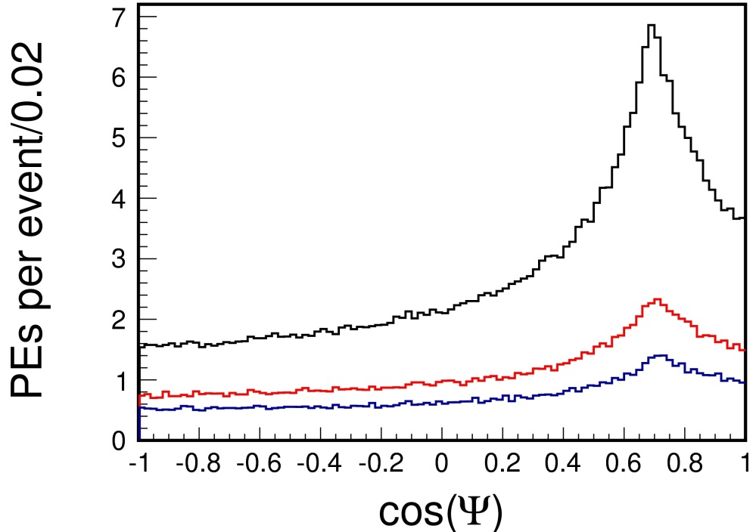
  Measuring Directionality in Neutrinoless Double-β Decay
Signal has 2 electrons; dominant (non-intrinsic) backgrounds have 1
Cherenkov light retains (some) directionality
Cherenkov light arrives before scintillation, as it’s redder (really)
Fast-timing allows selection on the early photons
Time-of-arrival
Time Cut
Scintillation photons
5 MeV
2.1 MeV
1.4 MeV
Cherenkov photons from center of 6.5m-radius sphere: TTS=100 psec
Cosine of angle between the photoelectron hit and the original electron direction after the 34 ns cut. Both Cherenkov and scintillation light are included. Note the peak at the Cherenkov angle.
Christof Aberle, Andrey Elagin, Matt Wetstein, Lindley Winslow, HJF; arXiv:1307.5813 (TBP JINST)
(see Andre Elagin’s talk)

Slide 6
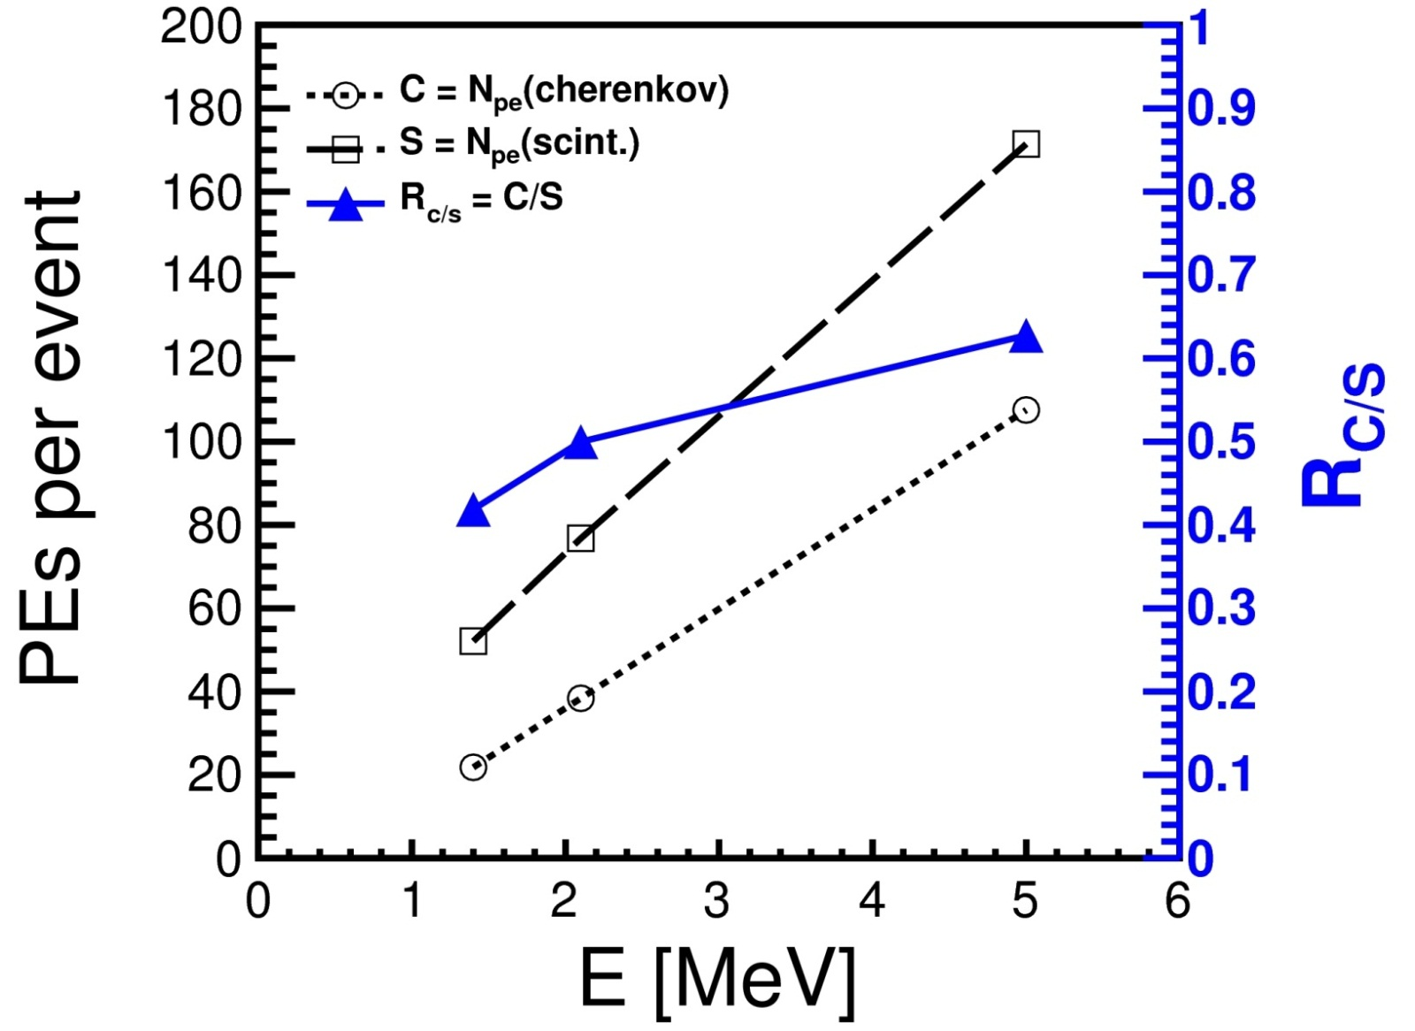
  Number of PhotoElectrons After Time Cut
Nscint
Ratio C/S
NCherenkov
The expected number of photo-electrons (PE) from Cherenkov (C) and Scintillation (S) light after the 34 nsec time cut, for electron energies of 1.4, 2.1, and 5 MeV, generated at the center of the 6.5m-radius liquid scintillator detector. The right-hand ordinate is the ratio C/S.
Christof Aberle, Andrey Elagin, Matt Wetstein, Lindley Winslow, HJF; arXiv:1307.5813 (TBP JINST)

Slide 7
Rare Kaon Decays- background rejection by reconstructing π⁰ vertex space point:
E.g. for KOTO (Yau Wah, JPARC)-beat down combinatoric π⁰ backgrounds
Detector Plane
Photon 1
(T₁, X₁, Y₁ )
Vertex (e.g. π⁰->γγ)
T_{v}, X_{v}, Y_{v}, Z_{v}
(t1-tv)c
Photon 2
One can reconstruct the vertex from the times and positions- 3D reconstruction
(t2-tv)c
(T₂, X₂, Y₂ )
N.B. Photon Drift Velocity is 0.298 mm/psec

Slide 8
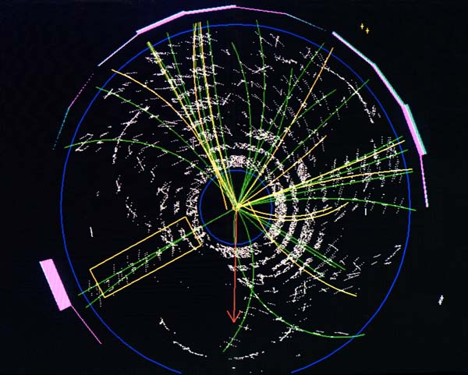
Colliders:
Goals: 1) identify the quark content of charged particles
2) separate vertices
3) vertex photons
CDF top quark event
See Snowmass white paper

Slide 9
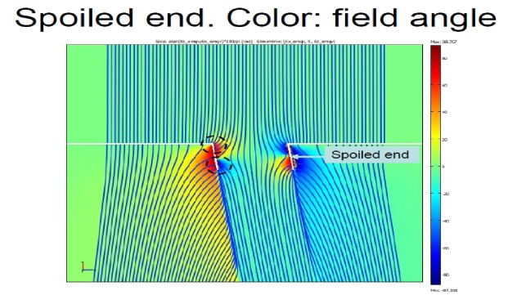
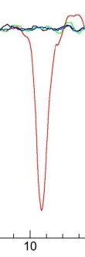
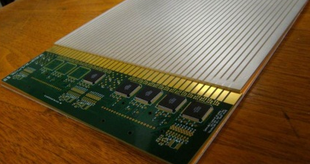
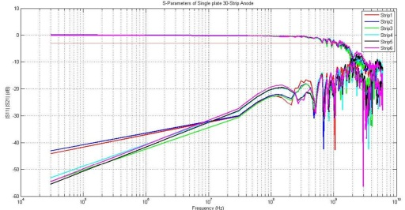
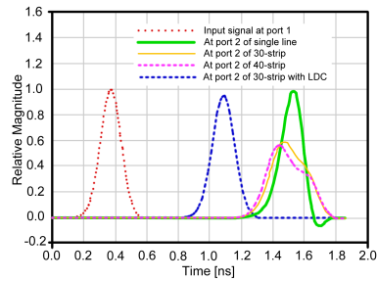
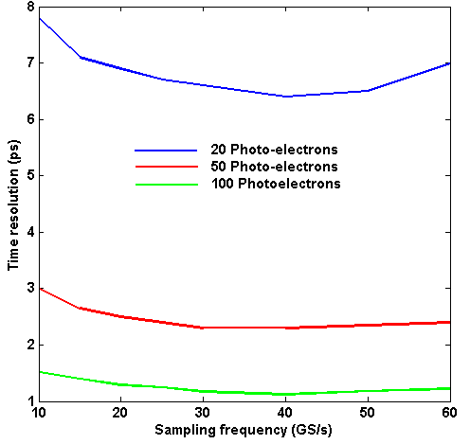
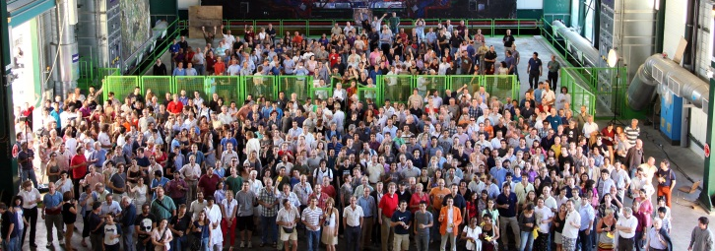
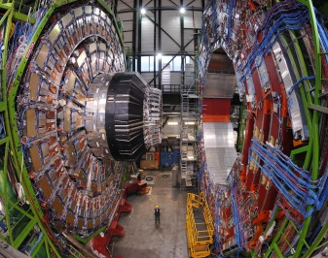
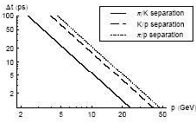
A Brief Tour of MCP-based Fast Timing
What determines the time resolution?
Pulse Generation – from photon to fast current pulse
Getting the fast pulse to the time-measuring place
Determining `the time’ of the pulse
System Considerations: Clock Distribution, Calibration, …
Transit-Time Spread (TTS) is determined by geometry, fields, and secondary-emission
Time (ns)
80 million pores need to be reduced to a small # (e.g. 30) of electronics channels while preserving the Analog BandWidth(ABW)
Frequency
Problems are Noise and Pulse Shape
(no noise, no problem, if all shapes the same)
Waveform sampling, Constant-Fraction-Disc, Single Threshold Disc., Multiple Threshold..
Time (ns)
Momentum(GeV)

Slide 10
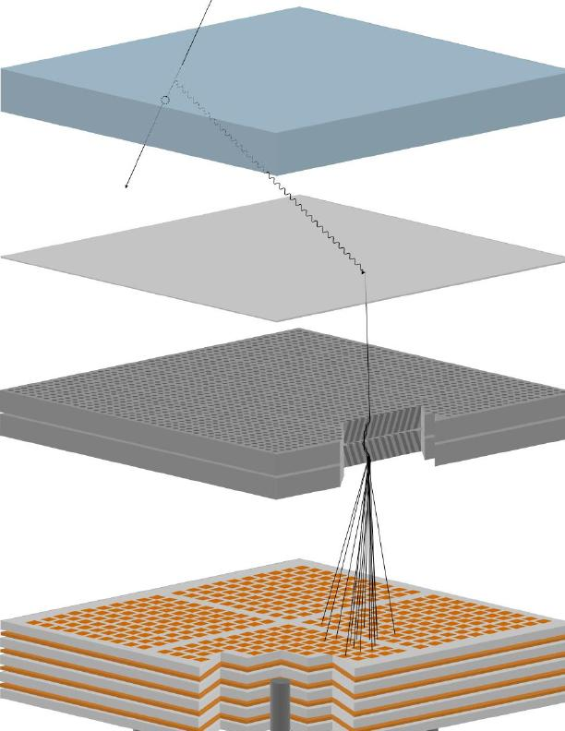
How Does it Work?
Requires large-area, gain > 10⁷, low noise, low-power, long life,
σ(t)<10 psec, σ(x) < 1mm, and low large-area system cost
Realized that an MCP-PMT has all these but large-area, low-cost:
(since intrinsic time and space scales are set by the pore sizes- 2-20µ)
Incoming charged particle
window
Radiated Cherenkov photon
Photocathode on inside of window
Photo-electron
from cathode
Pair of micro-channel plates
Output pulse of 10⁷ electrons
RF strip-line anode
(old-version- now we use microstrips)

Slide 11
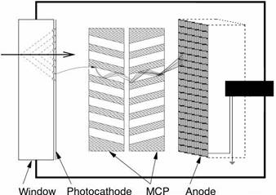
Key parameters: Number of Photons and Transit-Time Spread
Pulse Generation – from photon to fast current pulse
A: Timing will depend on light source: Cherenkov light in 8mm radiator (window) gives ~50 PE’s; many applications are single photons
400 Cherenkov optical photons
Incoming charged particle
10⁶ to 10⁸ electrons in current pulse
50 photo-electrons from cathode
B: Transit-Time Spread (TTS) depends on geometry, electric field, and first-strike secondary-emission coefficient;
Picture of 1 pore
(currently L/D=60, 8º )
Incoming photo-electrons
From photocathode (only 1/pore)
secondary emission (SEY) electrons
First^{t}-strikes

Slide 12
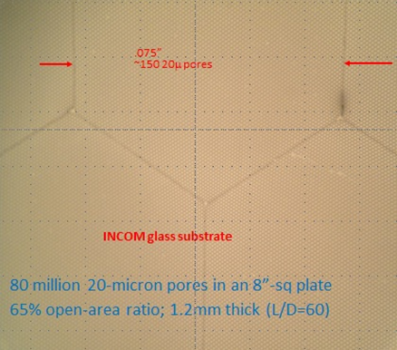
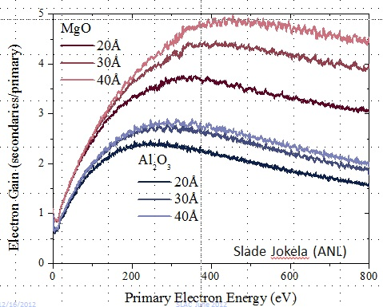
`First-Strike’ Parameters to play with
Pore size and angle
Higher SEY Materials
Optimized voltages
Other:
Cathode-MCP gap size and shape
Discrete dynode structure (Elam)
Reflection-mode photocathode on MCP
Tailoring Efield for equal times
Other voltages, geometries…

Slide 13
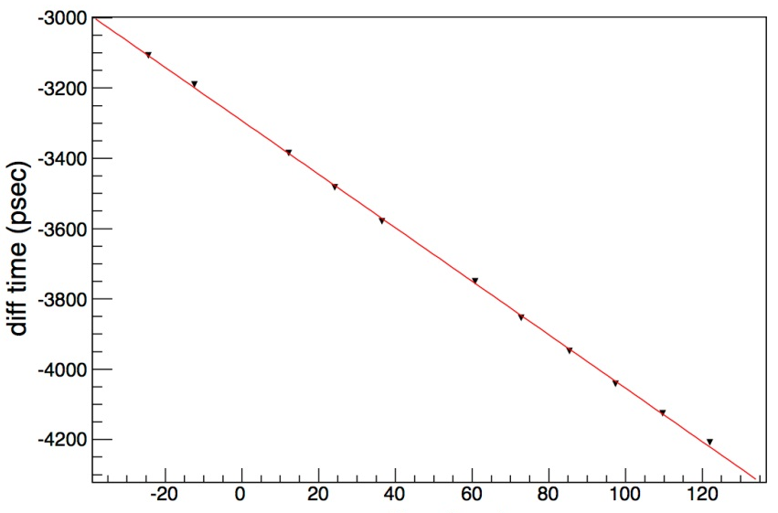
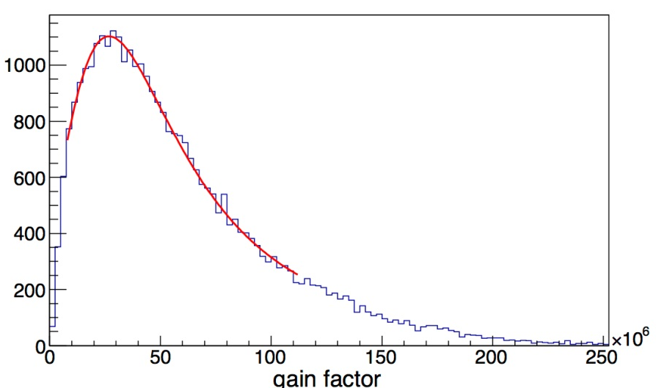
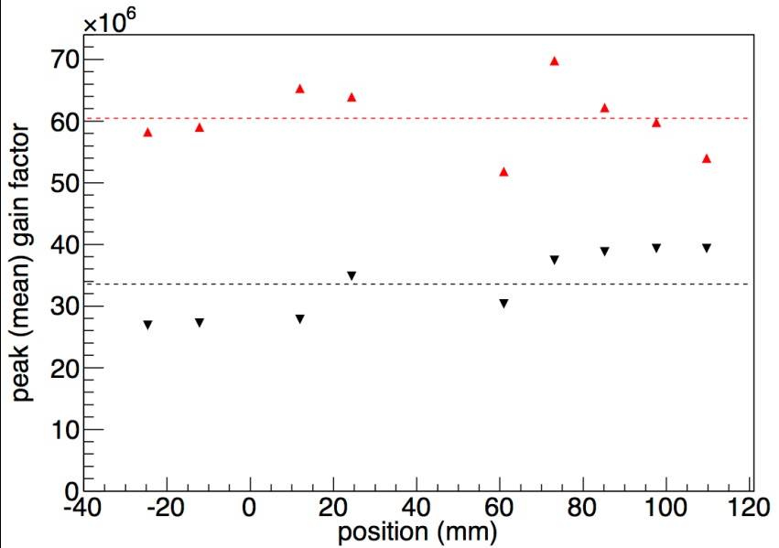
Arradiance, Inc
MgO-coated ALD-functionalized MCPs
Arradiance delivered 2 matched, stable, MgO-coated plates. They have been operated in the full 8”-tile Demountable test facility.
Linearity in position measurement
Pulse-height
Distribution (N.B. charge)
Time (psec)
X
Position (mm)
Gain (x10⁶)
Av gain
Peak gain
(3.4E7)
Gain uniformity
(strip20)
Fermilab, CalTech &UC are in the process of ordering 6 more plates thru Incom (Incom PO) for a sampling calorimeter beam test.

Slide 14
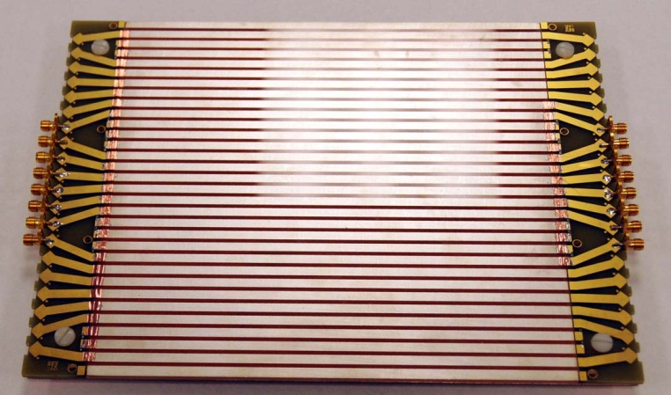
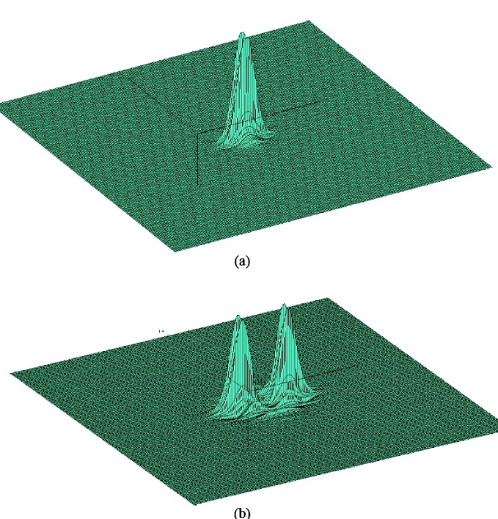
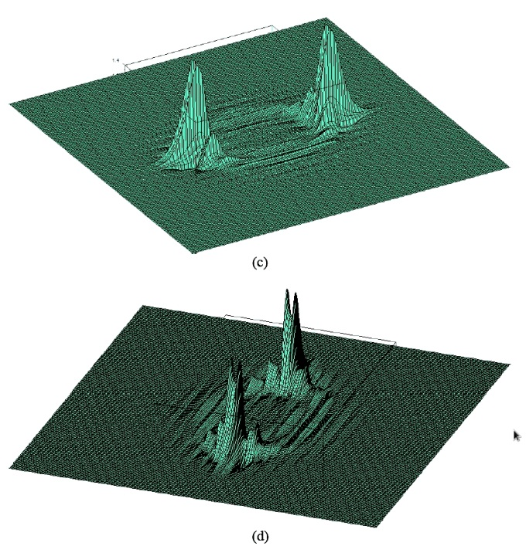
Getting the fast pulse to the digitizer
80 million pores need to be reduced to a small # (e.g. 30)
of electronics channels while preserving the Analog BandWidth(ABW)
Early 30-strip test anode, each strip is 50 Ohms, read out on both ends
Simulated time evolution of pulse on 30-strip anode- note the growing crosstalk in neighboring strips as the pulse propagates toward both ends
Time (v=.57c)
(time-domain simulation with proprietary FE code by InnoSys, Inc)

Slide 15
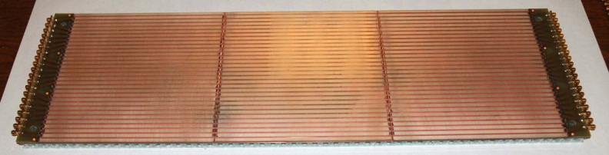
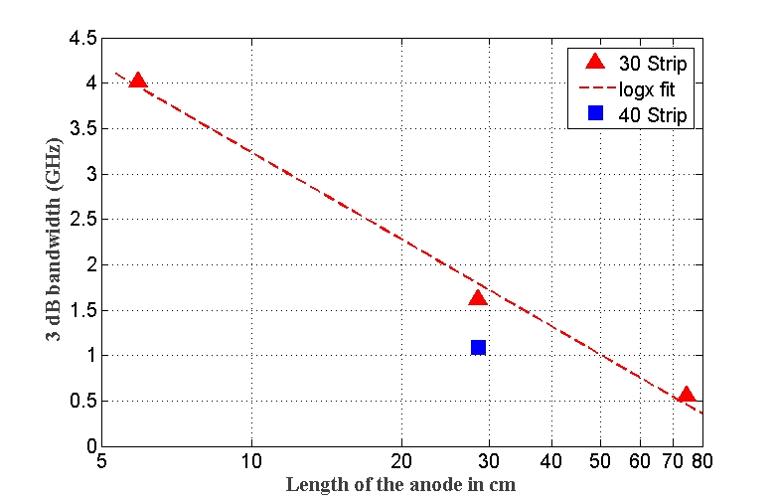
Daisy-chaining tile modules
Cover large areas at low electronics channel count by daisy-chaining RF striplines across MCP-PMT modules
But one loses bandwidth as the strips get longer, largely due to crosstalk.
Analog -3db Bandwidth (GHz )
Anode length (cm)

Slide 16

Effect of Crosstalk on Pulse Shape (Timing)
Crosstalk also affects the pulse shape, making the time measurement dependent on distance along the μstrip line
Time-domain simulation with proprietary FE code by InnoSys, Inc)
Note distortion in leading edge in the 30-strip LAPPD anode (in yellow- apologies)
30-strip
LAPPD
Input
Improved anode
Single strip
Time measured across 8” anode (nsec)

Slide 17
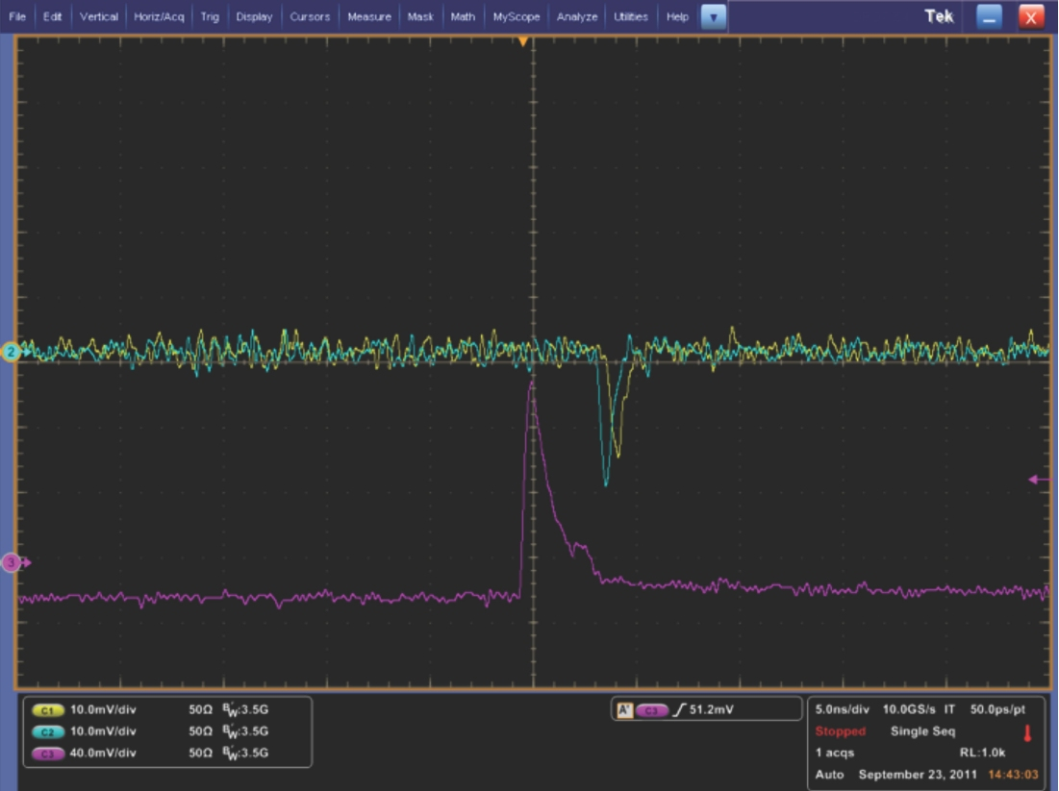
Measuring time t₀ from a pulse
Baseline
Baseline
Threshold
Constant fraction
peak
Simple discriminator
(single threshold)
Constant Fraction discriminator (CFD)
10 GS/sec Waveform Sampling
(10 bits/pt PSEC4)
Waveform sampling is basically a fast digital scope on each channel- measures the baseline, pulse shape, pile-up, and allows averaging the noise with N samples on the leading edge (noise can have higher bandwidth than signal, unfortunately)- see E. Oberla’s talk
J.-F. Genat, G.Varner, F. Tang, HJF; Pico-second Resolution Timing Measurements;
Nucl.Instrum.Meth.A607:387-393,2009; arXiv:0810.5590

Slide 18
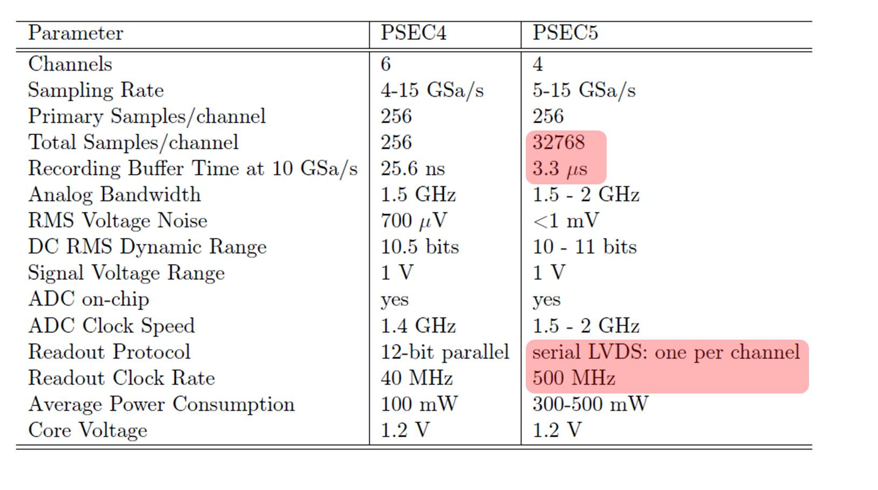
Waveform Samplng-PSEC4&5
PSEC5 is based on PSEC4 but with a deeper buffer for LHC, KOTO, Annie, …i.e. HEP experiments with trigger latency
New
Joint Hawaii UC effort: M. Bogdan, E. Oberla, I. Mostafanezhad,
G. Varner, HJF
See poster by M. Bogdan

Slide 19
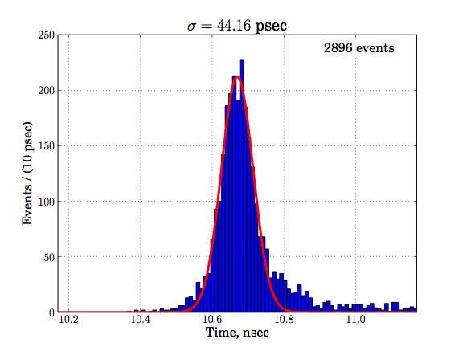
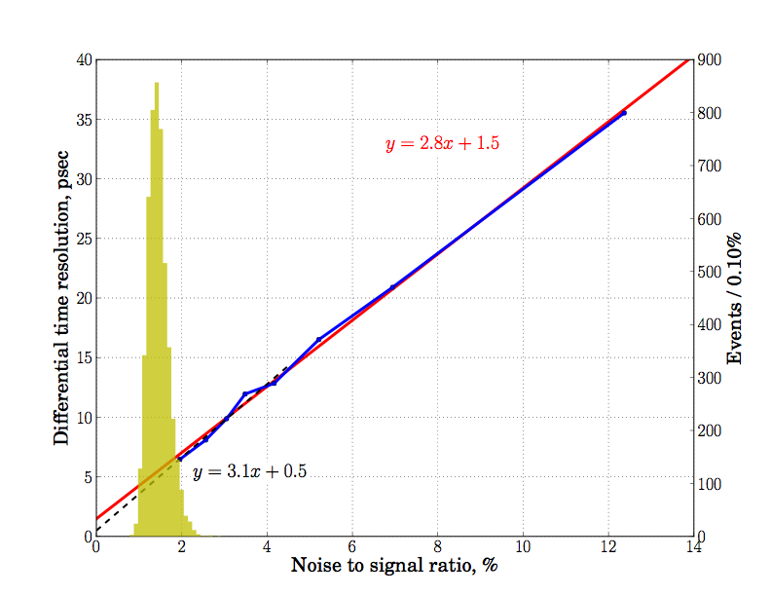
Present Time Resolution
Single Photo-electron
PSEC4 Waveform sampling
Sigma=44 psec
Differential Time Resolution
Large signal Limit
Oscilloscope Readout
Black line is y=3.1x+0.5 (ps)
Red line is y=2.8x +1.5 (ps)
Where the constant term represents the large S/N limit (0.5-1.5 ps)
Highly non-optimized system (!)- could do much better

Slide 20
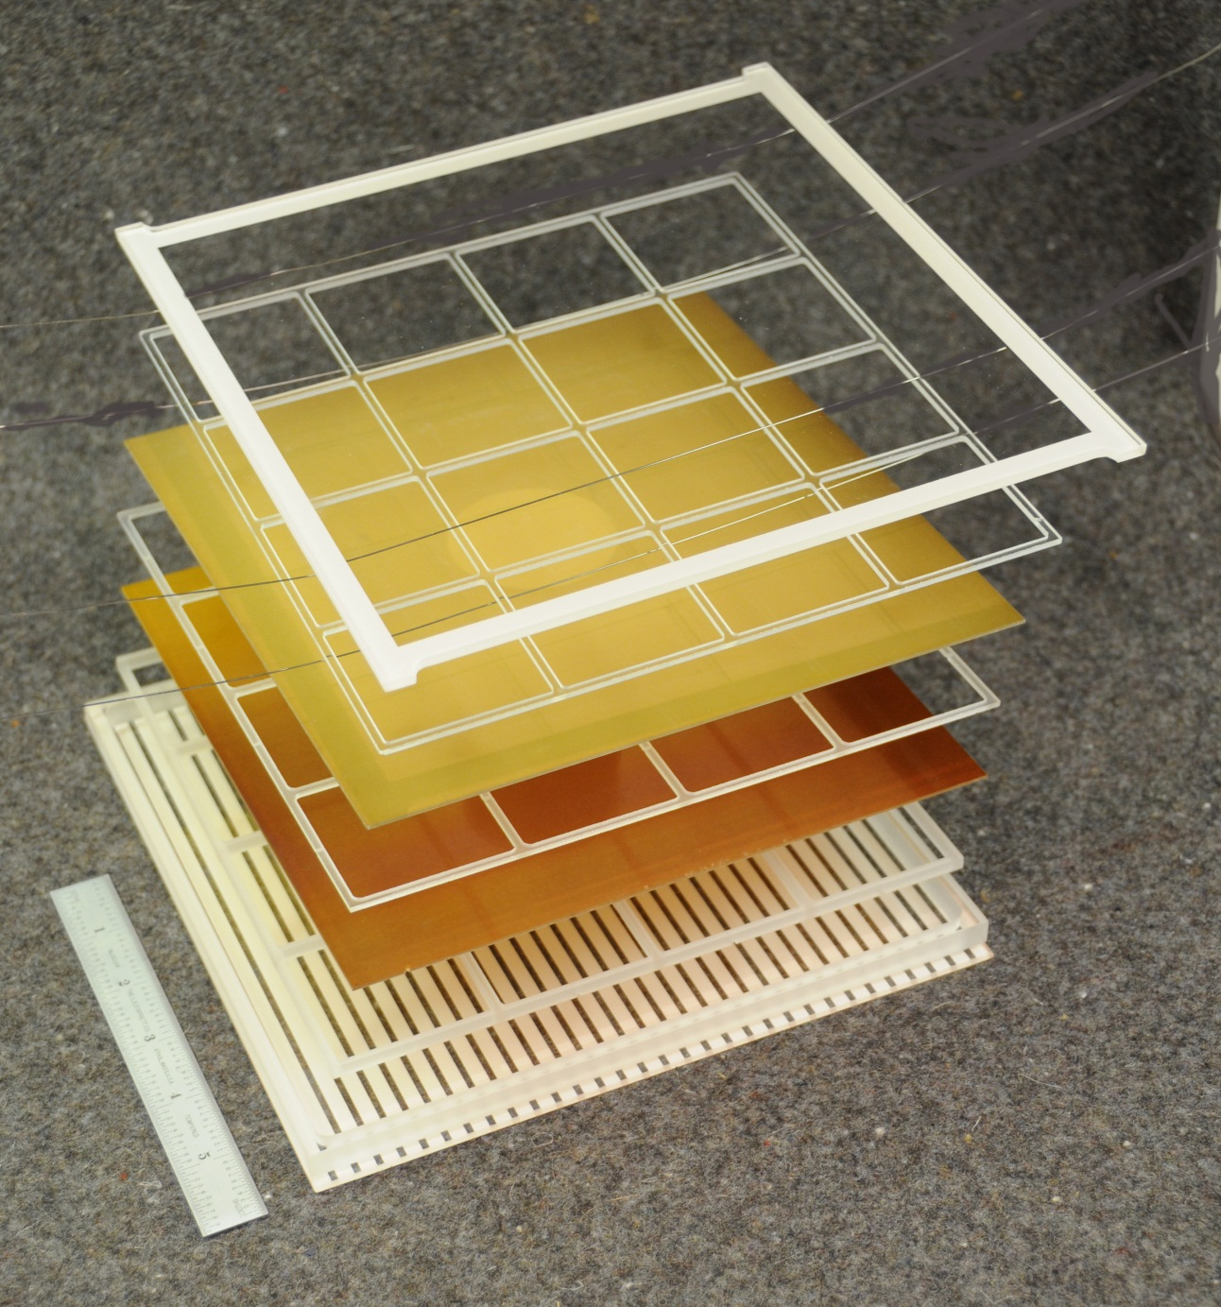
Keep It Simple- 8 parts
1 topwindow
2 MCP’s
3 Spacers
1 Tilebase
1 Getter Necklace
TOTAL: 8 parts
I (strongly) recommend
using the ALD internal HV divider- the Arradiance plates are matched, we can make matched plates, the plates are stable,…it’s a proven technology.

Slide 21
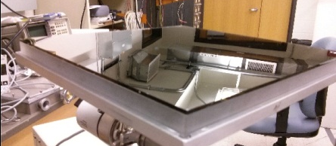
Indium-Bismuth Window Solder Seal
First try at SSL proved principle- only needed finesse (didn’t expect this much success first try, frankly- it looks really good, though not an industrial production method)
Had a full 8” cathode with good QE
Tube was operational in tank- looked very good
(O. Siegmund, J. McPhate, …)
8” metallized window hermetically sealed to sidewall (now 4 successful seals in a row in glove box by Elagin- exact same chemistry and solder as SSL seal) (see his talk)

Slide 22
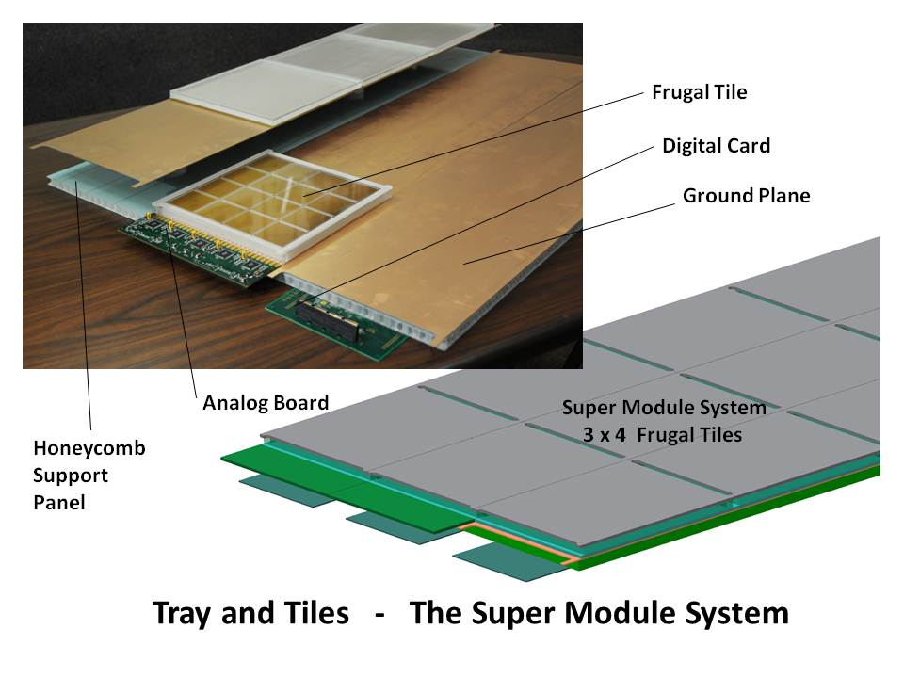
Tile-Tray Integrated Design
Because this is an RF-based readout system, the geometry and packaging are an integral part of the electronic design
The design is modular, with 8”-square MCP sealed vacuum tubes (`tiles’) with internal strip-lines capacitively coupled to a ground plane (tray) that also holds the electronics.

Slide 23
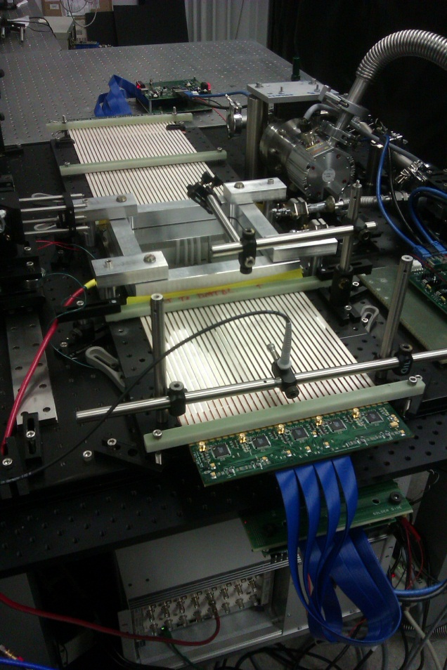
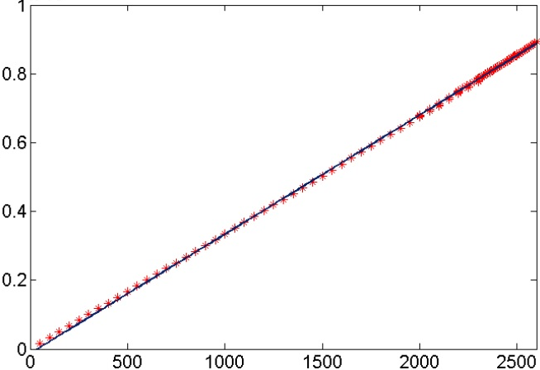
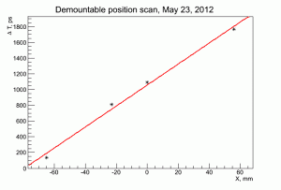
Demonstration of the Internal ALD HV Divider in the Demountable Tile
Current (x0.1mA)
IV Curve
Measure 29 Megs; expected 32
Demountable at APS
Scanning the laser:
Voltage (V)
Time
Position

Slide 24
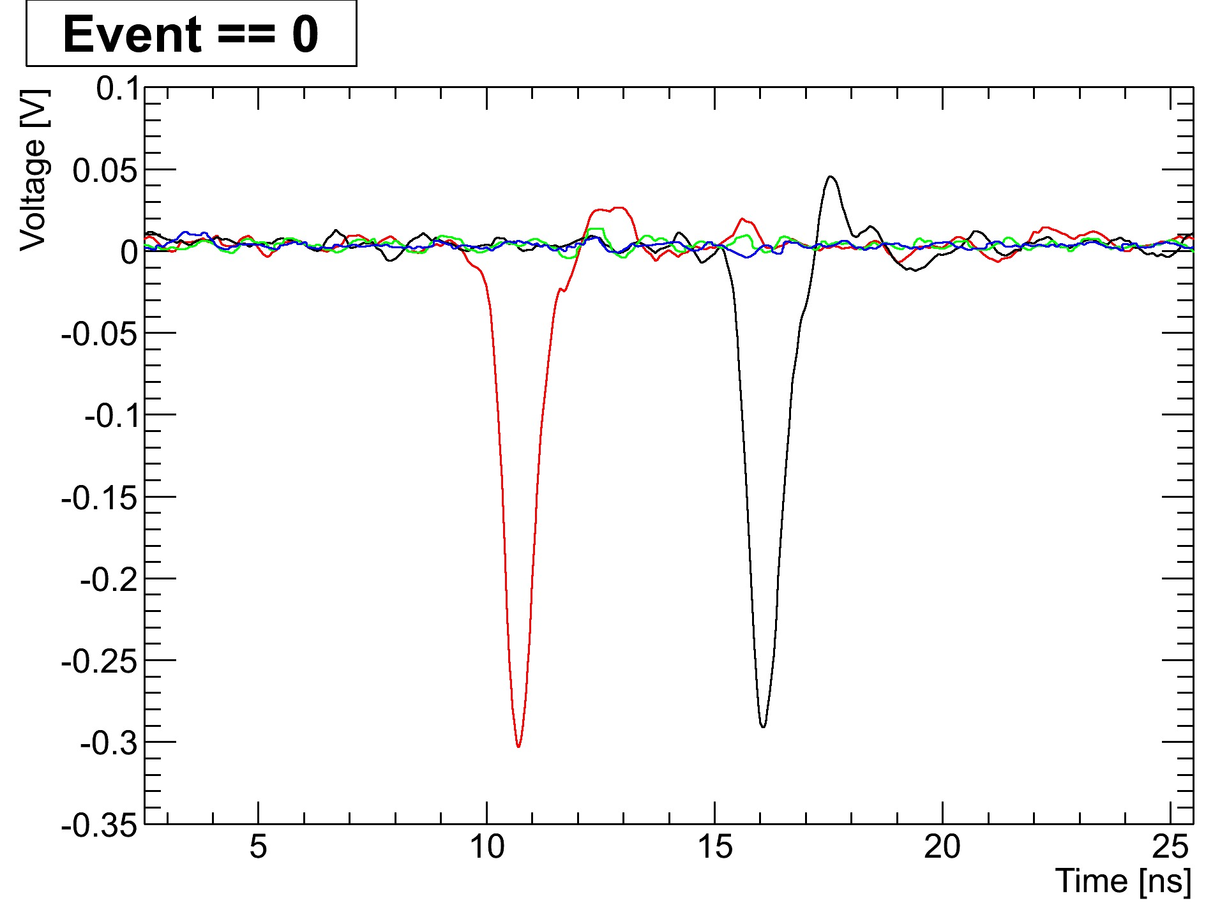
Pulses from a pair of 8” MCP Al2O3 plates
B. Adams, A. Elagin, R. Obaid, E. Oberla, M. Wetstein et al.
Left end of strip
Right end of strip
(Note-to-self: forward-reference Eric Oberla’s single-ended readout)

Slide 25
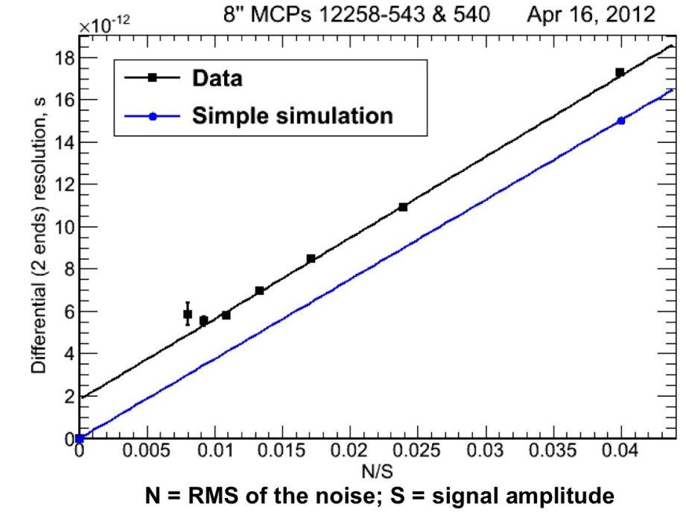
Timing res. agrees with MC
< 6 psec
Time resolution on 2 ends of 8”-anode strip vs (S/N)⁻¹ in psec (pair of 8” MCP’s)
Laser spot
size
M. Wetstein, B. Adams, A. Elagin, R. Obaid, A. Vostrikov, …

Slide 26

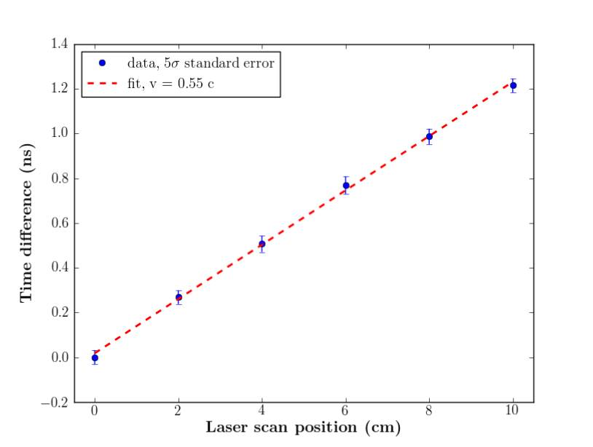
Demonstrated Position Sensitivity
Razib’s scanning stage
4-tile `tile-row’
of Supermodule
Time difference of 2 ends vs laser position

Slide 27
Breaking the 1-Psec Barrier
Summarize where are we now:
  The TTS (Transit-Time-Spread: FWHM) ~50psec for large pulses
Beam particle
  We measured in the Fermilab Test Beam (T979, 2008) that a Photonis Planicon with an 8-mm quartz radiator produces ~50 PEs (Photo-Electrons) when a charged particle traverses the radiator and window
  The present precision is completely dominated by the measuring setups and not the intrinsic resolution of the pulse generation or time measurement

Slide 28
Breaking the 1-Psec Barrier
Make a simple-minded `guesstimate’ of resolution:
  Get a mean of 50 PE’s in a TTS of 50psec
  Mean # of PE’s per psec is 1 (1PE/psec)
  Probability of getting n PE’s expecting m is
  P_{m}(n)=m^{n}e^{-m}/n!, so prob of 0 is e⁻¹
  Probability of 0 PEs in 1st 3 psec is e⁻³=10%
  The prob. of >=1 in the 1st 3 psec is flat;
  σ=3/sqrt(12)=0.9 psec
  And if, with smaller pores, higher secondary emission for first strike, and better focusing we can get a TTS of 25psec, the probability of 0 PEs in 1st 3 psec is e⁻⁶=1%
  Not proven, but not nuts

Slide 29
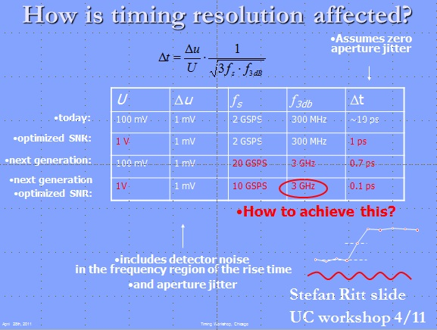
What about measuring the pulse?
Stefan Ritt’s ‘Rule-of-Thumb (see “The Factors that Limit Time Resolution in Photodetectors, Workshop, Univ. of Chicago, Chicago, IL; 28-29 April 2011 )
3 parameters: Signal-to-Noise (U/dU), sampling rate (f_{s}), and analog bandwidth (f_{3db}). Analog bandwidth is related inversely to pulse risetime: 350 MHz corresponds to 1 nsec.
Simplified version of Stefan’s Rule:
For a fixed number of samples on the rising edge (e.g. between 10% and 90%), the resolution is inversely proportional to the S/N ratio and the analog bandwidth.

Slide 30
So What Does Stefan’s ROT Predict?
Stefan Ritt slide from 2nd Photocathode Workshop* (annotated)
LAPPD:1V
0.7 mv
15 GS/sec
1.6 GHz
20??
Measured differential (1 end to another) resolution is ~5 psec: a measure of how well we are doing on the pulses
I suspect most of the rest is in the test setup, but there may be other effects we don’t yet know. Needs effort
*see psec library web page

Slide 31
Sub-psec Front End Prospects
E. Oberla invented a sweet idea- read out only one end of the 50Ohm lines, and leave the other unterminated=> one reads the near end directly and the far end `on the bounce’ in the same electronics channel. He then uses the digital waveform to autocorrelate the two pulses to get the position.
This suggests an answer to the problem of holding the number of samples constant as the risetime decreases (see C. Craven talk on faster substrates at Incom). Photek (Howorth et al.) have already achieved 60 psec risetimes- to get 10 samples on the leading edge need to sample at 160 GHz. Sampling is not a well-matched solution.
One solution, for low occupancy settings (e.g. large neutrino detectors, lepton colliders), would be to do the time and position analysis analog in a front-end ASIC. Postion from analog autocorrelation; time from a `Chronotron’- exploit the constant length (time) of the tile.

Slide 32
Reminder of the Pulses from a pair of 8” MCP Al2O3 plates
B. Adams, A. Elagin, R. Obaid, E. Oberla, M. Wetstein et al.
Left end of strip
Right end of strip

Slide 33
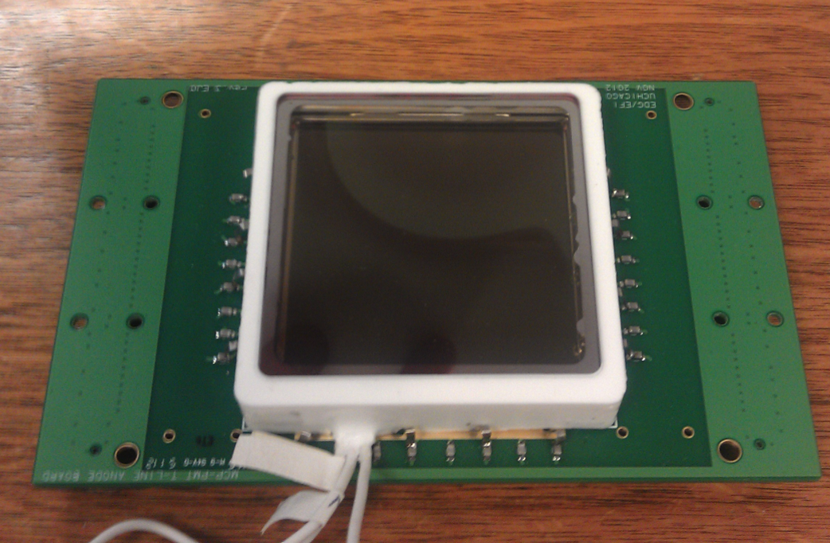
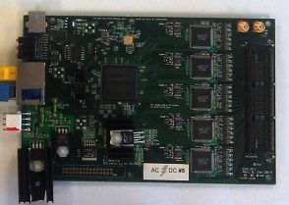
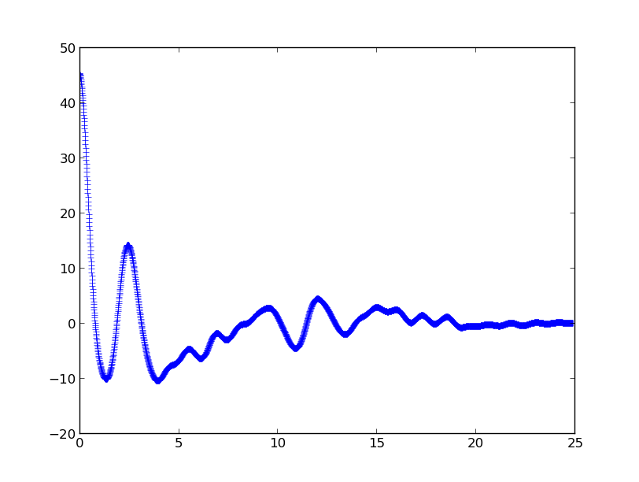
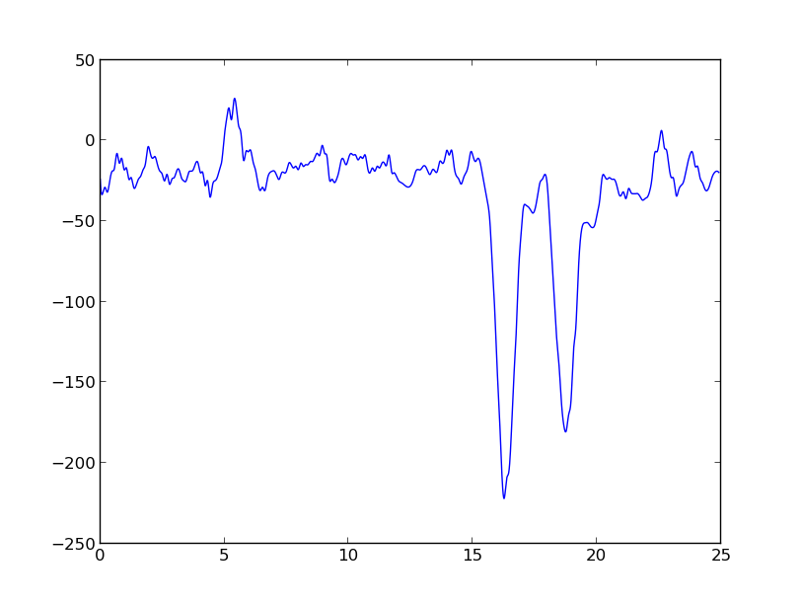
Transmission line single-ended readout
50 ohm cable delay
E. Oberla slide
30 channels PSEC4 readout
Record pulse and reflection on open end:
Extract time difference = position of photon hit
1)Interpolate
2)Resample timebase
3)Autocorrelate
25 ns

Slide 34
A Comment on Calibration
With jitter cleaners one can distribute a clock with psec-level stability. However, the task of holding calibrations to better than a psec over long-time scales is formidable.
Proposal: Measure the difference in arrival times of photons and charged particles which arrive a few psec later.

Slide 35

What’s the limit? (2009 cartoon)
Funnel pore with reflection cathode, dynode rings, ceramic anode,…
N.B.- this is a `cartoon’- working on workable designs-join us…
Front Window and Radiator
Photocathode
Pump Gap
High Emissivity Material
Low Emissivity Material
`Normal’ MCP pore material
Gold Anode
50 Ohm Transmission Line
Rogers PC Card
Capacitive Pickup to Sampling Readout

Slide 36
Lastly, let’s come back to mirrors and the Optical TPC
Adding psec-resolution changes the space in which considerations of Liouville’s Theorem operates from 3dimensional to 4dimensional. In analogy with accelerator physics, we can exchange transverse emittance to longitudinal emittance.
There may be interesting and clever ways to exploit this in large water/scint Cherenkov counters.
E. Oberla
Homage to T. Ypsilantis

Slide 37
Some References
MCP Testing and Pulse Performance : B. Adams, M. Chollet, A. Elagin, A. Vostrikov, M. Wetstein, R. Obaid, and P. Webster
A Test-facility for Large-Area Microchannel Plate Detector Assemblies using a Pulse Sub-picosecond Laser;
Review of Scientific Instruments 84, 061301 (2013)
PSEC-4 Waveform Sampling Chip E. Oberla, J.-F. Genat, H. Grabas, H. Frisch, K. Nishimura, and G Varner
A 15 GSa/s, 1.5 GHz Bandwidth Waveform Digitizing ASIC;
Nucl. Instr. Meth. A735, Jan., 2014, http://dx.doi.org/10.1016/j.nima.2013.09.042; http://arxiv.org/abs/1309.4397
Microstrip Anode Performance H. Grabas, R. Obaid, E. Oberla, H. Frisch J.-F. Genat, R. Northrop, F. Tang, D. McGinnis, B. Adams, and M. Wetstein;
RF Strip-line Anodes for Psec Large-area MCP-based Photodetectors,
Nucl. Instr. Meth. A71, pp124-131, May 2013
SSL MCP Performance, Testing and Ceramic Tile Program O.H.W. Siegmund,*, J.B. McPhate, J.V. Vallerga, A.S. Tremsin, H. Frisch, J. Elam, A. Mane, and R. Wagner; Large Area Event Counting Detectors with High Spatial and
Temporal Resolution, submitted to JINST; Dec, 2013
Fast Timing in Searches for Double Beta Decay C. Aberle, A. Elagin, H.J. Frisch, M. Wetstein, L. Winslow. Measuring Directionality in Double-Beta Decay and Neutrino Interactions with Kiloton-Scale Scintillation Detectors; Jul 22, 2013. To Be Published in JINST; e-Print: arXiv:1307.5813
LAPPD documentation can be found at http://psec.uchicago.edu/library/doclib/
(thanks to Mary Heintz, system administrator)

Slide 38
Many Thanks to:
My LAPPD Collaborators at ANL, UC-Berkeley SSL, Uchicago, Hawaii, and Washington University
Staff and management at Incom, Arradiance, and InnoSys
Others in the field of fast-timing , with special thanks to T. Ohshima and J. Vavra; and waveform sampling, (special thanks here to D. Breton, E. Delagnes, J.F.-Genat, S. Ritt, and G. Varner)
Howard Nicholson and the US DOE Office of HEP
The organizers, staff, and students of TIPP2014 (!)

Slide 39

The End

Slide 40
Backup Slides

Slide 41
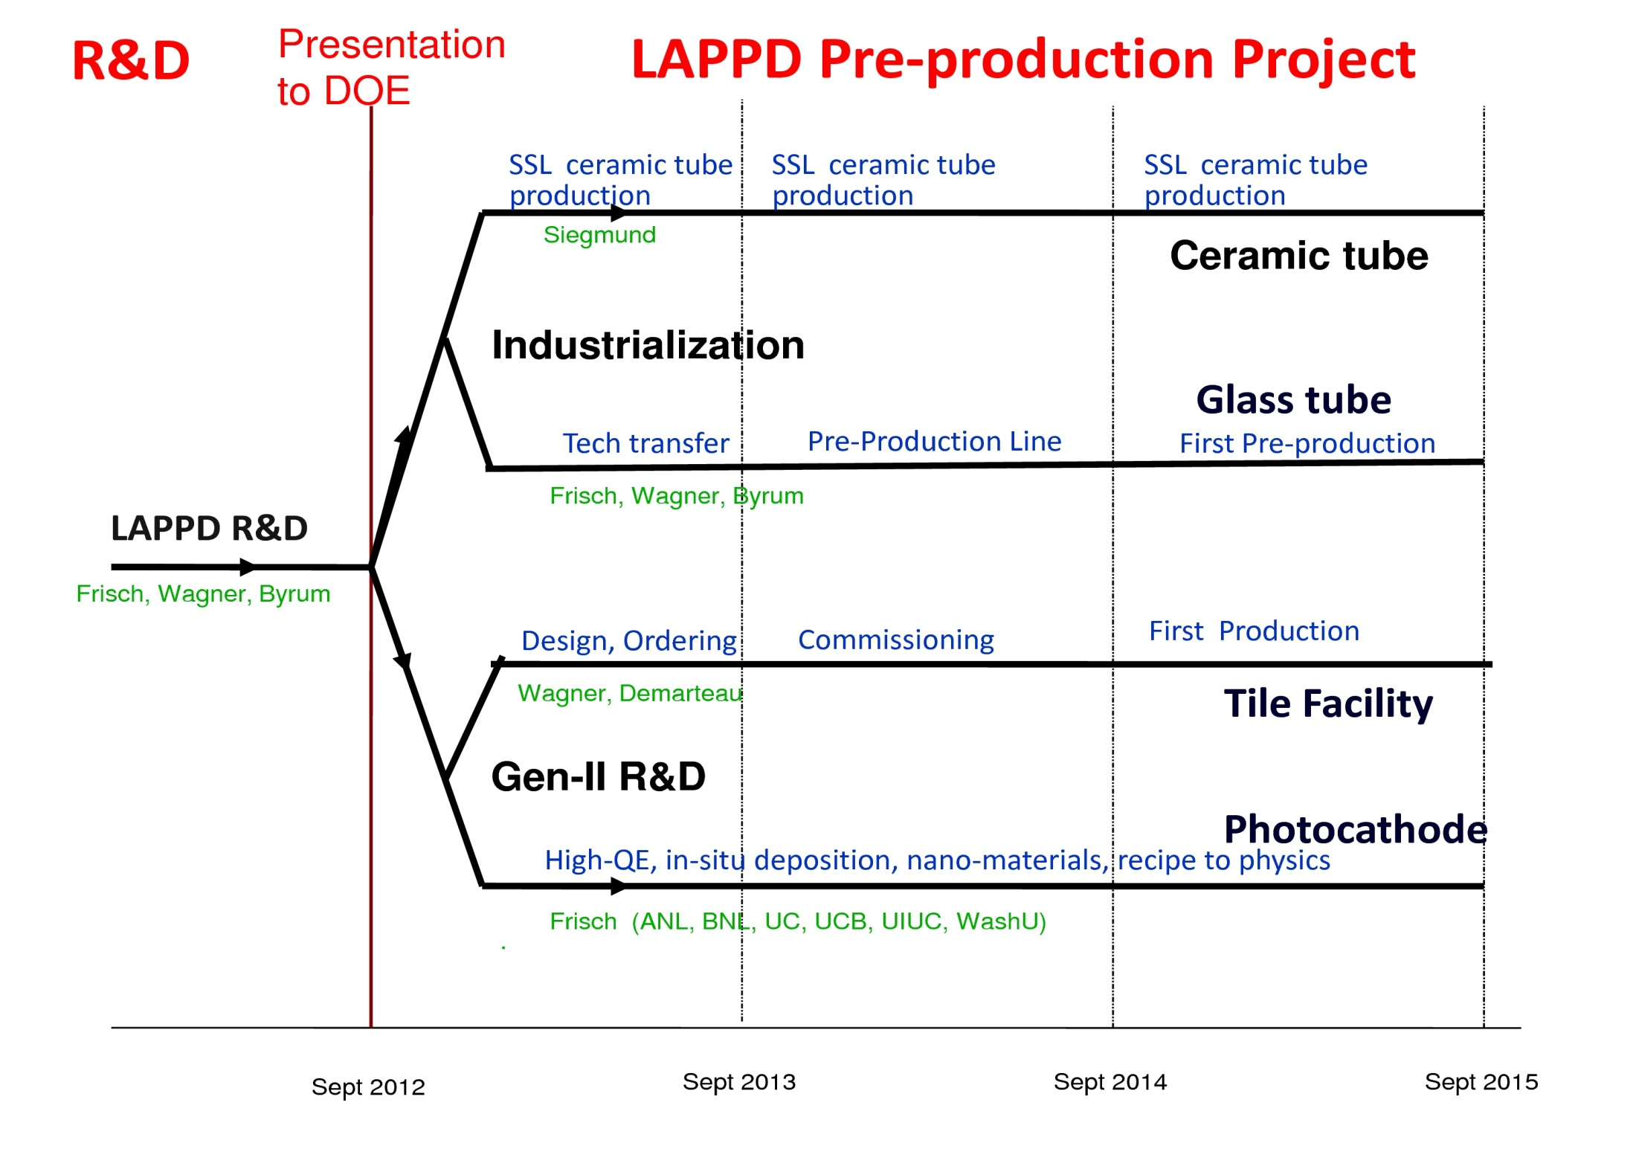
Dec.12,2012 Proposed Plan

Slide 42
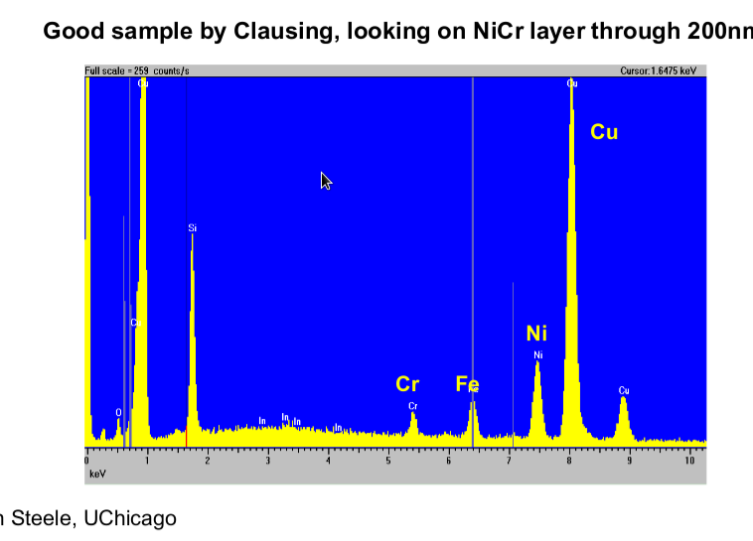
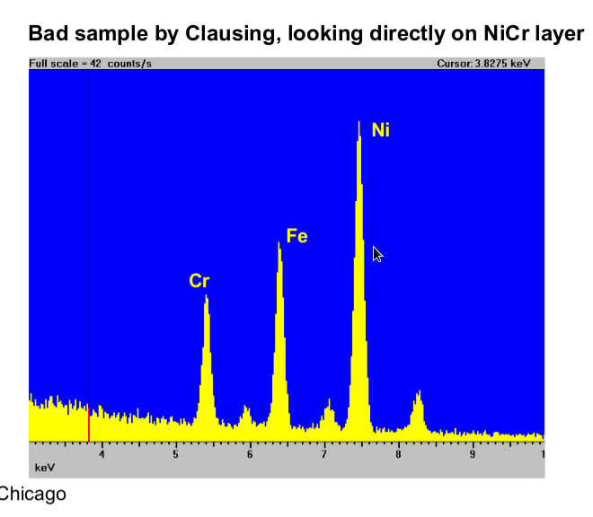
Getting Quantitative on the Solder Seal
Andrei, Ian Steele
Use same recipe as SSL- main difference is flat vs groove, and thickness of Cu
on sidewall (window is the same)
Still some parameter we don’t understand- evap rate, temp, OH, H, …
Frugal Tile Support

Slide 43



LAPPD - Last Review
single PE: σ ~ 44 psec
large signal limit
complete system testing with PSEC electronics
GAIN DISTRIBUTION
Landau fit to peak
most probable value: 3.0e7
DOE review - May 2014
43

Slide 44


Electronics-PSEC4
120-channel system running at UC on the OTPC (Eric)
60-channel system running at APS Teststand
U. Of Vermont has 6 -channel system running
(not shown)
And Sandia ordered 120 PSEC4 (720 channels); we piggy-backed 80 (480 channels)
Huston, D.R., et al, "Concrete bridge deck condition assessment with automated multisensor techniques", Structure and Infrastructure Engineering , Sept. 2010

Slide 45




Micro-Channel Plate Development
Incom with SSL testing developed 8”-sq high-quality MCP Plates
Incom 8”-sq high-quality MCP plate with > 65% OAR
Characterization of SEY of emitting materials (ANL/MSD, here for Arradiance)
Detailed simulation of MCP’s and materials; comparison with data

Slide 46


The Half-Meter-Squared SuperModule
A `tile’ is a sealed vacuum-tube with cathode, 2 MCP’s, RF-strip anode, and internal voltage divider
HV string is made with ALD
A `tray’ holds 12 tiles in 3 tile-rows
15 waveform sampling ASICS on each
end of the tray digitize 90 strips
2 layers of local processing (Altera)
measure extract charge, time,
position, goodness-of-fit

Slide 47
Looking beyond first tiles: high performance photodetectors
High QE- photocathodes-
High volume/lower cost --innovative production techniques (both assembly and design)
Application-specific anodes: pads, patterns, crossed-delay lines, …
Electronics, complete systems, packaging
Need a coherent effort, with an eye on the competition.

Slide 48
Essential Innovations from conventional MCP-PMT’s
8” hardglass (`pyrex’) substrates (Incom)
Proprietary resistive layer (ANL/ESD)
`Frugal’ plate-glass body, water-jet cut
Glass frit bottom seal over anode traces
Silk-screened frugal transmission line anodes
No-pin ALD-based resistive HV divider
>15 GS/sec waveform-sampling ASICs
Local analysis FPGA-based DAQ->time,space
Modular design for large-area coverage
`Femtosec’ laser testing (ANL/XSD)

Slide 49

Looking beyond first tiles: high performance photodetectors
Sub-psec time resolution: Ritt extrapolation gives 100 fsec at 3GHz (but settle for 500)
Funnels, reflective geometry, high-ABW anodes
Sub-psec is possible
(I’m willing
To bet $)

Slide 50
The Transition from 3 Years of R&D to Applications: Roles of SBIR/STTR and TTO
Tech Transfer
Tube Production, Market Development
Processes/designs move to production
Tubes return for testing, adopters
R&D advances move to production
“Pull of the mkt” informs R&D
Advances return for integration
LAPPD
R&D effort moves to industry
SBIR/STTRs
Process development, Testing, Applications
R&D on cost, performance

Slide 51

Complementarity of 2 Packages
J. McPhate

Slide 52

Comparison with existing detectors
K. Arisaka; UCLA
Psec
Cm²

Slide 53

Measured Timing Resolution on 8” Pair
pico-seconds
Approx Laser Spot Size

Slide 54

The 2013 Transition from LAPPD to Production: The 4 Parallel Paths
Dec 12, 2012 Presentation to DOE
(a UC view)
SSL (Ossy)
Incom
ANL/HEPD
BNL,RMD,UC,….

Slide 55

Position Measuring ANL APS
Demountable Tile
1 nsec
Slope=0.55c
0 nsec
B. Adams, A. Elagin, R. Obaid, E. Oberla, M. Wetstein et al.

Slide 56
Next Gen Waveform Sampling PSEC5 specs
(Hawaii, Innosys, and Chicago)
Eric Oberla table

Slide 57

Alkali Cathode Spectral Responses
From A. Lyashenko
First Photocathode Workshop
UC July 2009

Slide 58


LAPPD system example: The ‘supermodule’: APS testing
(many thanks to Bernhard Adams, ANL+ others- see RSI paper)
Eric Oberla slide

Slide 59
What’s the limit? (2009 cartoon)
Funnel pore with reflection cathode, dynode rings, ceramic anode,…
N.B.- this is a `cartoon’- working on workable designs-join us…
Front Window and Radiator
Photocathode
Pump Gap
High Emissivity Material
Low Emissivity Material
`Normal’ MCP pore material
Gold Anode
50 Ohm Transmission Line
Rogers PC Card
Capacitive Pickup to Sampling Readout

Slide 60
Going Another Order-of-Magnitude
Stefan Ritt slide, doctored
(agrees with JF MC)
For 100 fsec
1.0
0.7
17
1.6
17
100 Femtosec (!)
Achieved by LAPPD
Subject of a 2013 SBIR with Innosys, SLC
Δt: γ e π K p
(ps) 0 10⁻⁶ 0.13 1.6 6.25
Differential TOF:
1.5m path

Slide 61
Slade Jokela (ANL)

Slide 62


PSEC-4 Performance
Eric Oberla, ANT11
Digitized Waveforms
Input: 800MHz, 300 mV_{pp} sine
Sampling rate : 10 GSa/s
Sampling rate : 13.3 GSa/s
Only simple pedestal correction to data
As the sampling rate-to-input frequency ratio decreases, the need for time-base calibration becomes more apparent (depending on necessary timing resolution)

Slide 63


Photocathodes
LAPPD goal- 20-25% QE, 8”-square- conv. alkali
2 parallel efforts: SSL (knows how), and ANL (learning)
ANL
Optical stand
Burle commercial
equipment
First cathodes made at ANL

Slide 64


Cathode Major Achievements
A successful 8” Bialkali Cathode
(Ossy’s Talk)
A 8” Bialkali made in the Burle Equip at ANL ( Ossy’s Talk)

Slide 65


8”-MCP Pair and Strip Anode Work
Laser mirrors and 8” anode for 8” MCP tests
Pulses from one strip of 8” anode with 8” MCP pair
Matt Wetstein, Bernhard Adams, Andrey Elagin, Razib Obaid, Sasha Vostrikov, Bob Wagner

Slide 66
Going Another Order-of-Magnitude
Stefan Ritt slide from 2nd Photocathode Workshop* (annotated by HJF )
*see psec library web page
For 100 fsec
1.0
0.7
17
1.6
17
100 Femtosec (!)
Achieved by LAPPD
(Yes, but… But, quantitatively, what are the reasons why not?) Needs a dedicated simulation program
Δt: γ e π K p
(ps) 0 10⁻⁶ 0.13 1.6 6.25
Differential TOF:
1.5m path

Slide 67
More Information on LAPPD:
Main Page: http://psec.uchicago.edu (has the links to the Library and Blogs)
Library: Workshops, Godparent Reviews, Image Library, Document Library, Links to MCP, Photocathode, Materials Literature, etc.;
Blog: Our log-book- open to all (say yes to certificate Cerberus, etc.)- can keep track of us (at least several companies do);

Slide 68



37b Needs: Bandwidth > 3 GHz for Δt < 1 psec
MCP-PMT as 3D waveguide
Anode risetimes (step function)
Analog bandwidth of `frugal’ anode
Bandwidth 3db point vs Anode length

Slide 69


Packaging Major Achievements
Development of a complete ceramic package system design
(Jason’s and Ossy’s talks)
Development of a `frugal’ glass
tile package with internal HV divider, capacitive GHz readout
(Andrey’s and Matt’s Talks)

Slide 70

Can we build a photon TPC?
Work of Matt Wetstein (Argonne,&Chicago) in his spare time (sic)

Slide 71
Pulses from a pair of 8” MCP Al2O3 plates
B. Adams, A. Elagin, R. Obaid, E. Oberla, M. Wetstein et al.
Left end of strip
Right end of strip
(Note-to-self: forward-reference Eric Oberla’s single-ended readout)

