Slide 1
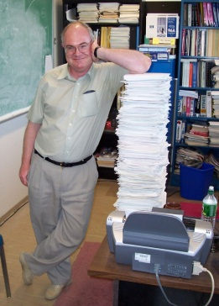
Uli and Signature-Based Searches With Gauge Bosons At the Tevatron
Henry Frisch
Enrico Fermi Institute, University of Chicago

Slide 2
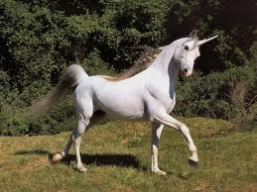
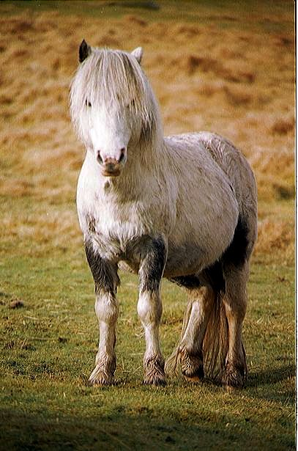
Uli Understood- test the SM
The identification of new phenomena is only possible if there are precise SM predictions- Uli’s forte
Task: identify
1 in 10¹⁴ of these
We depended on Uli for guidance

Slide 3
Uli Understood- test the SM
The gauge sector- W’s and Z’s at a hadron collider are a filter
1 in 1,000,000
Earth::QCD
Soccerball::W’s and Z’s
Uli focused on understanding rare events in the smaller sphere

Slide 4
The danger of exploring without a trusted guide who owns a SM topo
Rubbia and the 1984 Top Discovery
Lederman and 1971 J/Psi
Expected and so Found
Unexpected and so Not Found

Slide 5
Announcement of the 1986 UA1 SUSY Discovery (Aspen 1986)
(original transparency-
don’t ask)
Shot down by Steve Ellis- it turned out to be explainable as a `cocktail’ of SM processes – power of theory (theorists)

Slide 6
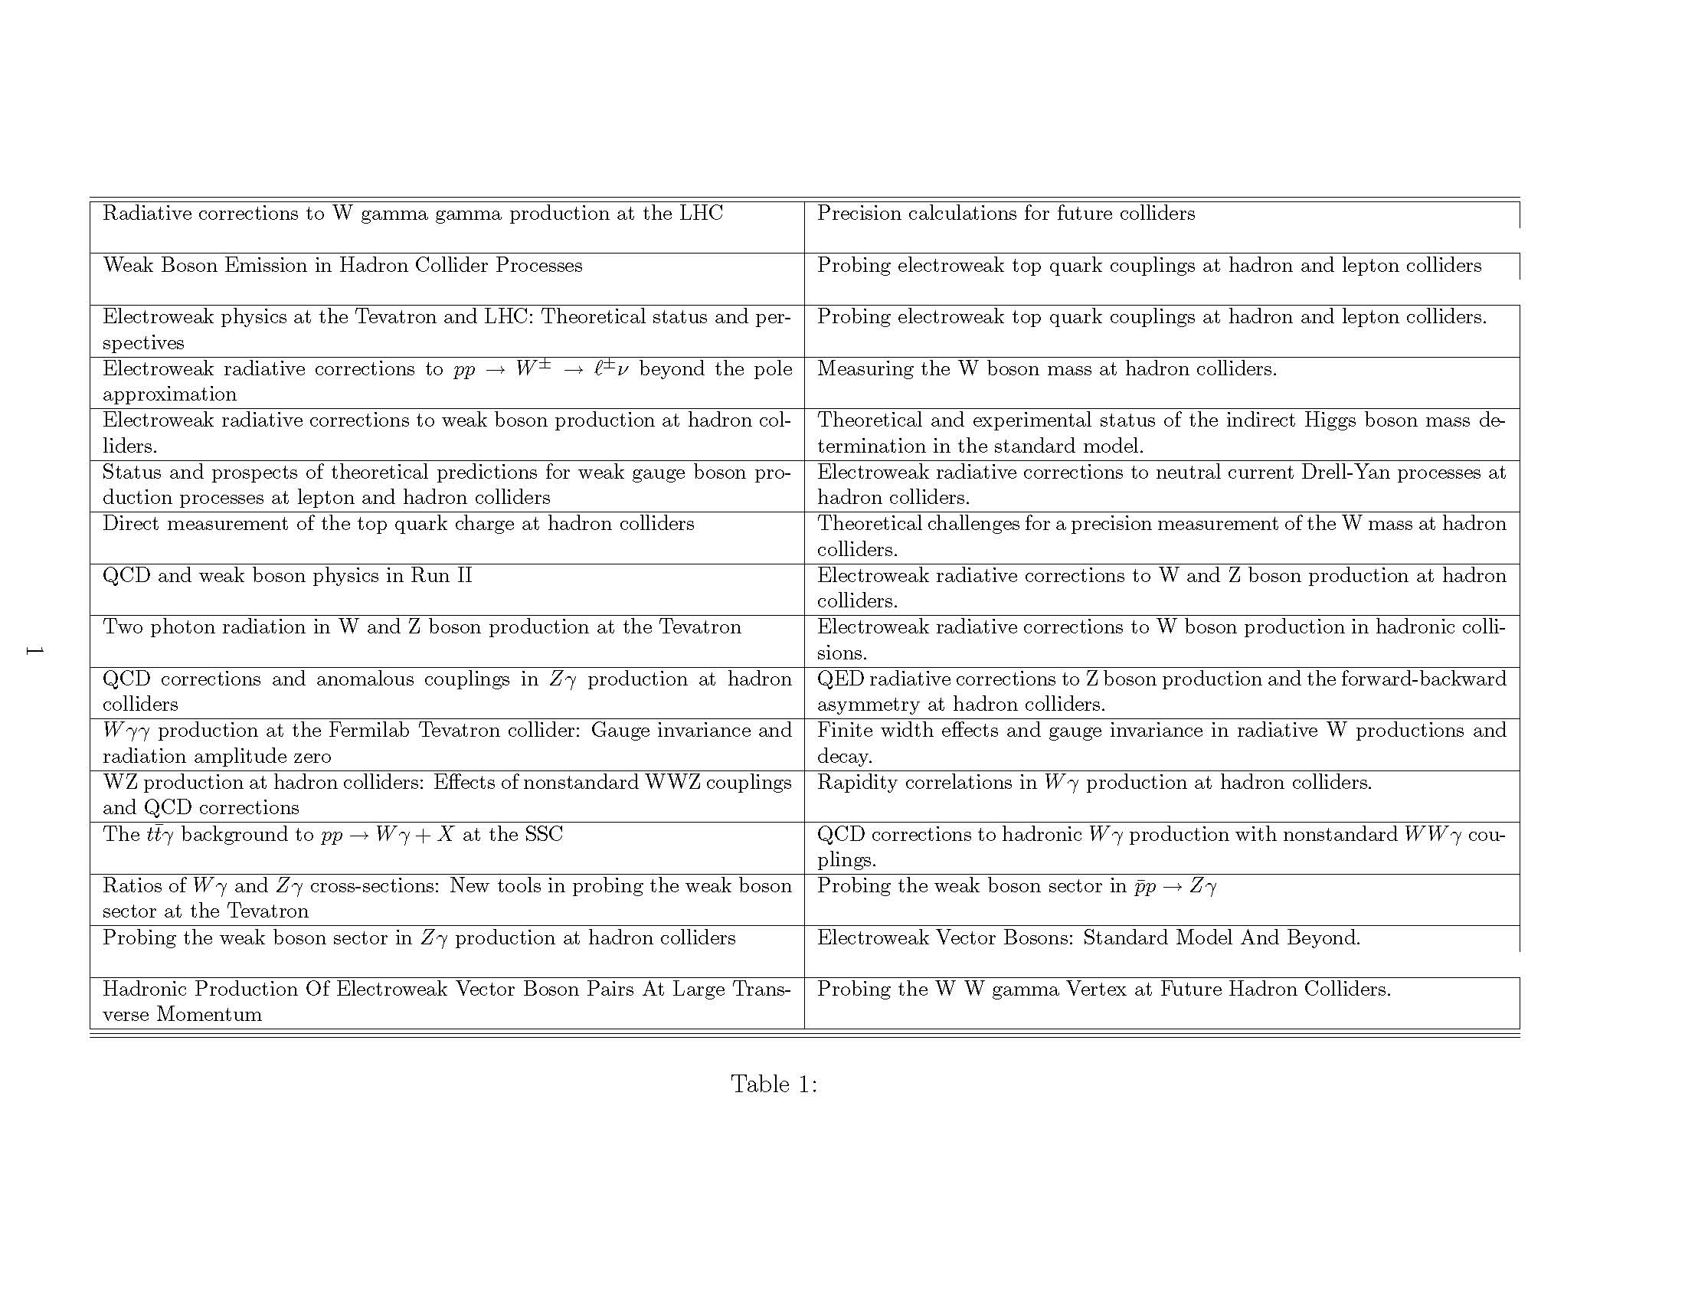
SelectedUli’s papers related to our group’s measurements
n. b.

Slide 7
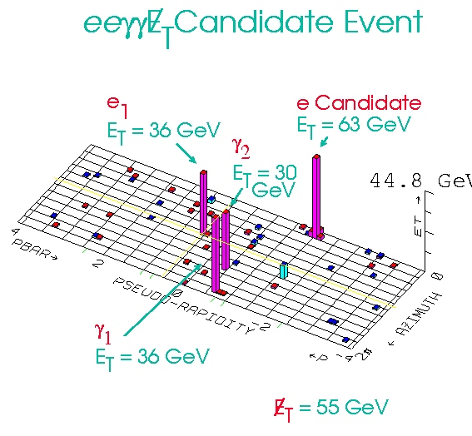
Our Own Odyssey at CDF Run I
Trigmon found one event-the `eeggmet’ event

Slide 8
Note the overlap with Uli’s interests
Event looks like it has (at least)
4 gauge bosons- 2 W’s and 2 gammas
Backgrounds are radiation + W and Z’s- one of Uli’s arenas
SM prediction is negligible- (2 very stiff gammas doesn’t happen radiatively, + high pair mass, and very large met (>>MW/2))
But it’s one event- what more can we do to explore beyond it?

Slide 9
KEY IDEA OF SIGNATURE-BASED SEARCHING LOOK FOR SIGNATURES THAT ARE FORBIDDEN/SUPPRESSED IN THE SM- ONE NEEDS AT LEAST SEVERAL EVENTS PER CHANNEL, AND IN (HOPEFULLY) MULTIPLE CHANNELS, BUT CAN LOOK FOR LOW CROSS-SECTION NEW PHYSICS BY LOOKING WHERE THE SM AIN’T. WHOLE ENTERPRISE RESTS ON RELIABLE SOLID SM PREDICTIONS- IN OUR CASE PARTICULARLY EWK BOSONS…- THIS IS WHY WE WENT TO ULI SO OFTEN…

Slide 10
Search for signatures related by (non-SM) Branching ratios (first signature-based search at the Tevatron, to my knowledge)
Called this looking for `cousins’-look for related BR’s
eeγγ-met
Example would be ttbar- look in l+jets, ll, and 6 jets…
2 decay chains ending in met, plus a decay into a photon in at least one chain (e.g. N2C1)
2 decay chains each ending in a photon (e.g. GMSM)
2 photons+X
Lepton+photon +X

Slide 11
The γγmet +X signature
D. Toback Ph.D Thesis Dec. 1997 PRL 81, 1791 (1998) PRD D59,092002 (1999)
SM expectation
Observed
Eeγγmet event

Slide 12
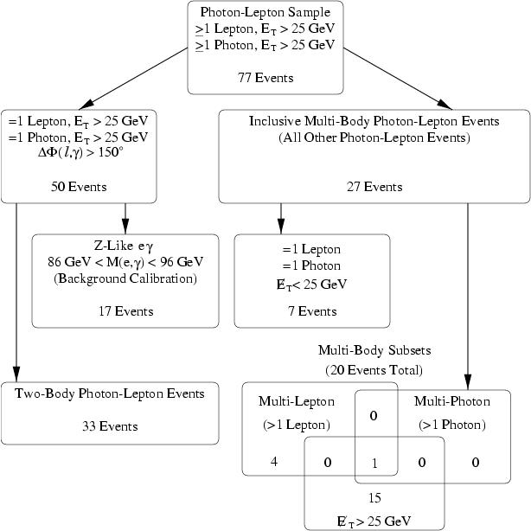
The lγmet signature
J. Berryhill Ph.D thesis, Dec. 2000 PRL 89,041802 (2002), Phys Rev D66, 12004 (2002)
Start with >4x10¹² events: this is the filter chain for rare SM signatures.
Note the dependence on precise
Wγ and Zγ
SM calculations- needed Uli
The other `cousin’ decay chain- -one leg charged current, other neutral- e.g. C1-N2 in SUSY

Slide 13
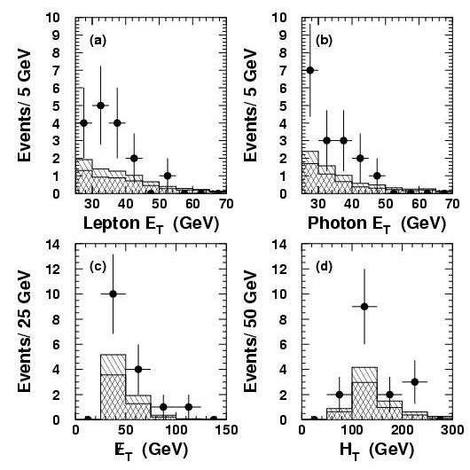
The lγmet signature-results
J. Berryhill Ph.D thesis, Dec. 2000 PRL 89,041802 (2002), Phys Rev D66, 12004 (2002)
(Run I- 86 inverse pb)
SM expect.
Observed
Note muons are P=4%- but I’m a
firm believer in Trieman’s theorem:
“You get (are allowed) only one miracle”

Slide 14
Run II eeγγmet Event Followup: lγ+X
In γ-l+X we found a 2.7s excess over SM. What to do?
Decided to repeat the analysis in Run II with the SAME (published) cuts-- forces it to be a priori. Only way to test.
Note- NOT optimized for GMSB, but is unchanged from Run I selection (we had to argue this with the CDF collab.).
CDF Run I PRL: ..”an interesting result, but … not a compelling observation of new physics. We look forward to more data…” (am proud of this- not so easy)

Slide 15
Run II eeggmet Event Followup
Andrei Loginov repeated the lgmet analysis- same cuts (no optimization- kept it truly a priori.
Run II: 929 pb-1 at 1.96 TeV vs Run I: 86 pb-1 at 1.8 TeV

Slide 16
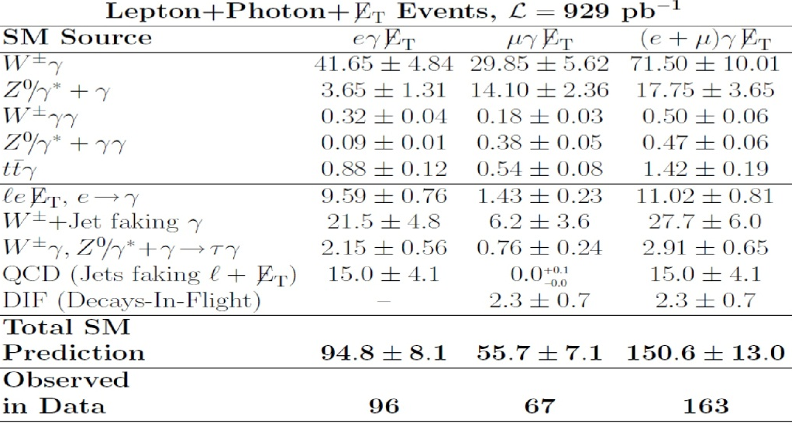
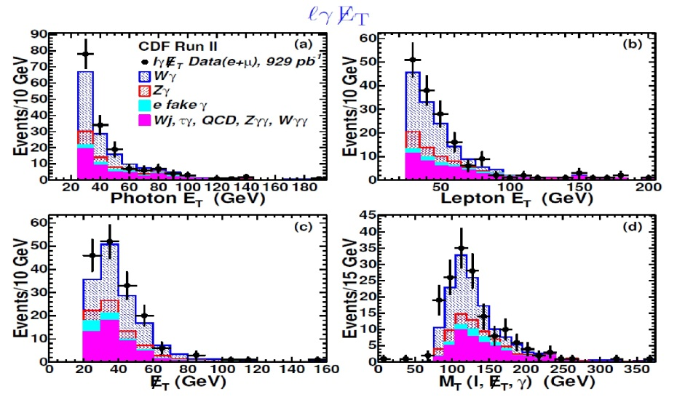
Run II eeggmet Event Followup
Run II: 929 pb-1 at 1.96 TeV
A. Loginov ITEP PhD thesis, Phys Rev D75, 11201 (2007)
`Anomally’ went away- should have gotten stronger if real- key is SM expectation (Uli)

Slide 17
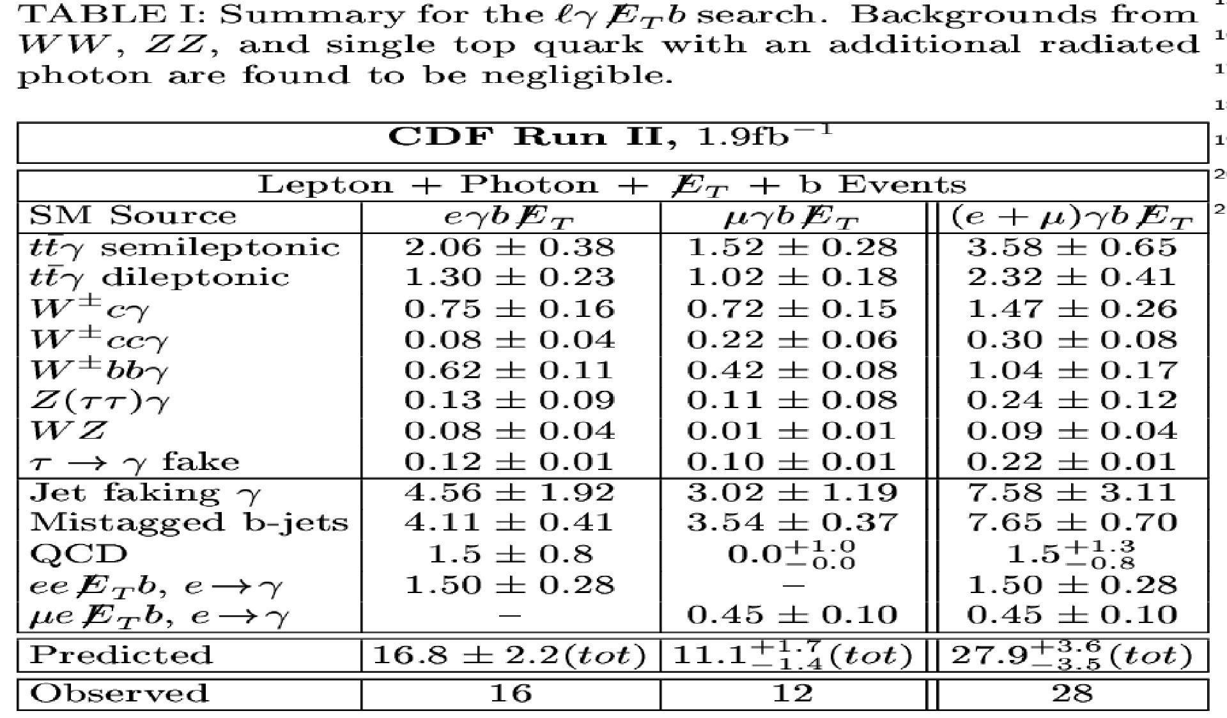
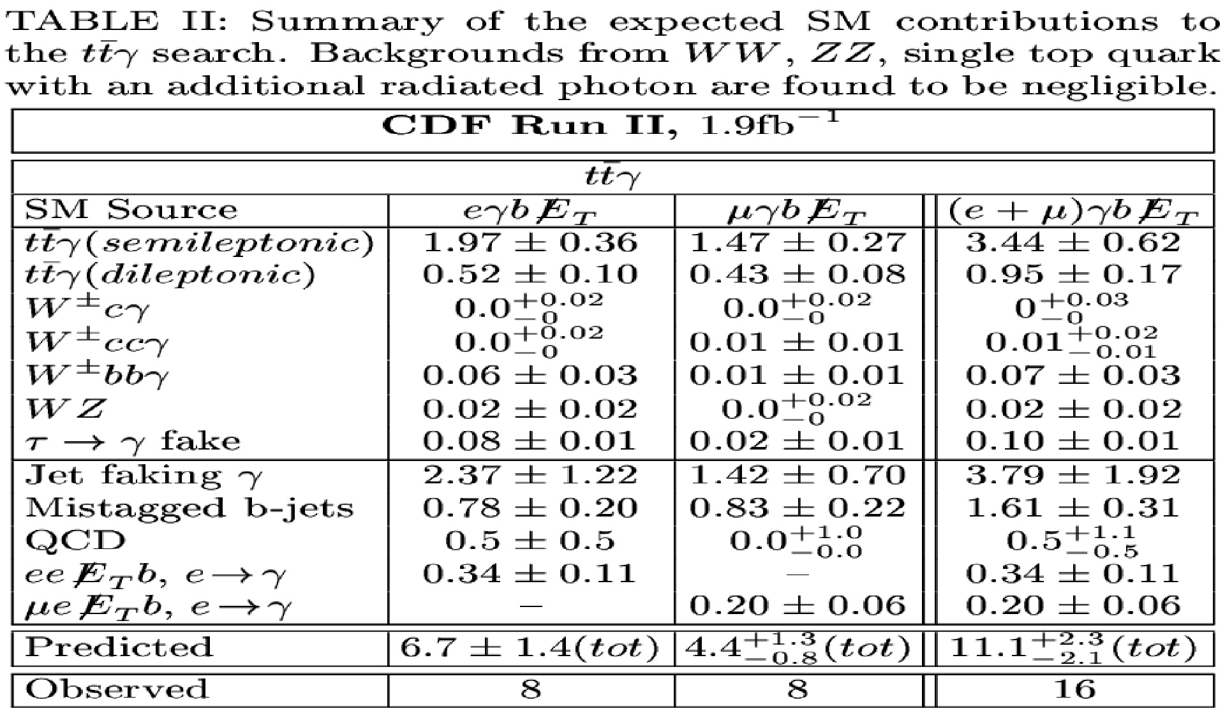
Irina Shreyber Ph.D thesis, Phys Rev D80, 1 (2009)
ttbar+Gamma: Adding a b-quark, >=3 jets, and large Ht
Irina Shreyber and Andrei: start with lgamma-met:
add the requirement of a b-quark: e or μ, γ, b+X
(nice channel for BSM)
Then add requirement for >=3 jets+ large Ht to look for SM radiative top decays: ttbar+ γ

Slide 18
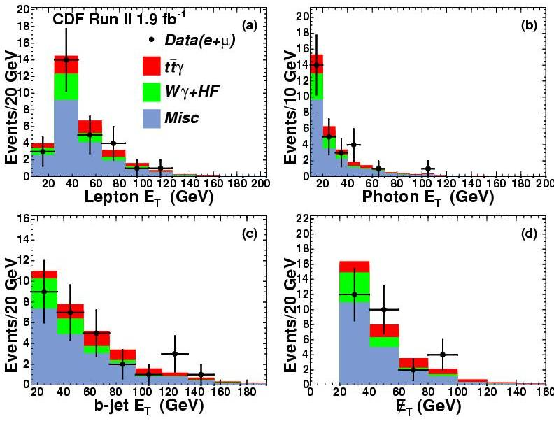
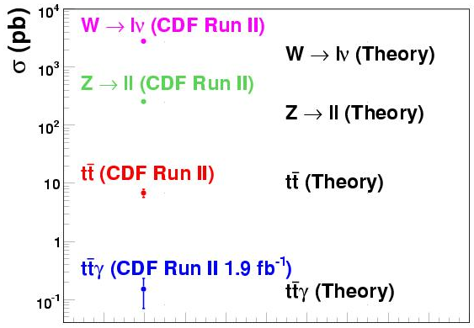
ttbar+Gamma
Irina Shreyber, ITEP Ph.D thesis, Phys Rev D80, 1 (2009)
1.9 pb⁻¹
No surprises- nothing really heavy, wild, or odd-
Consistent with ttbargamma =0.15+-0.08 pb (80 fb (!))
ttbar-gamma cross-section (?)

Slide 19
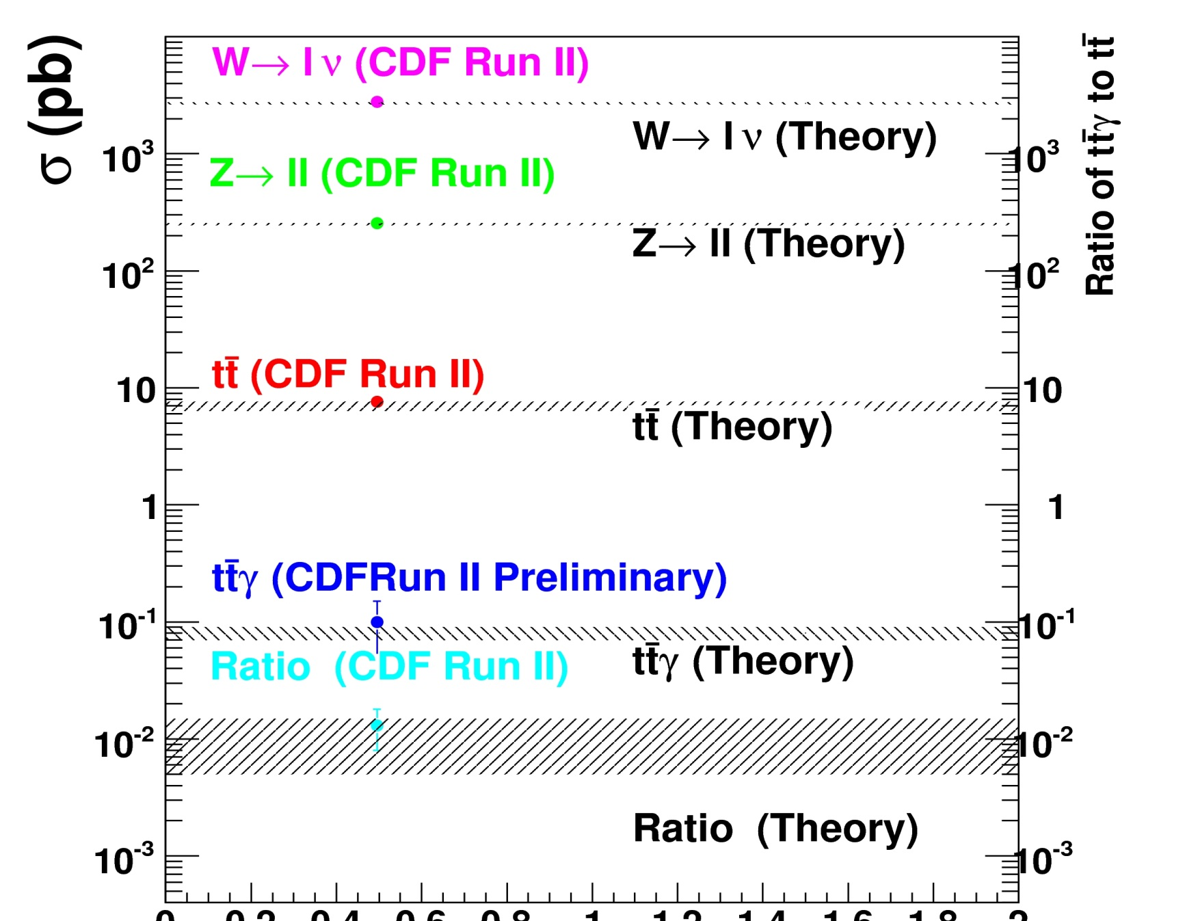
ttbar+Gamma:- next student…
Ben Auerbach, Yale Ph.D thesis, submitted to Phys Rev D (2011)
6pb⁻¹
ratio
Cross-section (!)
Note Uli ttγ paper- also control for ttbarH

Slide 20
Now for something wild and alas: Run I: the Eeggmet event and the gbjmet signature
Gordy Kane suggested looking for C2N2-> stopbγN1->bcγmet
We found a big bump(!)
10 events
This was a priori- selected cone=1.0 for dijet mass from UA2 W ->jj detection
We got excited (even Gordy)- but data not robust to changing cuts, and too little statistics to be sure…
BUMP(!)
M(b,jet)

Slide 21
Run I: gbjmet signature cont.
Different cone sizes: a) not robust; b) kinematic edge?
D3-body vs 2-body mass- bump and outliers- odd? (or not)

Slide 22
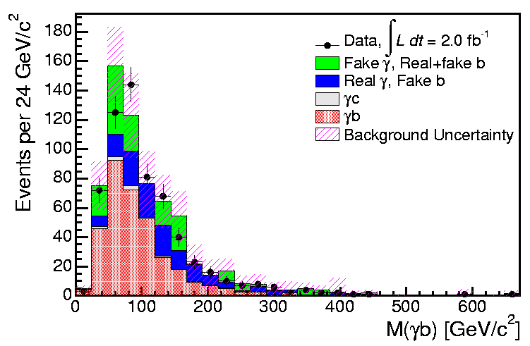
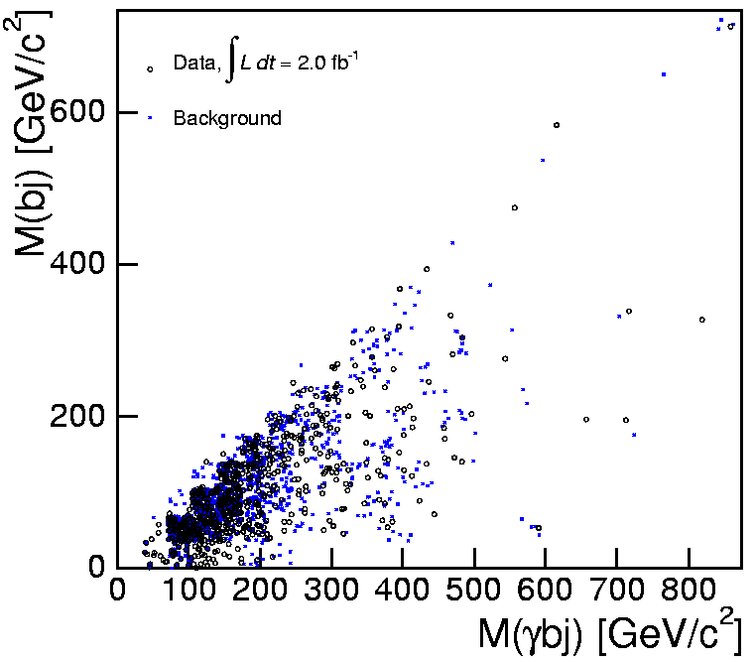
Run II- the gbjmet signature
Dan Krop, Shin-Shan Yu, Carla Pilcher, Scott Wilbur, Ray Culbertson, HJF
Look at the same 2 plots with >20 times the data
NO BUMP
As Sasha Paramonov would say, `Alas’ (`worse than losing a girl-friend’)
PRD D80, 52003 (2009)

Slide 23
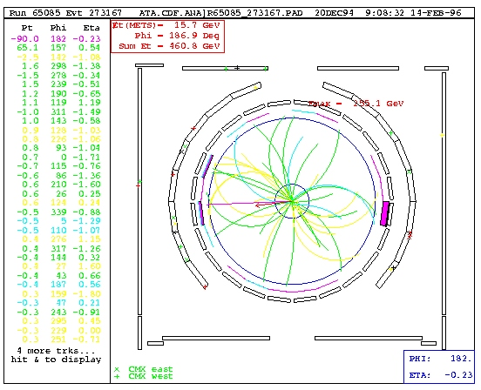
Run I: Other Odd Events with Photons and Leptons (another Uli interest)
Just one example
2 legs of the Z (!)
200 Gev
Photon
Z-boson to mu-mu balanced by a 200 GeV-Pt photon (presumably)

Slide 24
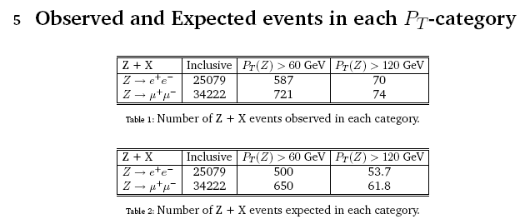
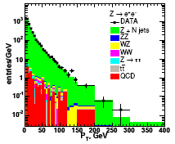
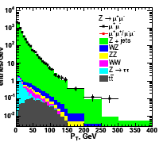
Run II: Search High Pt Z+X
Look at a central Z +X, for Pt > 0, 60, 120 GeV, and at distributions…
Need SM predictions even for something as `simple’ as this

Slide 25
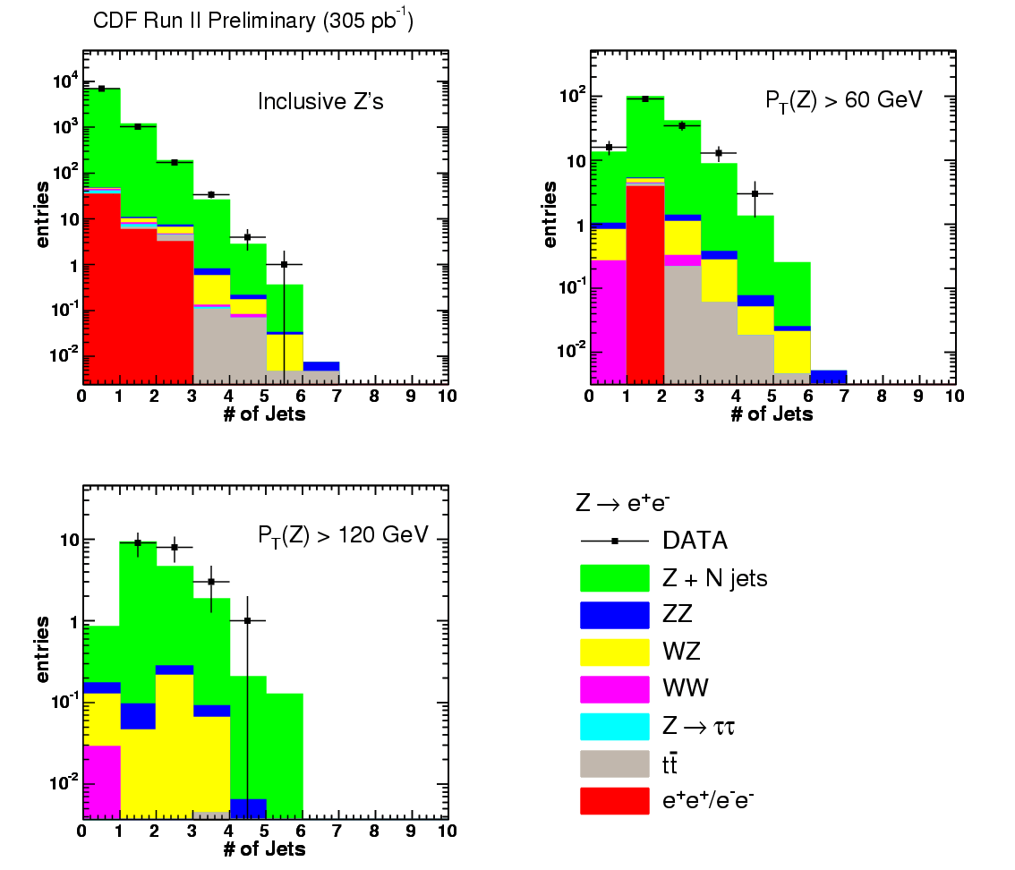
Signature-Based High Pt Z+X Searches
Sasha Paramonov (now Maria-Goeppert Mayer Fellow at ANL on Atlas
P_{T}^{Z}>0
PTZ>60
PTZ> 60
PTZ>120
N_{jets} for P_{T}^{Z}>0, P_{T}^{Z}> 60, and P_{T}^{Z}>120 GeV Z’s vs Pythia (Tune AW)- this channel is the control for Met+Jets at the LHC (excise leptons – replace with neutrinos).

Slide 26
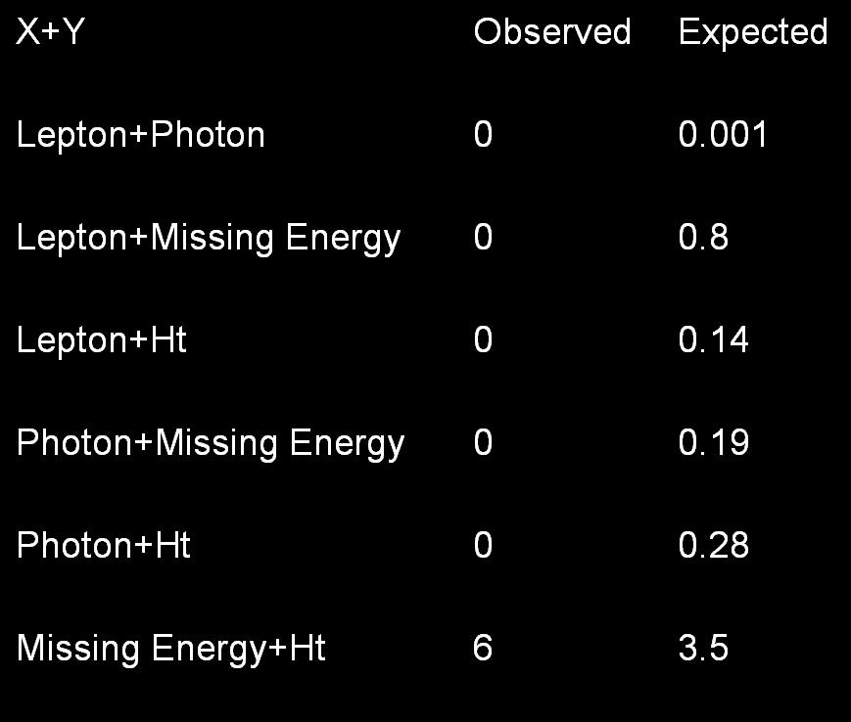
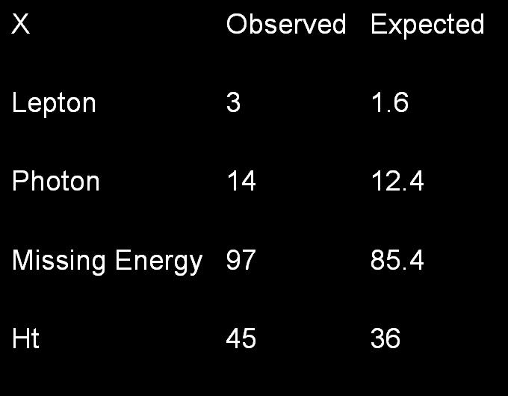
Signature-Based High Pt Z+X+Y
Z+X+anything
Simple Counting Expt- ask for a Z + one object, or Z+ 2objects
Two Objects
One Object
Z+X+Y+anything
Z+X+anything
Sasha Paramonov (now Maria-Goeppert Mayer Fellow at ANL on Atlas

Slide 27
Last Topic- Using Ratios to minimize systematics at the Tevatron and (especially) the LHC
Systematics rather than statistics limits the SM predictions for many W and Z channels- e.g. W or Z +jets.
Uli recognized this early (me too at CDF)- use ratios to cancel out systematics- can be much more sensitive to non-SM contributions
Seminal paper of Uli’s..
 | U. Baur (Florida State U.), S. Errede (Illinois U., Urbana),J.Ohnemus (Durham U.) 1993 Phys.Rev. D48 (1993)

Slide 28
Signature-based W/Z+Njets Search
Crossection vs number of jets in W and Z events
% uncertainty vs number of jets in W and Z events
So, switch to a measurable that is more robust: look for new physics by precise measurements of (W+Njets)/(Z+Njets). Systematics at few % level (Erin Abouzaid and HF, PRD68,033014;hep-ph/030388

Slide 29
Recent ATLAS ratio measurement basically Uli’s 1993 strategy
Thanks to Jason Nielsen, UCSC and Atlas

Slide 30
Uli at Fermilab 2001
Thank You, Uli, for everything

