Slide 1
Discovering the Higgs Boson
- latest results from the CERN LHC
J. Pilcher – November 1, 2012

Slide 2
Outline
Evidence for the Higgs boson has accumulated slowly for almost two years
  cross section is small
  backgrounds are large
Credibility of the experiment is essential
  a lightning review of other ATLAS results
    understanding of detector, environment, data sample in question?
Evidence for the Higgs from both ATLAS and CMS experiments
  “discovery-level” significance from each experiment individually
    joint results very relevant for a skeptic
Implications

Slide 3
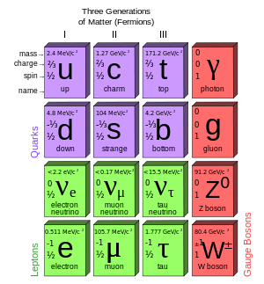
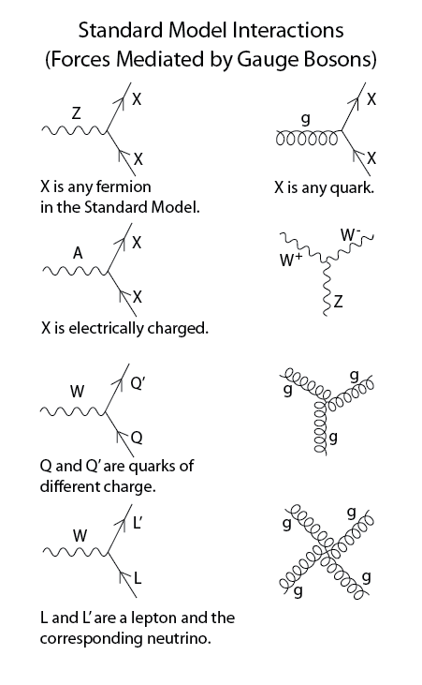
Introduction
Standard Model of particle physics
  dating from discovery of the electron in late 19th century
  bound states of the constituents (atoms, p, n, π, … )
  constituents from decays and scattering experiments

Slide 4
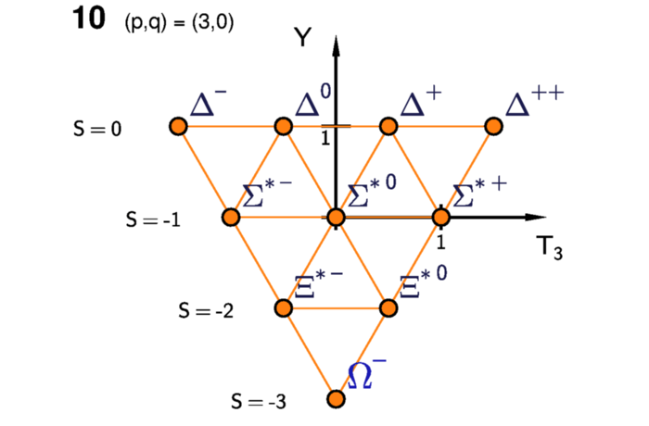
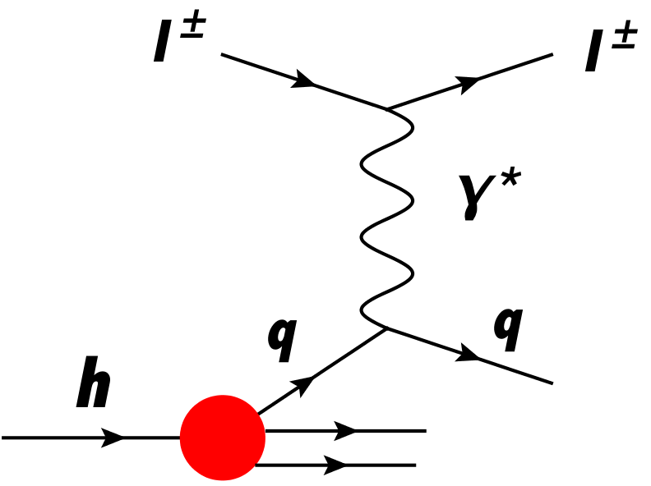
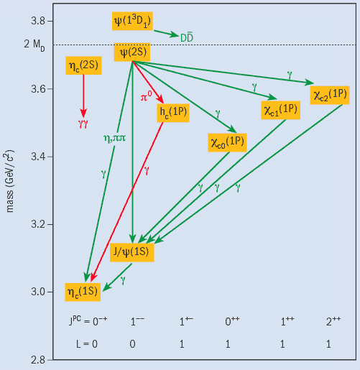
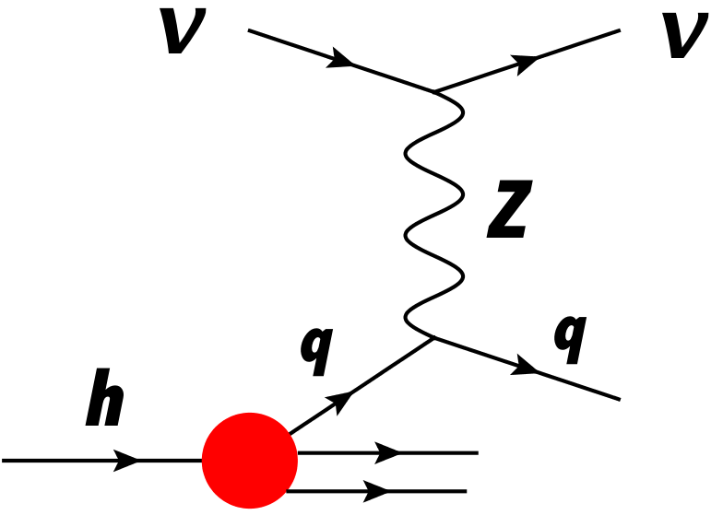
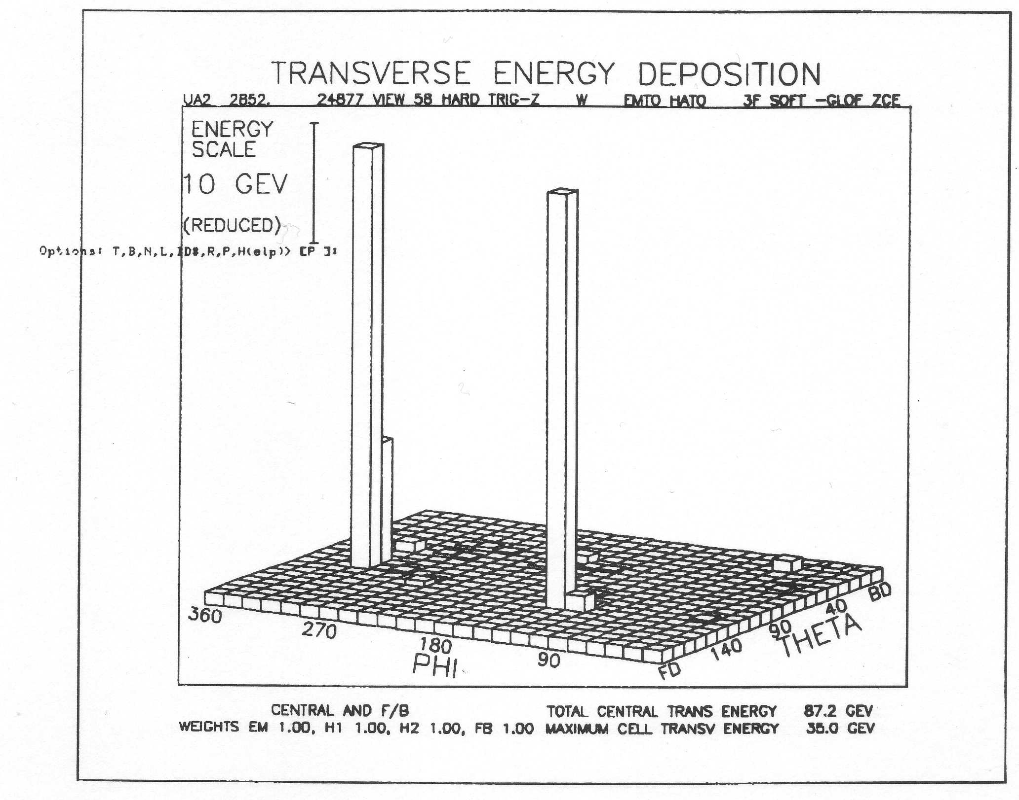
Introduction
Some experimental milestones
  quarks as a classification scheme (1960’s)
    Ω⁻ discovered, as predicted
  quarks as dynamical objects (1970’s)
    deep inelastic lepton scattering
    high p_{T} hadron scattering
    lepton-pair production
    c quarks, b quarks
      bound states and excitations
  discovery the gauge bosons
    neutral weak currents (1973)
      ν interactions via virtual Z
      first evidence for the Z boson
    gluon (1979)
    W, Z (1983)
      product of EW symmetry breaking via Higgs mechanism
      unification of weak and electromagnetic interactions
  three light neutrino flavors
    from (1989)
Charmonium spectroscopy
in UA2
Notes:
N_nu = 2.984 ± 0.008 (2 sigma different than 3.0)

Slide 5
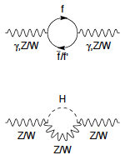
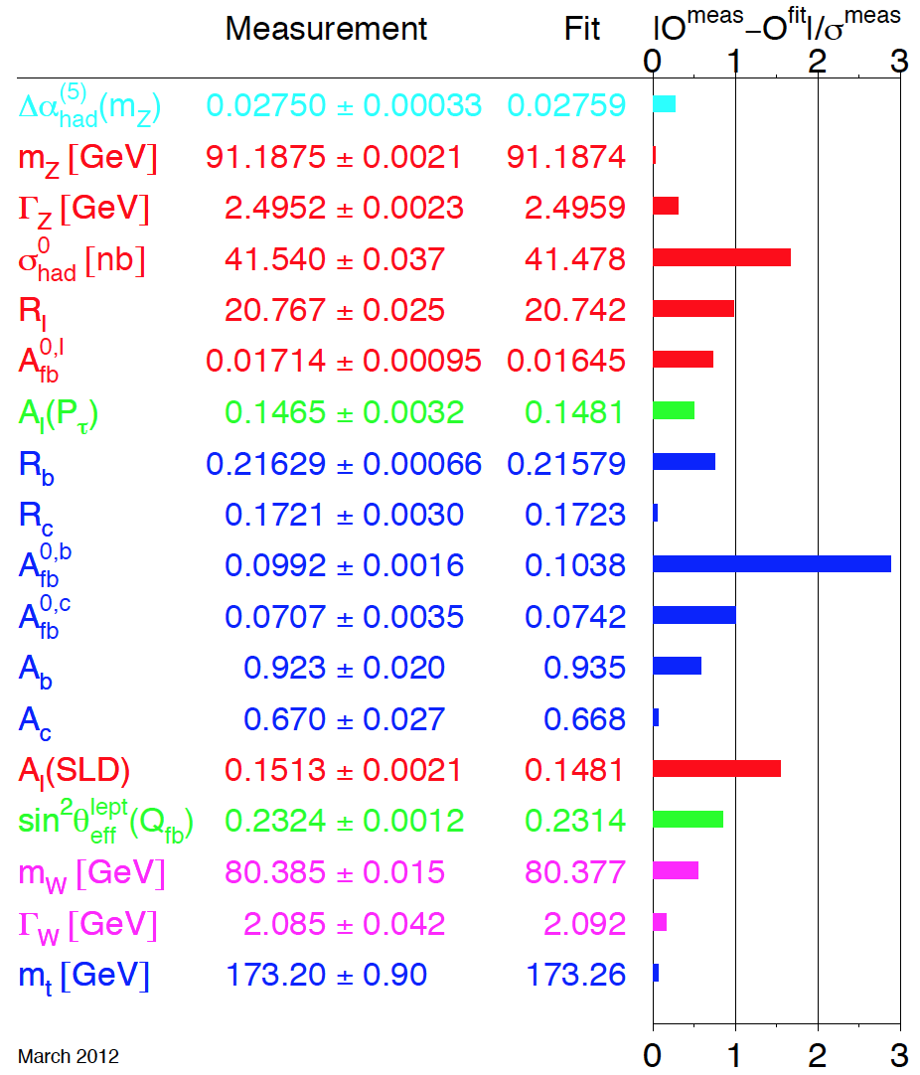
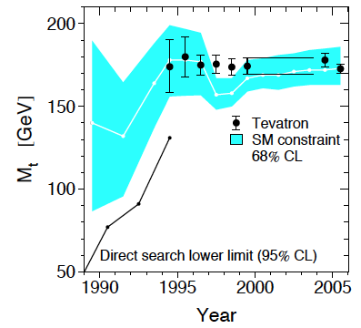
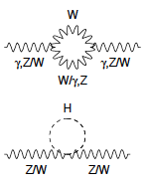
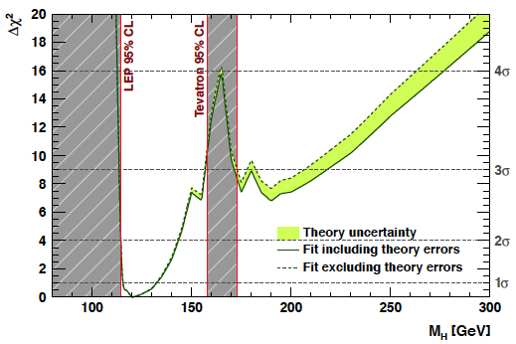
Introduction
Further experimental milestones
  discovery of the top quark (1994)
  high precision electroweak measurements (uncertainties often < 1%)
    depend on top quark and Higgs boson masses through virtual effects
Top quark mass vs. year
Fit quality vs Higgs mass
Electroweak Observables
Notes:
CL for EW fit is 23% (Chisq with 14 DF)
Fit value for M_h = 120 +12 -5 GeV (analysis of 2011)
Ignoring excluded regions (CL 21%)
M_h = 90 +30 -25 GeV

Slide 6
Introduction
Associated theoretical developments
  Yang-Mills – non-abelian gauge theories (1954)
  Nambu, Goldstone – spontaneous symmetry breaking (1960)
    2008 Nobel Prize
  Higgs, Englert, Brout, … – mass generation in symmetry breaking (1964)
  Weinberg, Salam, Glashow – electromagnetic-weak unification (1967)
    1979 Nobel Prize
  t’Hooft, Veltman – renormalizability of electroweak interactions (1971)
    1999 Nobel Prize
Implication of this description is an additional massive scalar boson
  conventionally called the Higgs boson
    one boson in simplest models but more in other popular models
  an essential ingredient of the standard model
  scalar field with non-zero expectation value in the ground state
    Higgs condensate permeates space
    particle masses arise from interactions with this condensate
  The object of experimental searches for more than 30 years
    capstone of the standard model

Slide 7

The Large Hadron Collider
ATLAS
A 27 km long collider ring
housed in a tunnel about 100 m
underground near Geneva

Slide 8
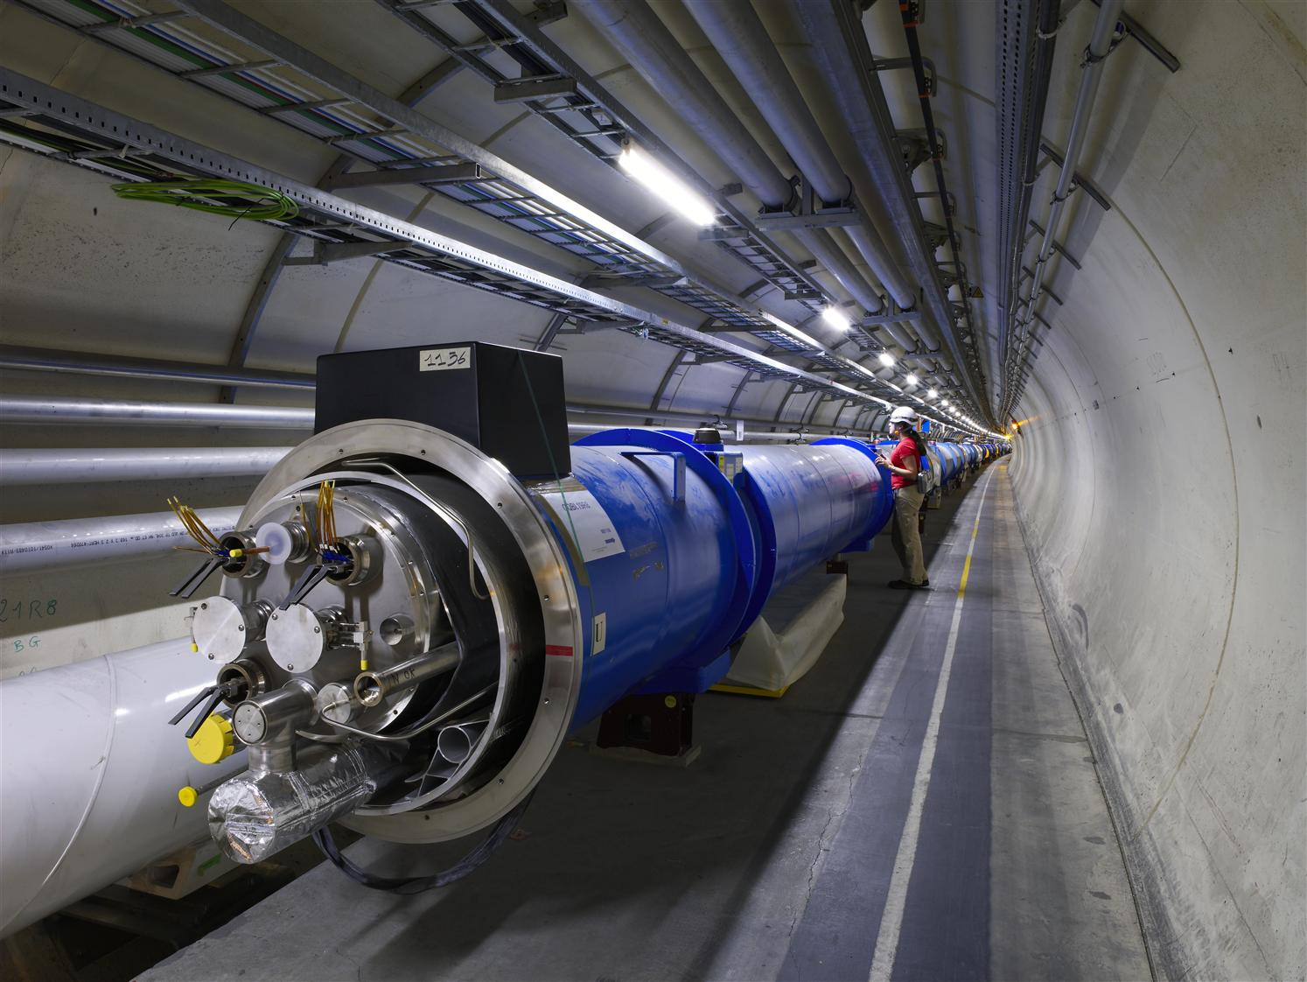
The Large Hadron Collider
The most challenging components are the
1232 high-tech superconducting dipole magnets
Length: 15 m
Magnetic field: 8.4 T
Operation temperature: 1.9 K
Dipole current: 11700 A
Stored energy: 7 MJ
Dipole weight: 34 tons
7600 km of Nb-Ti superconducting cable
Notes:
Dipoles

Slide 9
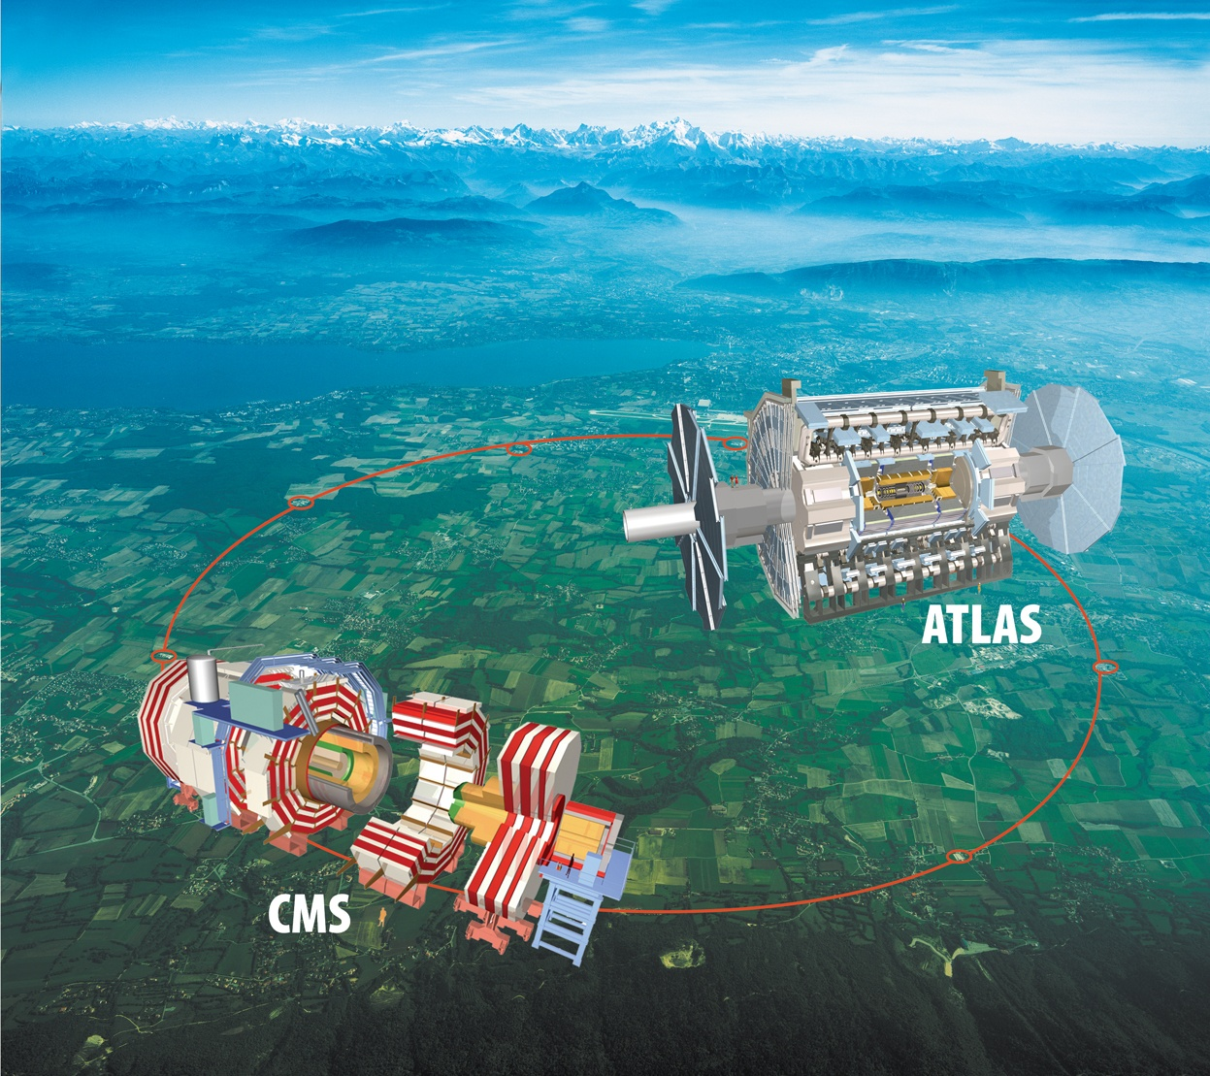
Two large general purpose detectors
Chicago group is a member of the ATLAS collaboration
Emphasis here is on ATLAS

Slide 10
The Chicago Team
Faculty
  Y.-K. Kim
  F. Merritt
  M. Oreglia
  J.P.
  M. Shochet
Academic researchers
  K. Anderson
  A. Boveia
  M. Fiascaris
  R. Gardner
  D. Miller
  Y. Okumura
  B. Penning
  L. Tompkins
PhD Thesis Students
  Y. Cheng
  A. Kapliy
  H. L. Li
  C. Melachrinos
  S. Meehan
  C. Meyer
  J. Webster
Graduate assistants
  B. Barber J. Dandoy
  W. Foreman J. Ho
  K. Krizka J. Olsson
  R. Povey M. Wu
Undergraduate assistants
  N. Dulchinos C. Herwig
  M. Rahaman N. Wasserman
  J. Zihao

Slide 11

ATLAS Collaboration
(Status June 2012)
38 Countries
176 Institutions
3000 Scientific participants total
(1000 Students)
Adelaide, Albany, Alberta, NIKHEF Amsterdam, Ankara, LAPP Annecy, Argonne NL, Arizona, UT Arlington, Athens, NTU Athens, Baku, IFAE Barcelona, Belgrade, Bergen, Berkeley LBL and UC, HU Berlin, Bern, Birmingham, UAN Bogota, Bologna, Bonn, Boston, Brandeis, Brasil Cluster, Bratislava/SAS Kosice, Brookhaven NL, Buenos Aires, Bucharest, Cambridge, Carleton, CERN,
Chinese Cluster, Chicago, Chile, Clermont-Ferrand, Columbia, NBI Copenhagen, Cosenza, AGH UST Cracow, IFJ PAN Cracow, SMU Dallas, UT Dallas, DESY, Dortmund, TU Dresden, JINR Dubna, Duke, Edinburgh, Frascati, Freiburg, Geneva, Genoa, Giessen, Glasgow, Göttingen, LPSC Grenoble, Technion Haifa, Hampton, Harvard, Heidelberg, Hiroshima IT, Indiana, Innsbruck, Iowa SU, Iowa, UC Irvine, Istanbul Bogazici, KEK, Kobe, Kyoto, Kyoto UE, Kyushu, Lancaster, UN La Plata, Lecce, Lisbon LIP, Liverpool, Ljubljana, QMW London, RHBNC London, UC London, Lund, UA Madrid, Mainz, Manchester, CPPM Marseille, Massachusetts, MIT, Melbourne, Michigan, Michigan SU, Milano, Minsk NAS, Minsk NCPHEP, Montreal, McGill Montreal, RUPHE Morocco,
FIAN Moscow, ITEP Moscow, MEPhI Moscow, MSU Moscow, LMU Munich, MPI Munich, Nagasaki IAS, Nagoya, Naples,
New Mexico, New York, Nijmegen, Northern Illinois, BINP Novosibirsk, Ohio SU, Okayama, Oklahoma, Oklahoma SU, Olomouc, Oregon, LAL Orsay, Osaka, Oslo, Oxford, Paris VI and VII, Pavia, Pennsylvania, NPI Petersburg, Pisa, Pittsburgh, CAS Prague,
CU Prague, TU Prague, IHEP Protvino, Rome I, Rome II, Rome III, Rutherford Appleton Laboratory, DAPNIA Saclay,
Santa Cruz UC, Sheffield, Shinshu, Siegen, Simon Fraser Burnaby, SLAC, South Africa, Stockholm, KTH Stockholm, Stony Brook, Sydney, Sussex, AS Taipei, Tbilisi, Tel Aviv, Thessaloniki, Tokyo ICEPP, Tokyo MU, Tokyo Tech, Toronto, TRIUMF, Tsukuba, Tufts, Udine/ICTP, Uppsala, UI Urbana, Valencia, UBC Vancouver, Victoria, Warwick, Waseda, Washington, Weizmann Rehovot,
FH Wiener Neustadt, Wisconsin, Wuppertal, Würzburg, Yale, Yerevan

Slide 12
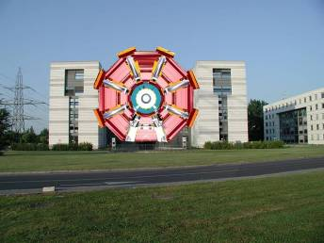


ATLAS Detector
45 m
ATLAS superimposed to
the 5 floors of building 40
> 20 years from conception to start of operation
10 years of construction
15 years of test beams, 20 years of detector and physics simulations
8 years of world-wide computing data challenges
17 Technical Design Reports
24 m
7000 Tons

Slide 13
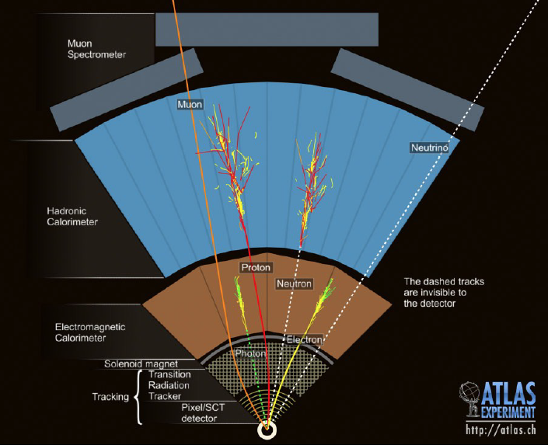
ATLAS detector

Slide 14
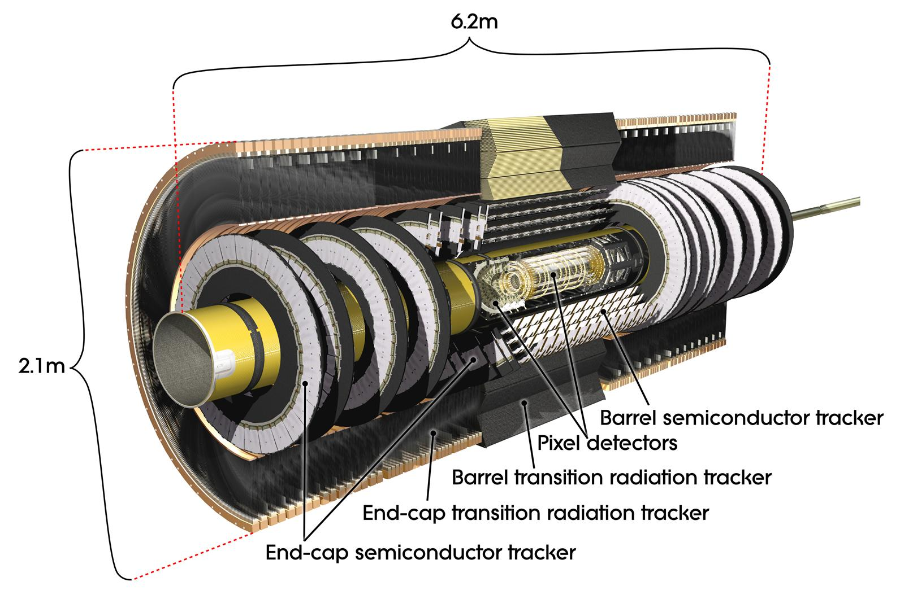
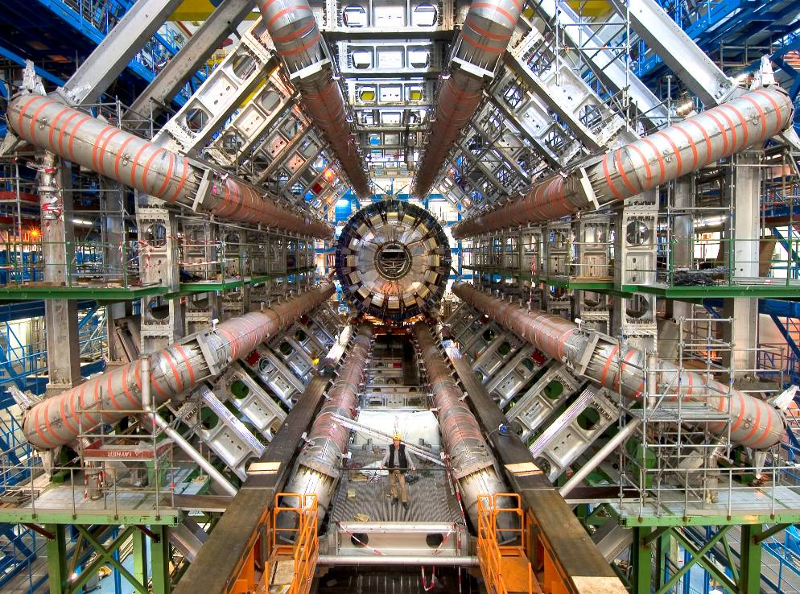
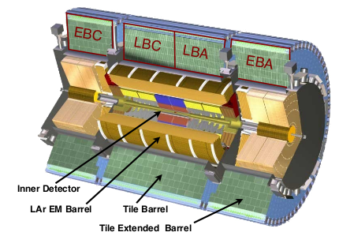
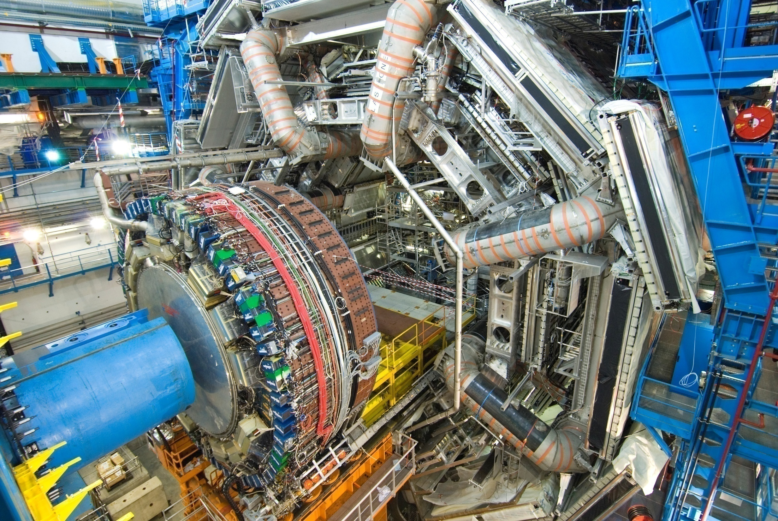
ATLAS Detector
Inner detector for
charged particles
Toroid magnet for
muon detection
Calorimeters for photon, quark, gluon detection
End-cap calorimeter
being inserted.

Slide 15
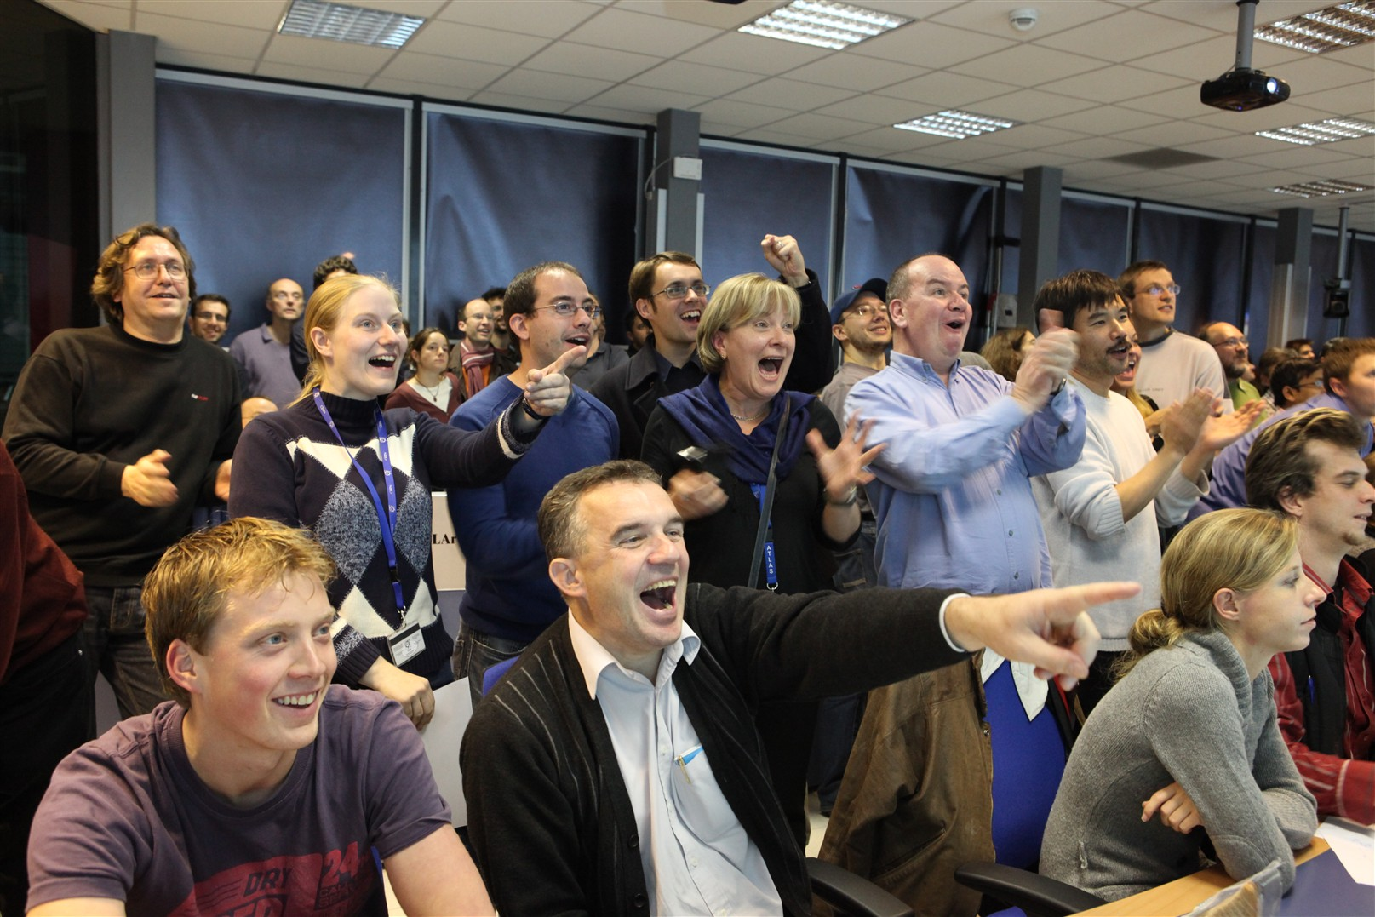
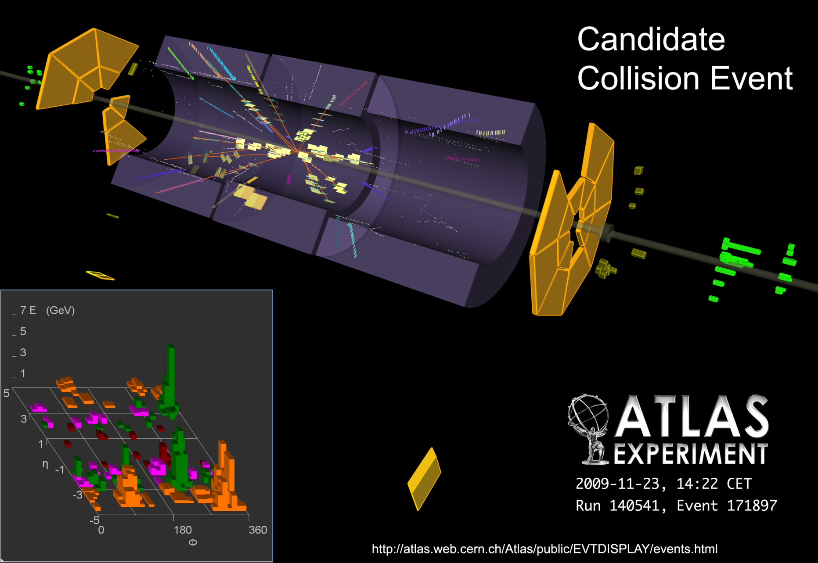
First collisions
The ATLAS Control Room
November 23rd, 2009....

Slide 16
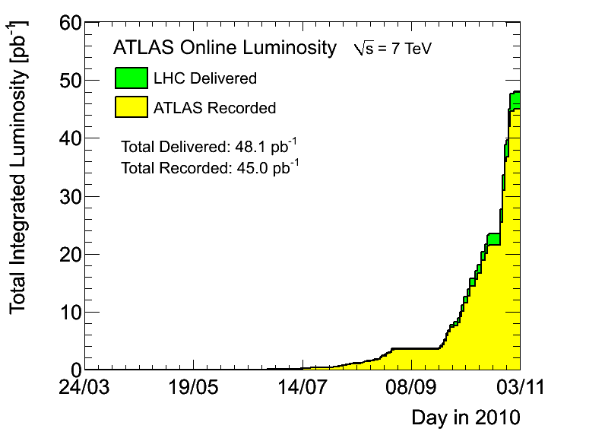
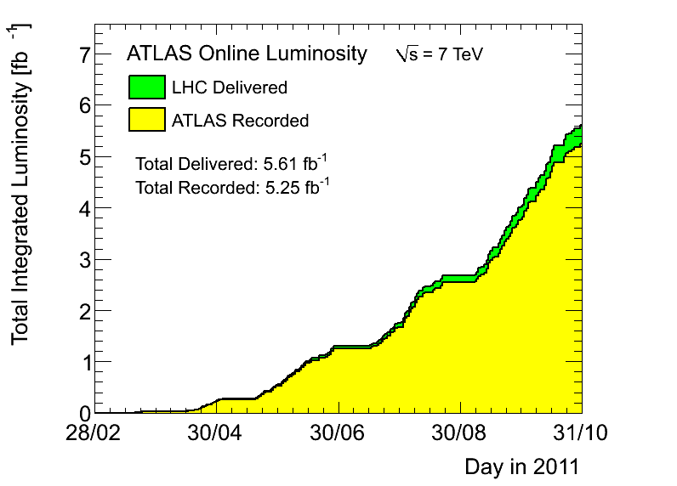
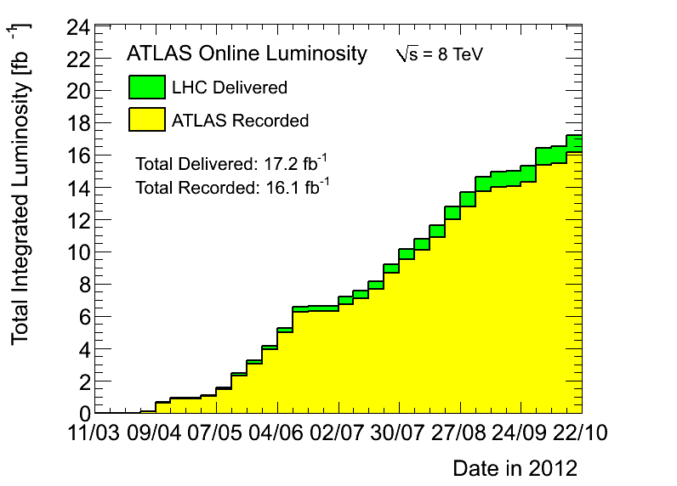
Evolution of data sample sensitivity

Slide 17
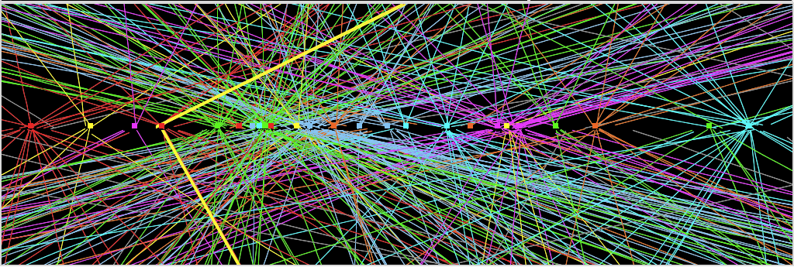
Technical challenges
5 x 10⁸ proton-proton interactions / s
  we record ~ 700 / s
  trigger must select interesting ones and discard the rest
~ 25 interactions per bunch crossing
  1374 circulating bunches separated by 50 ns
  ~ 25 soft interactions superimposed on interesting interactions
  luminous volume ~ 30 μm x 30 μm x 60 mm RMS
Z→ μμ event from 2012 data with 25 reconstructed vertices
Z→ μμ
Notes:
Luminous volume smaller in cross section than a human hair and with length about 2000 times the width
Vertex resolution in x, y is ~ 20 um for ~ 20 tracks from vertex
Vertex resolution in z is ~ 50 um for ~20 tracks from vertex (~ 1/20 of size of square)
Beam pipe radius 30 mm with first detector layer at 50 mm

Slide 18
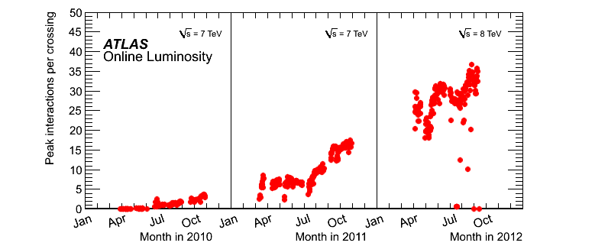
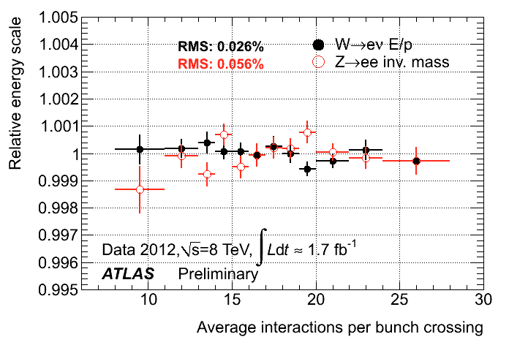
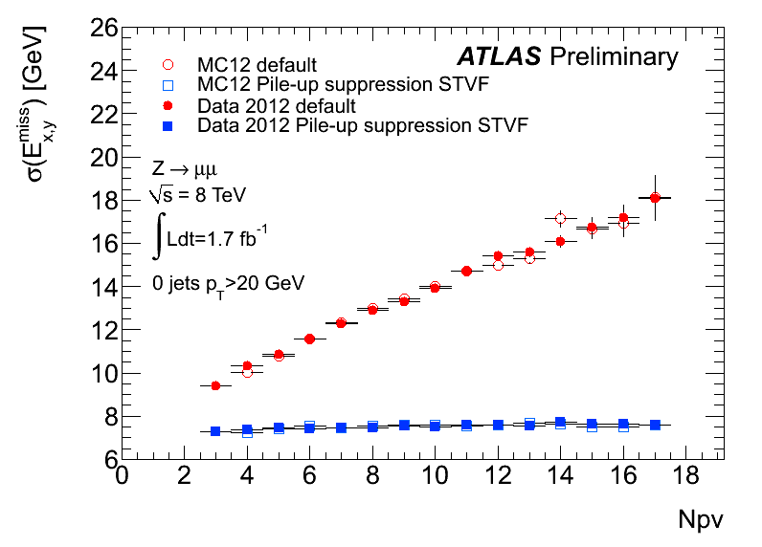
Technical challenges
Design value
at L=10³⁴
Stability of EM calorimeter response vs time
(and pile-up) during full 2011 run better than 0.1%
E_{T}^{miss} resolution vs pile-up before and
after pile-up suppression using tracks
2012 Z→ μμ data
Number of reconstructed primary vertices
Notes:
In lower RH plot, STVF is “soft term vertex fraction.” The JVF is calculated for all soft objects in the event and their Etmiss is scaled accordingly

Slide 19
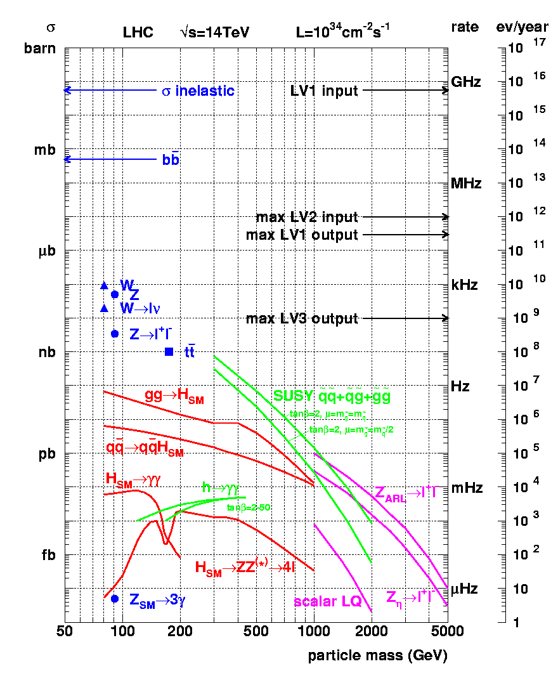
Physics landscape vs sensitivity
Physics Highlights:
General event properties
Heavy flavour physics
Standard Model physics
including QCD jets
Searches for SUSY
Higgs searches
Examples of searches
for ‘exotic’ new physics
Notes:
Event rate assumes: pi x 10^7 sec. of operation per year but avg lumi ~ 1/pi of peak, no acceptance included

Slide 20
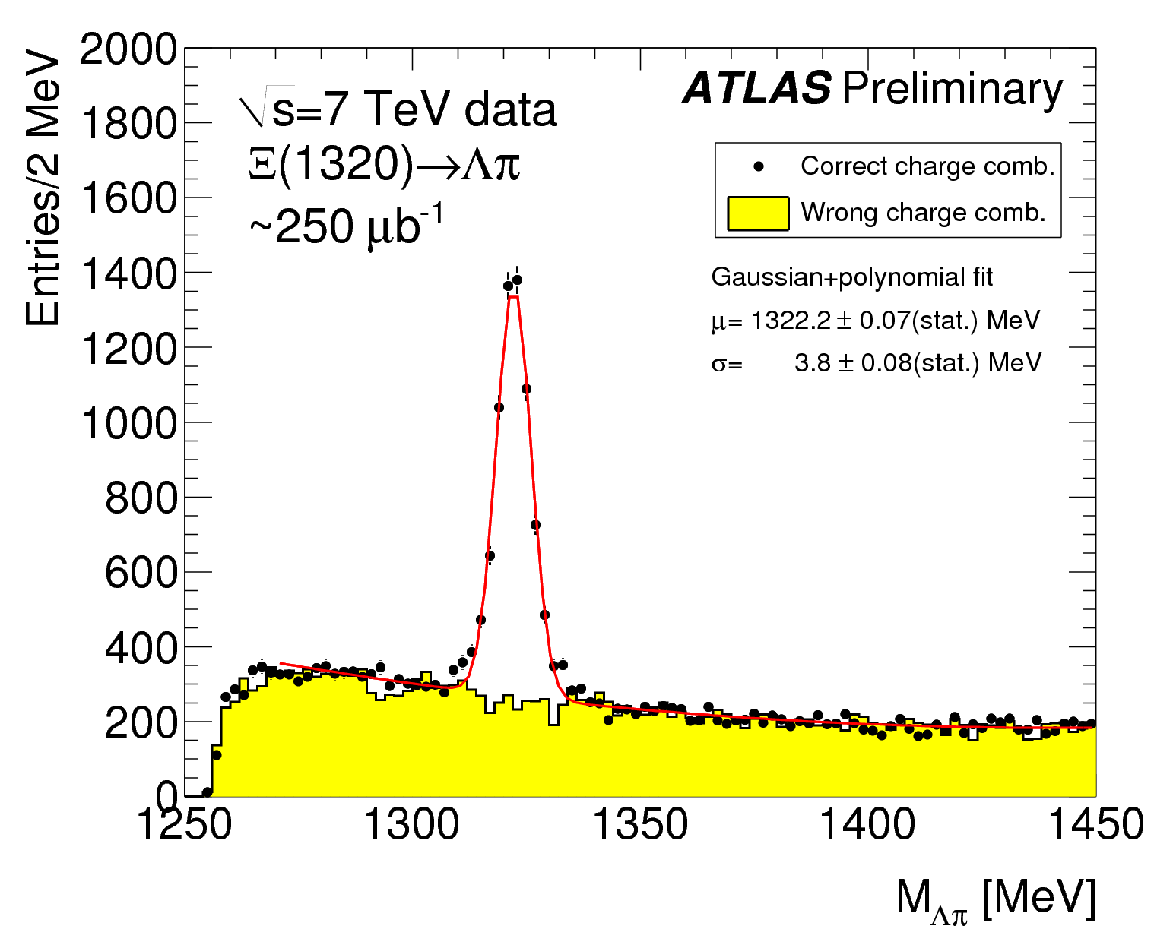
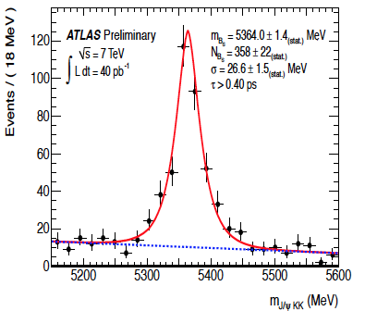
Low mass resonance signals
δM/M ~ 0.5%
δM/M ~ 0.3%
State containing a b and s quark
State containing two s quarks

Slide 21
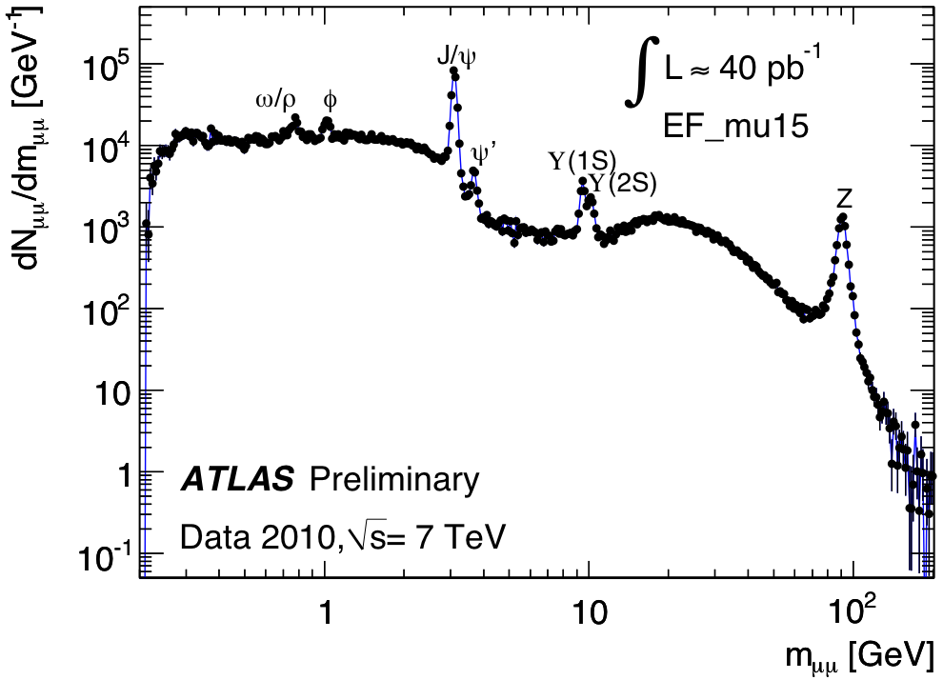
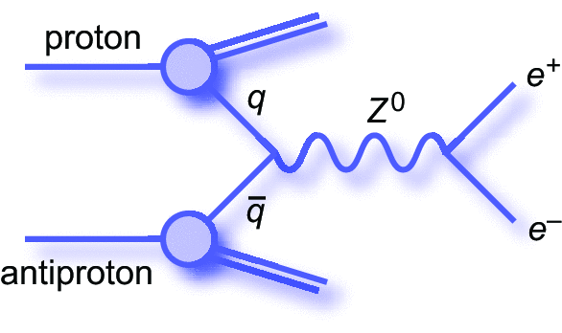
μ-pair mass spectrum
μ⁺
~1960
1974
μ⁻
1978
proton
1983
2010
States with discoveries spanning many years

Slide 22
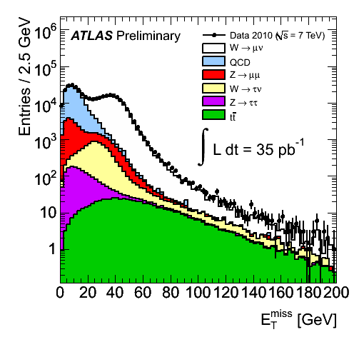
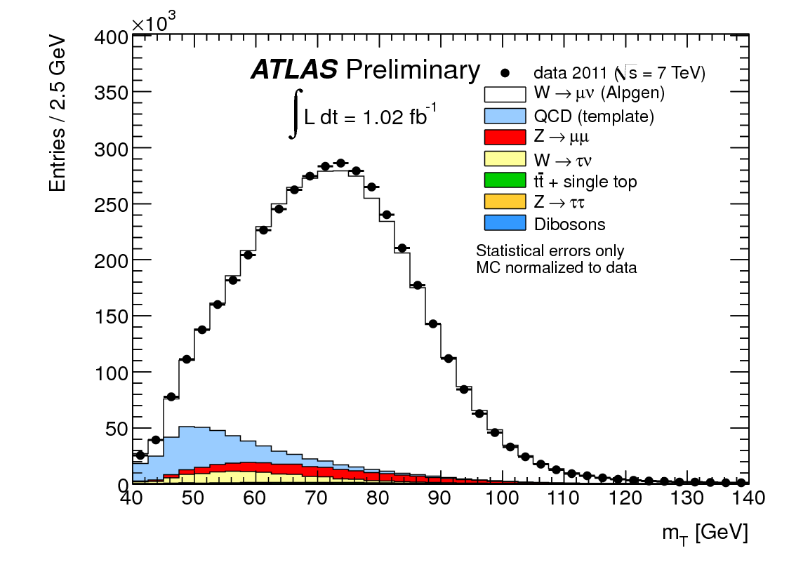
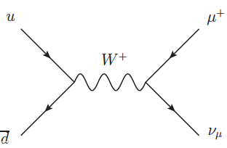

Benchmark measurements – W±
Missing transverse energy
Transverse mass of lepton and missing p_{T}
Notes:
W mass 80.4 GeV

Slide 23
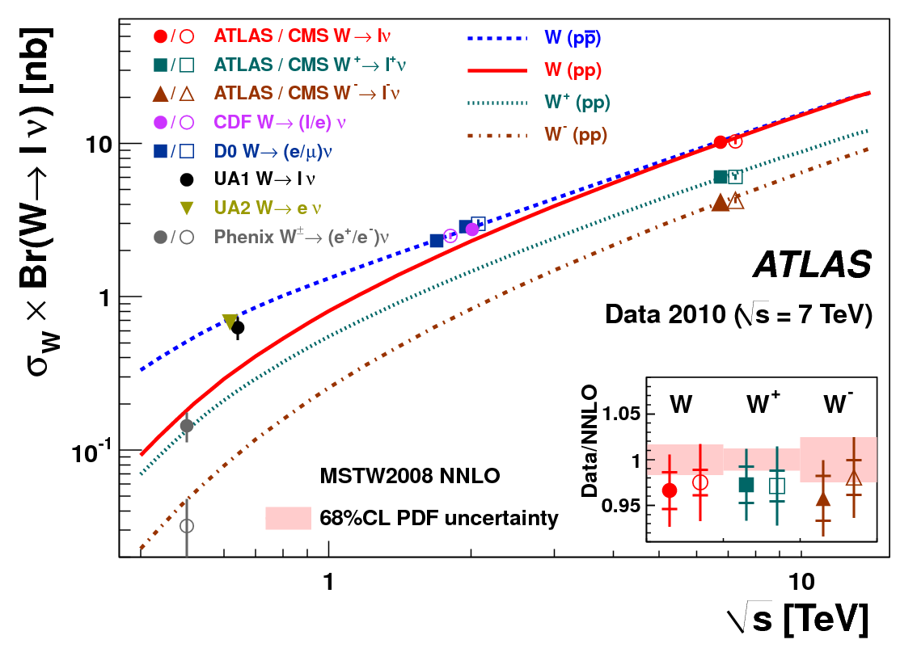
Benchmark measurements – W±

Slide 24
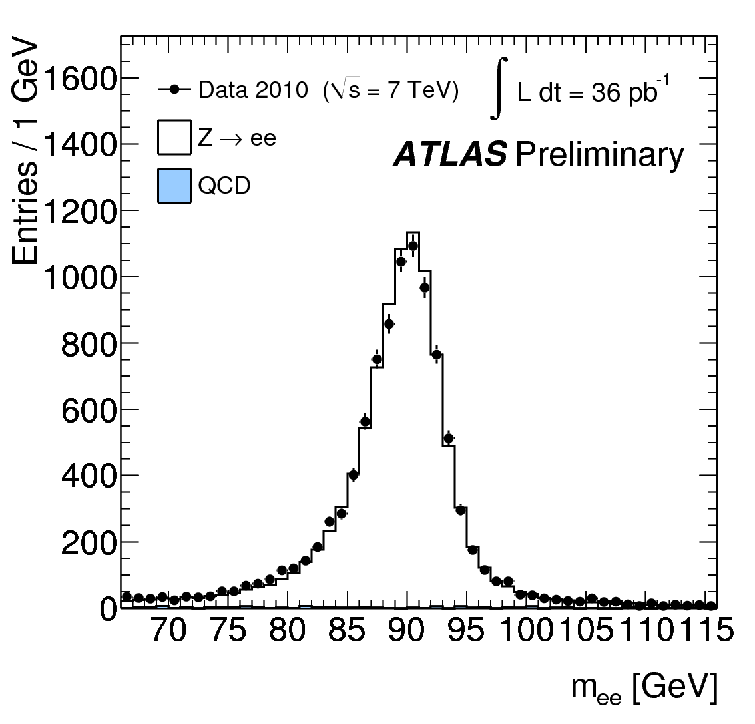
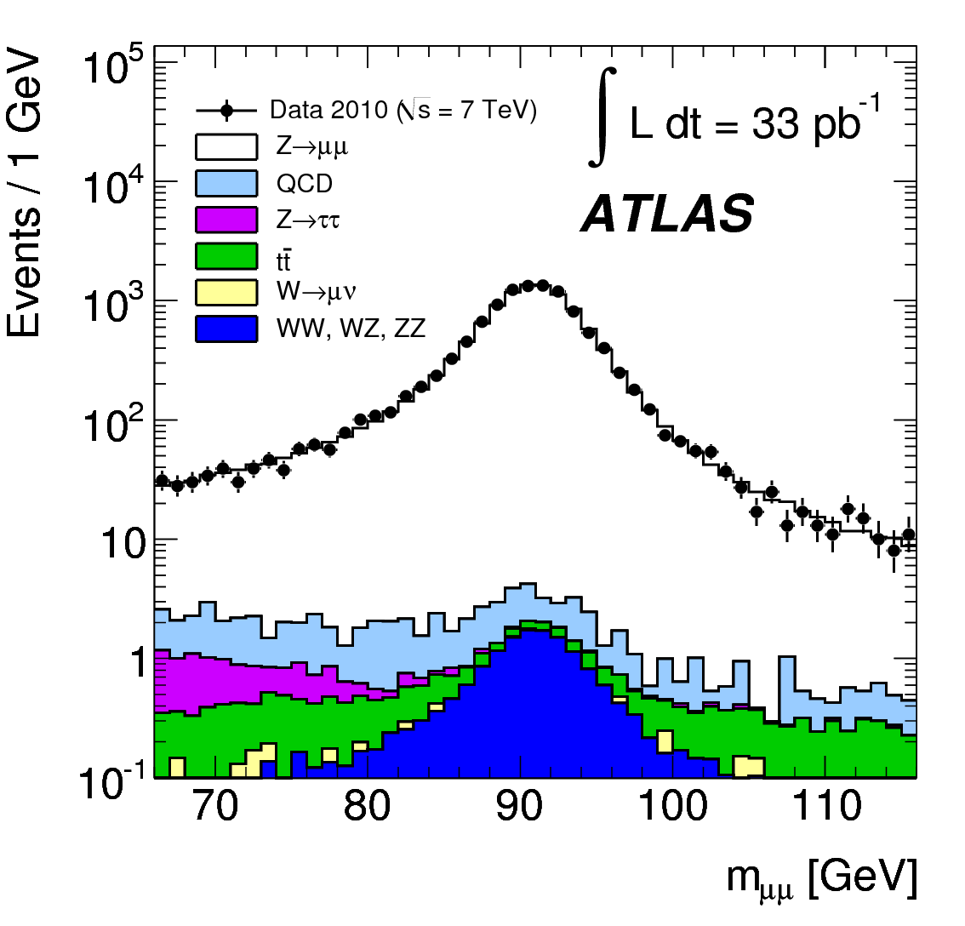
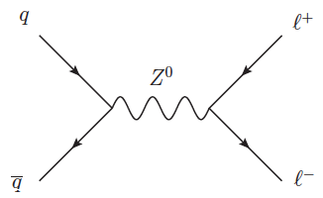
Benchmark measurements – Z⁰
Z→e⁺e⁻
Z→μ⁺μ⁻
Z peak backgrounds < 1%
Observed line shape in excellent agreement with MC prediction
Notes:
M_Z = 91.2 GeV

Slide 25
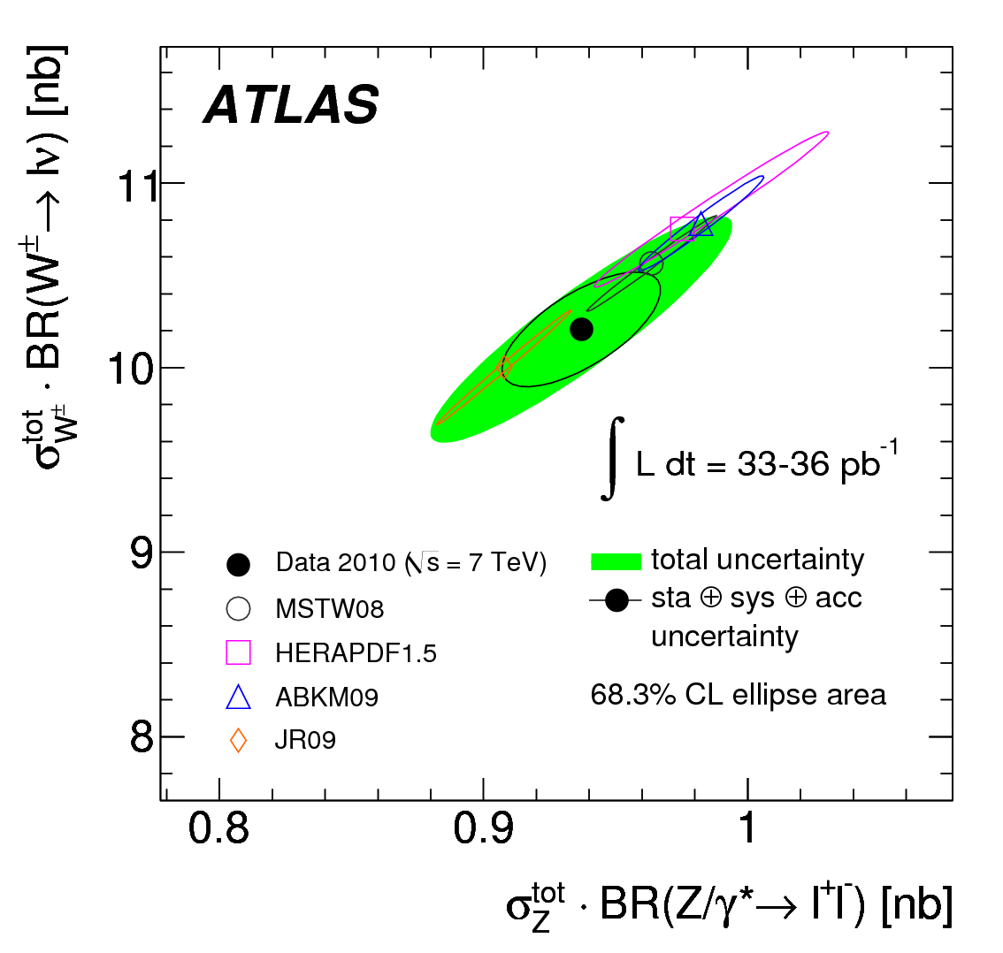
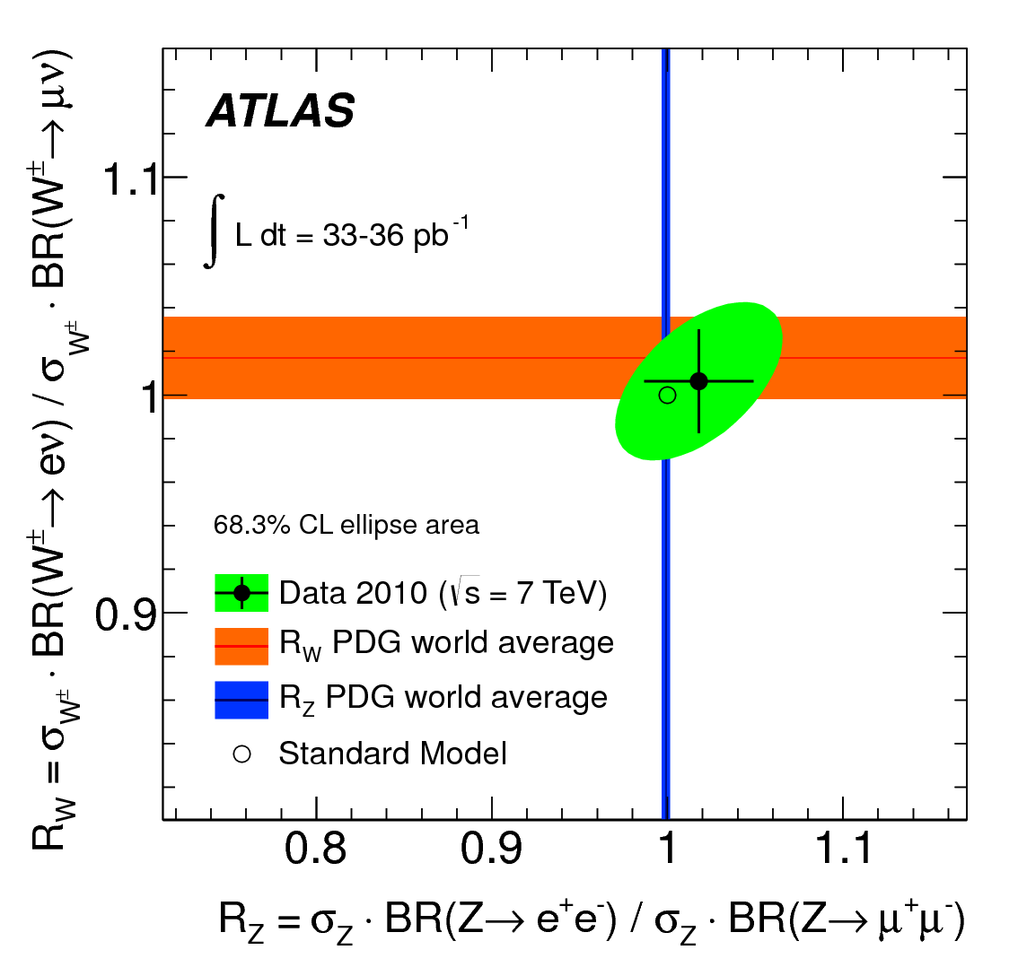
Benchmark measurements – W±, Z⁰
W, Z production in excellent agreement with SM expectations
Phys. Rev. D85 072004 (2012)

Slide 26
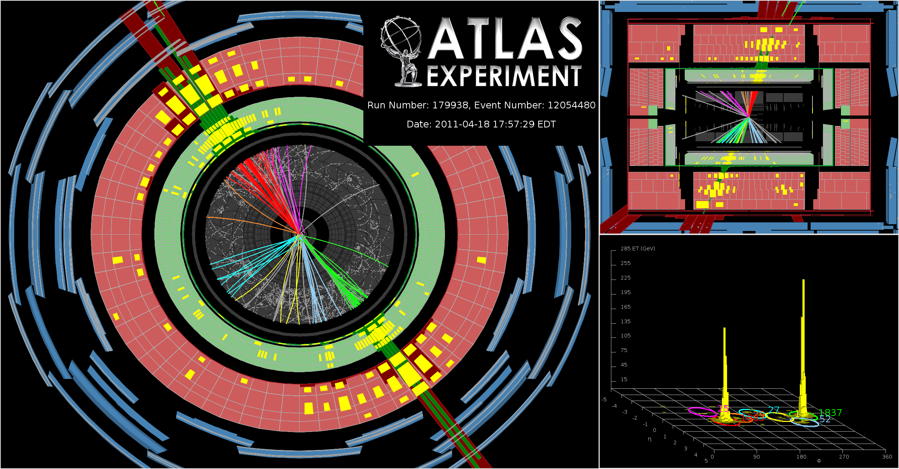
Benchmark measurements – jet physics
gg+gq+qq scattering
agrees well with SM at ~10% level
consistent with point-like scattering
no excited quarks or gluons
no sign of contact interaction
Multi-jet final state: M_{jj} ~ 4 TeV

Slide 27
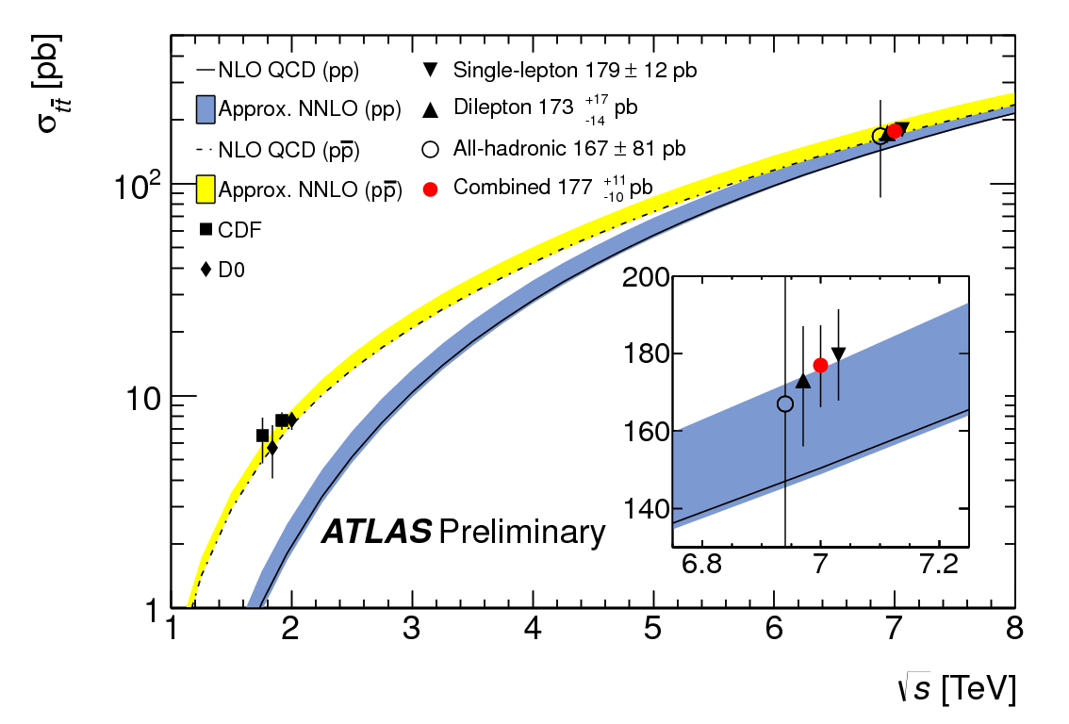
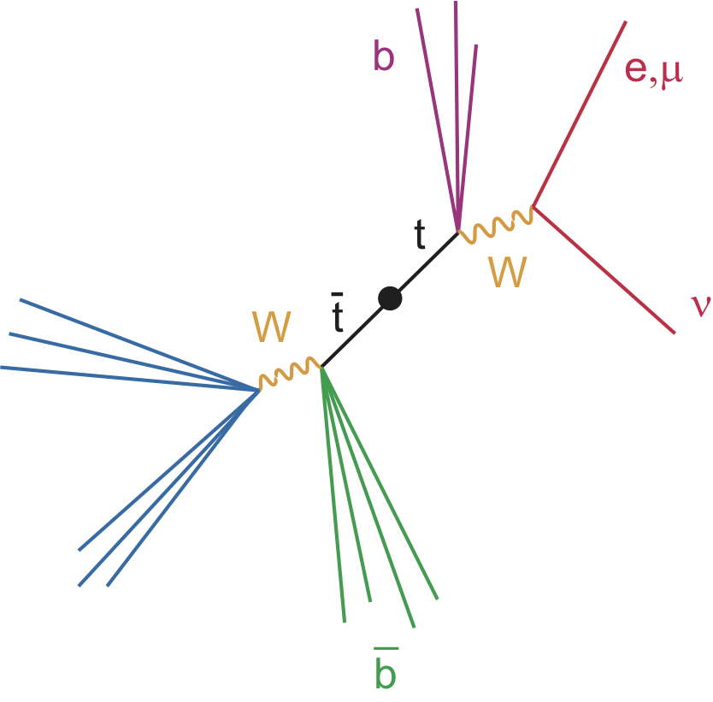
Benchmark measurements – top quark

Slide 28
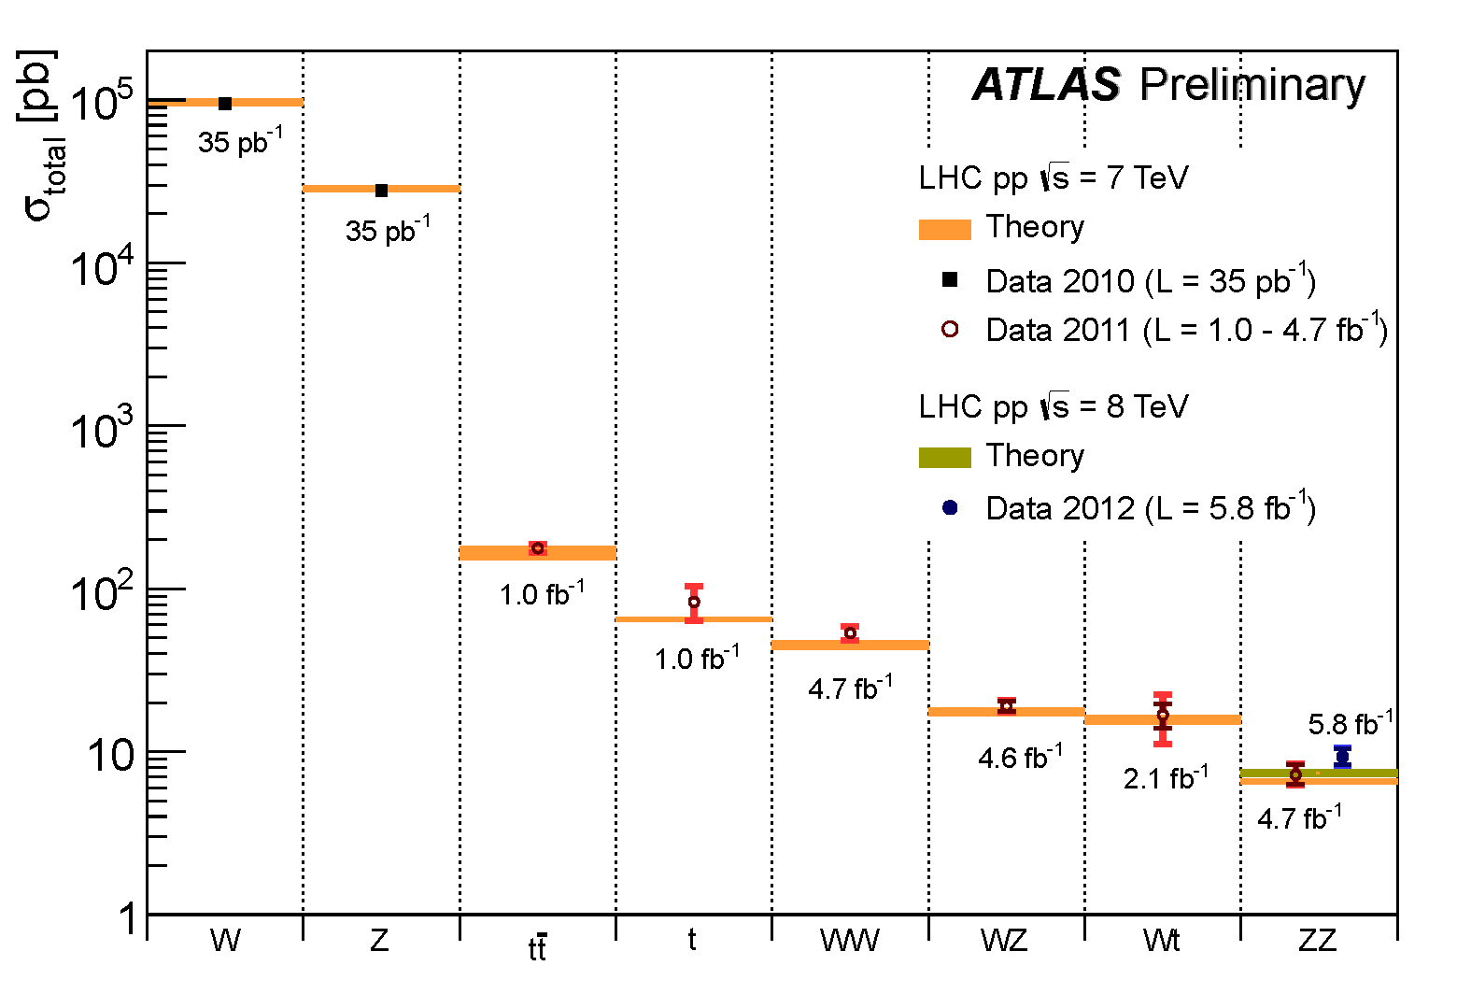
Benchmark measurements - summary
Excellent performance in measuring Standard Model physics gives
confidence in the capability to search for New Physics

Slide 29
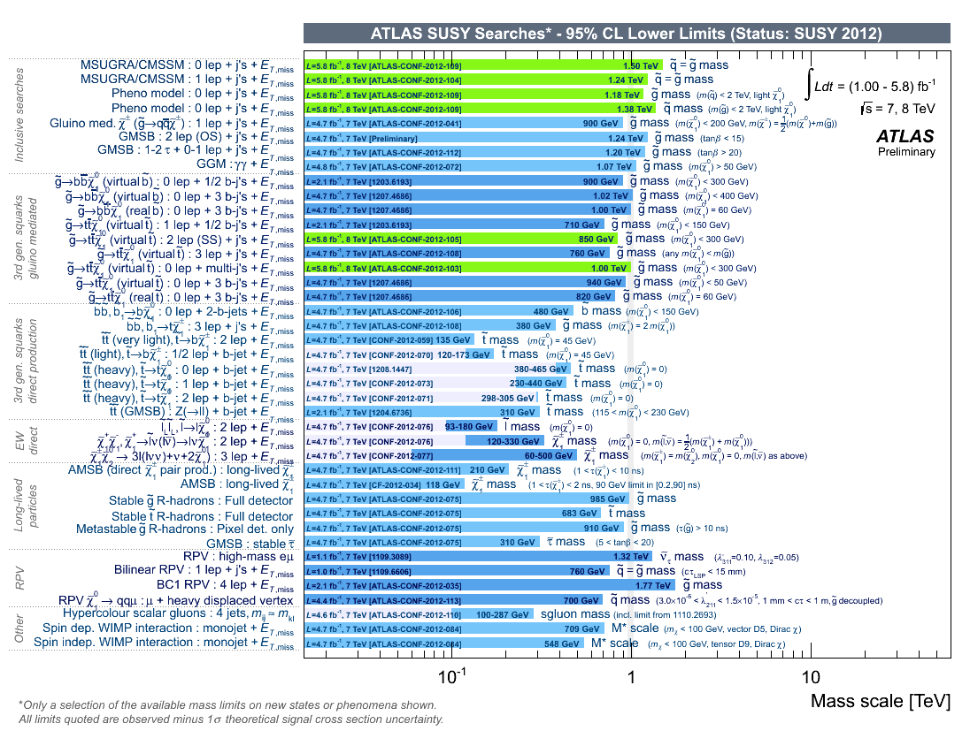
Most New Physics searches are negative - SUSY
ATLAS SUSY limits
41 Signature-based searches.
Backgrounds agree well with predictions
No new discoveries here yet.

Slide 30
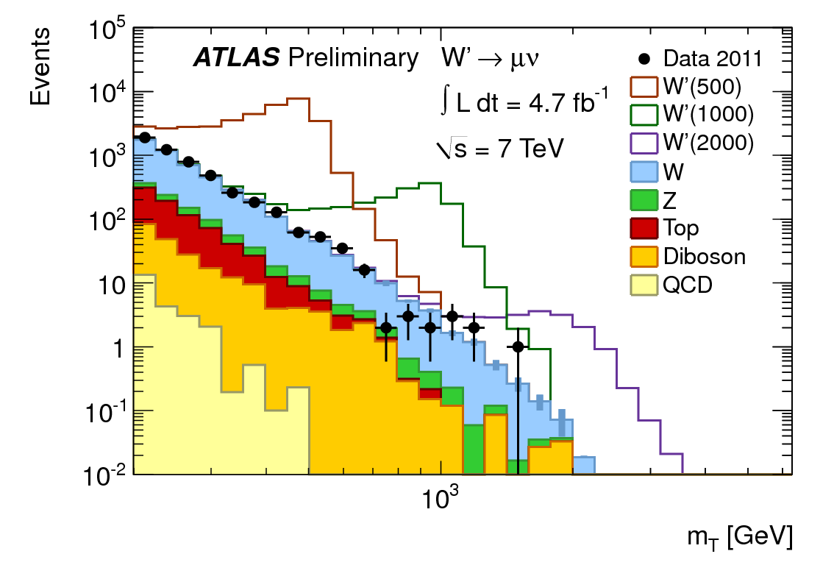
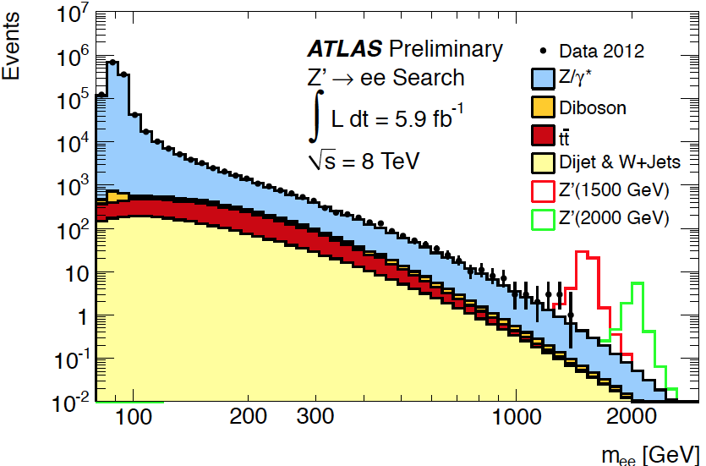
Most New Physics searches are negative – heavy W, Z
Straight-forward searches, similar to normal W and Z bosons
backgrounds agree very well with expectations
M_{W’} > 2.5 TeV
(assuming SM couplings)
M_{Z’} > 2.5 TeV
(assuming SM couplings)

Slide 31



The search for the Higgs
its properties are prescribed theoretically except for its mass
  charge zero boson with spin-parity 0⁺
  M_{H} ≾ 700 GeV to preserve unitarity in W⁺W⁻ scattering
Decay
Production
Notes:
BR of Z to ee is 3.4%
BR of W to ell nu is 10.8%

Slide 32


ZZ^{(*)} channel (ATLAS)
Use the decays and
  “easy” to detect in high background conditions (but BR only 6.8% for each Z)
  one Z is virtual unless M_{H} ≿ 180 GeV
  cross section (times BR) ~ 2.8 fb at M_{H} ~ 125 GeV
  M_{H} mass resolution ~2 GeV
Consistency with background only hypothesis
Data sample M_{H} of max local significance
significance obs. (exp. SM H)
2011+2012 125.0 GeV 3.6 σ (2.7)
For 120 < M_{4l} < 130 GeV
Observed Events | Background Events | Predicted H Signal
13 | 4.9 | 5.3
Notes:
ZZ* SM production cross section is ~ 5 fb
Leptons satisfy single lepton trigger or dilepton trigger
single requires pt > 24 GeV, members of pairs have pt > 12 GeV
In analysis leptons have pt > 7 GeV with leading lepton having pt > 20 GeV and next-to-leading pt > 15 GeV
Dominant background is Z+bbar (ttbar is ~10% of this)
Average acceptance 36% for 4mu channel, 20% for 4e channel
Mass resolution 1.7 GeV for 4mu channel, 2.3 GeV for 4e channel

Slide 33

ZZ^{(*)} channel (ATLAS)
H→ 4e candidate with M_{4e} = 124.6 GeV
M₁₂ = 70.6 GeV, M₃₄ = 44.7 GeV
p_{T}(e,e,e,e) = (24.9, 53.9, 61.9, 17.8) GeV
Notes:
Event from 5/18/2012. Peak initial number of interactions per crossing at this time in run was ~25.

Slide 34


ZZ^{(*)} channel (CMS)
Similar capabilities
Selection details differ slightly
For 121.5 < M_{4l} < 130.5 GeV
Data sample M_{H} of max local significance
significance obs. (exp. SM H)
2011+2012 125.6 GeV 3.2 σ (3.8)
Observed Events | Background Events | Predicted H Signal
9 | 3.8 | 7.5

Slide 35


γγ channel (ATLAS)
“High statistics” channel
  cross section (times BR) ~ 50 fb
  average mass resolution δM/M~1.7 GeV
  use 10 photon categories
Unweighted spectrum
Expected exclusion
for SM Higgs at
given M_{H}
Events weighted by S/B in each category
Data sample M_{H} of max local significance
significance obs. (exp. SM H)
2011+2012 126.5 GeV 4.5 σ (2.5)

Slide 36

γγ channel (ATLAS)
H→ 2γ candidate with M_{4e} = 126.9 GeV
p_{T}(γ, γ) = (62.2, 55.5) GeV
Notes:
Event recorded 5/23/2012.

Slide 37


γγ channel (CMS)
Divide data into 6 categories using multivariate analysis method (BDT)
Average mass resolution δM/M ~1.8 GeV
Data sample M_{H} of max local significance
significance obs. (exp. SM H)
2011+2012 125.0 GeV 4.1 σ (2.8)

Slide 38



WW^{(*)} channel (ATLAS)
Use the decays and
  2 leptons of opposite charge plus missing energy
  initially just used eμ events (85% of sensitivity and less background)
  allow up to 1 additional jet to include events with radiation
σ x BR ~ 200 fb
large cross section but no mass peak
Observed Events | Background Events | Predicted H Signal
223 | 168 ± 20 | 25 ± 5
Broad excess because of
limited mass sensitivity
Data sample M_{H} of max local significance
significance obs. (exp. SM H)
2011+2012 125.0 GeV 2.8 σ (2.3)

Slide 39

WW^{(*)} channel (CMS)
classify candidates into 6 categories for significance analysis
Observed Events | Background Events | Predicted H Signal
391 | 344 ± 21.6 | 55.8 ± 7.0
Data sample M_{H} of max local significance
significance obs. (exp. SM H)
2011+2012 125.0 GeV 1.6 σ (2.4)

Slide 40




Putting it all together (for ATLAS)
Channel | M_{H} of max. significance | Local significance observed (expected)
 | 125.0 GeV | 3.6 σ (2.7)
 | 126.5 GeV | 4.5 σ (2.5)
 | 125.0 GeV | 2.8 σ (2.3)
Combination | 126.5 GeV | 5.9 σ (4.9)
Combination
New state seen at M_{H} = 126.5 GeV
Local significance 5.9 σ (bkgd. pby. 1.8x10⁻⁹)
Global sig. 5.2 σ for range 110-600 GeV
Higgs-like signal is excluded at 95% CL for
112 < M_{H} < 122 GeV and 131 < M_{H} < 559 GeV

Slide 41


Putting it all together (for CMS)
Channel | M_{H} of max. significance | Local significance observed (expected)
 | 125.6 GeV | 3.2 σ (3.8)
 | 125.0 GeV | 4.1 σ (2.8)
 | 125.0 GeV | 1.6 σ (2.4)
Combination | 125.3 GeV | 5.1 σ (5.2)
New state seen at M_{H} = 125.3 GeV
Local significance 5.1 σ (bkgd. pby. 1.7x10⁻⁷)
Higgs-like signal is excluded at 95% CL for
110 < M_{H} < 121.5 GeV and 127 < M_{H} < 600 GeV
The two experiments are in excellent agreement

Slide 42
Properties of the new state
Spin
  decays to two bosons (WW, ZZ, γγ) so it must be a boson
  spin 1 excluded because it decays to two photons (Landau-Yang theorem)
  possibilities 0, 2, …
Electromagnetic charge
  zero, since it decays to neutral final states (W⁺W⁻, Z⁰Z⁰, γγ)

Slide 43


Properties of the new state
Mass and signal strength
From a 2-D fit to ZZ* and γγ channels
Observed width consistent with
experimental resolution of ~ 2 GeV
expected width of SM Higgs ~ 4 MeV
Mass = 126.0 ± 0.4 ± 0.4 GeV
σ/σ_{SM} = 1.4 ± 0.3
Mass = 125.3 ± 0.4 ± 0.5 GeV
σ/σ_{SM} = 0.87 ± 0.23
CMS
SM
SM
Strengths in good agreement with prediction
for SM Higgs at current precision.

Slide 44


Properties of the new state
Strengths in individual channels compared to SM Higgs
CMS
CMS
Again fully consistent with SM
Higgs at current precision.

Slide 45




Properties of the new state
Coupling strengths
observed rates reflect both production and decay processes
Production
Decay
New particles
in the loops?
Is H→ΥΥ channel consistent with expected
contributions from ggF and VBF ?
Coupling constants for Hγγ and Hgg loops
relative to SM (all other strengths SM).
Hgg coupling /SM
μ_{γγ}=1.8 ± 0.5
VBF strength/SM
ggF strength/SM
Hγγ coupling /SM
Ratio of W to Z coupling

Slide 46
Score card for the Higgs interpretation
Property | Higgs | Other
Observed mass 126 GeV EW fits of July 2011 predict GeV (including exclusions) can solve unitarity problem in cross section for | ✓ | ✗
Observed width consistent with experimental resolution natural width at M_{H} = 126 GeV is ~ 4 MeV | ✓ | ✗
Observed state is a neutral boson (spin 1 excluded) expected J^{CP} for Higgs is 0⁺ | ✓ | ✗
Production cross section consistent with expectations | ✓ | ✗
Large coupling to massive W, Z states | ✓ | ✗
Ratio of coupling strengths to W and Z consistent with unity expected for custodial symmetry | ✓ | ✗
Small coupling to massless γ consistent with expected second-order coupling | ✓ | ✗
Coupling to fermions inferred for t-quark from virtual loops in ggH and Hγγ | (✓) | (✗)

Slide 47

Outstanding issues
Why is mass so light (naturalness problem)?
  higher order corrections are quadratically divergent
Supersymmetry is one solution
  new bosons and fermions lead to cancellations of loops
  in “minimal” SUSY model M_{H} < M_{Z} = 91.2 GeV, at leading order
    higher order corrections lead to modest increase mass
  also predicts heavier Higgs bosons, and charged Higgs (h, H, A, H±)
Where is SUSY?
  there should be SUSY counterparts to all known states
  all searches so far are negative
    haven’t looked in the right place?
    is SUSY mass scale is heavier and currently out of reach?
    perhaps SUSY is not the answer
Λ is energy scale of
new physics or
Planck mass

Slide 48

Near term prospects
Spin-parity
  ongoing work to resolve 0⁺, 0⁻, 2⁺, 2⁻
Improved sensitivity
  final data sample for 2012 should be ~ 3 times that used here
Significant measurements in and channels
  no results yet with 2012 data
  should provide direct measurements of fermion couplings

Slide 49

Longer term prospects
data sample of ~25 fb⁻¹ expected by end of year
operation to resume in 2015 at CM energy of 13 TeV (vs. current value of 8 TeV)
  ~ 3 times larger cross section for Higgs production
    ~1.5 times better S/B
  greater reach for solving naturalness problem
    present reach to ~1 TeV mass scale
  luminosity target is 300 fb⁻¹ by ~ 2020
studies have been done for a high luminosity phase with 3000 fb⁻¹

Slide 50


Longer term prospects
Higgs self coupling (hhh vertex below)
  requires very high sensitivity at LHC
    3000 fb⁻¹ gives 3σ measurement from each experiment in channel
WW scattering and unitarity
  solved in a natural way by the Higgs
  alternative solution may involve ZZ resonances at TeV scale
SM Background
Signal
Notes:
Destructive interference between the two diagrams
λ / λsm = 0 has 71 fb cross section
λ / λsm = 1 has 34 fb cross section ⬅
λ / λsm = 2 has 16 fb cross section
cross section of interest gives 15 signal events with bkgd of 24 events

Slide 51
Conclusions
New state at 126 GeV looks like the Higgs boson
  excellent prospects for much more precise information on its properties
No evidence yet for a mechanism which keeps the mass this low
  higher collider energy will facilitate the search
Detector and collider working very well, with improvements planned in the near future
stay tuned for further developments

Slide 52
Extra Slides

Slide 53
B.σ for Higgs production

Slide 54
Profile likelihood ratio
Distributions of s and b from Monte Carlo.
s and b depend on systematic uncertainties θ.
Additional terms in L reflect constraints on θ.
Distributed like a Chi-squared distribution
with 1 degree of freedom
Probability q₀ is this large or larger

Slide 55

Search in the ZZ^{(*)} channel
Sub-leading lepton-pair mass spectrum before suppression of heavy quark decays with vertex requirement

Slide 56
Search in the ZZ^{(*)} channel
Systematic Source | Size
Luminosity | 3.6%
Muon reconstruction and identification (rel.) | 1%
Electron reconstruction and identification (rel.) | 2.6-8%
QCD scale effects | 5%
PDF’s | 8%

Slide 57

Spin-parity analysis of H

Slide 58
Computing Infrastructure
50,000 CPU cores in T1 centers
  mainly used for data analysis
70,000 CPU cores in T2 centers
  mainly used for Monte Carlo event generation
~100 PB of data stored (100 x 10¹⁵ bytes)

